Slide 1

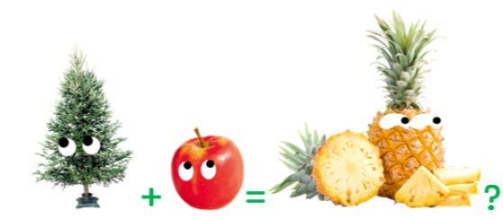
Unit 2 Exploring English
Understanding ideas

Slide 2

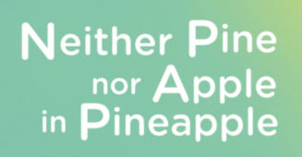

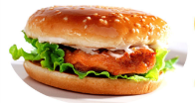









Pre-reading: prediction
Look at the title of the passage and the pictures. Guess what the passage is about.
food
cooking
hamburger ? ham
words
plants
pine + apple =pineapple ?
eggplant ? egg
fruit

Slide 3
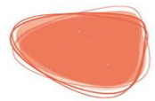




While-reading: skimming
1. The passage is about:
food
cooking
words
plants
fruit
2. The author’s writing purpose is:
您的内容打在这里，或者通过复制您的文本后，在此框中选择粘贴，并选择只保留文字。您的内容打在这里，或者通过复制您的文本后，在此框中选择粘贴，并选择只保留文字。
a. To tell that English is very difficult to learn.
b. To give advice on how to learn English.
c. To show that English is interesting and creative.
d. To explain how English was created.
选题背景

Slide 4
While-reading: skimming
Read the passage and match the main idea with each part.
Part 1
(para.___)
Part2
(para.___ -para.___)
Part3
(para.___)
Body:
supportive examples
1
您的内容打在这里，或者通过复制您的文本后，在此框中选择粘贴，并选择只保留文字。您的内容打在这里，或者通过复制您的文本后，在此框中选择粘贴，并选择只保留文字。
Conclusion:
the reason
Reading tips:
Pay attention to the first sentence of each paragraph.
2
6
Introduction：
the author’s opinion
选题背景
7
English can be a crazy language to learn.

Slide 5
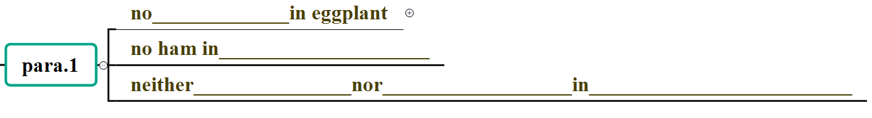




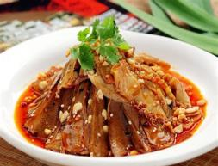
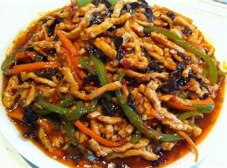
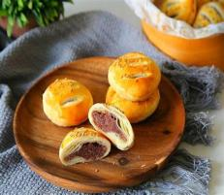
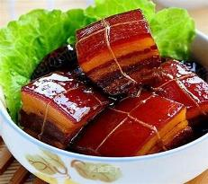
While-reading: scanning
egg
hamburger
pine
apple
pineapple
We can’t always understand a compound word by adding the meanings of the words it is made up of!
Chinese is also interesting and creative.
夫妻肺片
鱼香肉丝
老婆饼
东坡肉

Slide 6

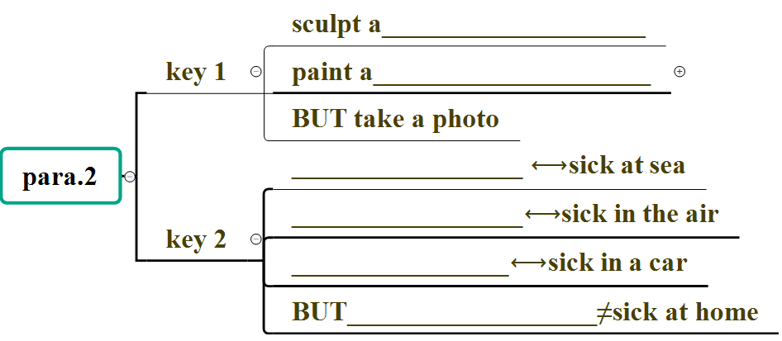




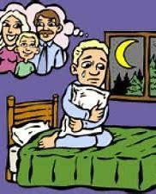
The same rule doesn’t always apply to everything!
sculpture
rules
painting
seasick
airsick
rules
carsick
homesick

Slide 7
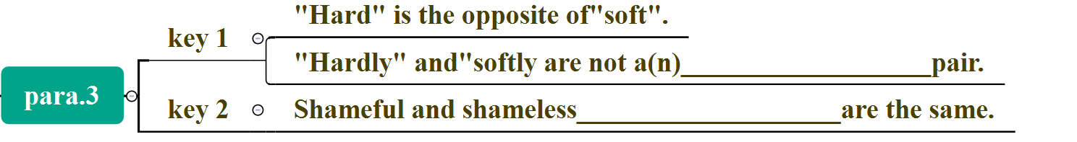
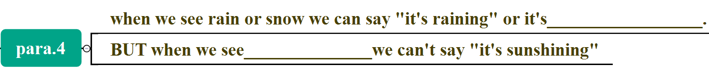

opposing
behaviors
Different words or phrases may have the same meaning!
snowing
sunshine
The same rules doesn’t always apply to everything!
capitalized WHO
lower case who
para. 5
capitalized IT
lower case it
capitalized US
lower case us
The same words and phrases may have different meanings in different contexts.

Slide 8

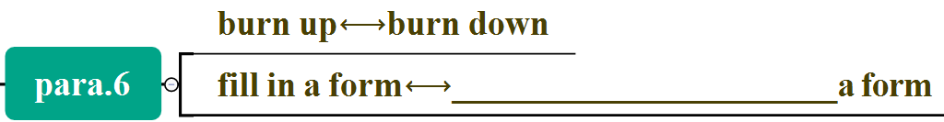


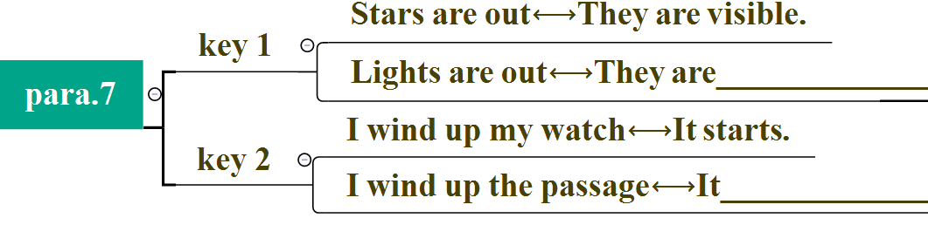
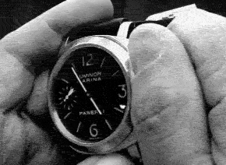
fill out
Different words or phrases may have the same meaning!
The same words and phrases may have different meanings in different contexts.
invisible
ends

Slide 9
Part 1 (1):
The author’s opinion
English can be a crazy language to learn.
Neither pine nor apple in pineapple
We can’t always understand a compound word by adding the meanings of the words it is made up of!
Part 2 (2-6):
Supportive examples
The same rule doesn’t always apply to everything!
您的内容打在这里，或者通过复制您的文本后，在此框中选择粘贴，并选择只保留文字。您的内容打在这里，或者通过复制您的文本后，在此框中选择粘贴，并选择只保留文字。
Different words or phrases may have the same meaning!
The same words and phrases may have different meanings in different contexts.
Part 3 (7):
Conclusion
选题背景
The invention of English reflects the creativity of human race.

Slide 10
After-reading: think & share
1. Do you agree with the author’s opinion about English language? Give your reasons.
您的内容打在这里，或者通过复制您的文本后，在此框中选择粘贴，并选择只保留文字。您的内容打在这里，或者通过复制您的文本后，在此框中选择粘贴，并选择只保留文字。
2. What do you find most challenging about learning English? How do you deal with it when facing all the craziness, complexity and creativity?
选题背景

Slide 11
After-reading: think & share
2. What do you find most challenging about learning English? How do you deal with it when facing all the craziness, complexity and creativity?
您的内容打在这里，或者通过复制您的文本后，在此框中选择粘贴，并选择只保留文字。您的内容打在这里，或者通过复制您的文本后，在此框中选择粘贴，并选择只保留文字。
It is the craziness, complexity and creativity that makes a language unique, interesting and enjoyable to learn.
Take a positive attitude, be curious, patient and open-minded and keep on exploring the reasons behind a language.
选题背景

Slide 12
Homework
Try to collect more words or expressions which are crazy, complex and creative.
Try to find more similar Chinese examples.

