Slide 1
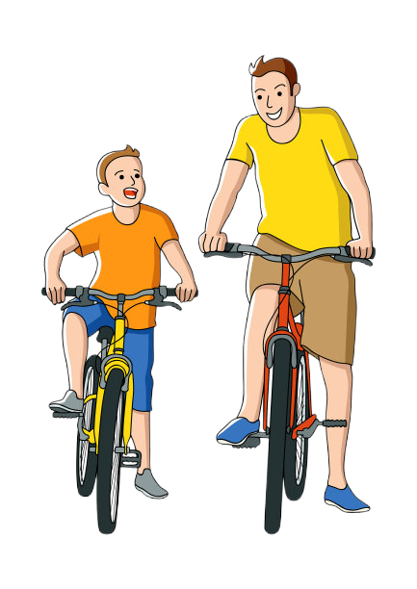
B1U3 Understanding ideas
--Like Father Like Son
高一英语

Slide 2
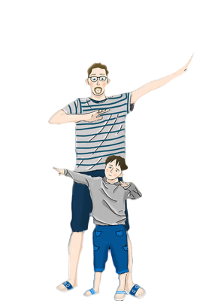
Step 1: Leading-in

Slide 3
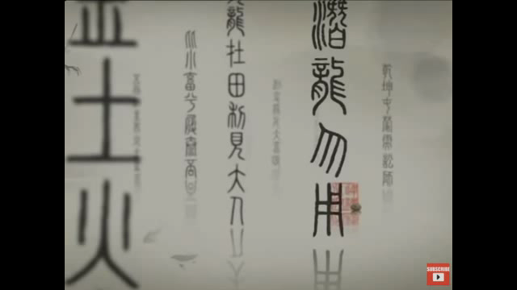
1.Watch and think: What does a family mean to Chinese people?

Slide 4

2.Read and tick
Tick the things you would ask your parents about for advice.
getting a new hairstyle
发型
school studies
friendship troubles
joining an after-school club
shopping for new clothes and shoes
购买
choosing your future area of study
未来研究领域

Slide 5
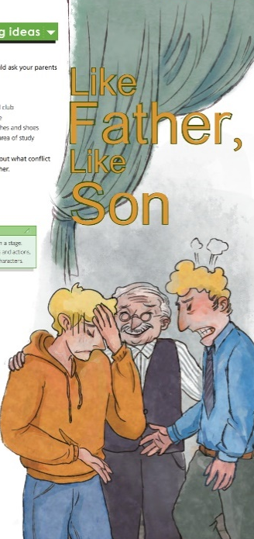
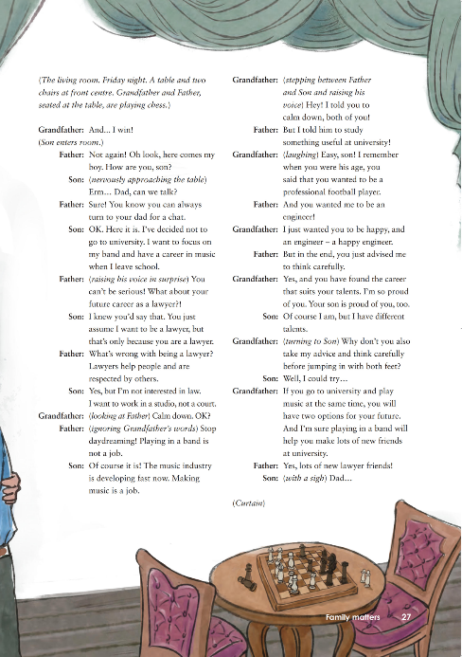
Step 2: Prediction
1. What do you see in the picture?
2. How does the young man feel?
3. When he is in trouble, who may he
turn to for advice?

Slide 6
Step3: While-reading

Slide 7
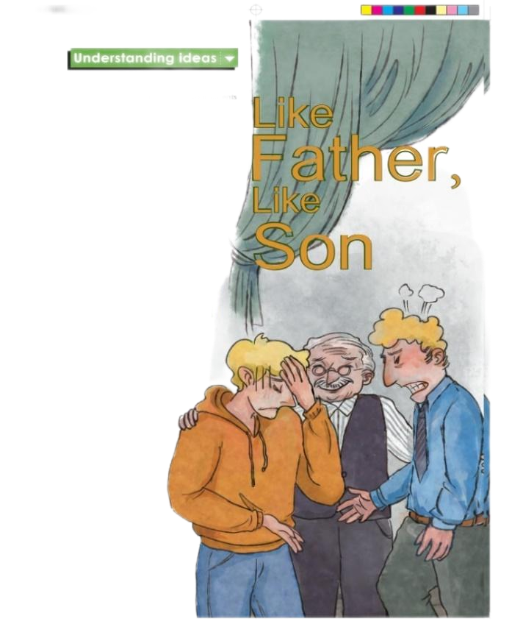
1.Fast reading
(1)
Read the play and find out what conflict does the son have with his father?
The son wants to have a career in music after graduating from senior high school, while his father wants him to go to university and become a lawyer.
e.g. The son wants to…, while his father wants him to …
conflict 冲突
have a conflict with sb
和某人有冲突

Slide 8

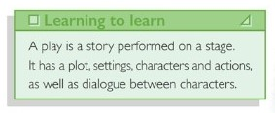
plot 情节
settings 背景
characters 角色
actions 动作
dialogue between characters 角色间的对白

Slide 9
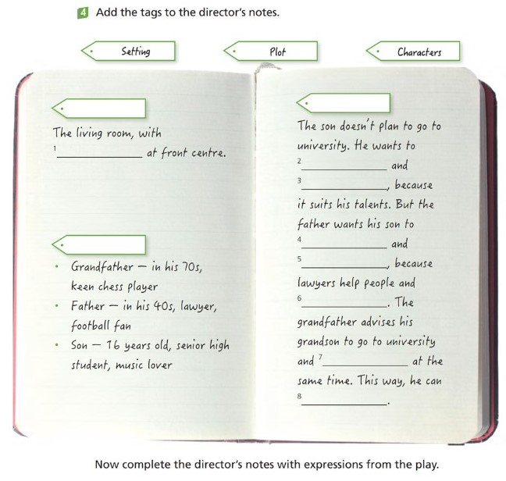
(2)
Add the tags to the director’s notes.

Slide 10
Add the tags to the director’s notes.
Setting
1. a table and two chairs
Characters
keen adj. 热衷的 be keen on 喜欢
be crazy about

Slide 11
Add the tags to the director’s notes.
Plot
2. focus on his band concentrate on 专注于
3. have a career in music 从事与音乐有关的工作
4. go to university
5. be a lawyer
6. are respected by others
7. play music
8. have two options for his future 选择
适合他的天赋

Slide 12

资料
Stage direction introduces time, place, the setting, stage props（道具）, the character’s action and emotion as well as how they should go up and down the stage. Stage direction is usually put in brackets, with concise (简洁的） language.

Slide 13
2.Detailed reading
(1)How does the son act at the beginning?
He is afraid of telling his father about his future career choice.
Stage direction
Language
资料
approach v. 走进、靠近
What’s his father’s response?
He is happy to have a chat with his son.
turn to sb for a chat 和某人聊一聊

Slide 14

(2)When the son says “I want to focus on my band and
have a career in music when I leave school”, how does the father’s response change?
情绪激动的
His father becomes surprised, shocked, and even emotional.
资料
How do you know ?
Stage direction
raise v. 提高、提升
Language
Punctuation 标点 ？！

Slide 15
资料
(3) Why doesn’t the father agree with his son? Why does he become emotional?
The father worries about his son’s future, and he hopes his son can have a good future.

Slide 16
(4) When the father and son have conflict and they cannot reach an agreement, what happens? Who helps them resolve the conflict? 解决冲突
The grandfather steps in. 介入
资料

Slide 17
资料
(5) How does the grandfather help them resolve the conflict?
  The grandfather uses the father’s experience as a successful example to convince him. 使某人信服
Stage direction
Language
What role does the grandfather
play in resolving the conflict?
He plays a role of a mediator. 调解员

Slide 18
(6) What advice does the grandfather give finally?
Taking his advice and thinking carefully before jumping in with both feet.
take sb’s advice 采纳某人的建议
Jumping in with both feet means to become involved in a situation too quickly without thinking about it first. 不经思考或头一热就仓促行动

Slide 19

Step 4: Post reading
1
Retell the story according to Activity 4.
Phrases: be seated at the table
nervously approach
focus on his band
have a career in music
seat v. e.g. They are seated at the table.
advise sb to do
jump in with both feet
have two options for future

Slide 20
Retell the story according to Activity 4.
The grandfather and the father, seated at the table, are playing chess. The son nervously approaches the table and tells his father he has decided not to go to university. He wants to focus on his band and have a career in music when he leaves school. The father doesn't think playing in a band is a job and he wants his son to be a lawyer because he thinks lawyers are respected by people.
However, the son is not interested in law. The grandfather advises the son to think carefully before jumping in with both feet. He says if the son goes to university and plays music at the same time, he will have two options for his future.

Slide 21
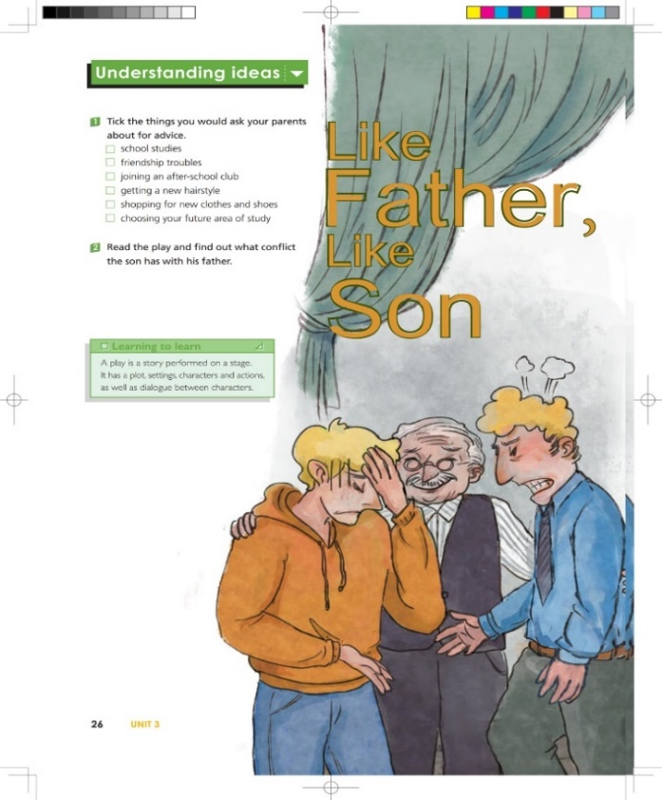

2
How do you understand the title?
It is used to say that a son’s character or behavior is similar to that of his father.
有其父必有其子

Slide 22
3
Choose another suitable title for the play and give your reasons.
The Secret to a Happy Family
A Generation Gap 代沟
A Dream Job
Grandfather’s Advice
My Career, My Choice

Slide 23
Choose another suitable title for the play and give
your reasons.
I will choose the second one “A Generation Gap”, because there are two generation gaps in this play. One is between the father and the son, and the other is between the father and the grandfather. When the generation gap exists, it may lead to conflicts. Finally, the grandfather resolves the conflict with his wisdom. The process of conflict resolution also provides the son with a chance to think and reflect.

Slide 24

Step 5: Practical application
Think and share
If you were in a similar situation to the son,
what would you do? Why?

Slide 25
Think and share
If you were in a similar situation to the son,
what would you do? Why?
Similar situation:
e.g. joining a drama club

Slide 26

Think and share
If you were in a similar situation to the son, what would you do? Why?
When I was at senior high, I was keen on acting and wanted to join the English drama club, but my parents worried that I couldn’t balance the time in study and after-school activities. They wanted me to focus only on my study. To resolve this conflict, I turned to my parents for a chat.

Slide 27
Think and share
If you were in a similar situation to the son, what would you do? Why?
Firstly, I told them I was crazy about performing English drama and I hoped they could support my hobby. Meanwhile, to win their support, I explained that performing English drama would bring me a lot of benefits, such as learning more English literature, improving my spoken English and broadening my view. Besides, I also made a promise to always put study in the first place and make the most of my time. At last, they understood me and put confidence in me.

Slide 28
Step 6: Homework
Think about what conflicts you once had with your parents. How did you resolve them? After learning this lesson, how can you improve your ways of resolving conflicts?
Tips:
1. Decide on a conflict between you and your parents.
2. Describe how you resolved the conflict.
3. Write how you will resolve that conflict after learning this play.

Slide 29
Thank you for watching!

