Slide 1
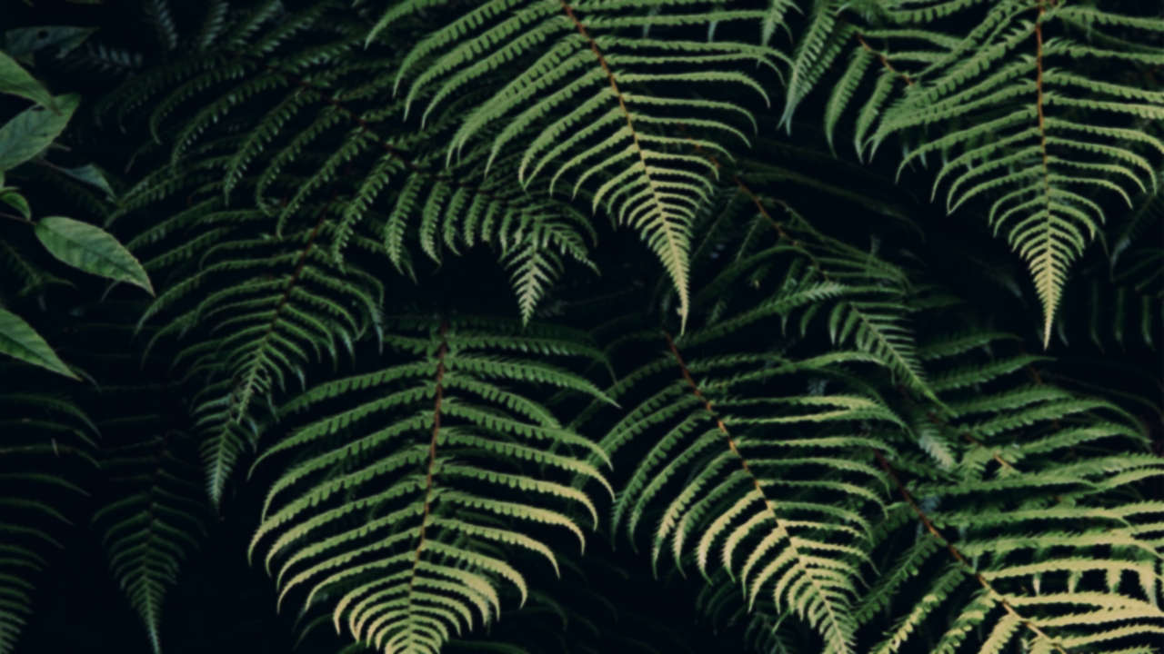


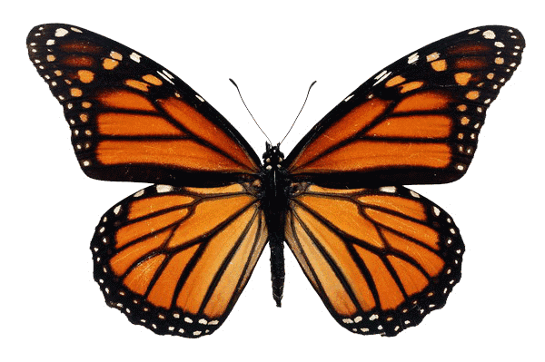
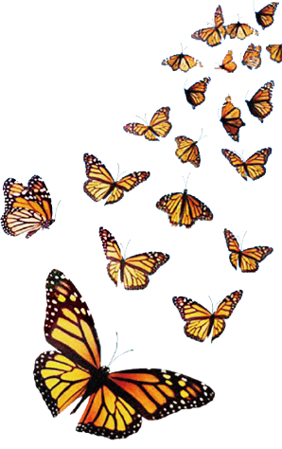
B1U5 Into the wild
The Monarch’s Journey

Slide 2


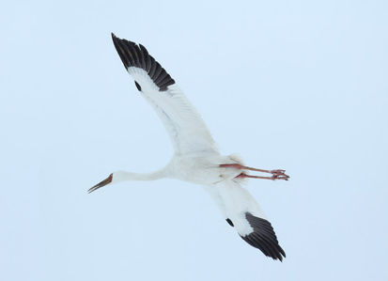
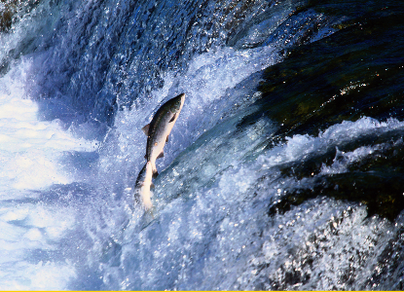
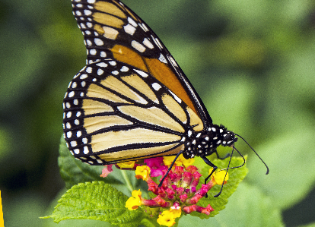
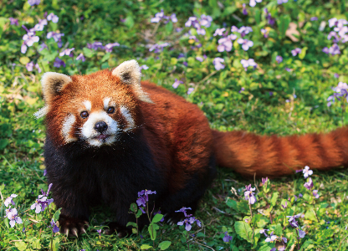
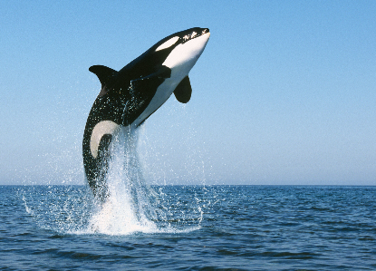
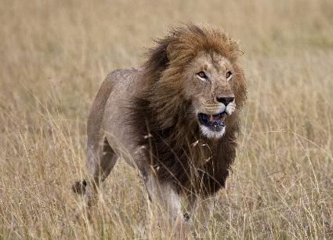
1. Warming up: Look at the pictures and choose the animals that migrate.
a
b
c
帝王蝶
西伯利亚鹤
大西洋鲑鱼
monarch butterfly
Siberian crane
Atlantic salmon
d
e
f
小熊猫
虎鲸
美洲狮
red panda
Killer whale
African lion

Slide 3
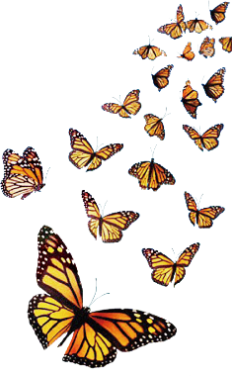


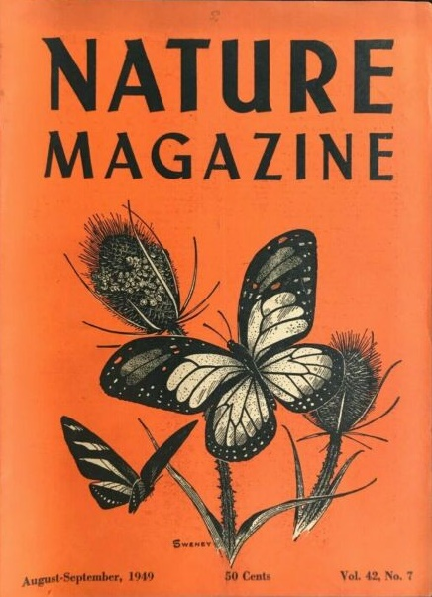
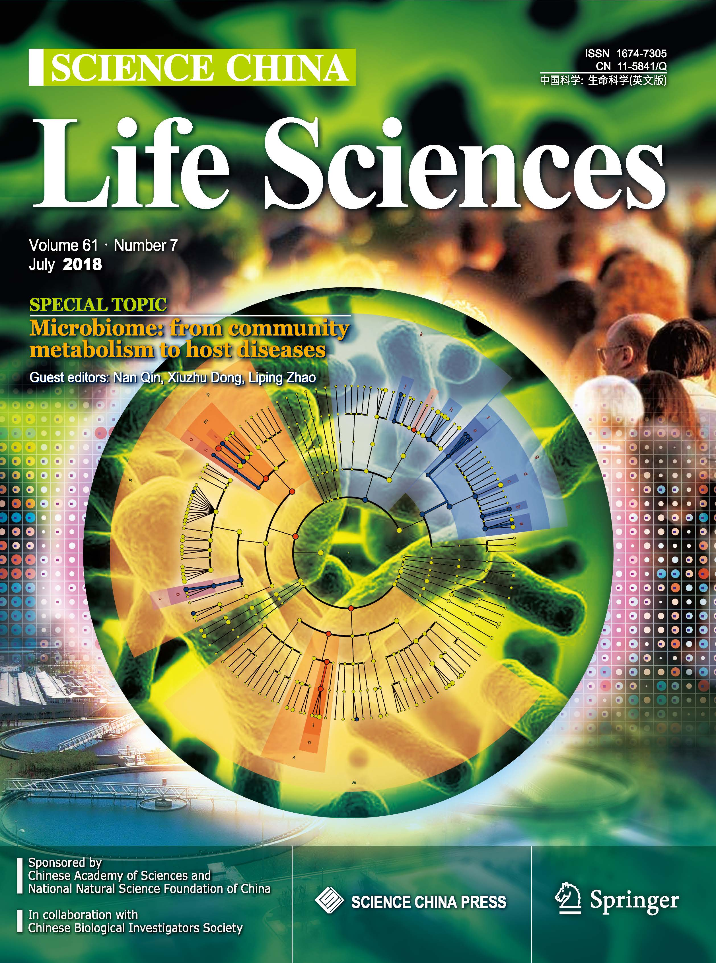
The Monarch’s Journey
2. Skimming.
Where are you most likely to find the passage?
旅游手册
科学研究论文
1. In a scientific research paper about the monarch butterfly’s migration.
2. In a popular nature magazine introducing the monarch butterfly.
3. In a travel leaflet encouraging people to visit North America.

Slide 4
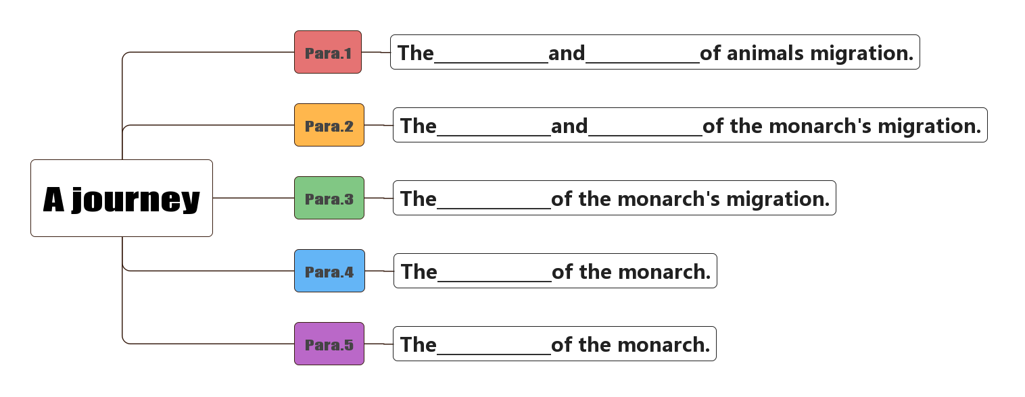
3. Scanning: Choose the word to fill in the blank.
what
why
when
where
how long
time
distance
how
ways
meaning
reasons
protection
trouble
destination

Slide 5
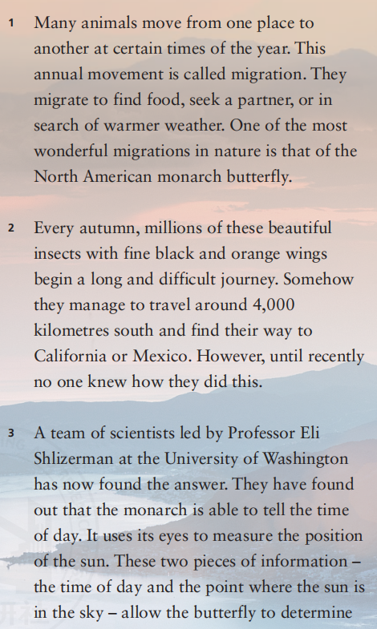
4. Read for details: Para 1. Find out the meaning and reasons of animals migration.
What is migration?
The annual movement that ___
__________________________________________________________________________________________
many animals move from one place to another at certain times of the year.
Why do they migrate?
1. ________________
2. ________________
3. ________________
find food
seek a partner
in search of warmer weather
Who is the most wonderful example of the migrations?

Slide 6

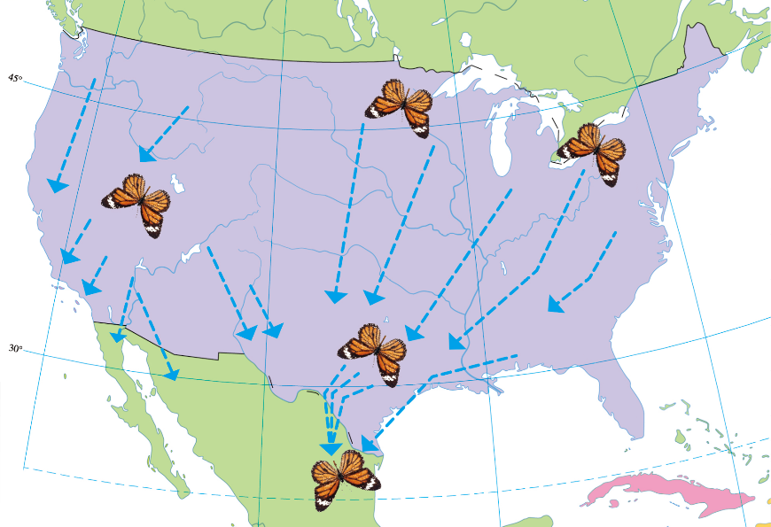
Why do we call it “one of the most wonderful migrations”?
Millions of monarchs with wings
Long and difficult journey
Small wings, big power.

Slide 7
4. Read for details: Para 2. The time and distance of the monarch's migration.
What is the time of migration?
____________________________
Every autumn.
到达
How long is the distance?
____________________________
____________________________
They manage to travel around 4,000 kilometres.
Where is the destination目的地?
____________________________
____________________________
They find thier way to California or Mexico.
Transition承上启下
how

Slide 8
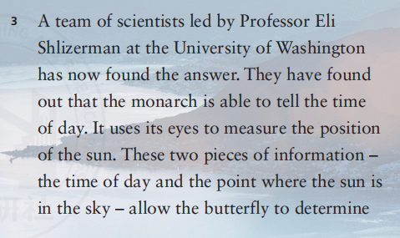

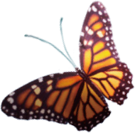
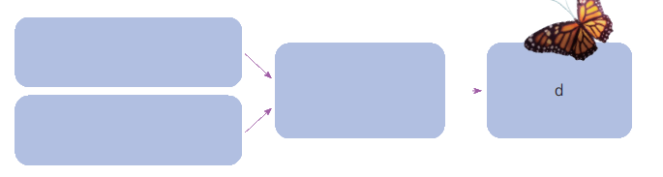
4. Read for details: Para 3. The ways of the monarch's migration.
a. The monarch butterfly is able to tell
_______________.
b. Using these two pieces of
information, the monarch butterfly
determines____________.
c. The monarch butterfly measures
_____________________ with its eyes.
d. The monarch butterfly reaches __________________________________.
the time of day
the way to go
the position of the sun
the places where it will spend the winter
Complete the cause-effect因果 flow charts流程图.
a
b
c

Slide 9
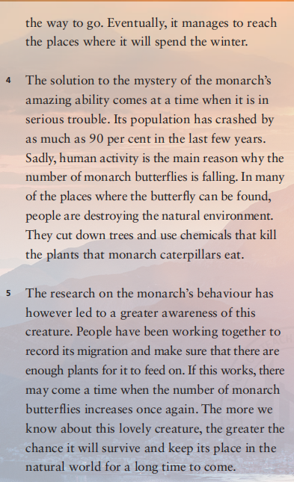
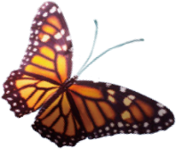
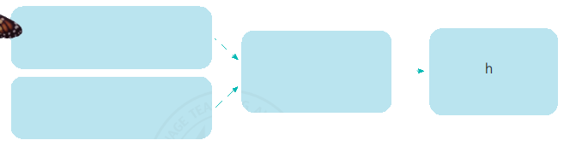
4. Read for details: Para 4. The trouble of the monarch.
cut down
e. Humans _________ trees.
f. The___________________________
where monarchs can be found is
destroyed.
g. Humans use chemicals that
____________ that monarch
caterpillars eat.
h. The monarch butterfly’s population
_____________________________
in the last few years.
砍倒；削减；减少
natural environment of many places
kill the plants
has crashed (by as much as 90 per cent)
e
Complete the cause-effect因果 flow charts流程图.
f
g

Slide 10
4. Read for details: Para 5. The protection of the monarch.
What should we do to protect the monarch?
dos:
___________________________________
______________________________________________________________________
___________________________________
___________________________________
don’ts: ___________________________________
______________________________________________________________________
___________________________________
have a greater awareness of this creature
work together to record its migration
make sure that there are enough plants for it to feed on
Don’t destroy the natural environment.
Don’t cut down trees
Dont’ use chemicals that kill the plants that monarch caterpillars eat.

Slide 11
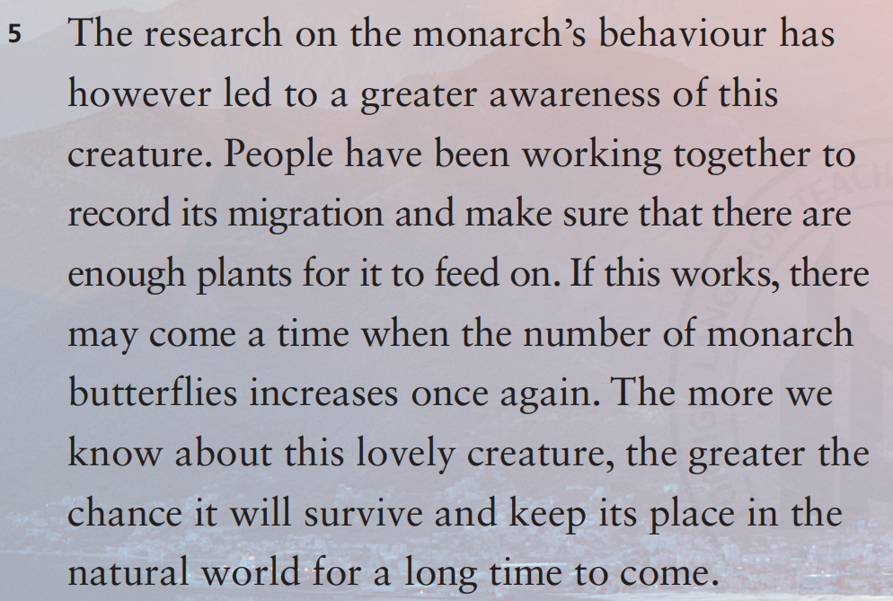
4. Read for details: Para 5. The protection of the monarch.
我们对这种迷人的生物了解越多,它们在自然界中得以长久生存并保持其位置的可能性就越大。
The 比较级；the 比较级

Slide 12
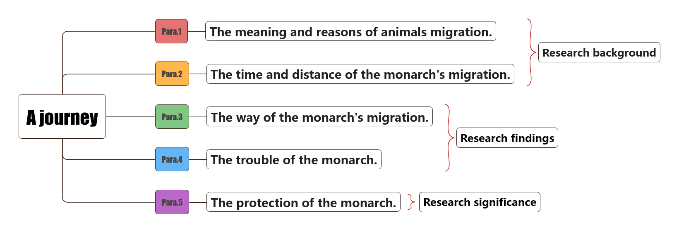
5. Read for the structure.

Slide 13
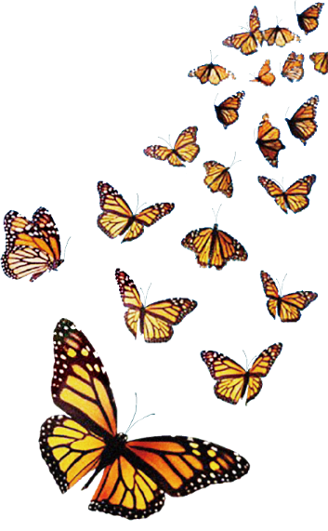

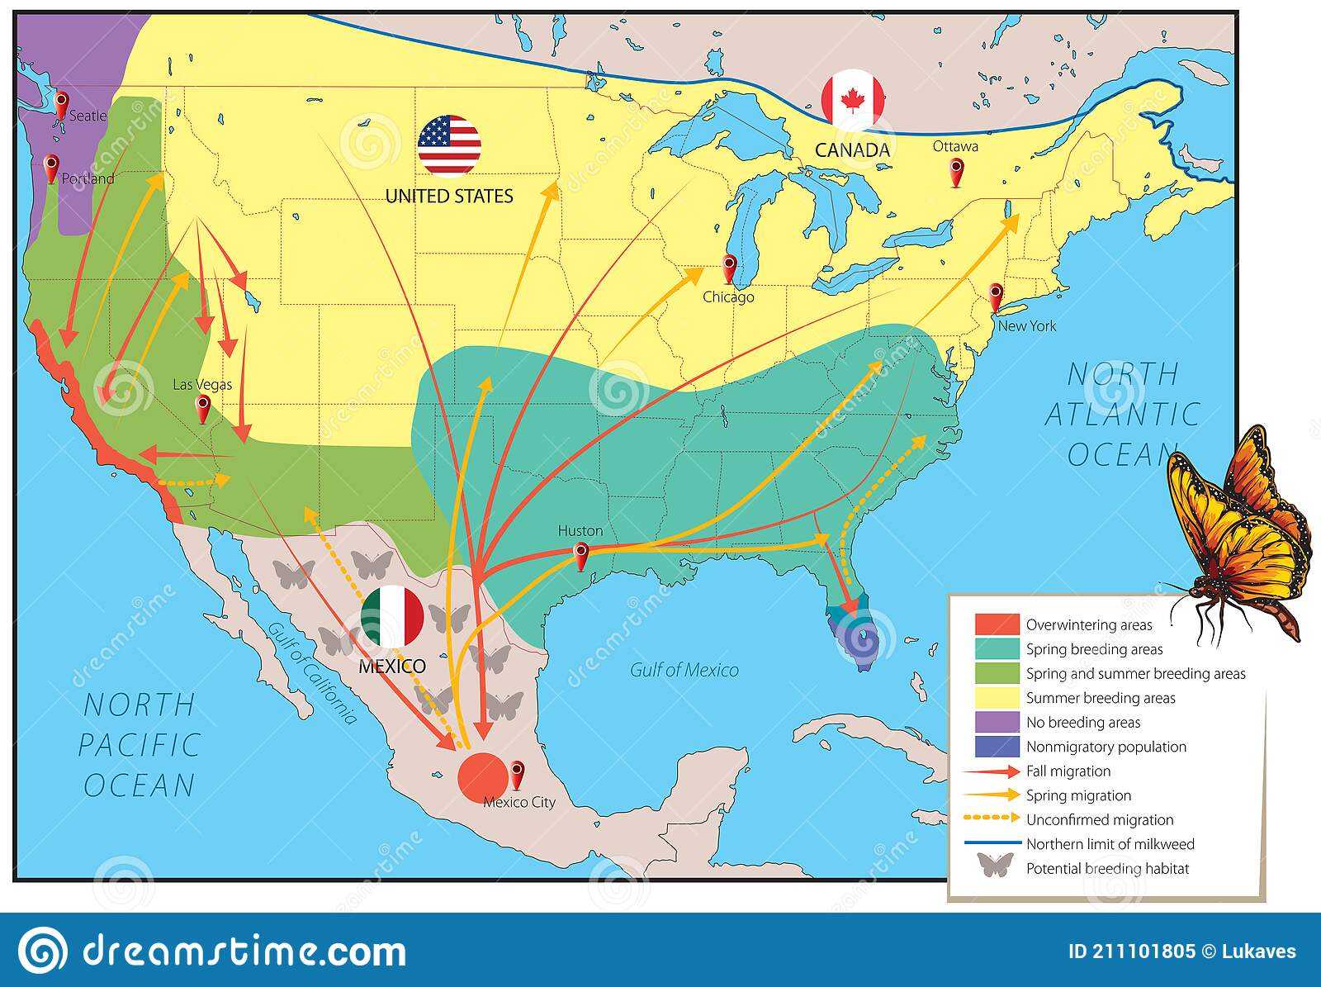
6. Read for the genre and skills.
What’s the genre of the text?
Skills
A. Expository writing 说明文
B. Argumentative writing议论文
C. Narrative writing 记叙文
D. Practical writing 应用文
definition 下定义
examples 举例子
assumption 假设
data 列数据
cause-and-effect 因果

Slide 14



6. Read for the genre and skills.
 | Skills
This annual movement from one place to another is called migration.
One of the most wonderful migrations in nature is that of the North American monarch butterfly.
These beautiful insects with fine black and orange wings manage to travel around 4,000 kms south to California or Mexico.

Slide 15


6. Read for the genre and skills.
 | Skills
The monarch butterfly is able to tell the time of day and measure the position of the sun. These two pieces of information allow the butterfly to determine the way to go.
People are destroying the natural environment. They cut down trees and use chemicals to kill their eating plants. Its population has crashed by as much as 90% in the past few years.
If this works, there may come a time when the number of the butterflies increases again.
因果关系句型：
..., causing...
..., which leads to...

Slide 16

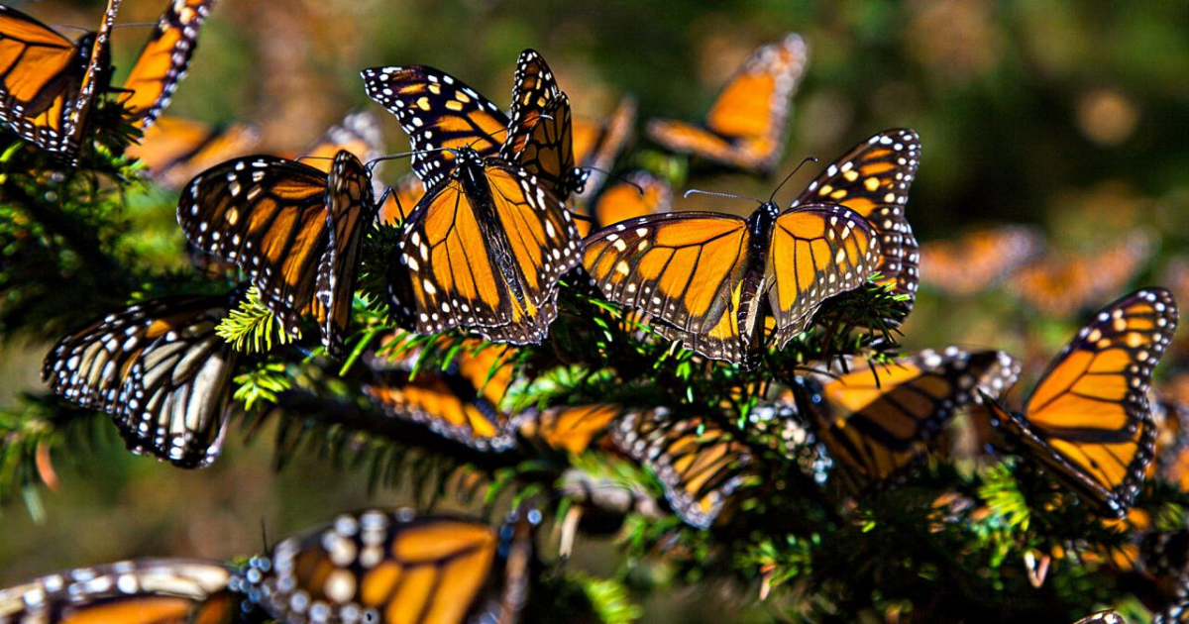

7. Think&Share
The Monarch’s Journey
Migration
The Monarch’s
Wildlife Protection
Why does the author use journey instead of migration in the title?
It is a long long journey but tough, which needs our efforts.
monarch’s journey to find their way to the destination
scientists’ journey to find the solution to the mystery
human’s journey to protect the monarch and wildlife.

Slide 17
7. Think&Share: What should we do to protect wildlife?
Our school will organize an activity to protect wildlife.
Discuss dos and donts to protect the wildlife.
Dos
Don’ts
Protect the natural environment
Keep away from their home
choose green means of transport
plant trees
live in harmony with nature
...
use poisonous chemicals
hunt for meat
kill for money
keep them for pet
...
First, _________. If we ..., ...will ...
Then, _________. It is ... for ... to do ...
Finally,________. The 比较级..., the 比较级...

Slide 18
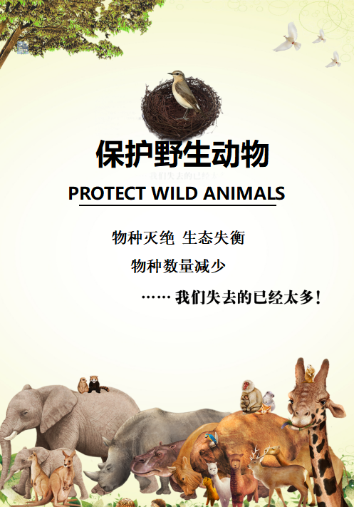
Homework
Create a poster
to
protect wild animals

Slide 19
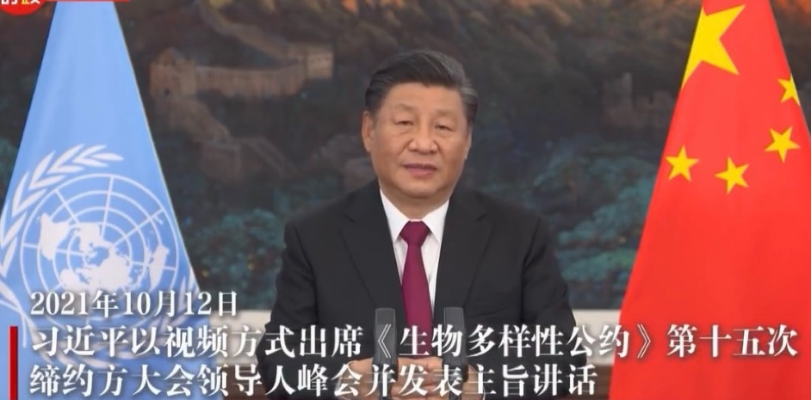


“All beings flourish when they live in harmony and receive nourishment from Nature.”
“If we humanity do not fail Nature, Nature will not fail us.”

Slide 20
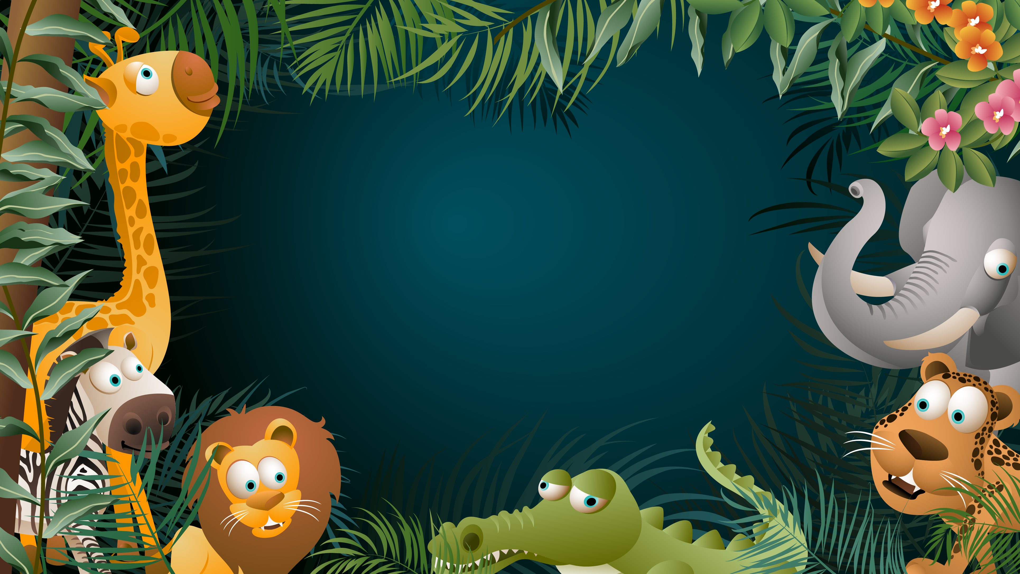
Thanks for listening
THANKS

