Slide 1
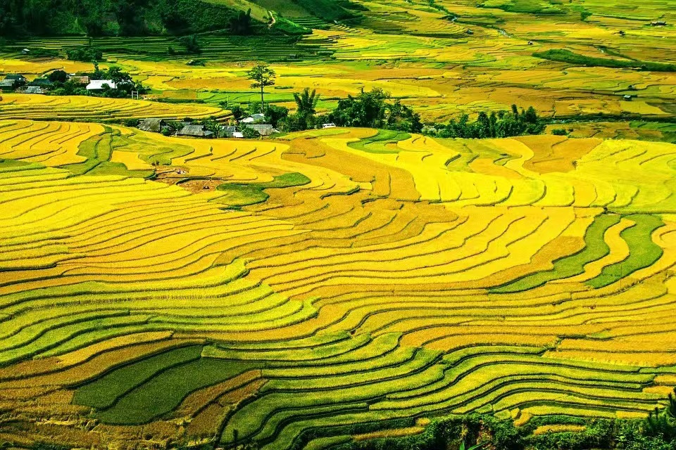
Unit 6 Longji Rice Terraces
-Reading

Slide 2

Watch a video and answer the questions
What are the problems faced by Venice?
Are there any similar cities or towns in China? Introduce one to the class.

Slide 3

What are the problems faced by Venice?
（无字幕）

Slide 4

What are the problems faced by Venice?
（有字幕）

Slide 5
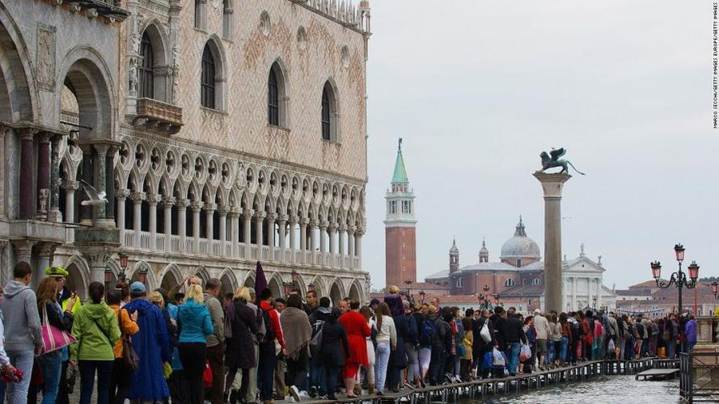
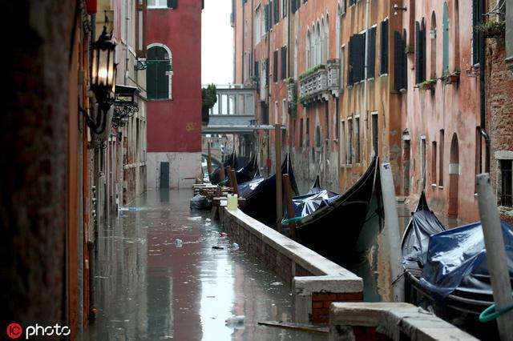
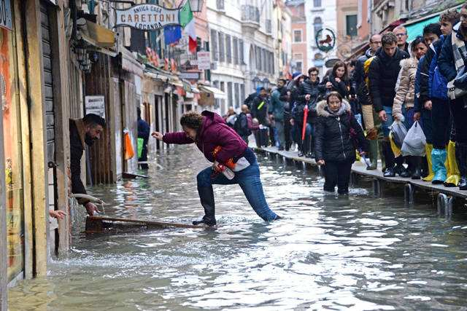
What are the problems faced by Venice?
Venice is faced with the problems caused by water. Saltwater is slowly damaging the bases of Venice’s buildings, making the city gradually sink. Floods also hit the city each winter, causing more problems.

Slide 6
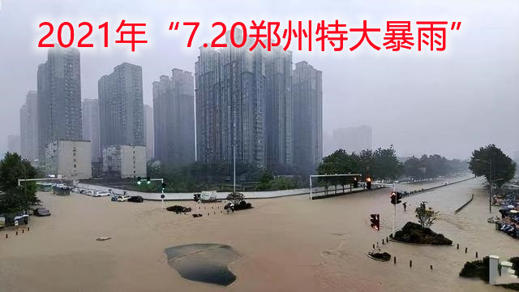
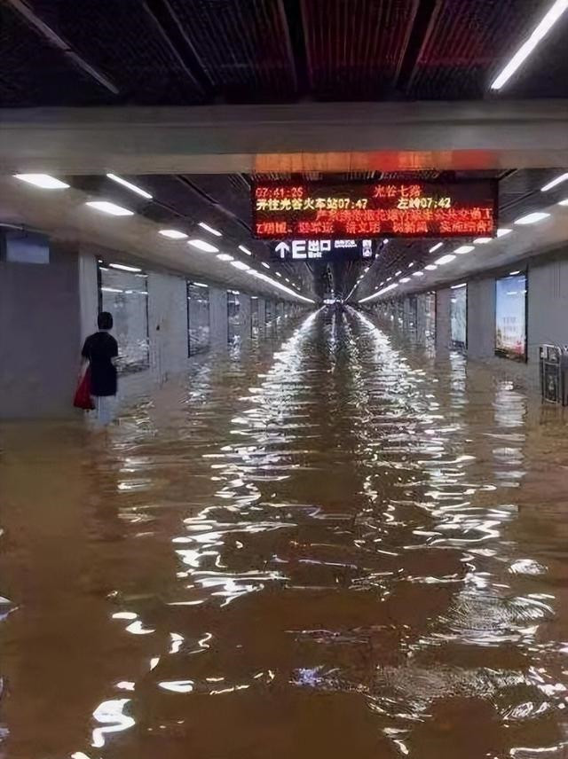
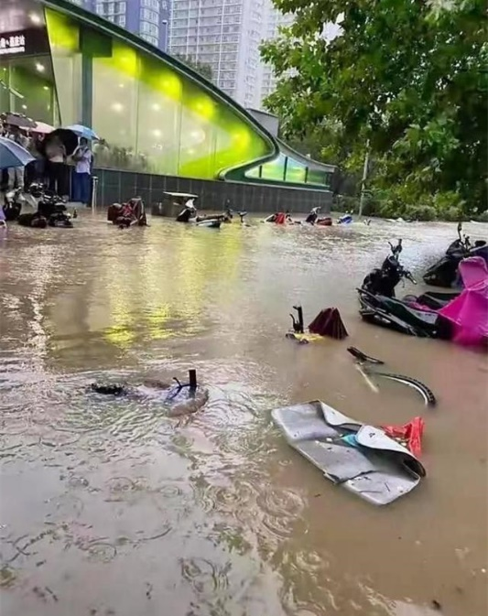
Are there any similar cities or towns in China? Introduce one to the class.
China’s city of Zhengzhou in the Henan province has been suffered a year’s worth of rain in less than a week. Buildings have been decimated(严重破坏), and streets are underwater.

Slide 7
Natural environment influences our lives!

Slide 8
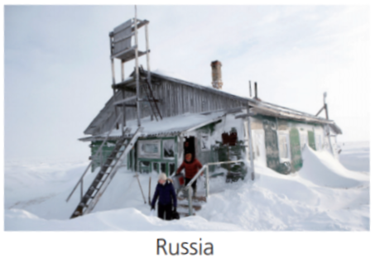
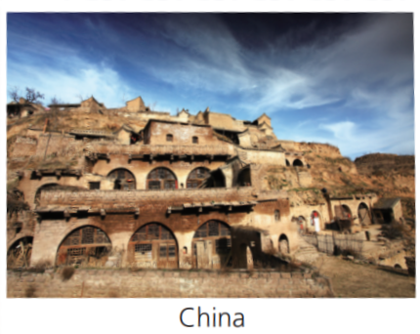
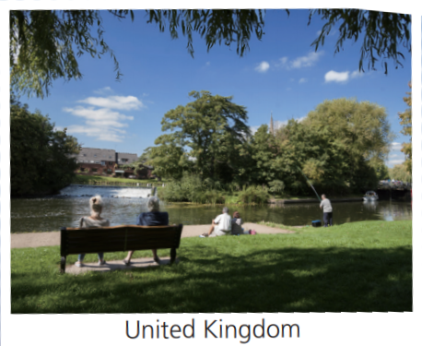
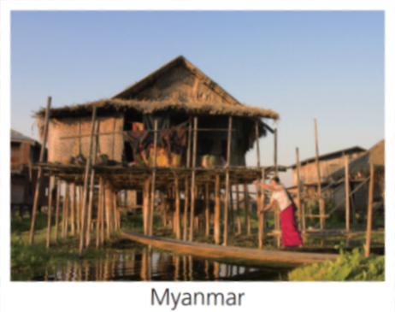
Look at the pictures and answer the question.
How does the natural environment influence the lives of the local people in each picture?

Slide 9
In Russia, it can get very cold with heavy snow in winter, so people live in houses with inclined roofs and wear thick clothes for outdoor activities.
In the UK , the mild climate and parks in towns and cities provide a pleasant natural environment in which people can relax and enjoy life.

Slide 10
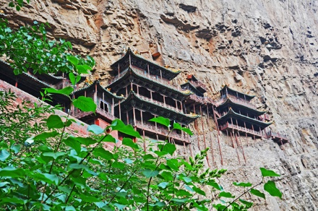
In northwest China, the yellow earth is thick and compacted, so people build cave dwellings as their place of residence.
In parts of north and north-west China, it is common for people to live in cave dwellings. In Shaanxi Province, where the less is relatively compacted and suitable for
carving, it has been a tradition for centuries. There are two main kinds of cave dwellings: cliffside dwellings, which are carved out of the side of a cliff and often face south, and pit dwellings, in places where there is no hill.

Slide 11

In Myanmar, the climate is hot and humid and there are many rivers. Many people live in bamboo houses on stilts (桩子) , which keep them above the water.
People need to solve these natural environment problems as soon as possible. But how?

Slide 12

Let's enjoy a video.
Q1:What do you learn from the video?

Slide 13

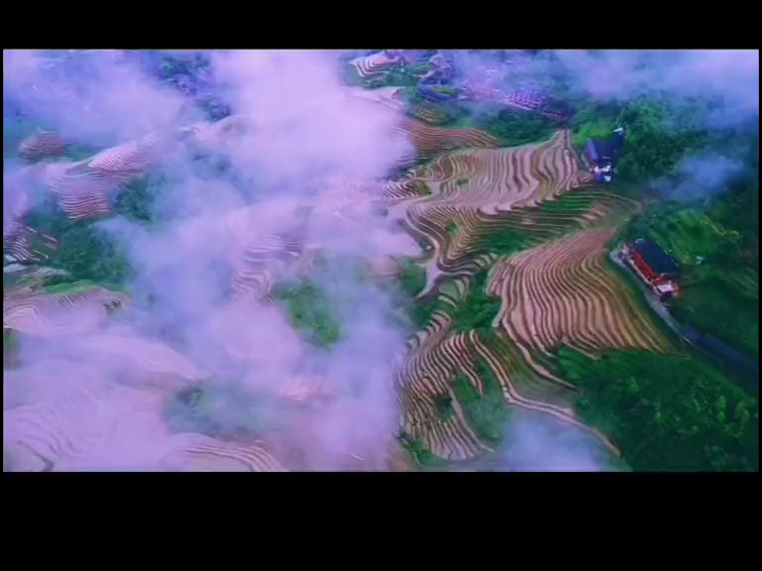
Warm-up: Video time
Q1:What do you learn from the video?

Slide 14
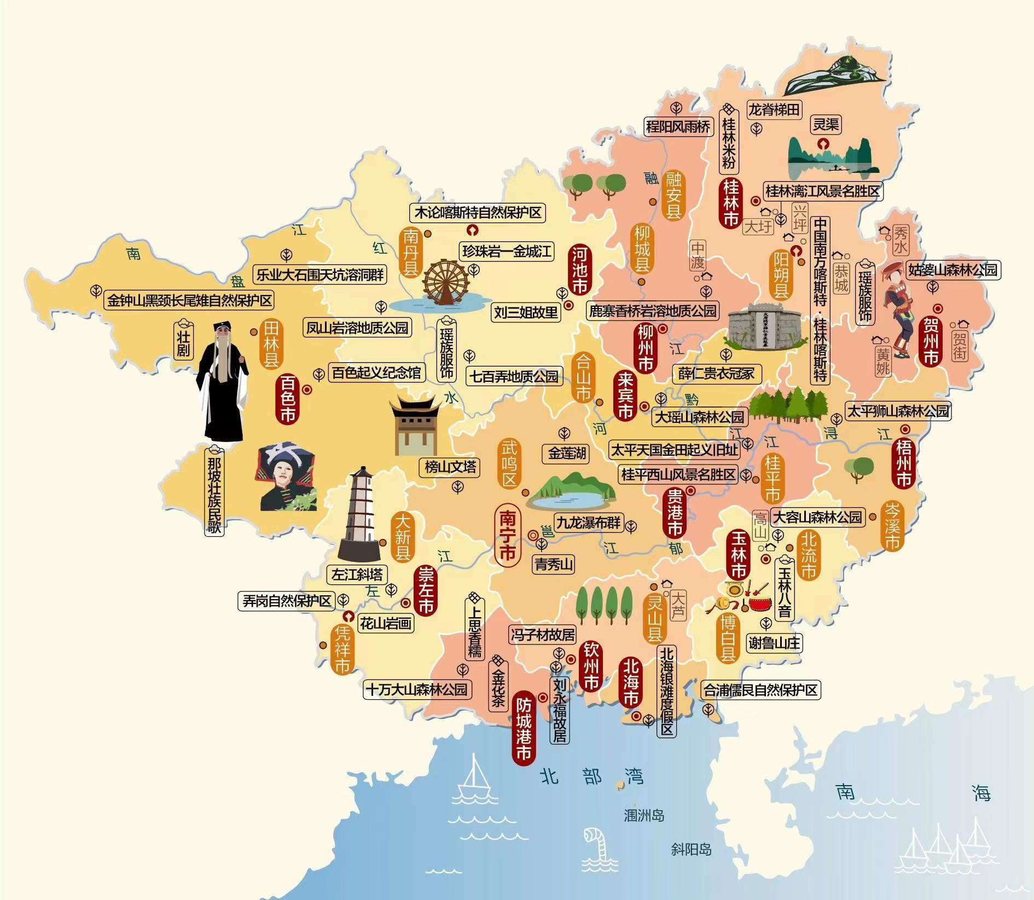

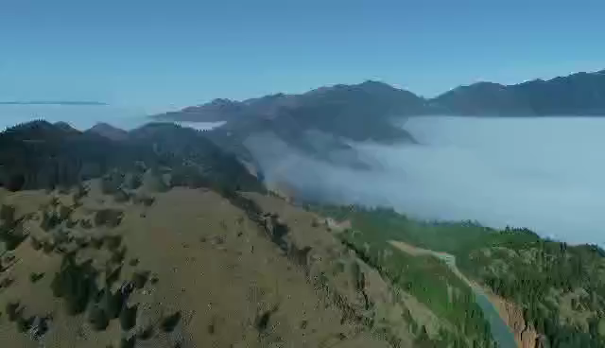

Let’s go travel around Guang Xi.
First stop:
Longji Rice Terraces

Slide 15
Longji Rice Terraces
(龙脊梯田)
龙脊梯田位于桂林龙胜县东南部和平乡境内的龙脊山。龙脊梯田距龙胜县城27公里，距桂林市80公里，景区面积共66平方公里，梯田分布在海拔300至1100米之间，坡度大多在26至35度之间，最大坡度达50度。前往梯田几乎都是盘山公路，一直升到约海拔600米以上，到梯田时海拔达到880米。

Slide 16

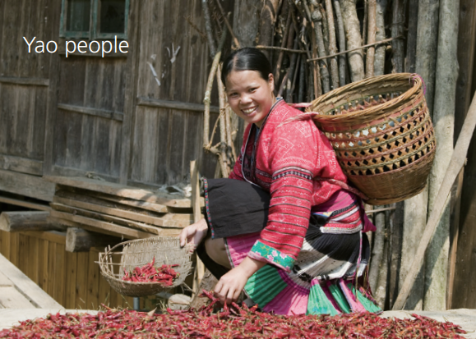
Local people
Most of Zhuang people (壮族) and Yao people (瑶族) live in Guangxi Zhuang Autonomous Region (广西壮族自治区). They mainly live on rice as the main food and they grow rice on terraces.

Slide 17
How do they grow rice?
Why do they grow rice on terrace?

Slide 18



travel tips
Read the following passage to learn about Longji Rice Terraces, which will help you enjoy your trip.

Slide 19

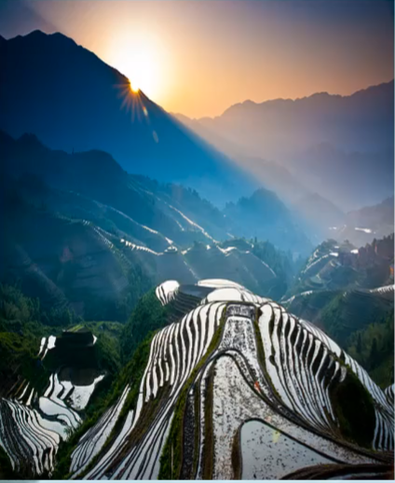
Activity 1: Read for understanding
Skim the passage and get the main idea of each paragraph.
paragraphs | main idea
P1
P2
P3
P4
P5
topic sentence
Learning to learn:
Main idea often comes at the beginning of a paragraph; sometimes, it appears in the middle or at the end.
the view
the background
the reason
So why did these people go to so much trouble to turn the entire mountains into terraces?
how they work
the meaning
Topic sentence: ...these terraces still mean a lot to the local people for whom traditions hold much value.

Slide 20
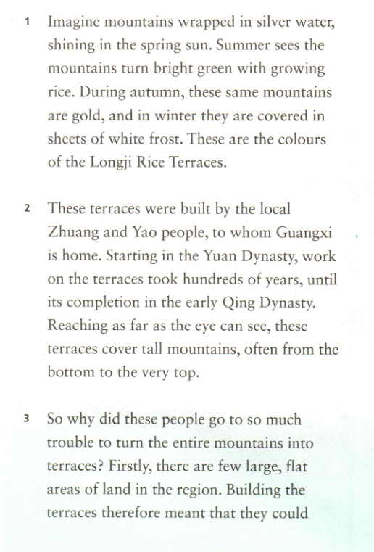
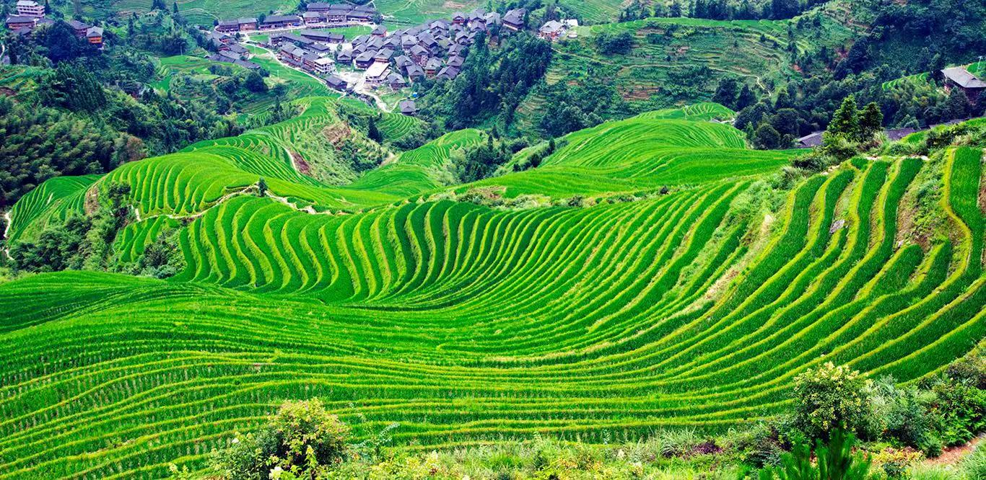
Read para 1 and fill in the form.
seasons | color
spring
summer
autumn
winter
silver
bright green
gold
white

Slide 21
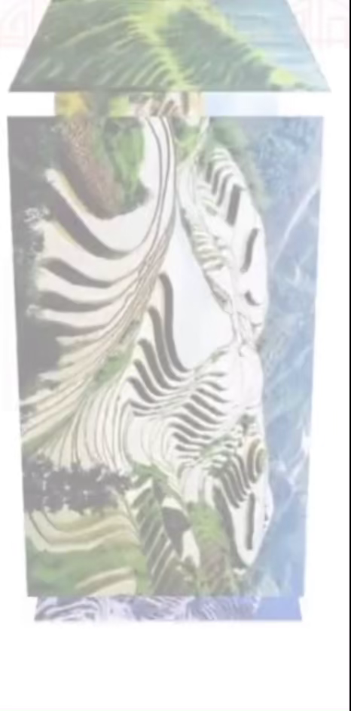

Why does the writer mention the view at the beginning?
st
Natural beauty: hook
Function:
to attract readers

Slide 22

Read para 2 and fill in the form.
hook
what
Natural way
elements | background of the construction
who
where
when
how long
Zhuang and Yao people
Why did it take so long to build them?
Guang xi
start in the Yuan Dynasty and complete in the early Qing Dynasty
hundreds of years

Slide 23
Read para3 and fill in the form.
hook
what
why
3. So why did these people go to so much trouble to turn the entire mountains into terraces? Firstly, there are few large, flat areas of land in the region. Building the terraces meant that they could increase the areas in which they could grow rice. Secondly, the mountains are steep and the soil is shallow. The flat terraces prevent the soil from being washed away.
topic sentence& transition words
Natural
protection
problem | solution
_______ large and flat areas in the region | _________ the areas where they could grow rice
_________ mountains | ________ rainwater
________ soil | _______ the soil from being _______ ________
few
increase
steep
catch
prevent
shallow
washed
away

Slide 24
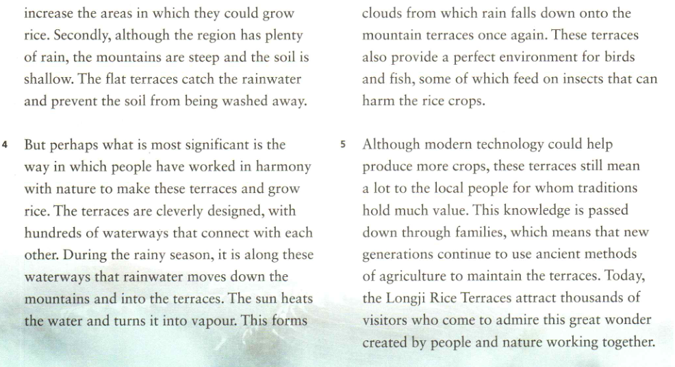

Read para 4 and draw a mind map to show the working principle.
hook
what
why
how
①
③
My mind map
②
④

Slide 25
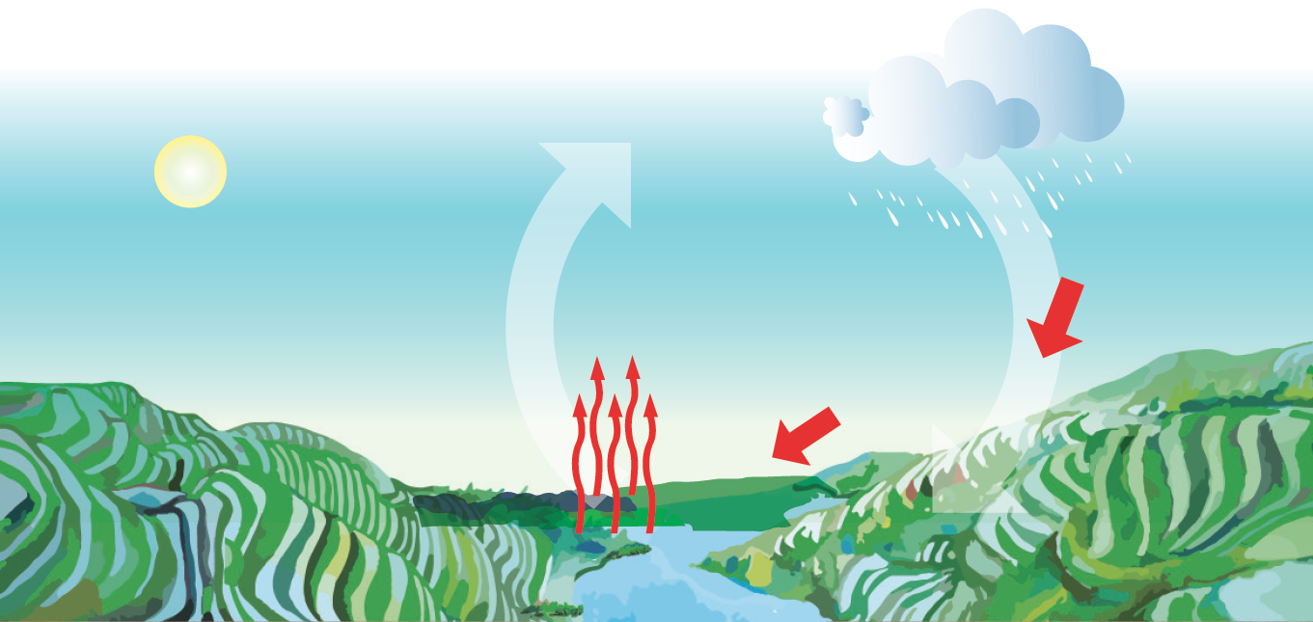
The Working Principle
④ clouds
①rainwater
fall down
sun
③turn into
vapour
②move down
waterways
heat
mountain terraces
water
Notes:
通过关键词的提示，引导学生按照顺序，运用过渡词，对原理进行复述。
过渡语：
You all did a good job. And we have absorbed much knowledge of Longji Rice Terraces. Hopefully, we can introduce this marvelous heritage to more people. And to do that, we have to be able to retell its working principle.
Let’s take a look at the picture…
Now please work in pairs, retell the principle to your partners, and then come to the stage and share.

Slide 26
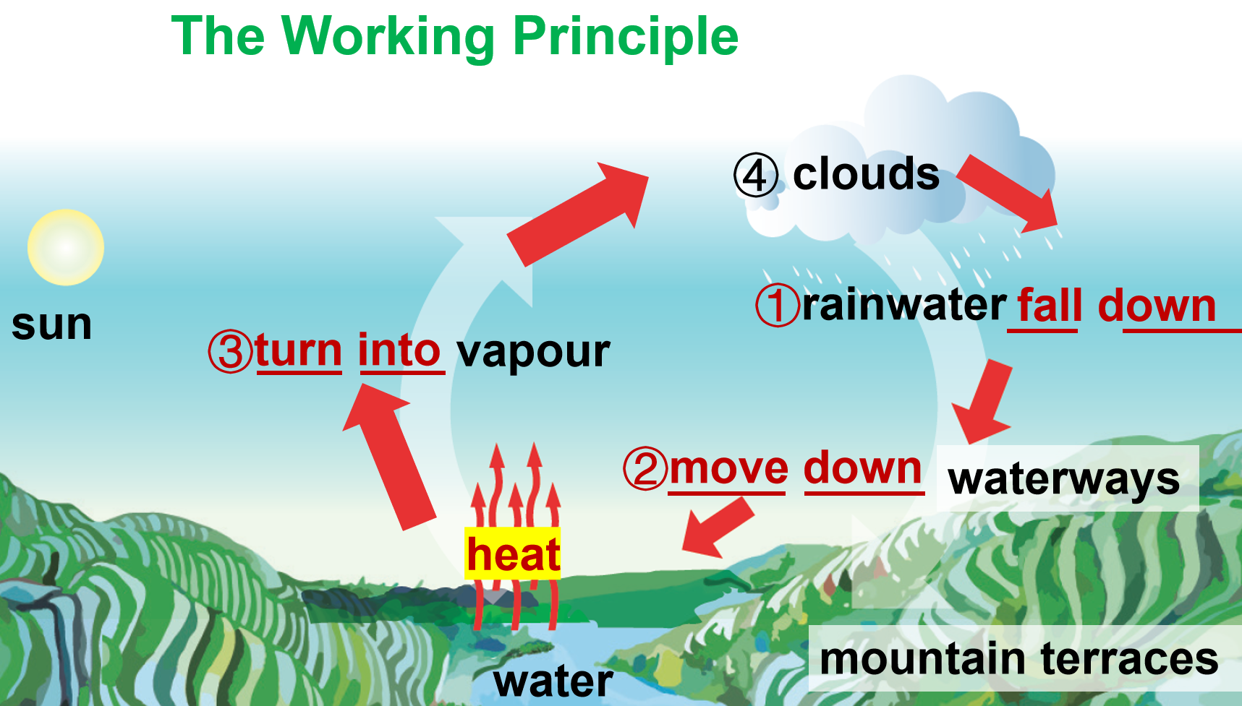
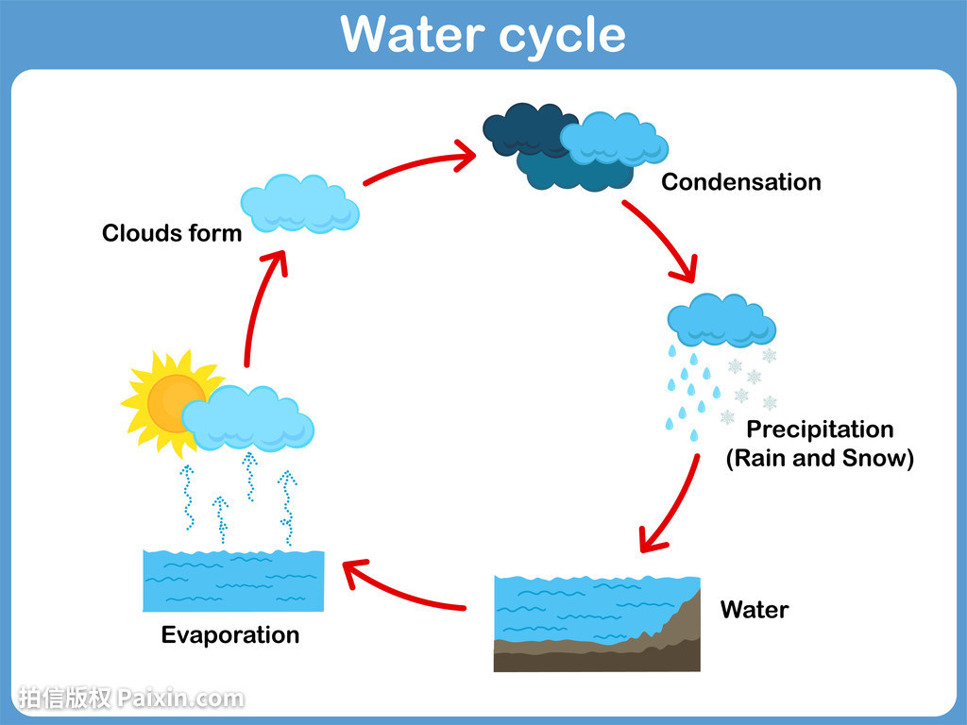
How do people work in harmony with nature?
By respecting and observing the law of nature.

Slide 27
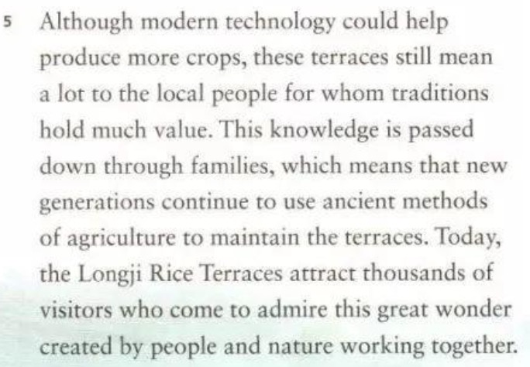
Read para 5 :What are the roles/value of terraces in the past and at modern times?
hook
what
why
how
what
a food provider
natural value
a valuable tradition
a tourist attraction

Slide 28


Activity 2: Read for applying and practicing
1. What type of writing is the passage?
A. Narration(记叙文) B. Argumentation(议论文)
C. Practical Writing(应用文) D. Exposition (说明文)
2. What’s the author’s purpose in writing this passage?
A. To praise the wisdom of the ethnic groups living in Guangxi Zhuang Autonomous Region. B. To explain how people worked in harmony with nature to create the Longji Rice Terraces. C. To describe the beauty of the Longji Rice Terraces and to attract visitors to this scenic spot.

Slide 29
Longji Rice Terraces is a perfect example of
people working in harmony with nature
harmony
interior
P5 The meaning
Natural value
P4 How they work
Natural function
P3 The reason
Natural protection
exterior
P2 The background
Natural way
P1 The view
Natural beauty

Slide 30

3. How do you define “ working in harmony with nature” ?
People benefit from nature by transforming it without causing damage to the environment.
Notes:
基于之前的段落细节分析，引导学生对”people worked in harmony with nature”进行探讨并进行自由陈述，认识人与自然和谐相处的本质，呈现参考答案：通过非破坏性的活动改造自然以从中获益。
过渡语：
After analyzing the whole passage, let’s get back to the author’s purpose. What is your understanding of “people worked in harmony with nature”?
Please work in groups and share your ideas.
…
Thank you all for sharing. Let’s take a look at my understanding: people benefit from nature by transforming it without causing damage to the environment.
Do you agree? OK. From this activity, I think you all have a better understanding of this passage about Longji Rice Terraces. Now let’s check your summary skill. You will read a summary of the passage and try to correct four factual mistakes in this summary. Before we start this activity, let’s talk about the meaning of factual mistakes.

Slide 31
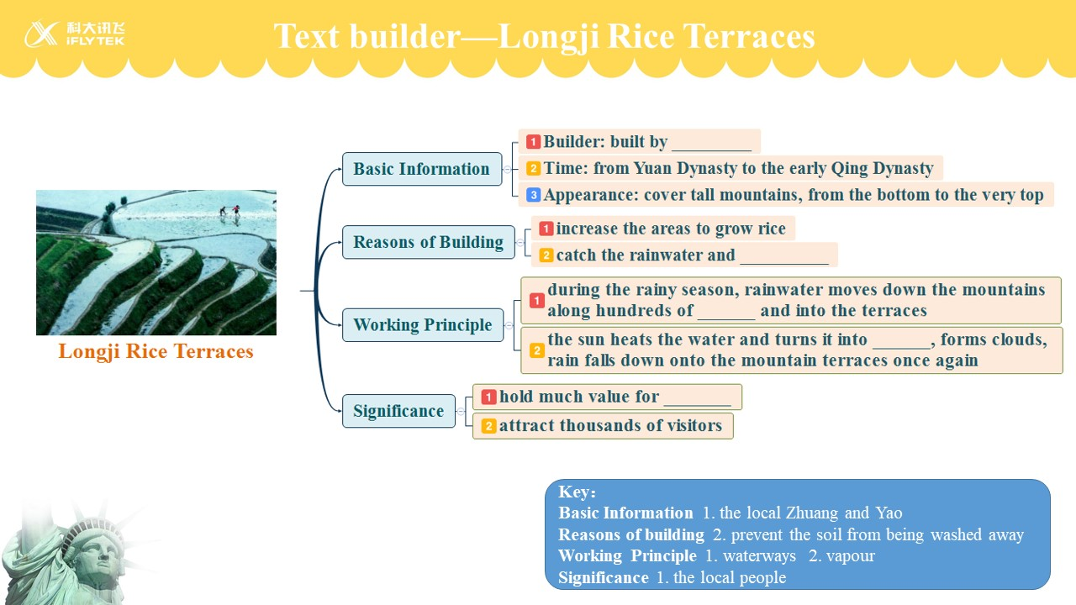


Activity 3 Read for transferring and creating
Supposing you are a publicity ambassador of Longji, please introduce the Longji Rice Terrace to foreigners.
Welcome to
Longji Rice Terrace

Slide 32

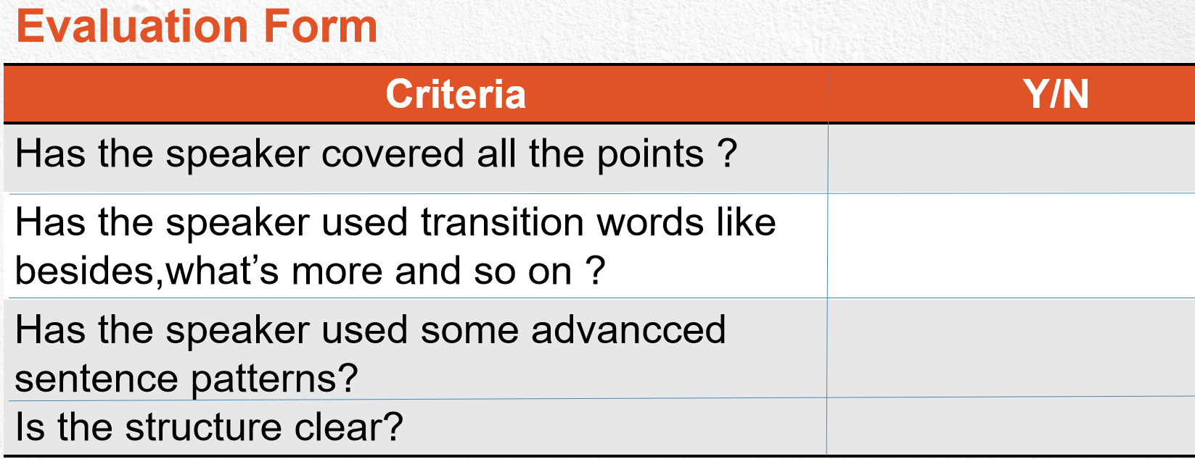
SHOW TIME!
Introduce the Longji Rice Terrace

Slide 33

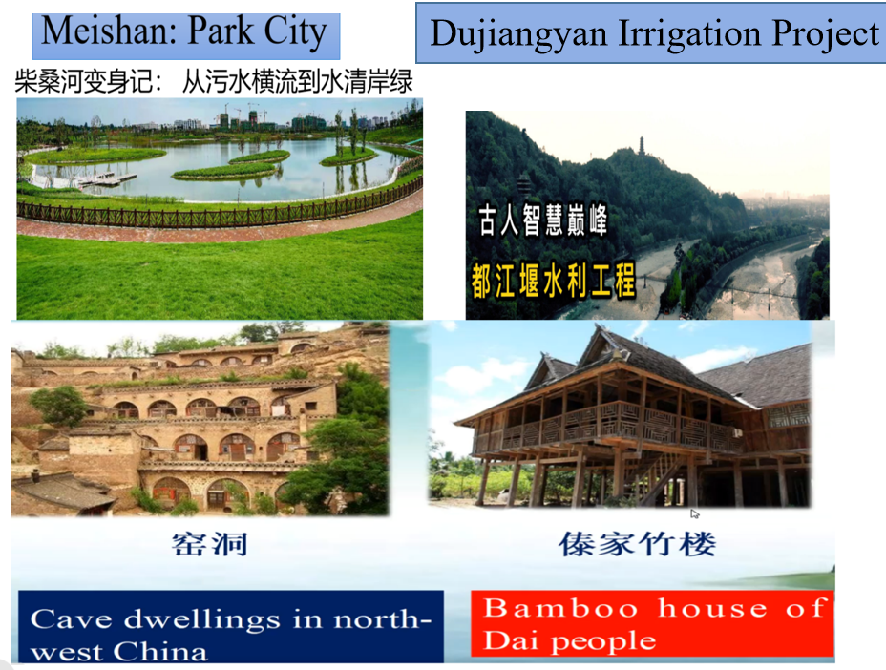

1. In what other ways do people live in harmony with nature? Give examples.
防洪灌溉 flood control and irrigation [ˌɪrɪˈgeɪʃən]
人与自然和谐共存harmonious coexistence
of human and nature
黄泥粘稠the yellow earth is thick
窑洞cave dwellings [d'welɪŋz]
保护环境及防治污染environmental protection
and pollution prevention

Slide 34
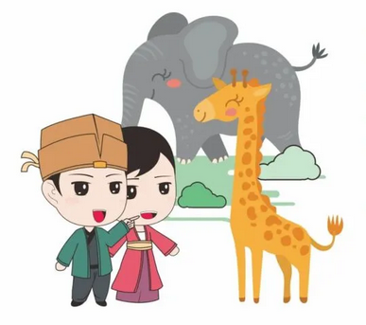



2. What can we do to live in harmony with nature?
Individual...
Government...
Society...
green development；
set up natural reserves；
keep ecological balance;
in harmony with nature;
take immediate measures；
make laws to protect the natural environment;
raise the awareness of protecting the environment;

Slide 35
Live in harmony with nature
Raise the awareness of protecting the
environment
Society
Set up natural reserves
Government
Make laws to protect the natural
environment
Individual
Use less chemicals
Plant more trees

Slide 36
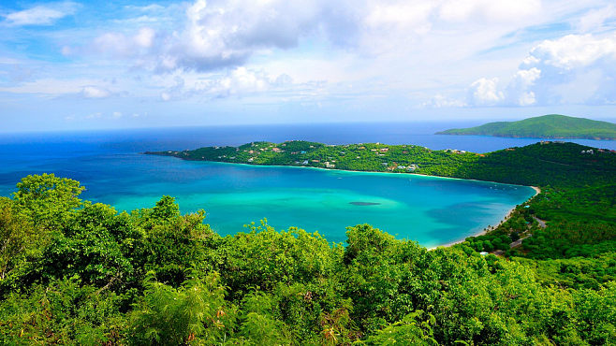


Respect but with no fear
Employ but not destroy
Appreciate but away from greed
Love is harmony

Slide 37

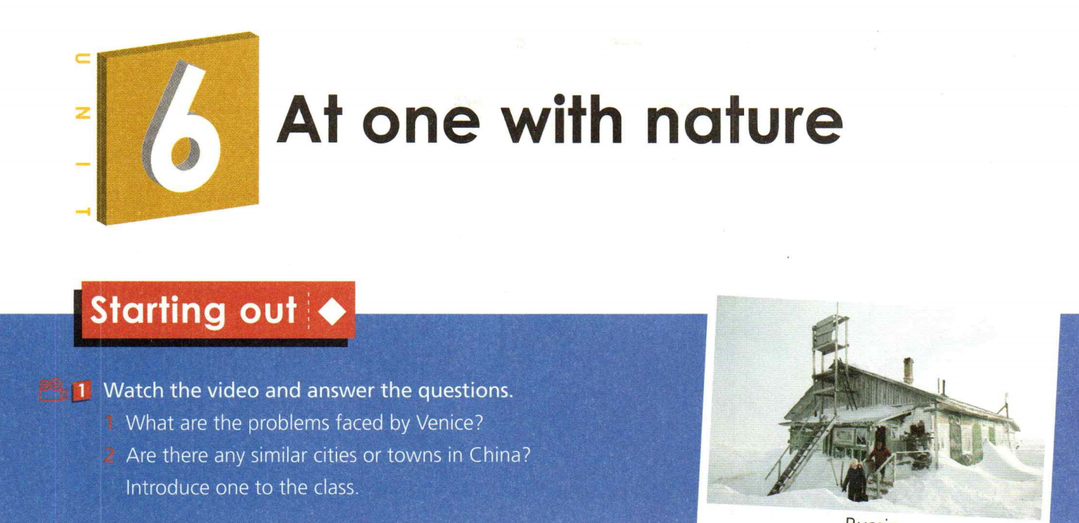
Xi’s words
Building a Community of Life Together
We must be committed to harmony between man and nature.
We must be committed to green development.

Slide 38


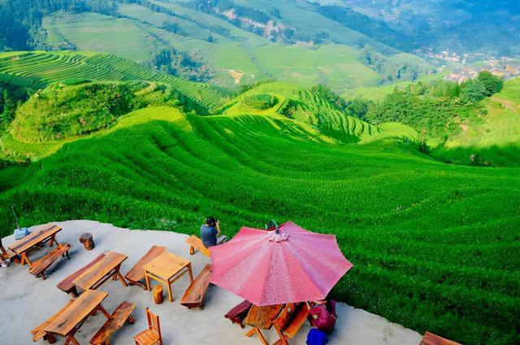
Search the Internet to find more examples to show people live in harmony with nature and share them with the class.

Slide 39

