Slide 1

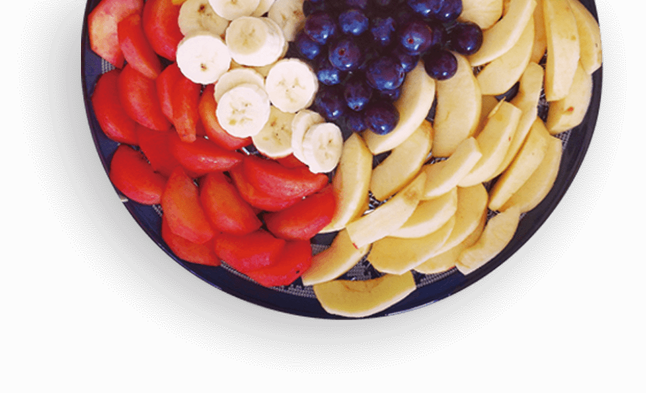
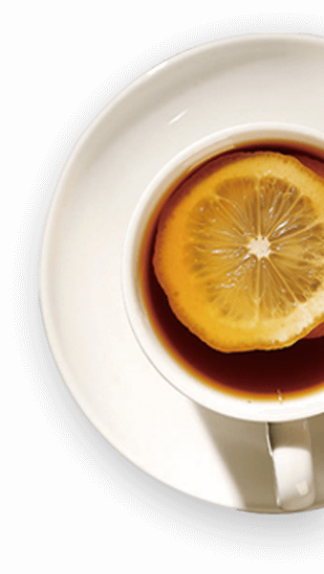
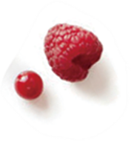
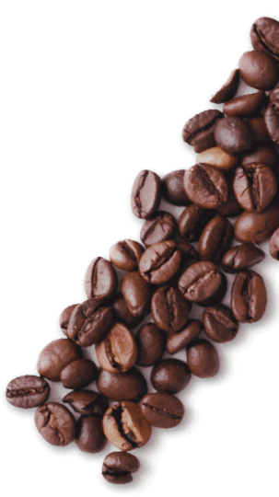
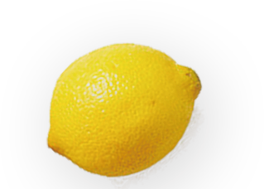
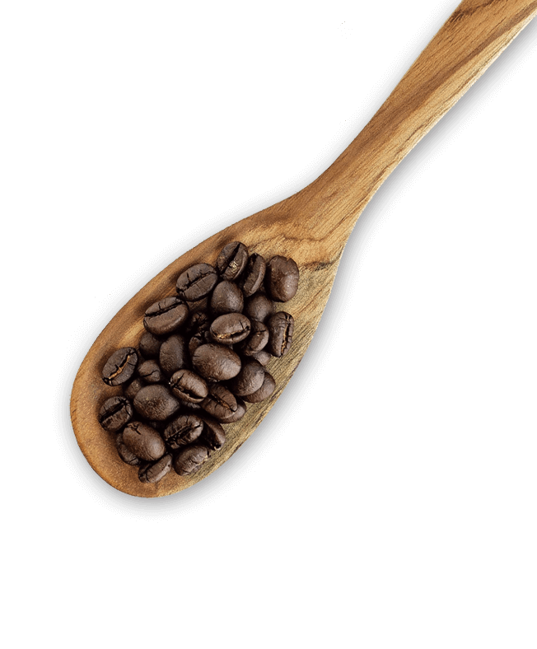
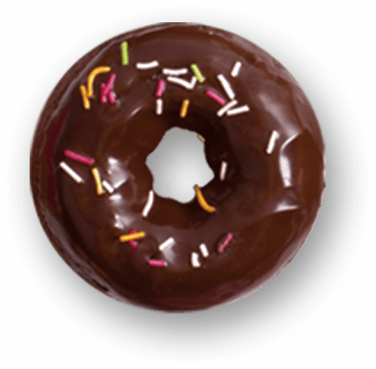


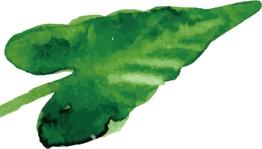
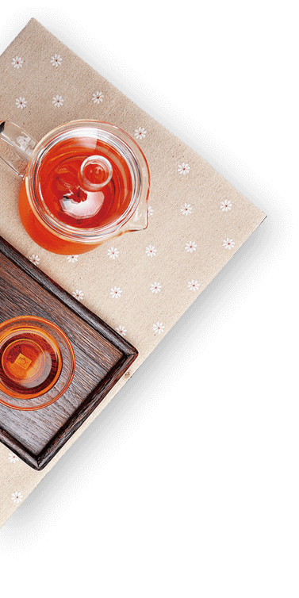
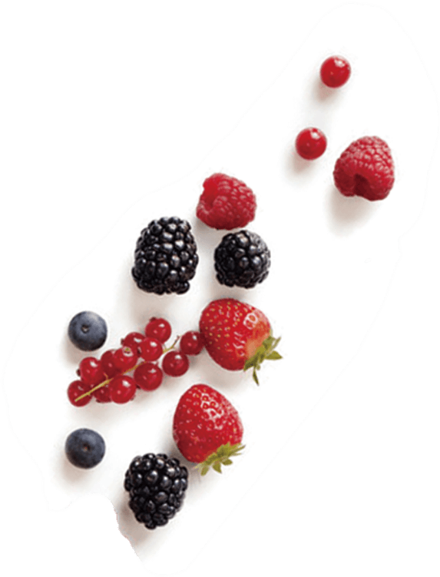

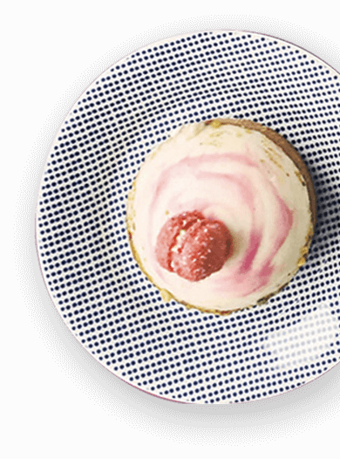
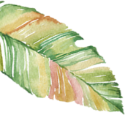
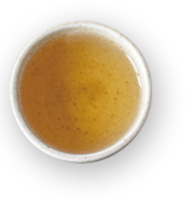
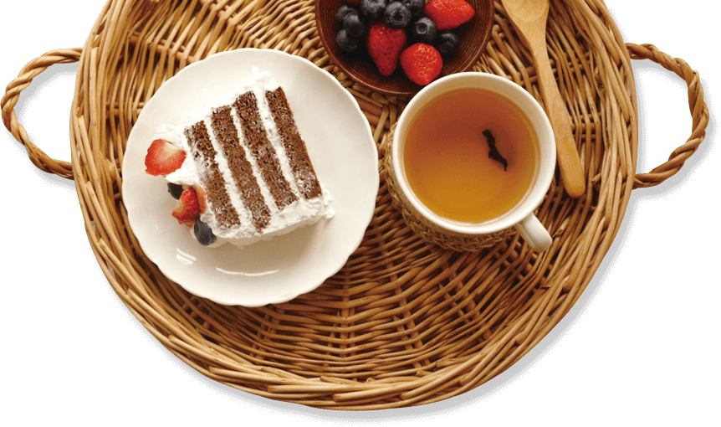



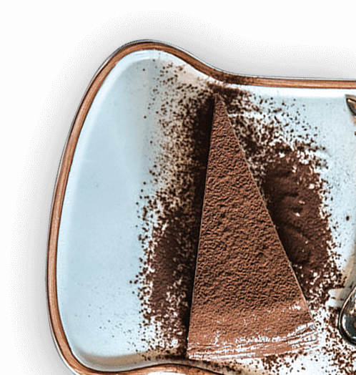
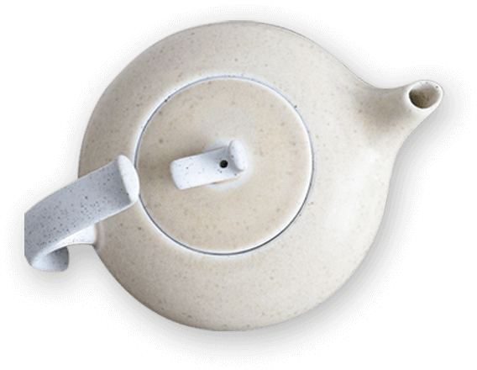


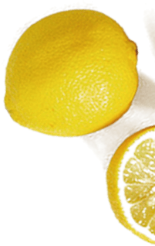

Unit 1 Food for thought Understanding ideas

Slide 2
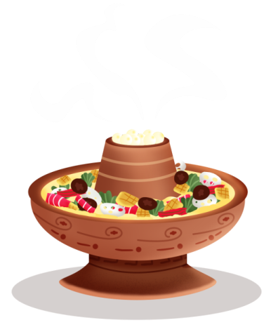
Learning objectives
By the end of this lesson, you will be able to:
1.get the meaning of the title and the main idea of the passage and introduce the food you like and share it with the people .
2.find out the key words that express the characters' views on food and sort out the details.
3.get a positive attitude towards different food from different countries.

Slide 3
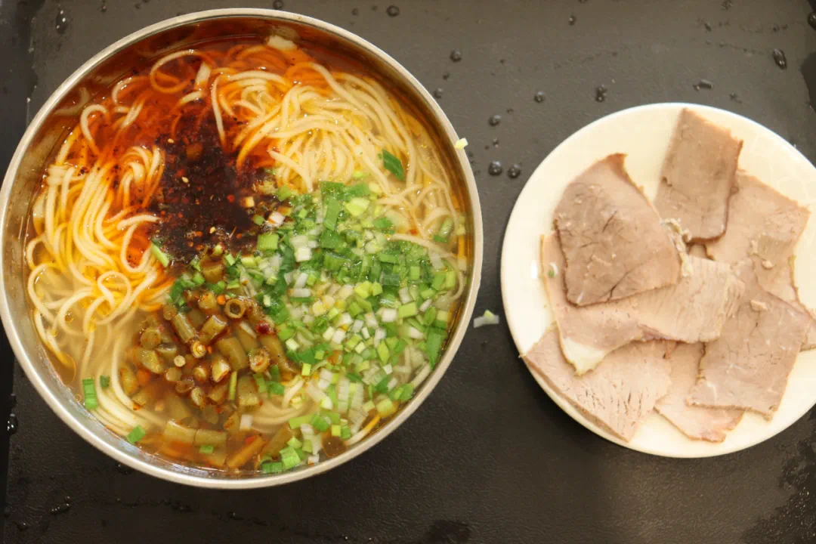
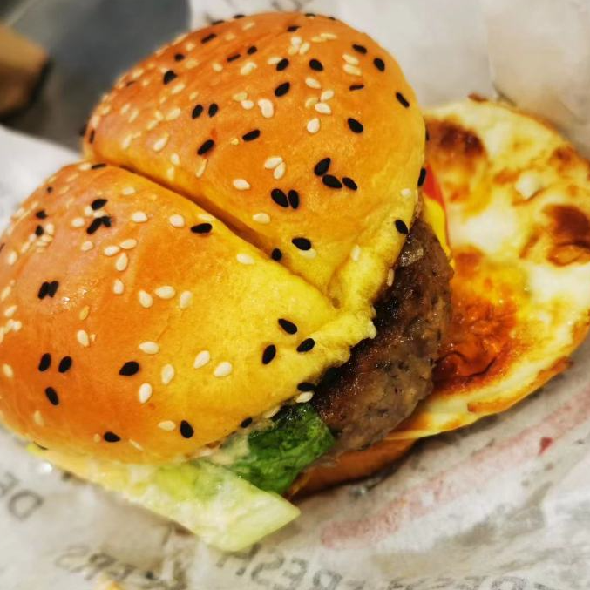
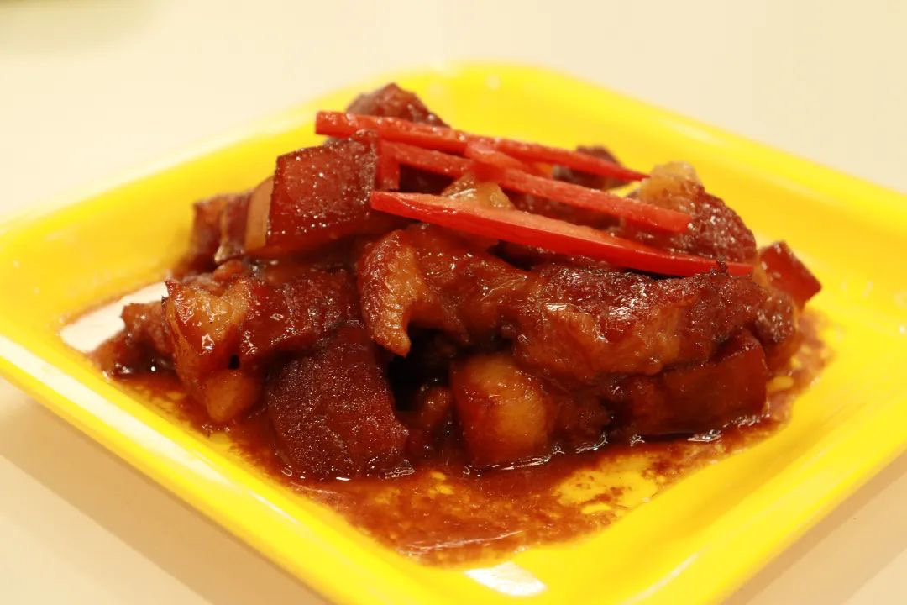
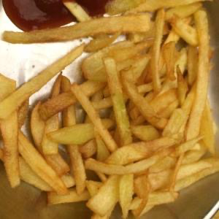
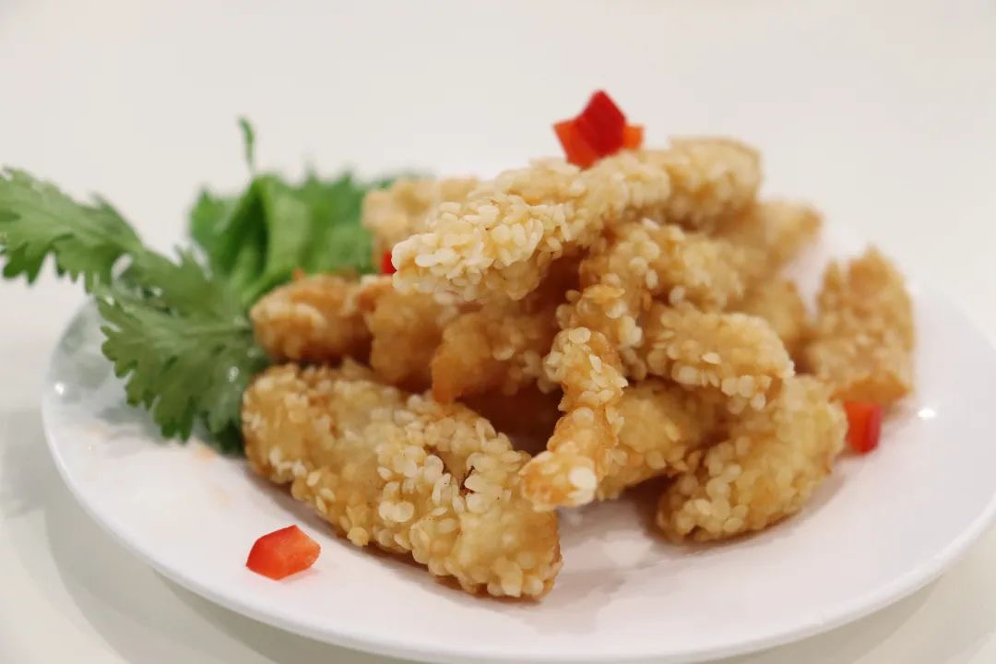
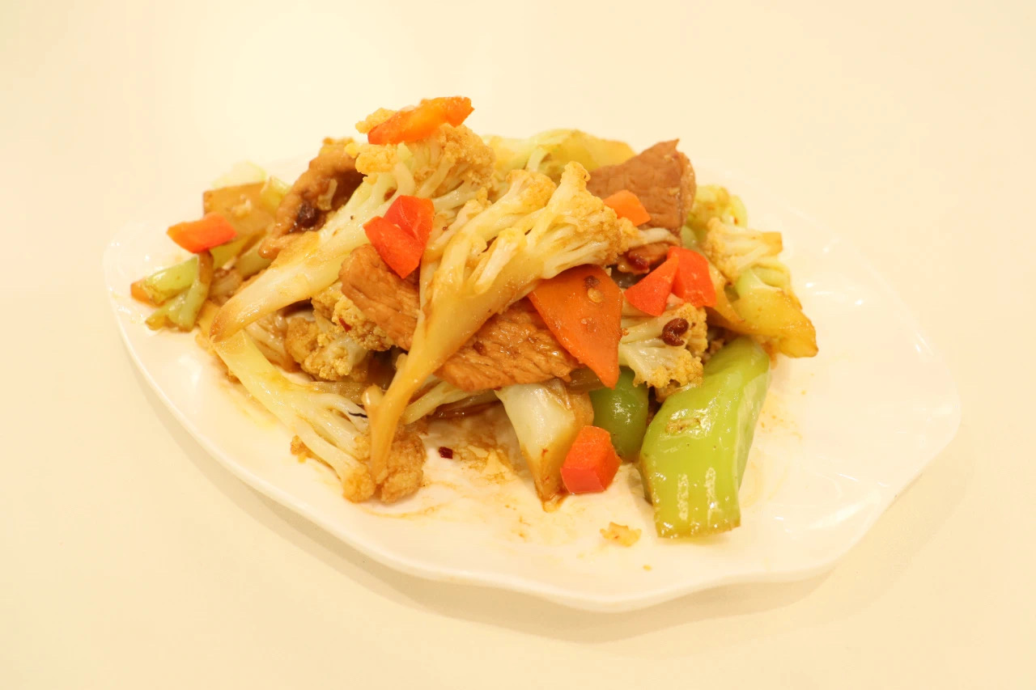
Lead in
Are you familiar with the following food ?
Beef noodles
Hamburger
Braised pork
Plain-frying
cauliflower
French fries
Fied pork

Slide 4
Divide these foods into two groups
Chinese cuisine
western cuisine

Slide 5
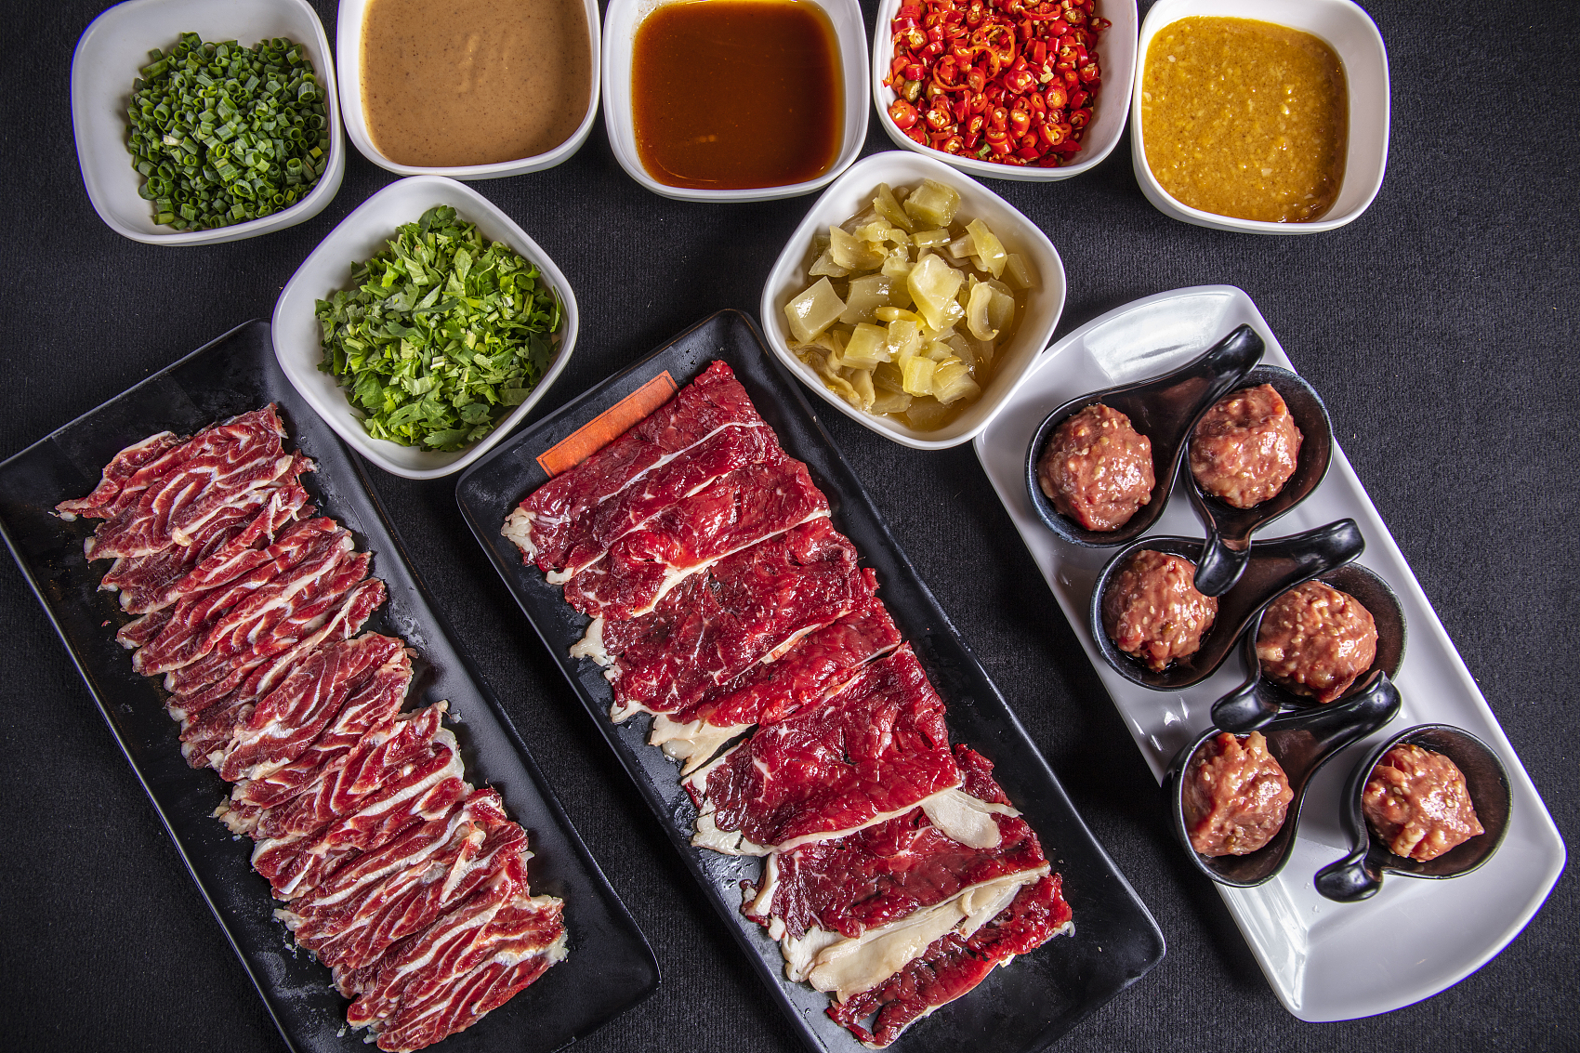
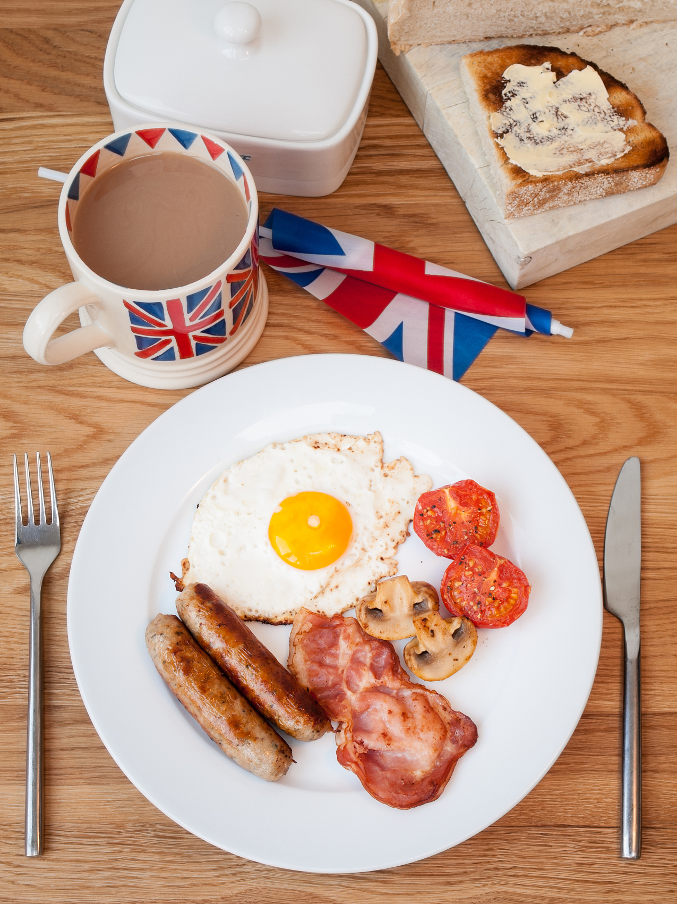
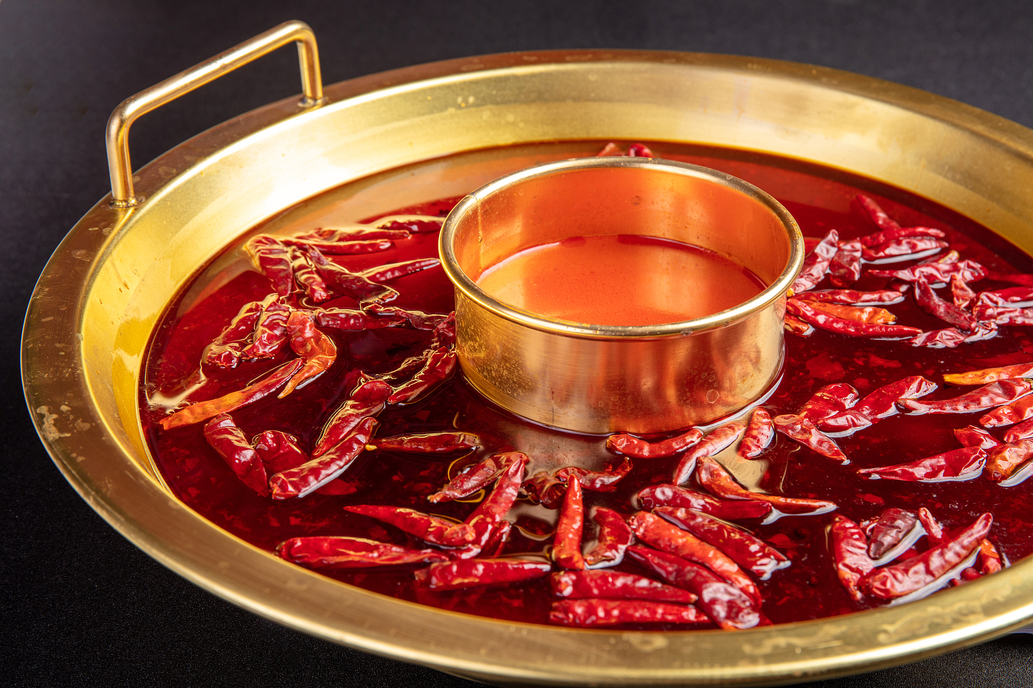
A
外研版 必修二 Unit1
child of
two
cuisines

Slide 6
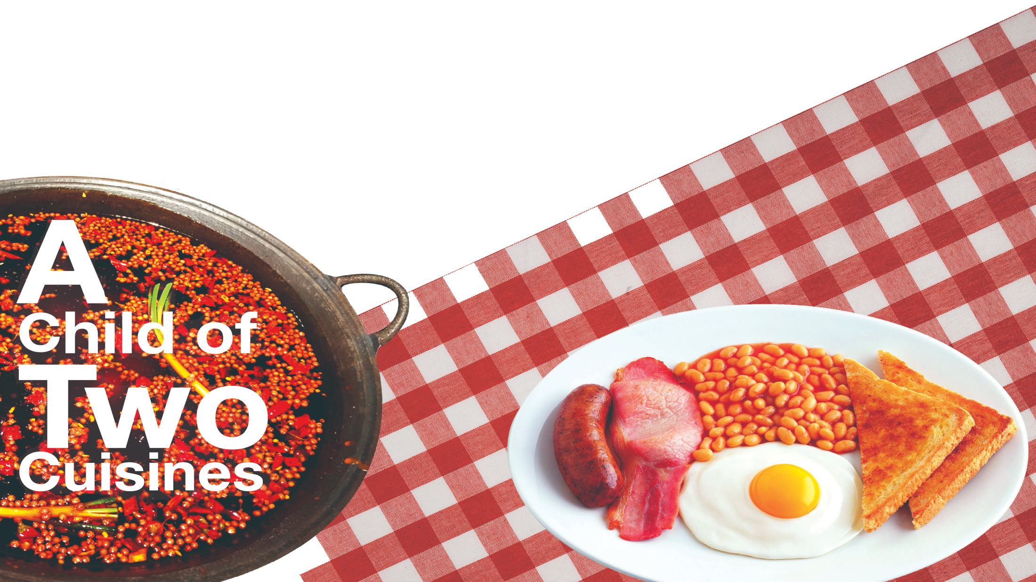
Make a prediction
Look at the pictures and the title, and predict the main idea of this passage.
What does “ two cuisines” refer to?
Chinese cuisine
British cuisine
Who is the child?
Why is she or he “a child of two cuisines”?

Slide 7

Read for text type and main idea
3min
1. What is the main idea of the passage?
1 How the family stays healthy by eating Chinese food.
2 What the family has done to promote Chinese food.
3 How the family cooks both Chinese and English food.
4 How the family combines food from two cultures.
2. What type of writing is this passage?
A
B
C
Argumentation
议论文
Exposition
说明文
Narration
记叙文

Slide 8
Read for detailed information
Growing up in England with a British father and a Chinese mother, I’ve enjoyed food from both countries ever since I was able to hold a knife and fork – and chopsticks!
The author says “I’ve enjoyed food from both countries”, and what will be talked about in the following paragraphs to prove his idea?
1. What kind of food will be mentioned?
2. What is the author's attitude towards each food mentioned in the passage?
3. What are the attitudes of the parents towards each other's food?
1.Who is the child?
The child is a kid growing up in
with a father and a mother.
England
British
Chinese

Slide 9
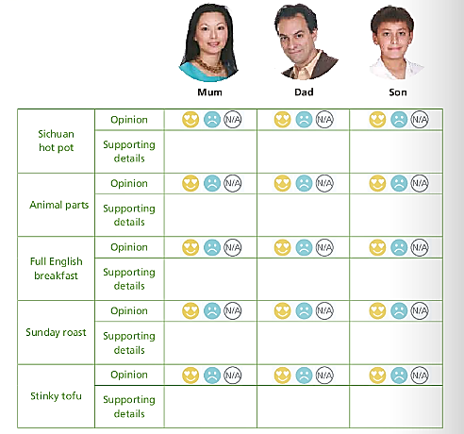
Read for detailed information
Fill in the blanks and choose the correct symbols.
Not applicable (对我不适用，常用于表格中，相当于汉语中的“无”)

Slide 10



Cuisines |  | Son | Mum | Dad
Sichuan hot pot | opinion
 | supporting details
Animal parts | opinion
 | supporting details
Mum has sweet memories of the food from her home town in Sichuan, and often cooks spicy dishes.
Thanks to this, Dad has come to love hot pot!
But I enjoy that sort of food myself.
Even today, he still does not easily take to eating things like chicken feet.
to start doing sth regularly or as a habit
Q: In paragraph 3, why does the author mention the butcher’s story?
The author mentions the butcher’s story to explain that his dad doesn’t eat some animal parts because of cultural differences, not because of personal preference.

Slide 11

Cuisines |  | Son | Mum | Dad
Full English breakfast | opinion
 | supporting details
Sunday roast | opinion
 | supporting details
Mum and I just have to find a way to get him into the kitchen!
Mum and I just have to find a way to get him into the kitchen!
We all love roast
beef and vegetables.
We all love roast
beef and vegetables.
We all love roast
beef and vegetables.
Q: In paragraph 4, why does the author mention the sentence “Mum says we’d better not eat too much roast food as it may make us suffer from heat inside our bodies, according to traditional Chinese medicine” ?
To indicate that the family combines food from two cultures although they have different traditions.

Slide 12
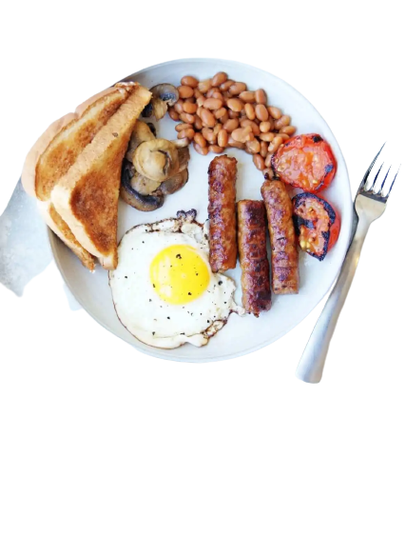
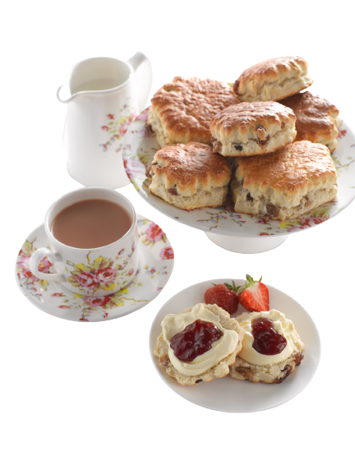
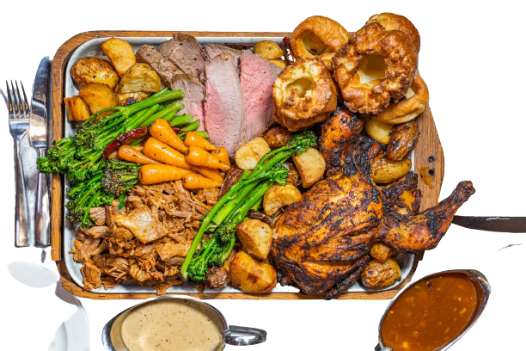
Guess what kind of food they are according to the passage.
full English breakfast
A full English breakfast is a breakfast meal that typically includes bacon, sausages, eggs, other cooked foods and a beverage (饮料) such as coffee or tea. It is usually shortened to “full English”.
afternoon tea
Sunday roast

Slide 13
Draw a line to show the author’s changing feelings towards stinky tofu.
came across stinky tofu
maybe/someday
horrible
amazed
fall in love with
gathered all my courage to take a bite
Q: What can we learn from the author when we are faced with unacceptable food?
We can learn from the author that we should be open-minded to try new cuisines, even if they may look unfamiliar or awful.

Slide 14
People in Hunan like to eat Stinky tofu. Stinky tofu is a traditional dish in Hunan cuisine, which has a long history in the local area. Many local residents grew up eating and enjoying it. Its unique scent and flavor have become a part of local culinary culture (烹饪文化).
I came across stinky tofu, a horrible grey thing that looked and smelt like a burnt sports shoe. I gathered all my courage to take a bite and was amazed to find it wasn’t so bad. It reminded me of blue cheese, a similarly strong smelling type of food you either love or hate.
One man’s meat is another
man’s poison.

Slide 15
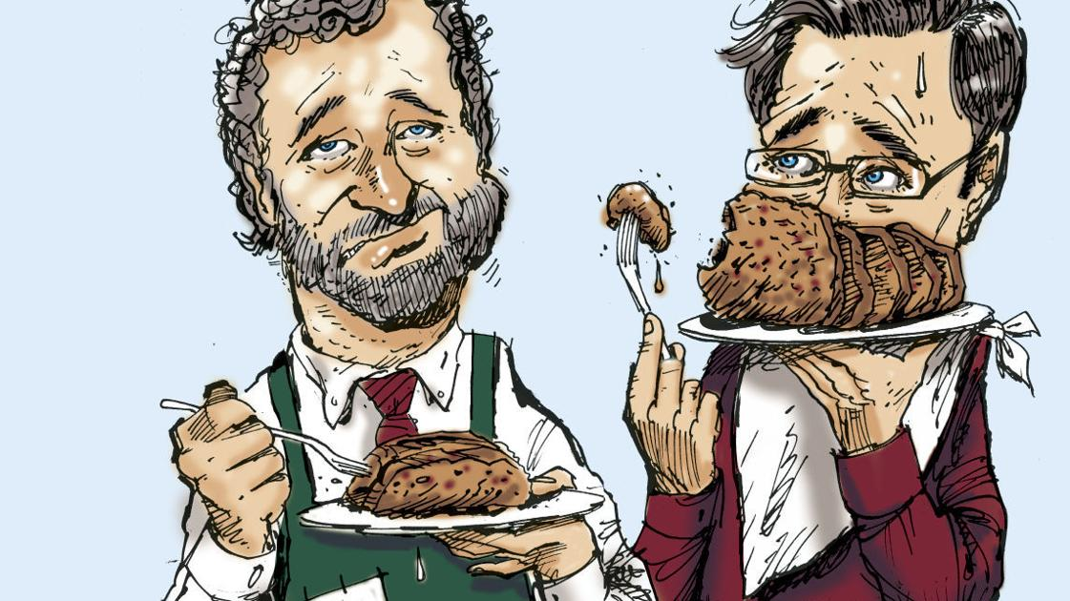
One man’s meat is another man’s poison.
Something that one person likes may not be liked by someone else.

Slide 16
Read for ideas/values
Q: What is the author's attitude towards the two cuisines?
He feels at home with food from both his cultures. That is to say, he feels a sense of belonging and comfort when eating food from both of his cultures.

Slide 17
Group work
Q: 1. What causes the differences in cuisines?
Q: 2. What attitude should we take towards different culinary cultures(烹饪文化)?

Slide 18
Group work(究)
Q: 1. What causes the differences in cuisines?
Culture and history: different cultures and historical backgrounds will shape different culinary styles.
Geography and climate: the geography and climate of different regions will also affect the development of cuisine.
Culinary techniques: differences in culinary techniques (steaming, boiling, roasting, frying, etc.) will also lead to differences in cuisine.
Table settings and eating habits: differences in table settings and eating habits will also affect the development of cuisine.

Slide 19
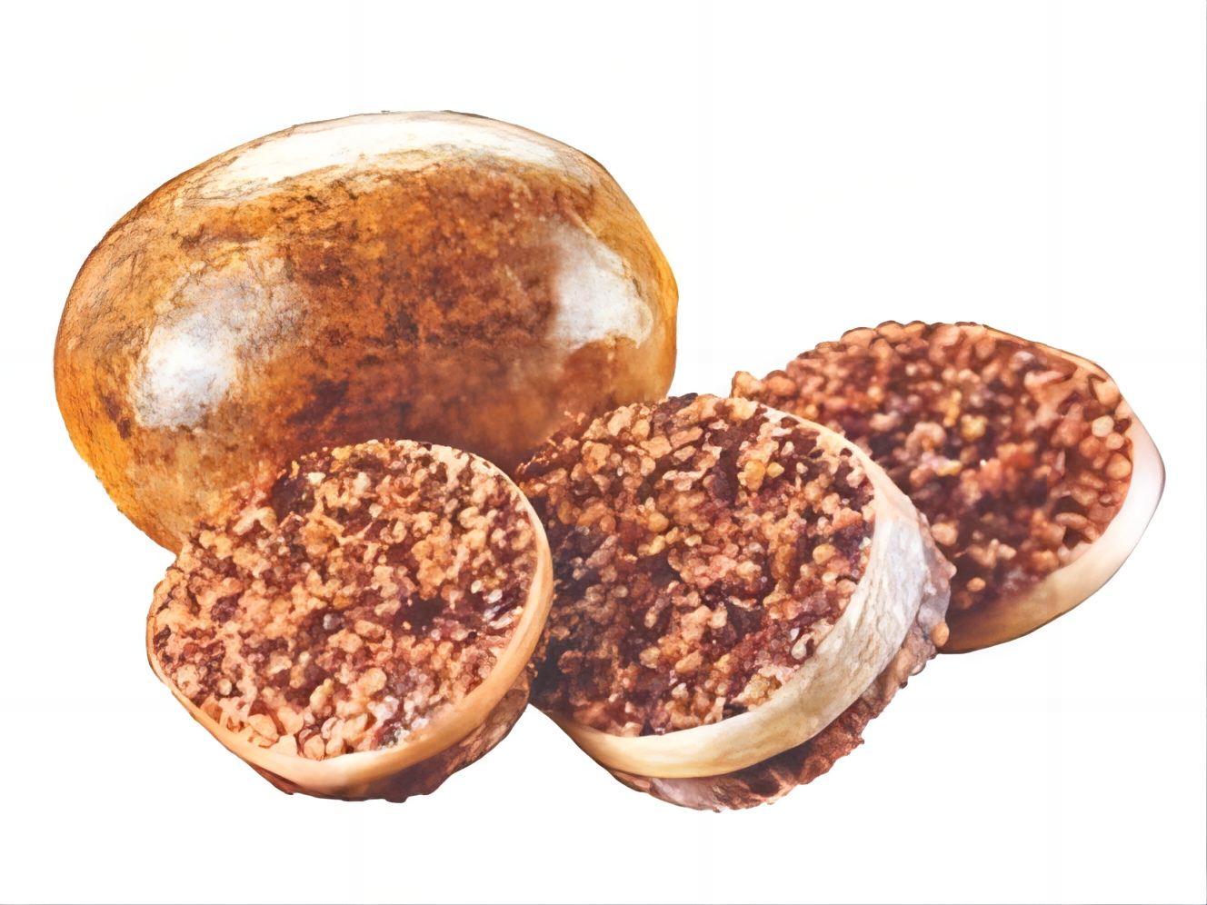
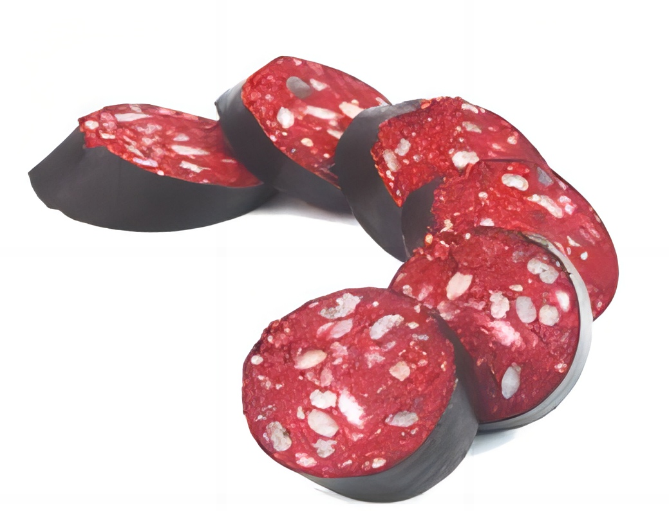
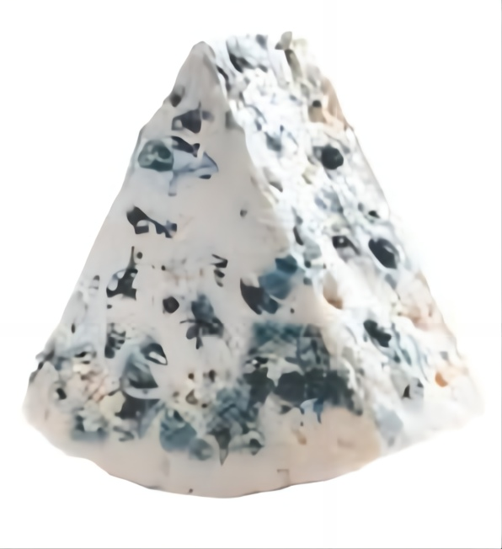
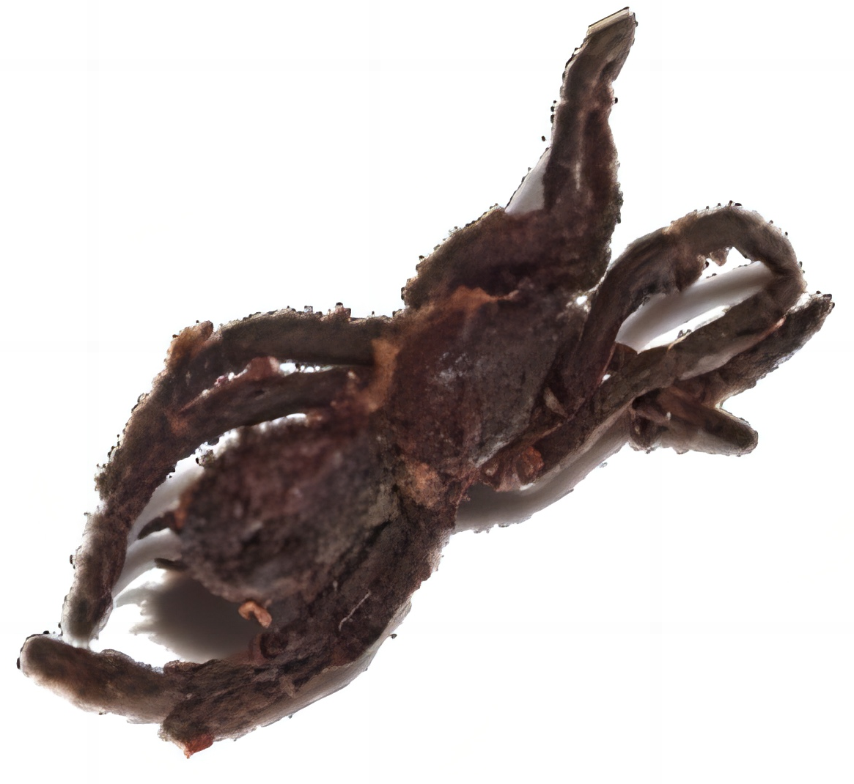
Dark cuisines
black pudding
blue cheese
haggis
fried spider
a type of dark sausage mainly
made from pig’s blood and fat, famous in the UK and some other parts of Europe
a type of cheese with blue lines
in it, popular in Europe and well-known for its strong taste
a Scottish dish made from the liver,
heart and lungs of a sheep
a popular snack in some parts of
South-east Asia

Slide 20
Group work
Q: 2. What attitude should we take towards different culinary cultures?
understand
respect
accept/enjoy
try
tolerate(包容)

Slide 21
各美其美,美人之美,美美与共,天下大同
-2019习近平总书记在亚洲文明对话大会开幕上演讲

Slide 22
Read for language
What expressions does the author use to describe food and people’s feelings towards food?
Food
Feelings(like)
Feelings (dislike)
spicy/super/typical/
stinky/a horrible grey thing looks and smells like a burnt sports shoe/a strong smelling type of food/
cross-cultural
have sweet memories of love/enjoy/come to love/amazed/take to doing/not so bad/fall in love with/feel at home with
dare not try/ surprised/shocked/amazed/do not take to doing/ gather all my courage to take a bite
DISH DISPLAY
DISH DISPLAY
Mercury is the closest planet to the Sun and the smallest one in the Solar System—it’s only a bit larger than our Moon. The planet’s name has nothing to do with the liquid metal,
Mercury is the closest planet to the Sun and the smallest one in the Solar System—it’s only a bit larger than our Moon. The planet’s name has nothing to do with the liquid metal,

Slide 23
phrases
1. grow up
2. thanks to
3. take to doing
4. go to the butcher’s
5. had better (not) do
6. suffer from
7. according to
8. encourage sb to do
9. a visit to sp.
10. deal with
11. come across
12. gather all one’s courage to do …
13. remind sb of
14. fall in love with
15. feel at home

Slide 24
Practice:
1.__________(长大) in Zibo, I _________________(爱上了)the beautiful place which is well-known _________its delicious barbecue.
2.What the teacher said that day reminds me _________ my dream and encourages me ________(go)all out to achieve it.
3.You ______________(最好不要) go to the butcher’s ______I was once cheated.
4.The first time I came ______him, he was dealing ______ a case for a school ________ (belong) to a local company.
Growing up
have fallen in love with
for
of
to go
had better not
where
across
with
belonging

Slide 25
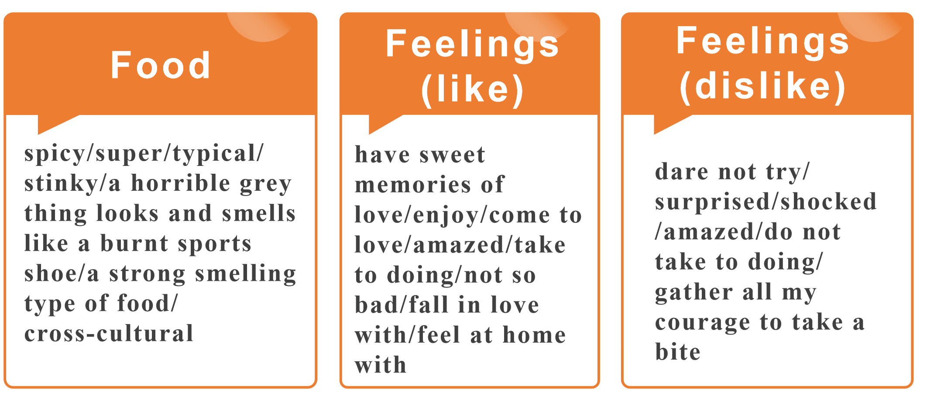
Homework
假如你是李华，你的外国朋友Tom下周将来拜访中国，希望你给他推荐你最喜欢的中国美食。
1.对他的到来表示欢迎
2.从色、香、味等方面描写你最喜欢的食物
3.推荐理由

Slide 26
Self-assessment（反思）
Criteria(评价标准)
1.Have you listened carefully and thought positively during the class?
2.Have you answered the questions quickly and correctly?
3.Do you think you will do well when encountering the cross-cultural cuisines?

Slide 27
外研版 必修二 Unit1
Thanks!

