Slide 1
B2U2
Understanding ideas
THE REAL
FATHER CHRISTMAS

Slide 2
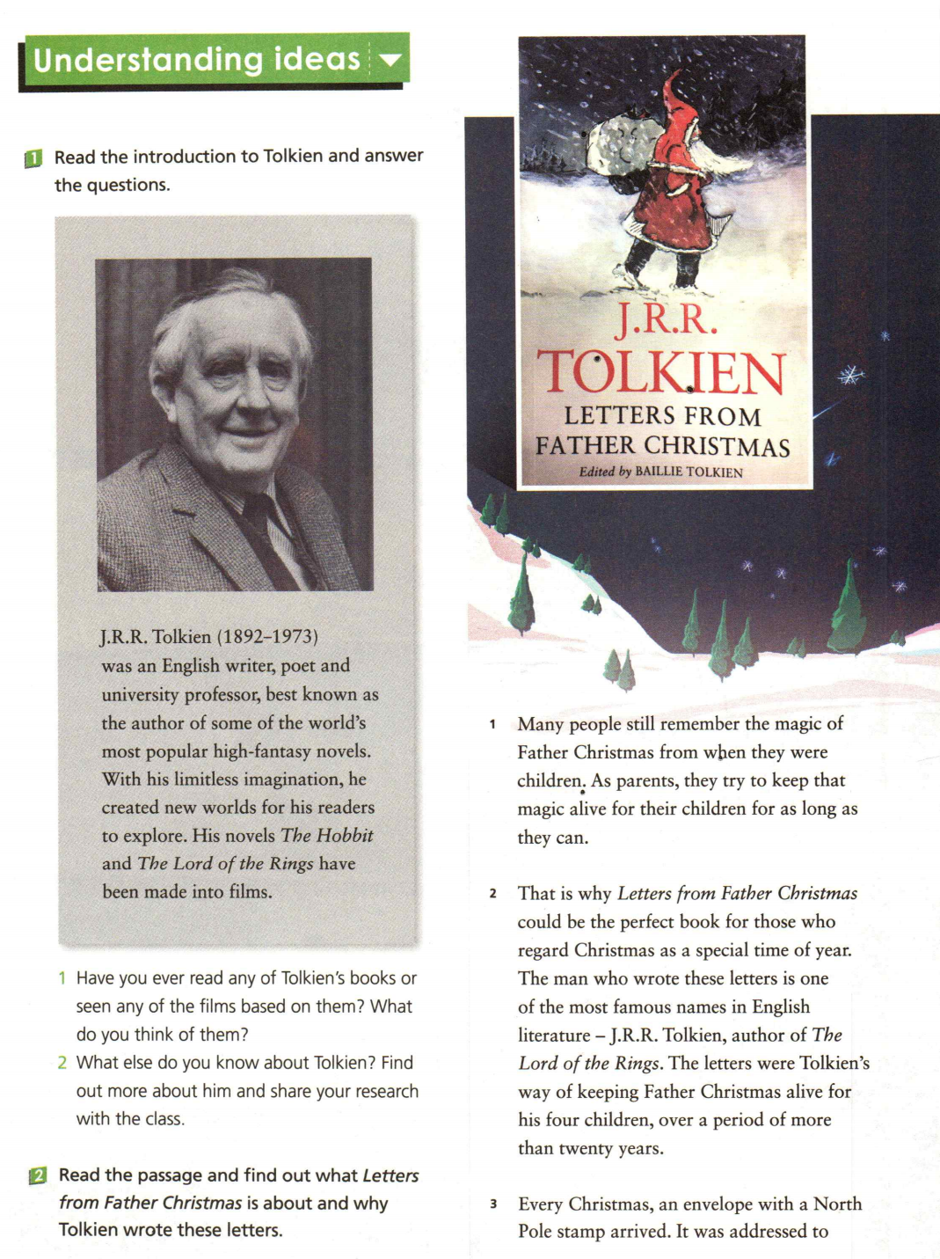
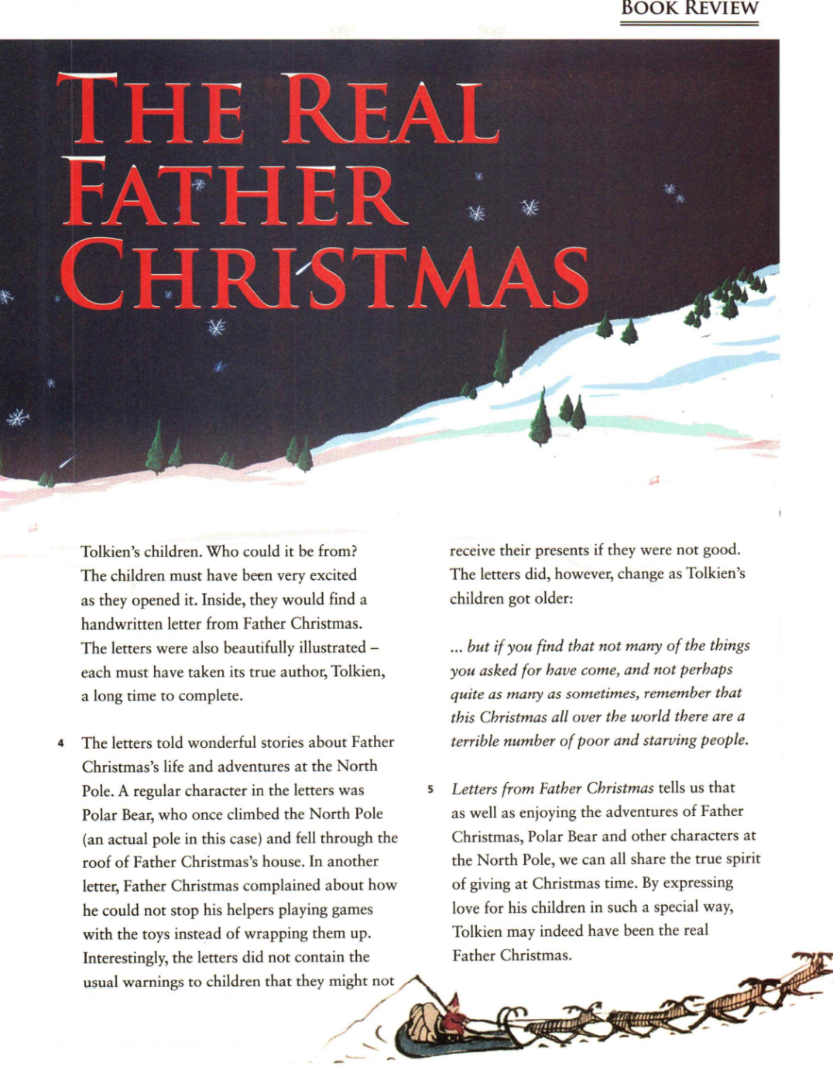
Pre-reding
What is the genre/type of this passage?
Title of the book
BOOK REVIEW
What information can you get by viewing page 14 and 15?
What else do you expect to read in this book review?
Author of the book
Author’s writing purpose
Background information
Contents of the letters
Reader’s evaluation
…
Editor of the book

Slide 3
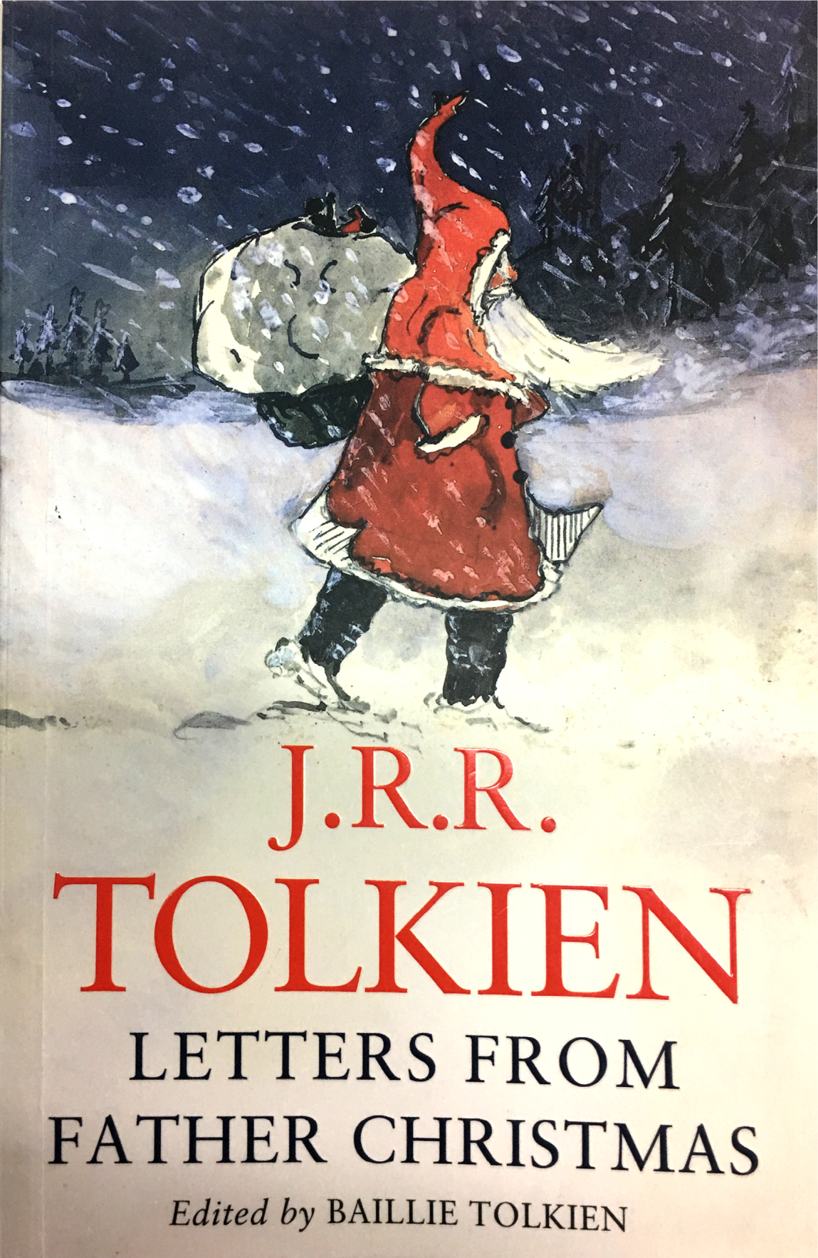
While-reading
Read the passage and match each part to the main idea.
Para.1-2
Background information
Para.3
Contents of the letters
Para.4
Reader’s evaluation
Para.5
Author’s writing purpose

Slide 4
While-reading
Read para.1-2 and find out why Tolkien wrote these letters.
Parents try to keep the magic of Father Christmas alive for their children;
Tolkien’s way was writing letters to his children in the name of Father Christmas.

Slide 5
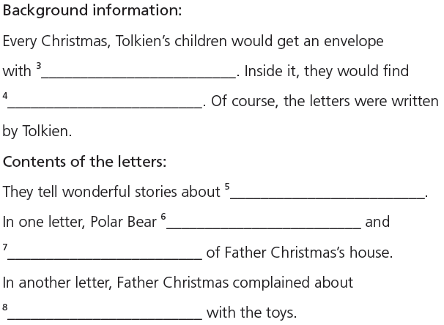
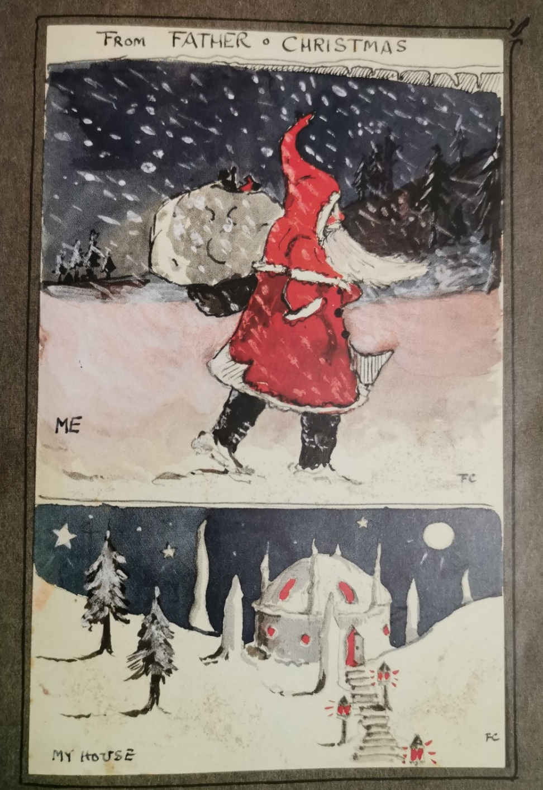
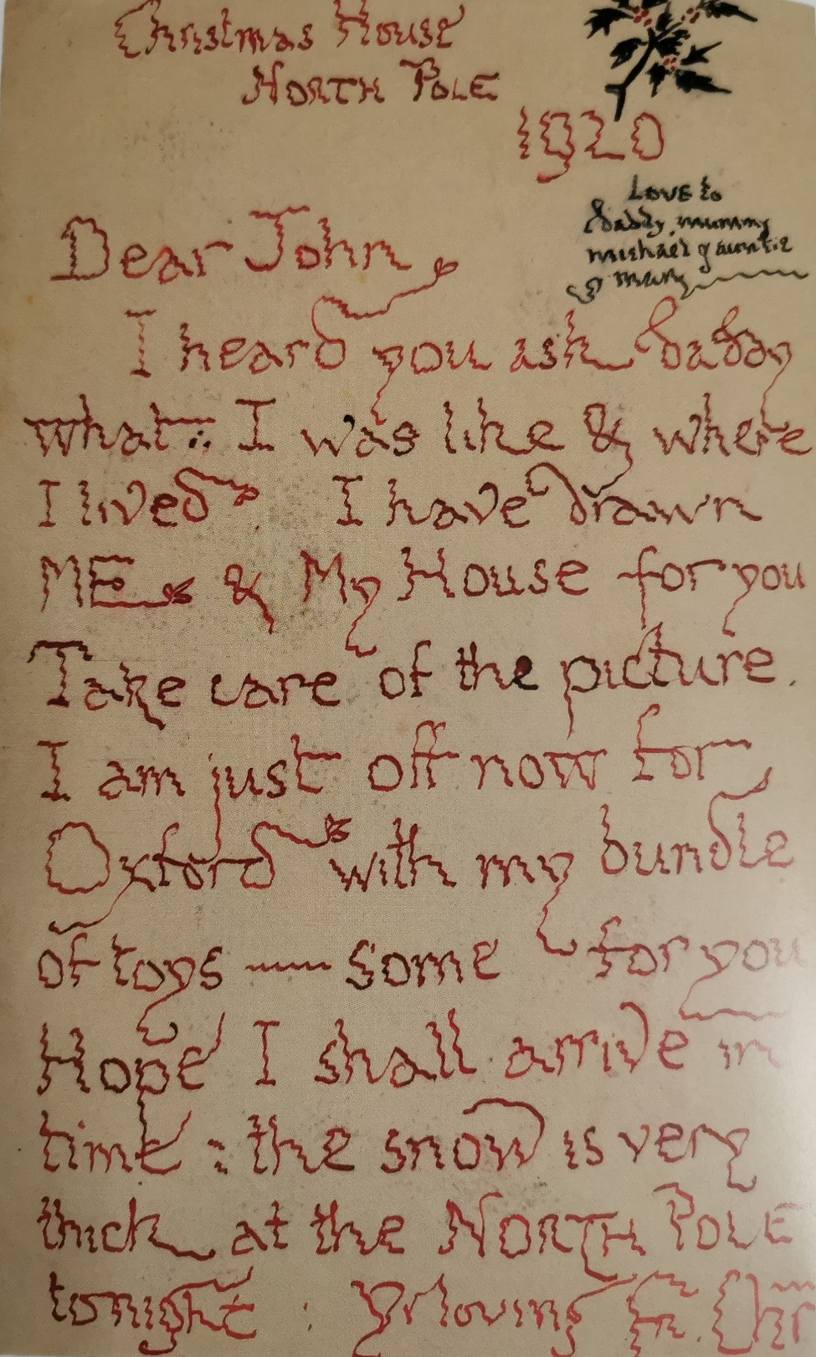
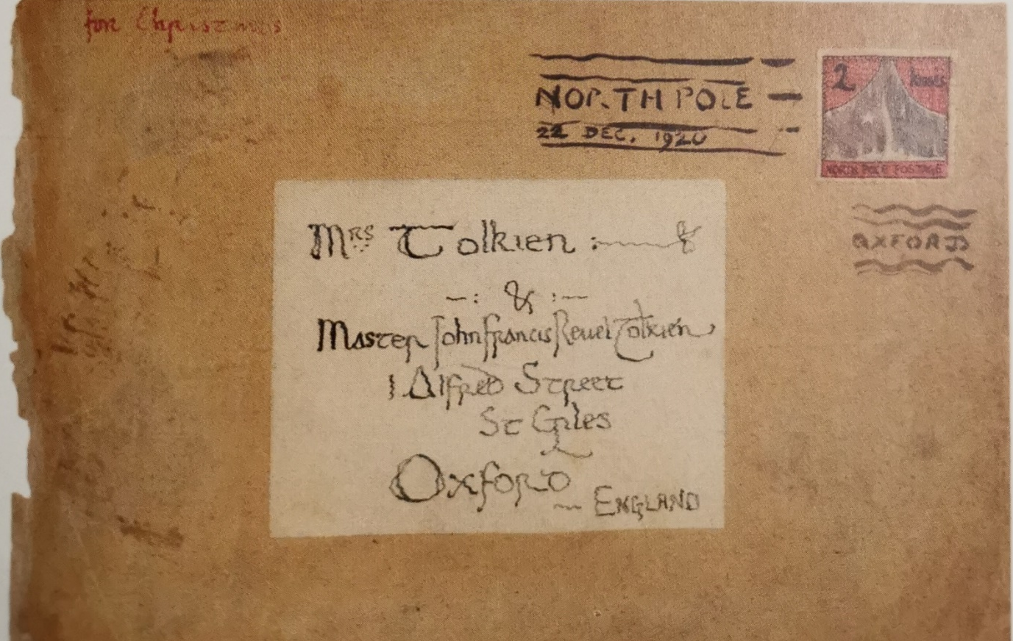

While-reading
Activity 4
Read para. 3-4 and complete the notes with expressions from the passage.
a North Pole stamp
a handwritten letter from Father Christmas
…were also beautifully illustrated…
What can you infer from the details of the stamp, the illustrations, and the handwriting?
illustrate /ˈɪləstreɪt/ vt.
to use pictures, photographs, diagrams, etc. in a book, etc.
加插图于；给（书等）做图表
to make the meaning of sth. clearer by using examples, pictures, etc.（用示例、图画等）说明，解释
Father Christmas’s life and
adventures at the North Pole
climbed the North Pole
fell through the roof
how he could not stop
his helpers playing games

Slide 6
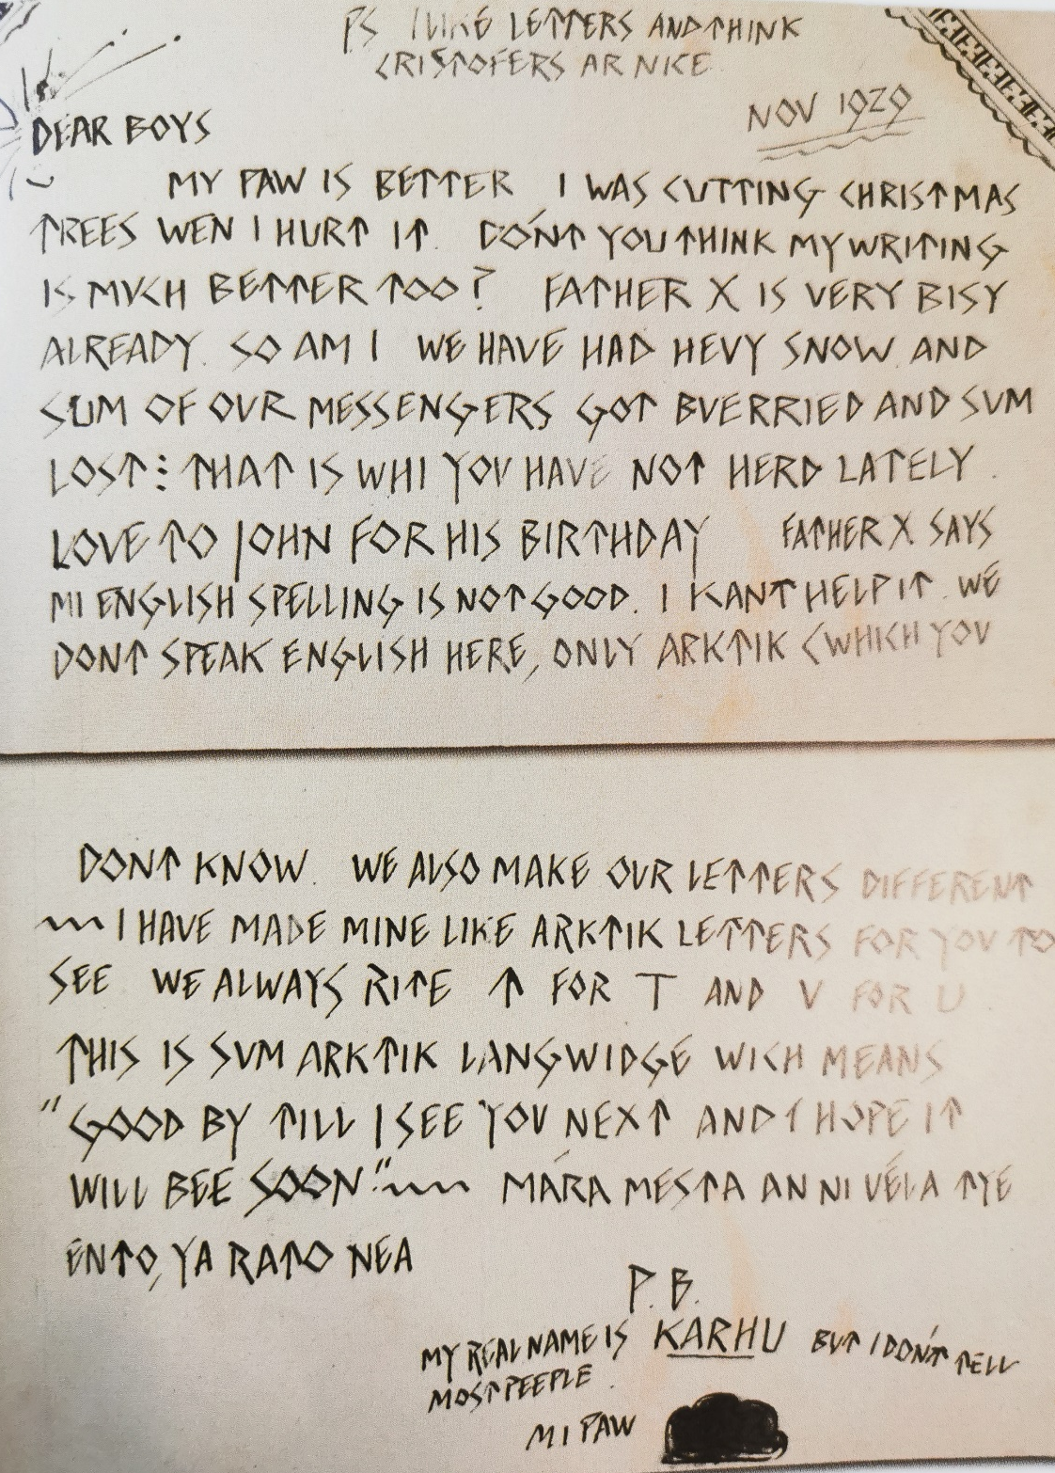
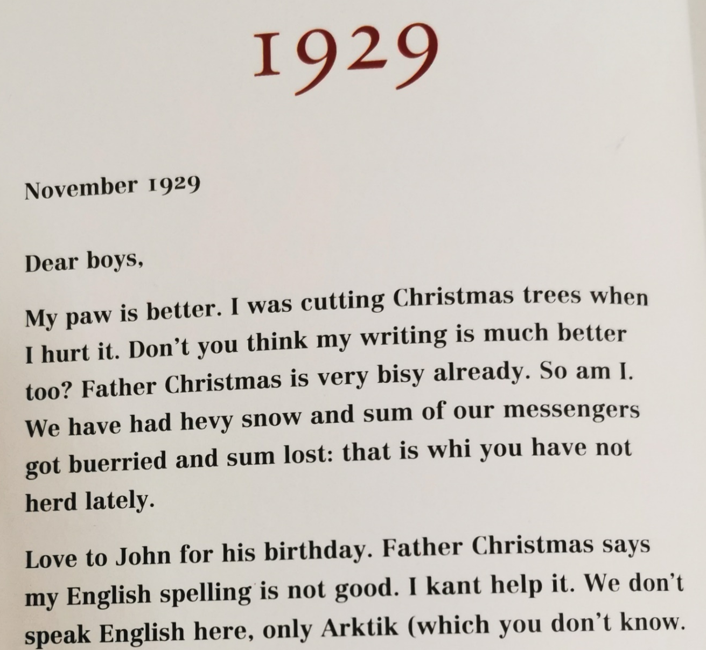
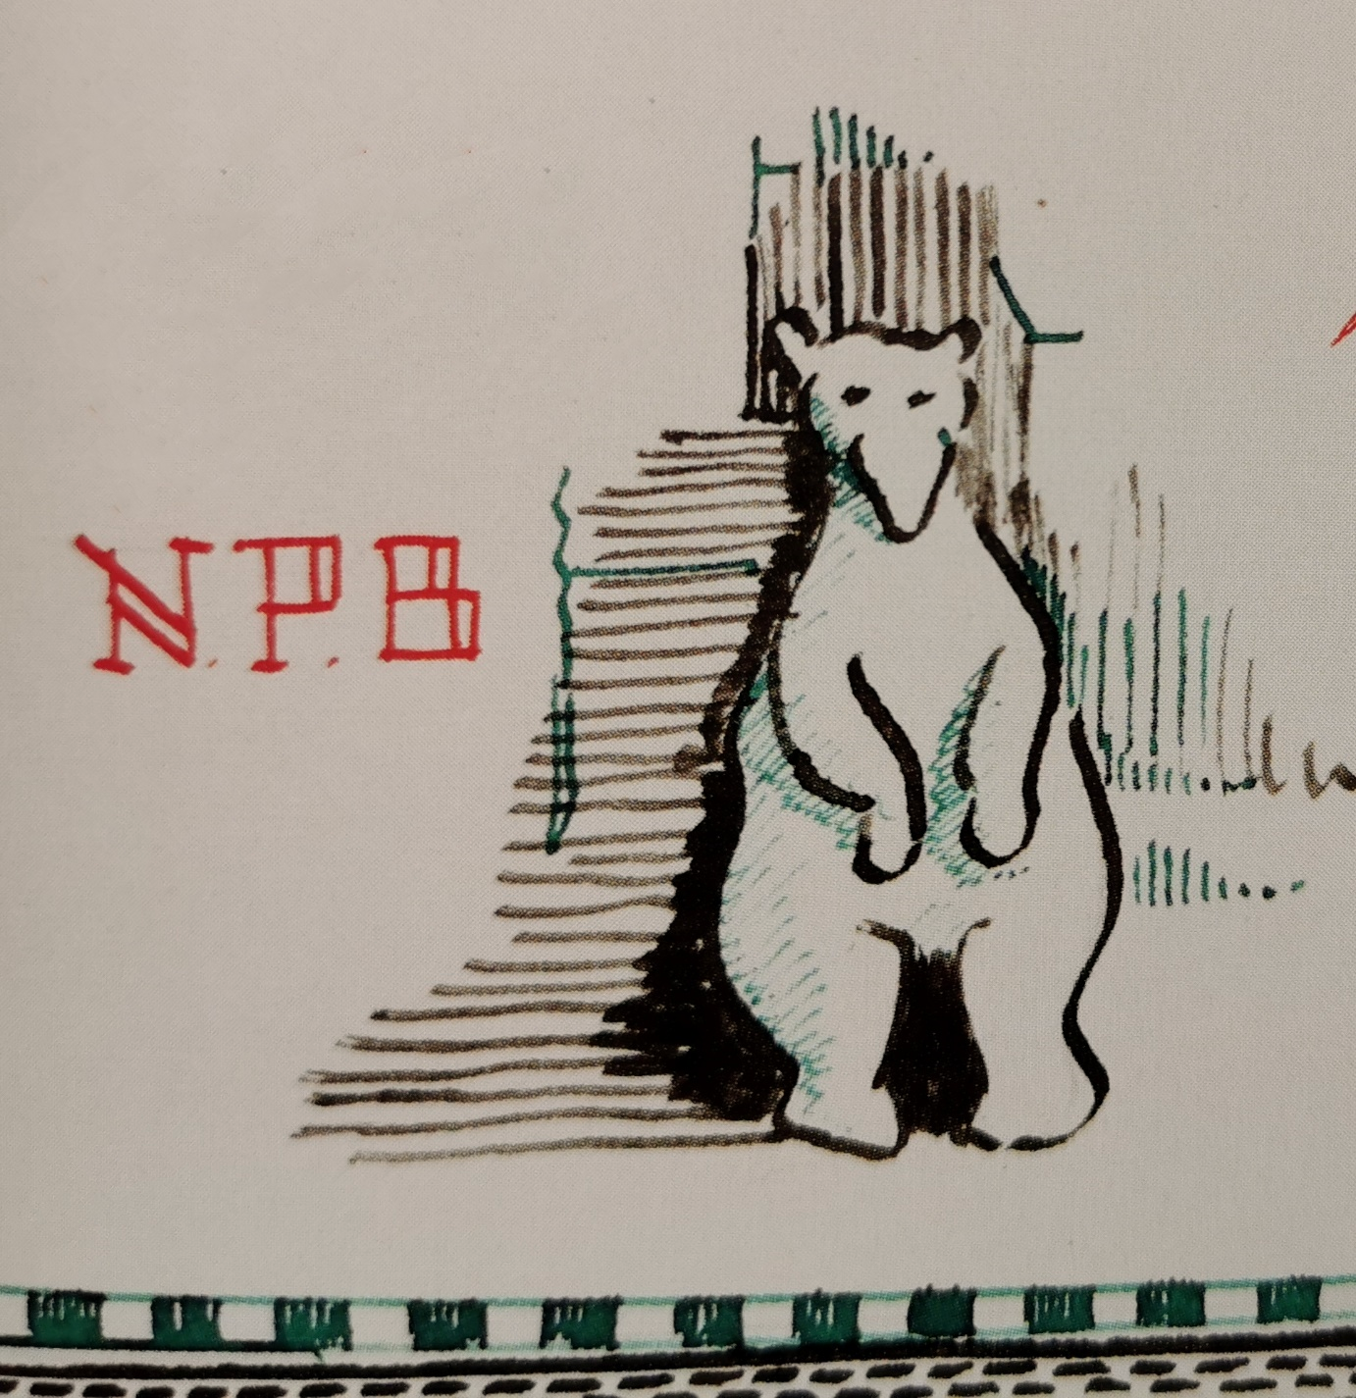
While-reading
Who wrote this letter?

Slide 7

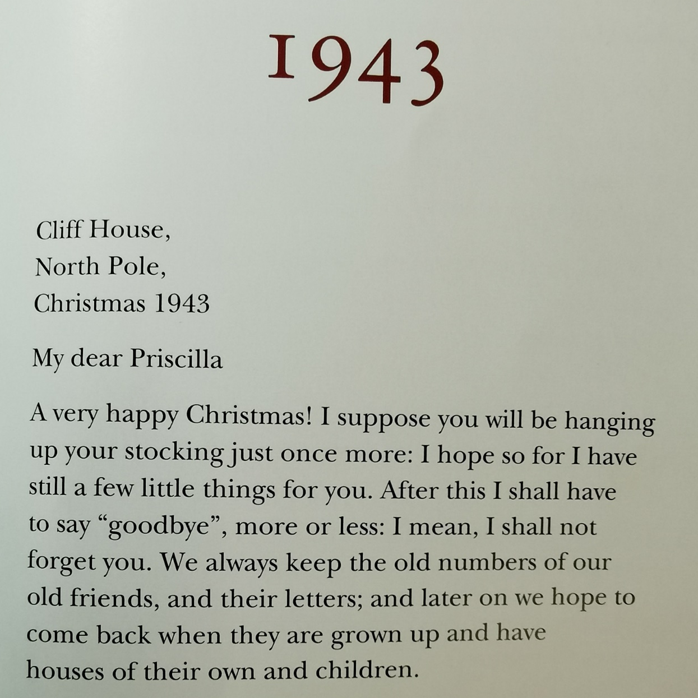
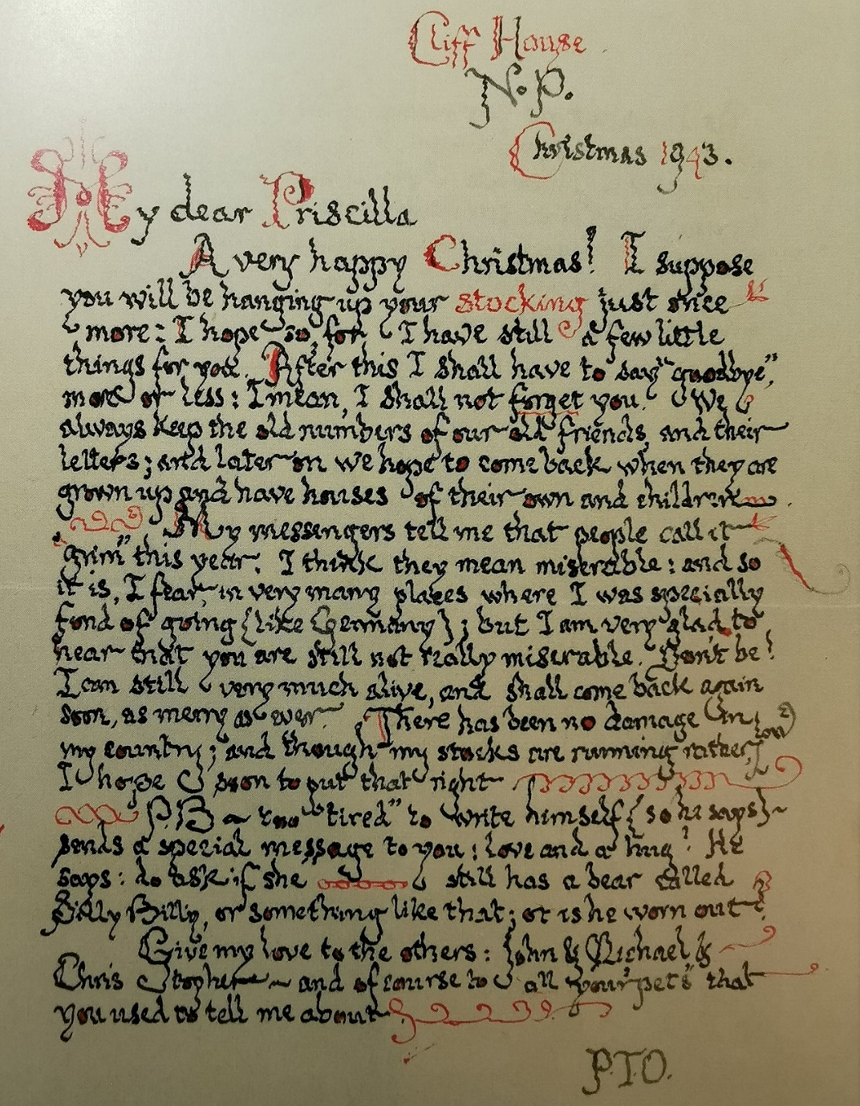
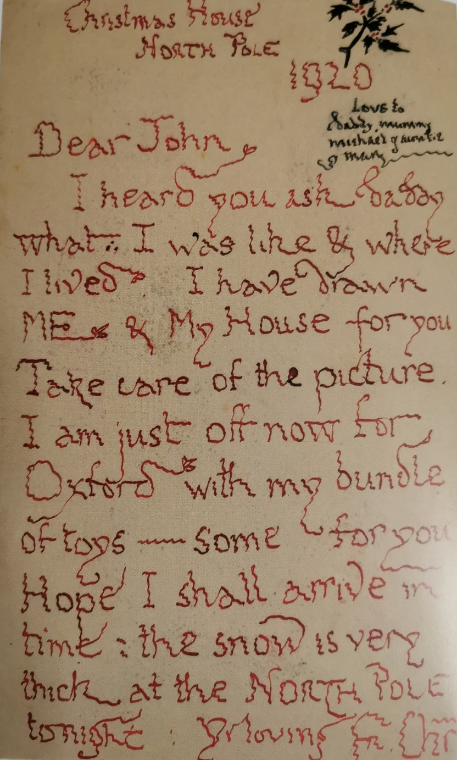
While-reading
How long did Tolkien keep writing letters?
From the first note to Tolkien’s eldest son in 1920 to the final letter to his daughter in 1943, how do you understand the title of the passage?
THE REAL FATHER CHRISTMAS

Slide 8
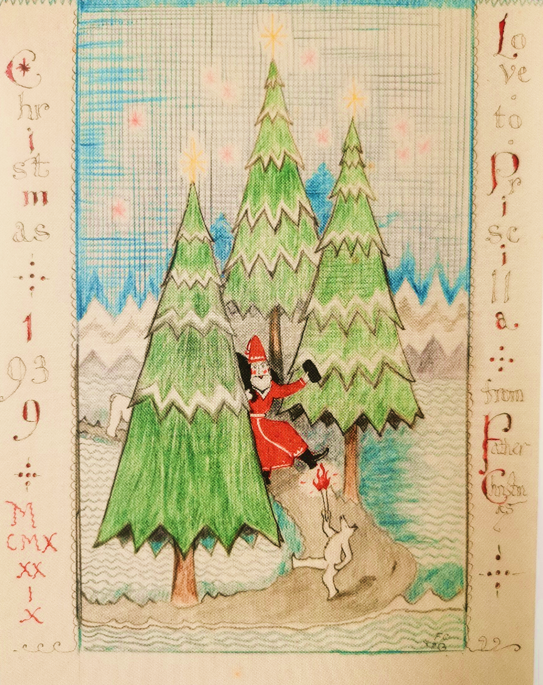
While-reading
Activity 3
Which of the sentences best explains the title of the passage?
The real Father Christmas was actually Tolkien himself.
Tolkien is the real Father Christmas, because he wrote letters using the name “Father Christmas”.
Tolkien’s love and care for his children make him very like Father Christmas.

Slide 9
While-reading
Read para. 5 and find out how “we” find the book.
You may use “Not only…, but also…”
Not only can we enjoy the adventures, but also we can share the true spirit of giving at Christmas time.
We are touched by Tolkien’s special way to express his love for his children.

Slide 10
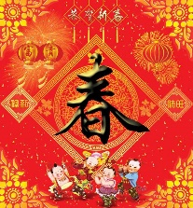
Think & Share
Title
Evaluation
Author
Discussion: Work in pairs.
Group A Would you like to read the book Letters from Father Christmas? What attracts you the most?
Group B What is the true spirit of the Spring Festival? Can you think of a way that you can stick to for decades to celebrate it with your family?
Book review
Writing purpose
Contents
Background
Activities of celebration
True spirit of celebration?
Activities of celebration?
Your way of celebration?
Why
How
Review & Celebrate

