Slide 1
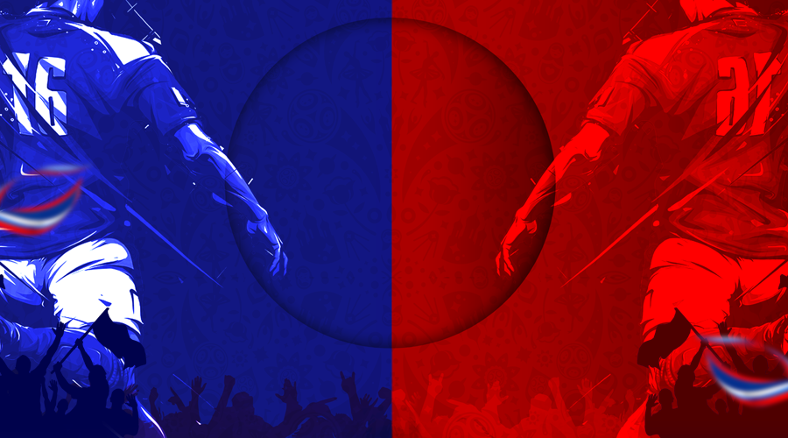
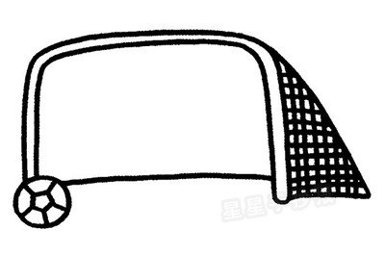
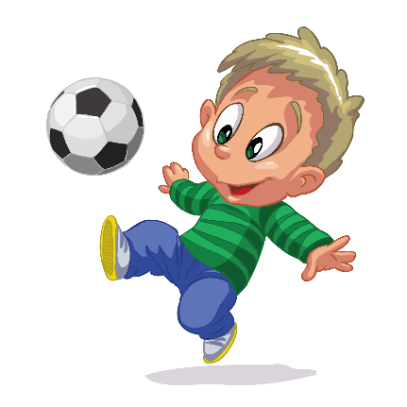
A Game for
the
World

Slide 2


Slide 3
A Game for
the
World

Slide 4

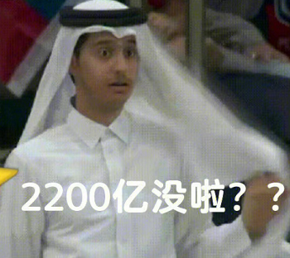

It is so exciting that football enjoys popularity all over the world.
Especially in the World Cup, 2022, in Qatar
5,000,000,000 participate, watch and follow

Slide 5


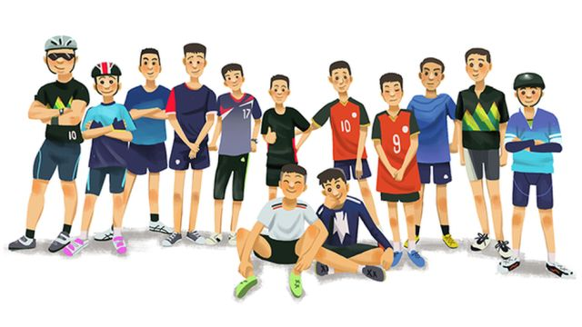

quiz about football
11
team

Slide 6
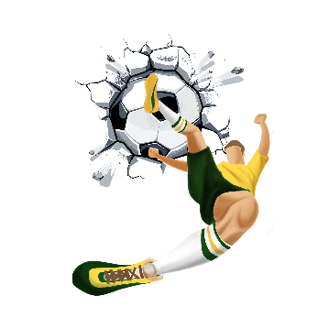
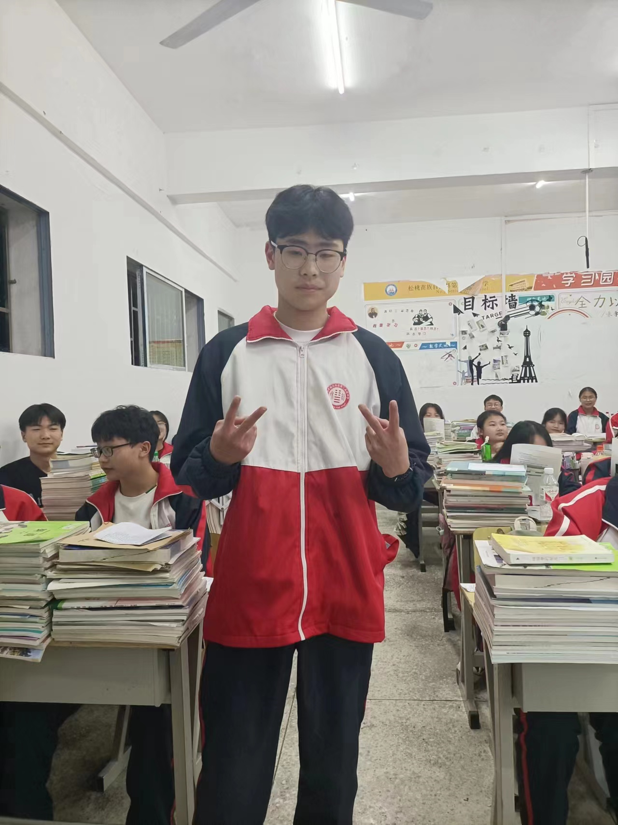
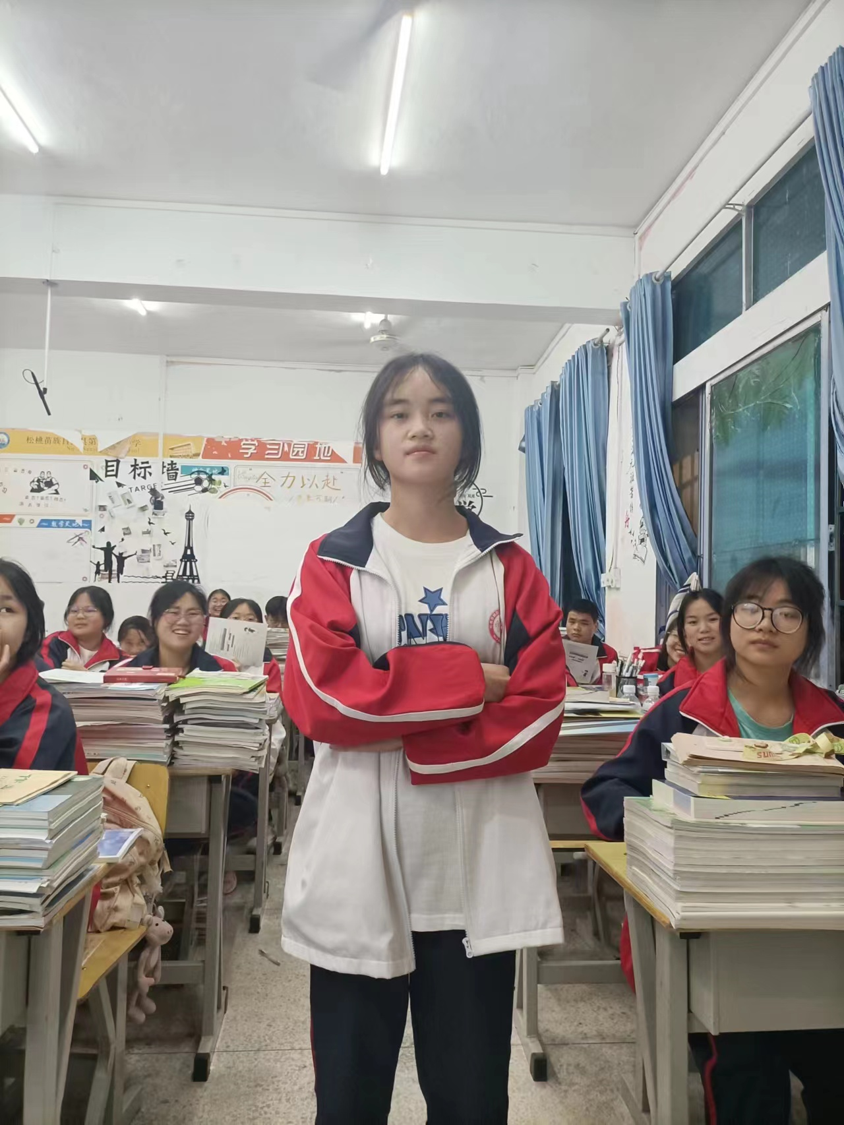
Team battles

Slide 7


fast reading
Individual training
structure filling
careful reading
Team battling
idea sharing

Slide 8


Individual training
Fast reading
1. Choose the author’s purpose in writing the passage.
A. To talk about the history of football.
B. To express his or her love of football.
C. To explain why football is such a popular game.
D. To prove that he or she is a professional football fan.

Slide 9
These days, football is one of the most popular sports in the world. Given that Neil Armstrong wanted to take a football to the Moon, we could even say that it is also the most popular sport out of this world! The history of the game goes back over two thousand years to Ancient China. It was then known as cuju (kick ball), a game using a ball of animal skins with hair inside. Goals were hung in the air. Football as we know it today started in Great Britain, where the game was given new rules.
What's more, football has become one of the best ways for people to communicate: it does not require words, but everyone understands it. It breaks down walls and brings people together on and off the field. Take, for example, the famous football game on Christmas Day 1914. World War I had broken out months before, but British and German soldiers put down their guns and played football together - one moment of peace to remember during years of conflict.
Tip 1: We always can find the main idea in the first sentence or first paragraph.
That football is such a simple game to play is perhaps the basis of its popularity. It is also a game that is very cheap to play. You don't need expensive equipment; even the ball doesn't have to cost much money. All over the world you can see kids playing to their hearts' content with a ball made of plastic bags; just like Pelé did when he was a boy.
''Some people believe football is a matter of life and death, ...'' said Bill Shankly, the famous footballer and manager. ''I can assure you it is much, much more important than that.'' This might sound funny, but one only has to think about the Earth to realise that our planet is shaped like a football.
Another factor behind football's global popularity is the creativity and excitement on the field. It is fun enough to attract millions of people. You do not have to be a fan to recognise the skill of professional players - how they use their bodies to pass, score and defend can be amazing to see - or to feel the excitement of a game ending with a surprising twist.

Slide 10


Individual training
Fast reading
2. Choose the right structure of this passage

Slide 11
fast reading
Individual training
structure filling
careful reading
Team battling
idea sharing

Slide 12

Individual training
Football enjoys popularity all over the world and it has a history that goes back to_______________.
Reason 1
It is________.
Example
The young Pele
played football
to his heart’s content with_________.
Reason 2
It is a game with________.
Example
It is amazing to see how professional players use their bodies to_________.
Reason 3
It breaks down walls and________
Example
British and German soldiers put down their guns and________ on Christmas Day 1914
Another factor...
What’s more...
Tip 2: We can use this structure to introduce other things.
Football is much more than a sport.

Slide 13
fast reading
Individual training
structure filling
careful reading
Team battling
idea sharing

Slide 14
Team battling
Careful reading
Work in groups to find the answers of the following questions.
1. What is the history of football?
2. What is special about cuju in ancient China?
3. What is the basis of the popularity of football?

Slide 15
fast reading
Individual training
structure filling
careful reading
Team battling
idea sharing

Slide 16
Team battling
Idea sharing
What kind of sport is popular in China? Please use the same structure to introduce it.
______enjoys popularity in China and it has a history that goes back to_______________.
Reason 1
It is________.
Reason 2
It is a game with________.
Reason 3
It breaks down walls and________.
Another factor...
What’s more...
_______ is much more than a sport.

Slide 17
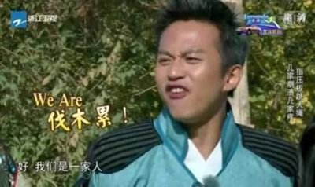

Summary
Team cooperation

Slide 18
Let’s finish the poem together!
We are class ___________, we are_________
We fight for our Team
We fight for our Dr________
We fight for our success of ice-cr________
We are class__________, we are___________
We are always on the move!

Slide 19


Homework
Read the additional reading material about cuju
Write a passage about a sport in China according to your structure.(pay attention to the conjunctions)

