Slide 1
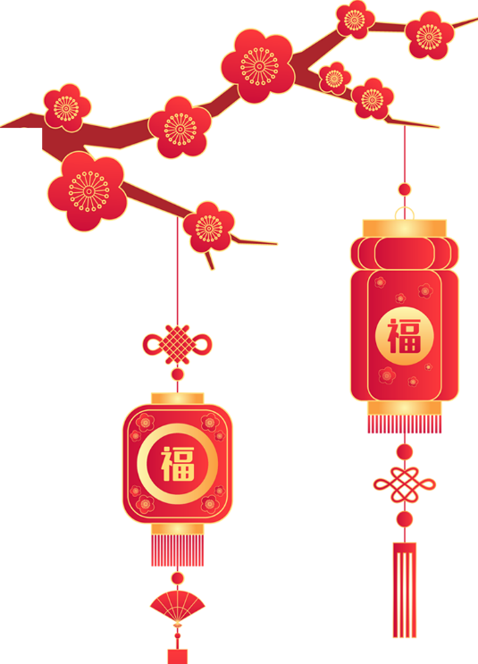
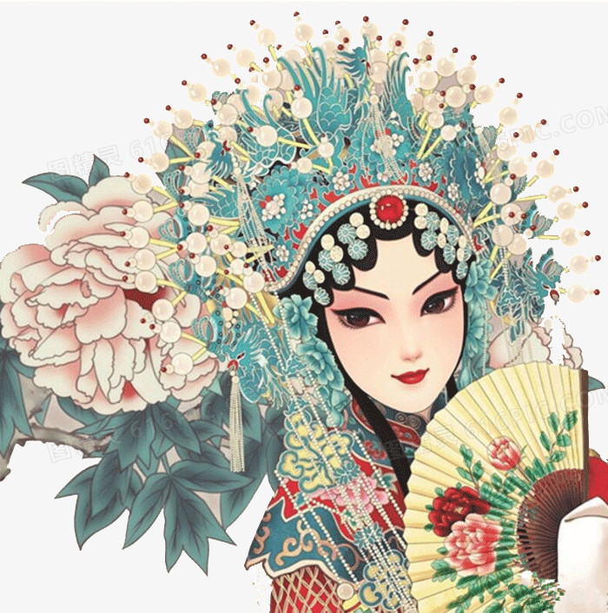



Unit Four
Stage and screen

Slide 2
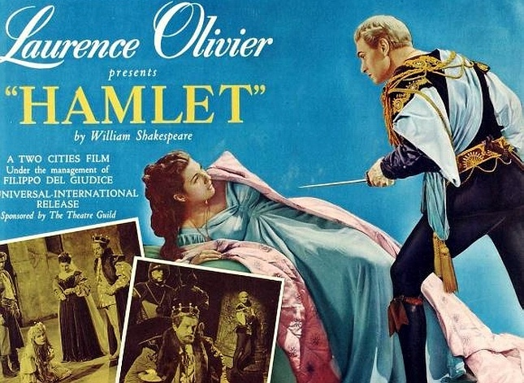
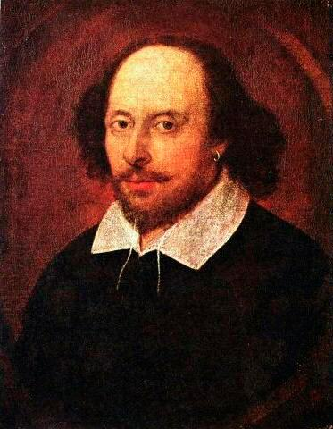
William Shakespeare （1564—1616）
is regarded as the greatest playwright of all time(有史以来最伟大的剧作家).
a play(戏剧)

Slide 3
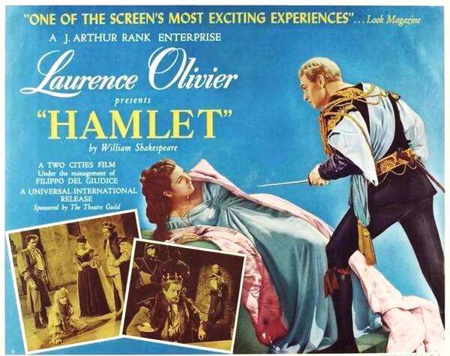
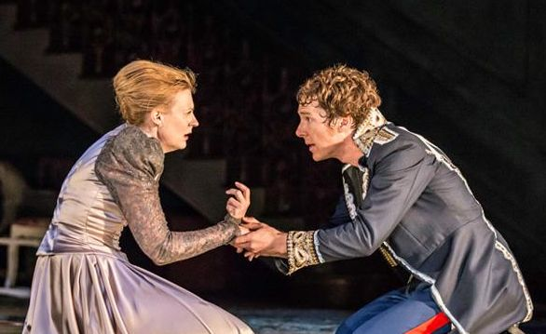
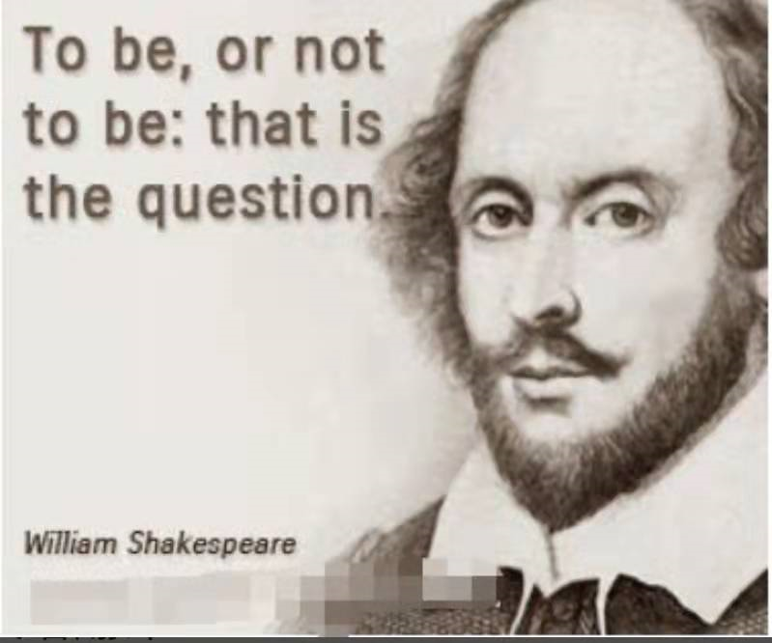
Hamlet is a tragedy（悲剧） written by William Shakespeare. Prince Hamlet takes revenge on （复仇）his uncle, Claudius, who has murdered the king, Hamlet’s father, seized the throne （王位）and married Hamlet’s mother.

Slide 4
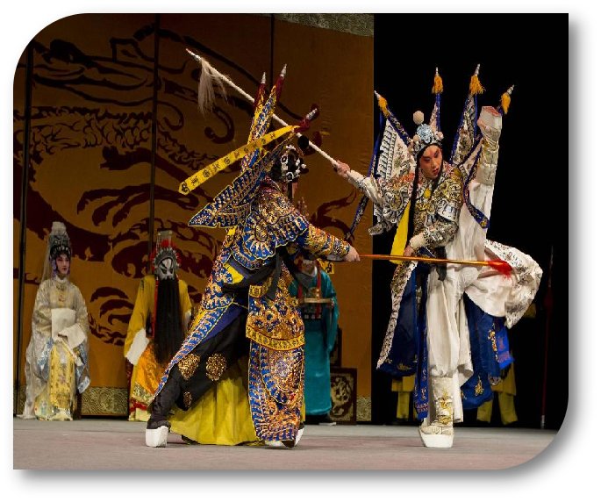
Peking Opera

Slide 5

Enjoy a video.

Slide 6
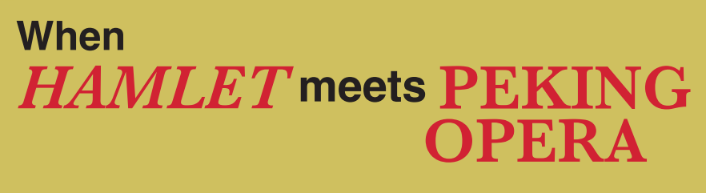

Slide 7


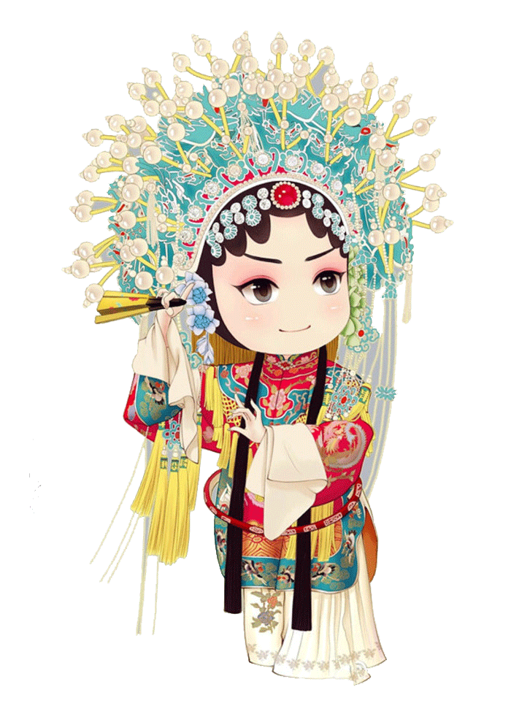
Task
1
Skim the passage and answer the question.
What's the genre of the passage?
A. Exposition(说明文)
B. Narration（记叙文）
C. Argument/persuasion（议论文）
Tip：I thoughgt...
I heard...
I was surprised....

Slide 8
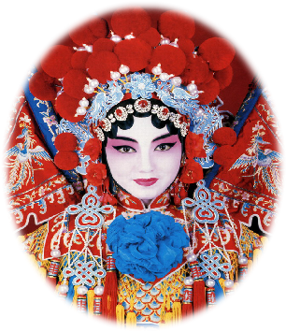
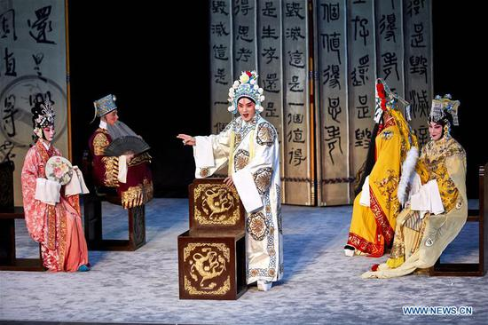
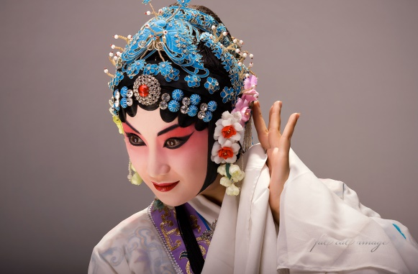
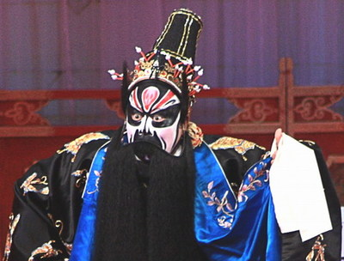
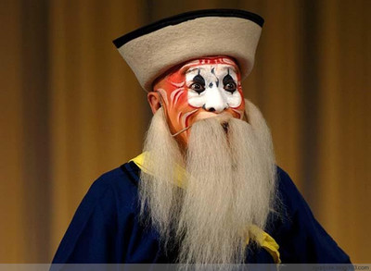
Task
2
Choose the author's purpose in writing the passage.
A. To prove that Peking Opera is a better way to perform Hamlet.
B. To inform the readers how to perform Hamlet through Peking Opera.
C. To share the unique experience of seeing a Peking Opera version of Hamlet.
D. To make a comparison between Eastern and Western cultures.
京剧版Hamlet

Slide 9
Divide the passage into 3 parts.
Task
3
Part1
Part2
Part3
Before the performance
During the performance
After the performance
Para.1-2
Para.3-4
Para.5

Slide 10
Task
4
Feelings
Reasons
·He thought 2.______________________.
·He wondered if Peking Opera is easier than a Shakespeare play to understand.
Before
1._____3._____
Para1-2
The Revenge of Prince Zidan
·
· voices
· stage
· movements
costumes and masks
amazing
________
During
4._______
5. ________
6. ________
Para3-4
7. ________
After
impressed
·He felt 8. __________________________
__________________________________
Para5

Slide 11
Feelings
Reasons
Task
4
·He thought _______________________.
·He wondered if Peking Opera is easier than a Shakespeare play to understand.
_______
he knew a lot about Hamlet
confident
Before
Para1-2
_______
The Revenge of Prince Zidan
How could we know the author knew a lot about Hamlet?

Slide 12
Task
4
Before the performance
Reasons
Feelings
1.
main subject
______________________
the most important play
2.
____________________ by the most important writer;
confident
Para1
quite a few productions
3.
had seen ____________________ and ______________ many times.
read the play
curious
He wondered if Peking Opera is easier than a Shakespeare play to understand.
Para2

Slide 13
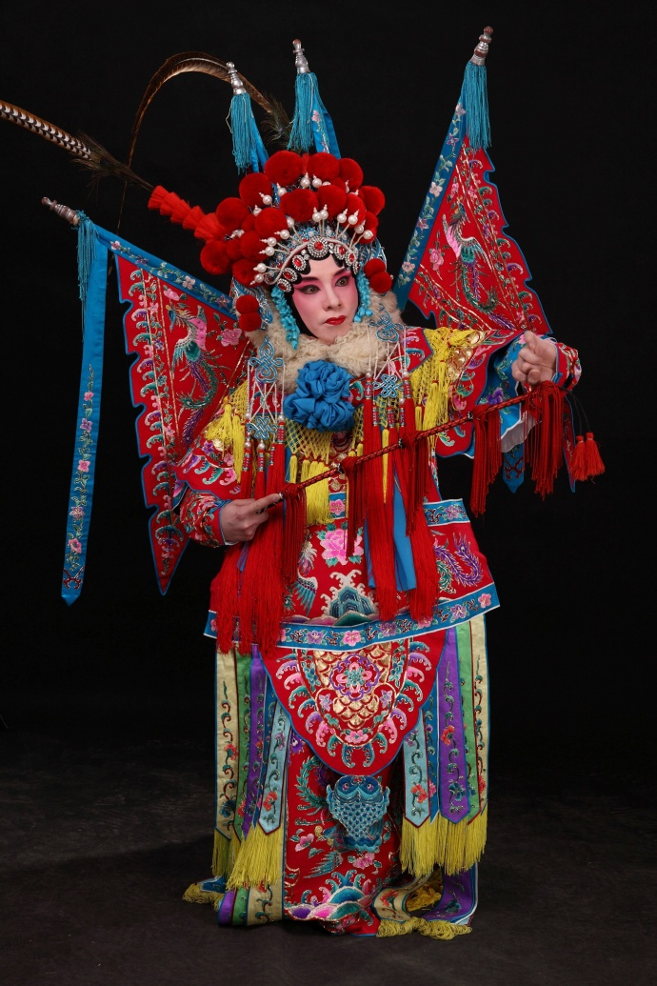
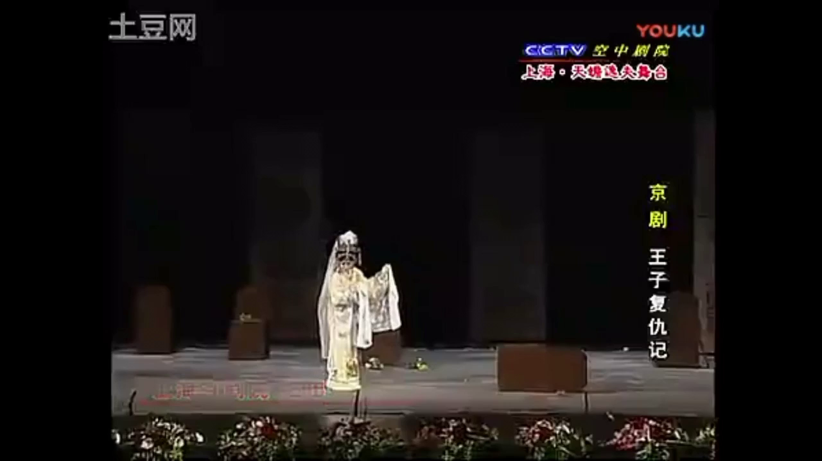
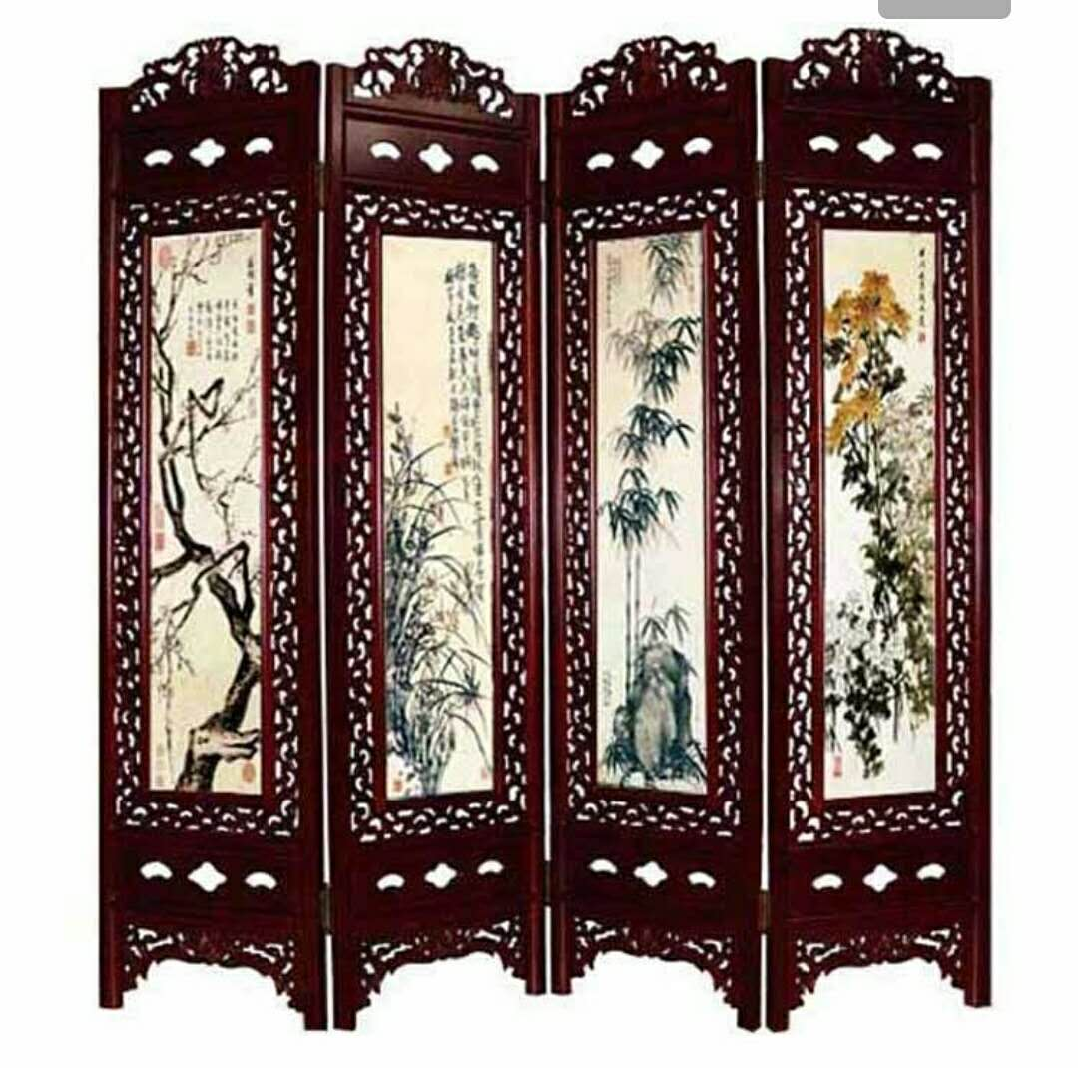
Feelings
Reasons
Task
4
·He thought _______________________.
·He wondered if Peking Opera is easier than a Shakespeare play to understand.
_______curious
he knew a lot about Hamlet
confident
Before
Para1-2
The Revenge of Prince Zidan
·
voices
· stage
· movements
During
surprised
amazing
_______
costumes and masks
unique.high
Para3-4
simple
exaggerated
(夸张的)

Slide 14
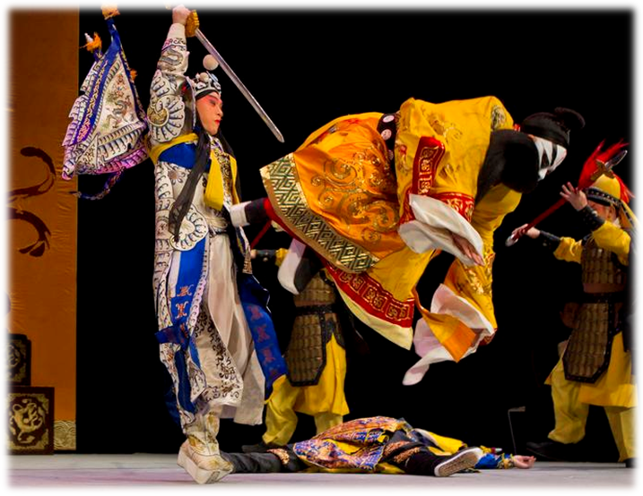
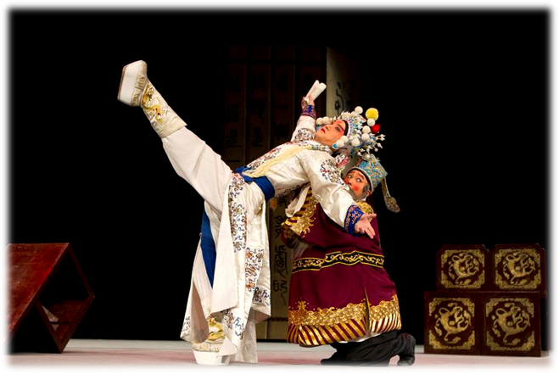
exaggerated movements
a stage
universe

Slide 15
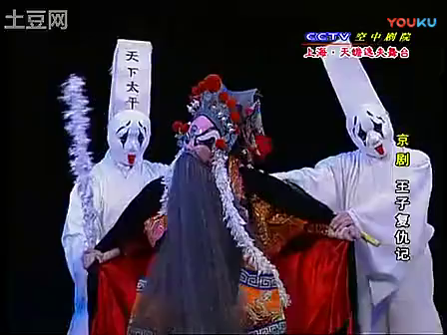

Slide 16
Feelings
Reasons
Task
4
·He thought _______________________.
·He wondered if Peking Opera is easier than a Shakespeare play to understand.
_______curious
he knew a lot about Hamlet
Before
confident
Para1-2
The Revenge of Prince Zidan
·
· voices
· stage
· movements
costumes and masks
amazing
During
surprised
_______
unique
Para3-4
simple
exaggerated
on the edge of his seat
incredible
dazzling
energetic
the strong emotions of love, anger, fear and grief in the performance
After
impressed
·He felt __________________________ _
________________________________.
Para5

Slide 17

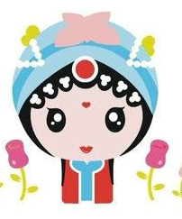
Task
5
Tick the answer
It ticks all the right boxes.
Did “The Revenge of Prince Zidan do a good job in the following aspects”?
music
singing
explosive effect
combine
with
It gets meanings across to the audience.
将意义传达给观众
drama
poetry
costume design

Slide 18
Task
6
Summarize the passage
_______curious
Before
confident
culture confidence
beyond expectation
During
surprised
_______
The Revenge of Prince Zidan
get culture across
After
impressed
Time order
Theme
Feelings
Key factors of a narration

Slide 19
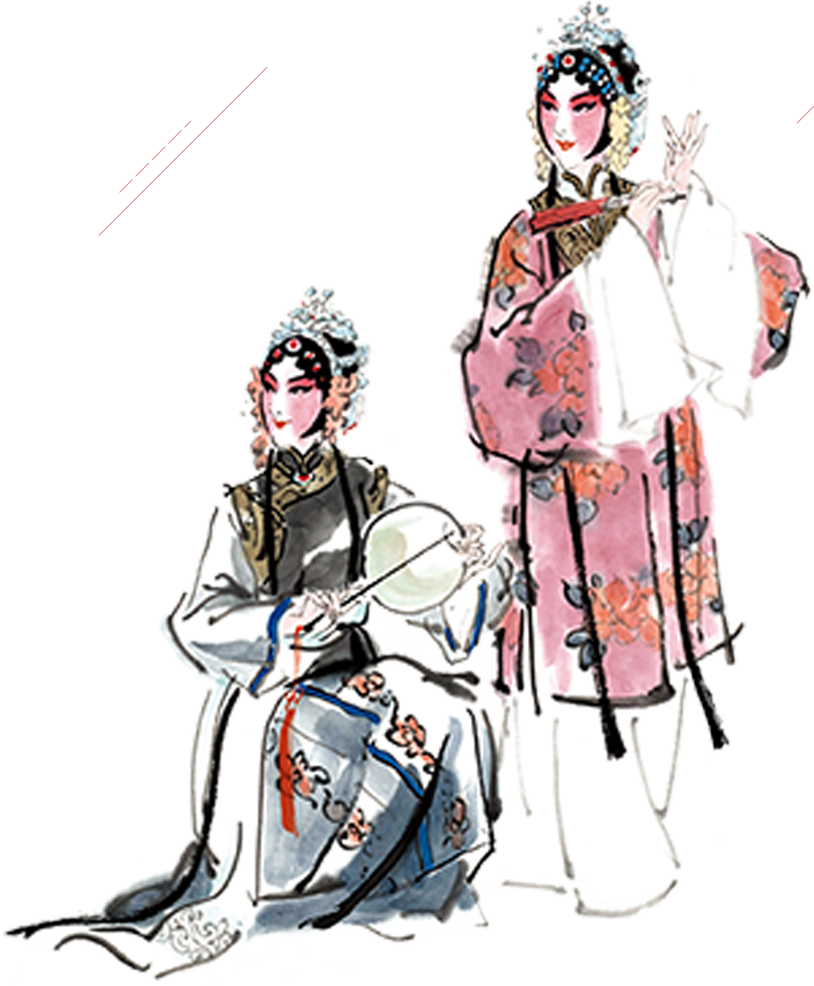
Excellent culture has no language barrier, no boarder, Peking Opera has its unique appeal.
优秀的文化没有语言障碍，没有国界，京剧拥有自己独特的魅力。

Slide 20
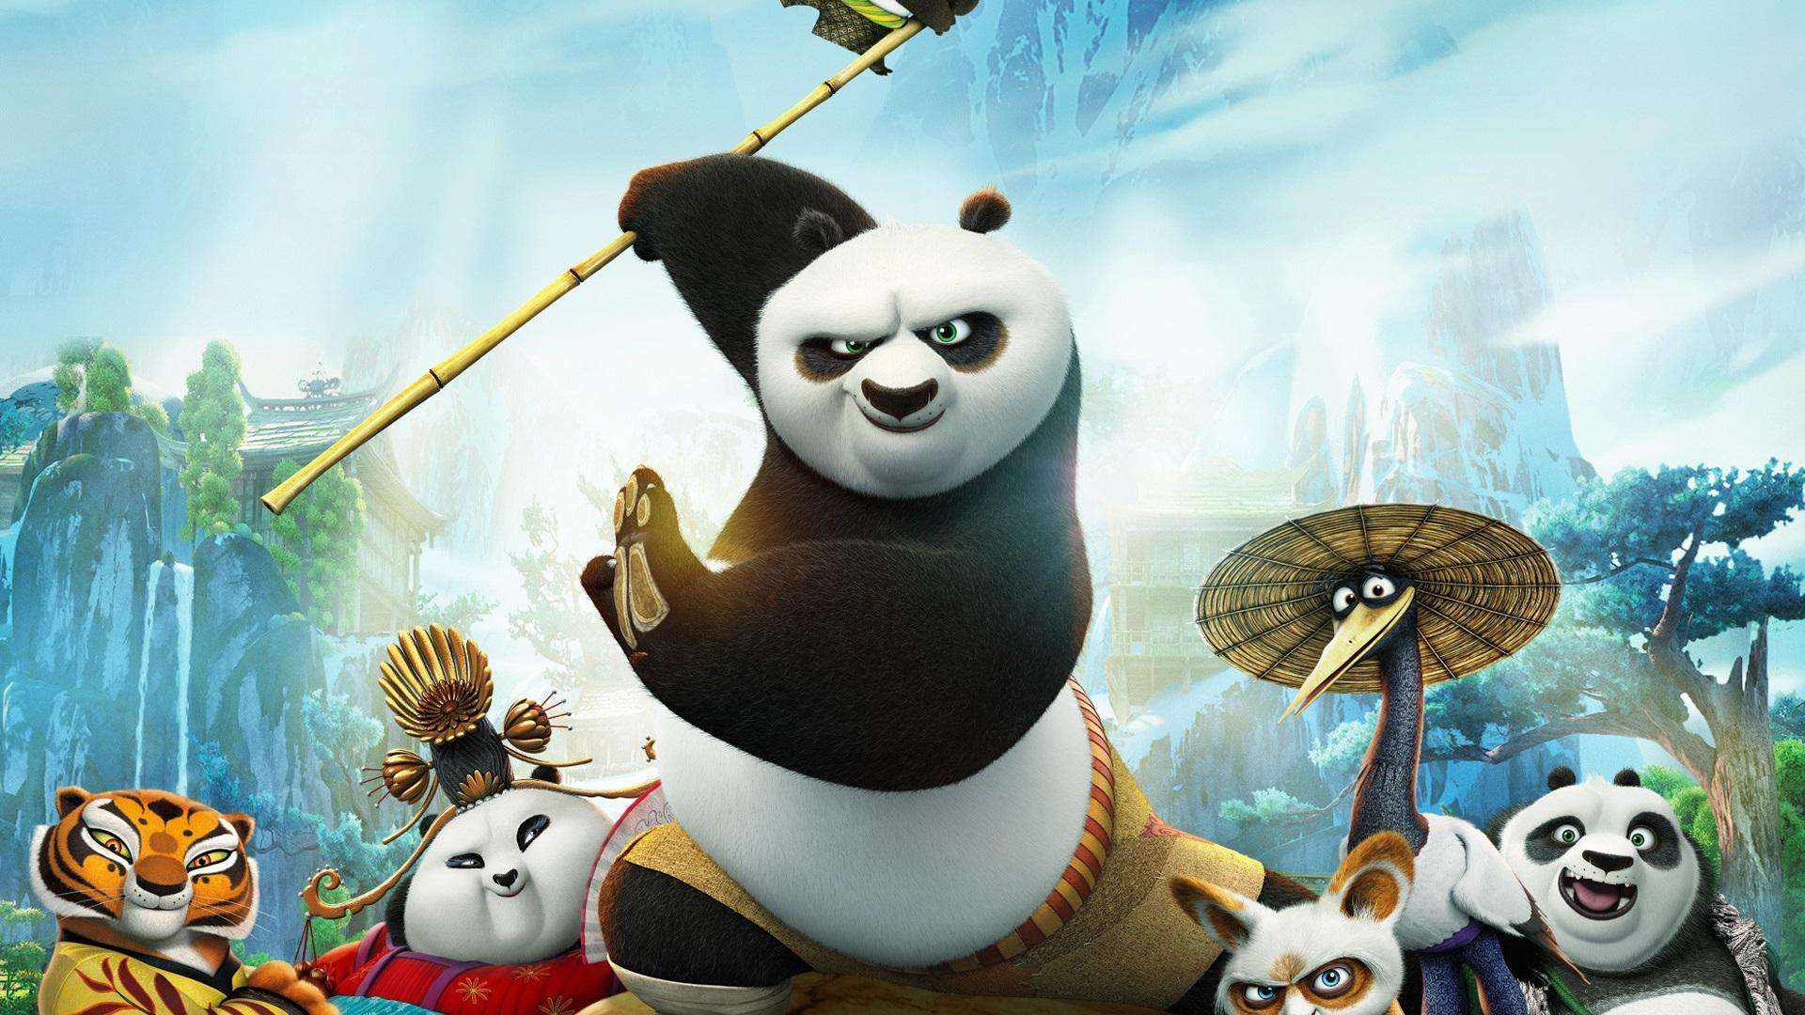
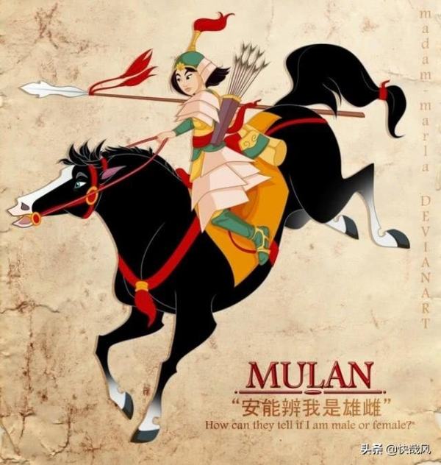
other examples of cultural integration(文化融合)

Slide 21
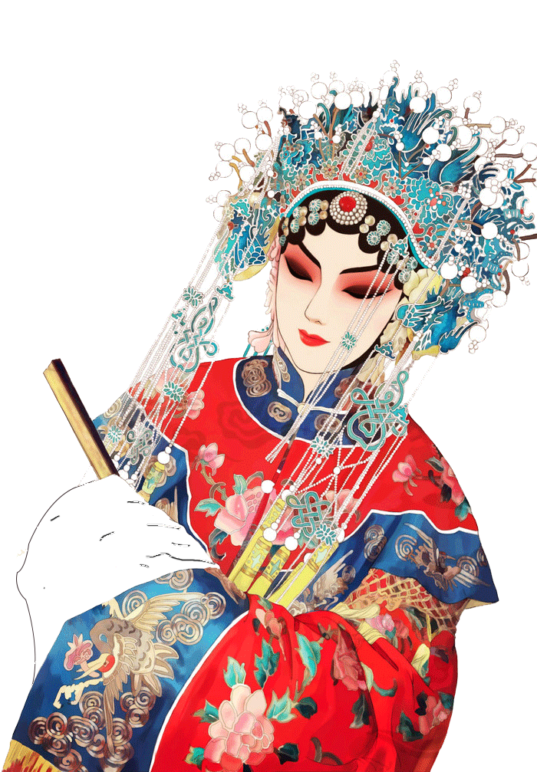
Think & Share
Task
7
How could we help a friend from overseas understand Peking Opera and our other traditional cultures?

Slide 22
Think & Share
Task
7
Understand our culture first;
Learn English not only as a subject, but also a tool to unstand other culture and spread Chinese culture;
Develop cultural confidence and a sense of national pride;
Combine our culture with others;
Present their culture in a traditional Chinese way;
Build a bridge of cultural integration in the world.

Slide 23
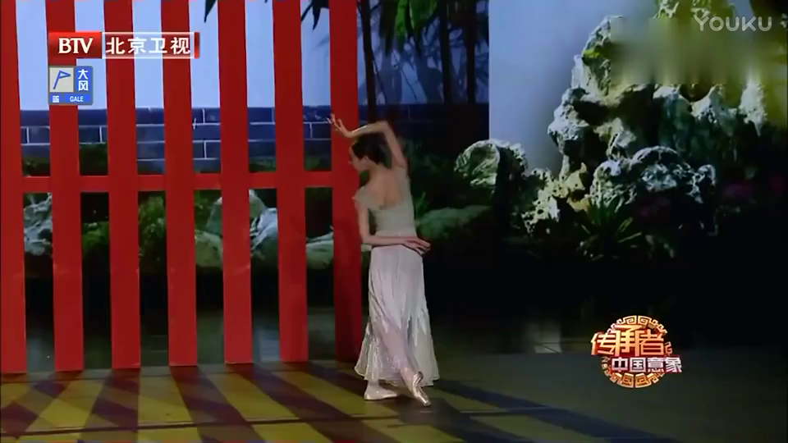
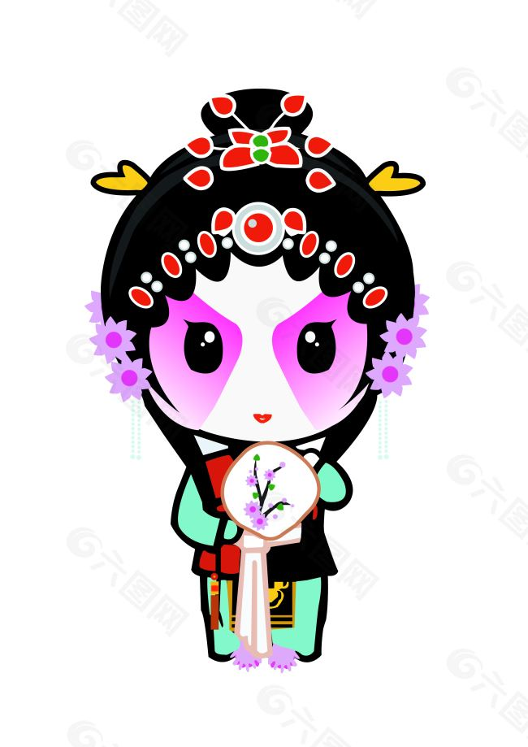
Chinese culture has its appeal,other culture also has its magic, so we should respect our own culture, appreciate the culture of others for the prosperity of human civilization.
各美其美，美人之美，美美与共，天下大同。

Slide 24
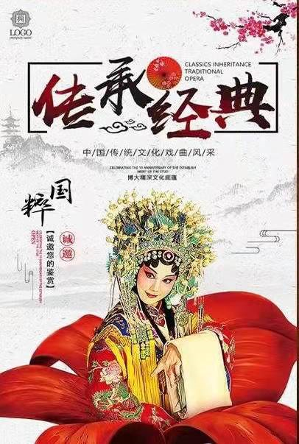
As teenagers, we are expected to respect cultural diversity(多样性), be full of confidence in Chinese traditional culture, and get Chinese traditional culture across to the whole world.

Slide 25
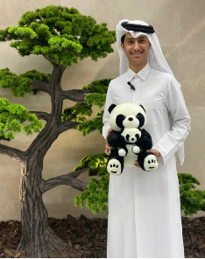
Homework
1.Please write a summary of the passage.
2. Writing
The Prince of Qatar is keen on Chinese traditional culture and is going to visit our school. You are the student representative, please introduce the Peking Opera version of The Revenge of Prince Zidan to him.卡塔尔王子即将来我校访问，他热衷于中国传统文化，你作为学生代表，请向他介绍京剧版的《王子复仇记》。

Slide 26
Dating back to the 18th century, Peking Opera has over two hundred years of history. Starting with an orchestra playing traditional Chinese instruments, the opera can bring an impressive sound to your ears.Then, seeing the main characters come on stage, you will be thrilled! Combining music, exaggerated movements and unique voices, the performers can get the meanings across to the audience, making us clap to our hearts’ content. Feeling the strong emotions, in fact, you are on the edge of your seat!
All in all, combining the spirit of Shakespeare with the form of Peking Opera perfectly, The Revenge of Prince Zidan ticks all the right boxes!

Slide 27
Thank you

