Slide 1
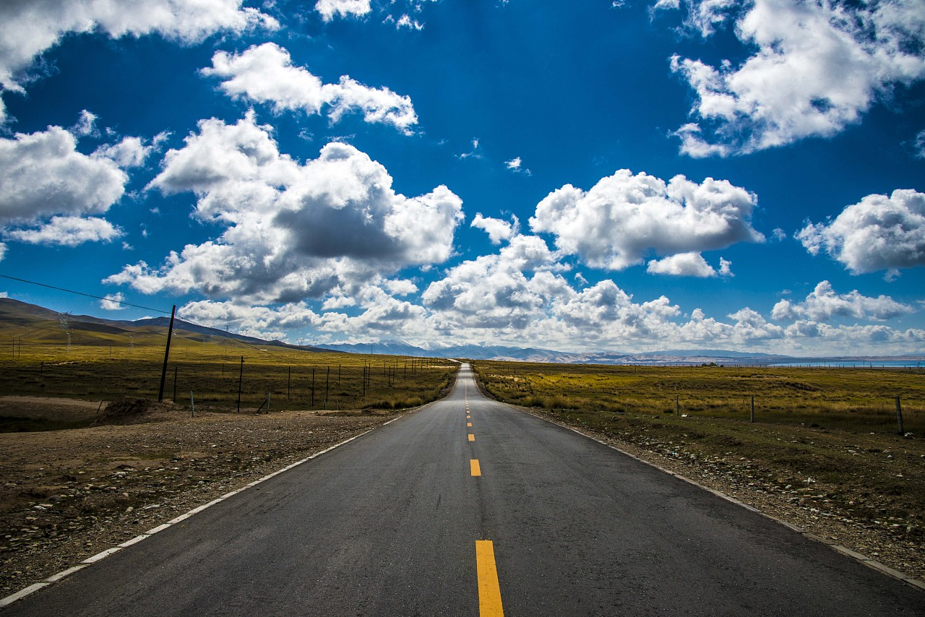
On the road
Book 2 Unit 5

Slide 2
B2U5
Starting out & Understanding ideas

Slide 3

Starting out
Activity 1
What are the top five tourists destinations and why?
Italy
Spain
the US
France
China

Slide 4
Starting out
Activity 1
Destinations | Why
Italy
Spain
the US
France
China
Full of history and culture; many choices of wonderful food
Colorful and lively; greatest artists; unique buildings; cultural treasures
Many different cultural experiences; city life & breathtaking natural a
attractions
Beautiful and romantic cities; Paris; fine dining
A variety of cultural wonders and natural attractions; well-developed roads and high-speed train makes it easy to get around

Slide 5
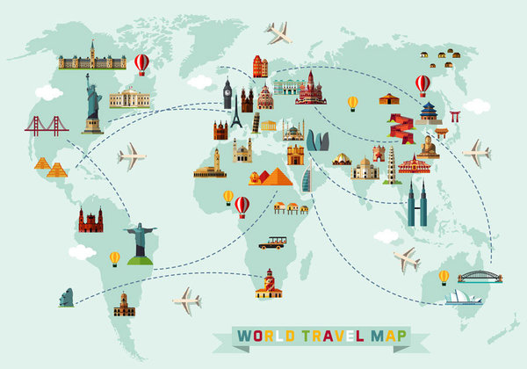
Which country do you want to visit most? Why?

Slide 6
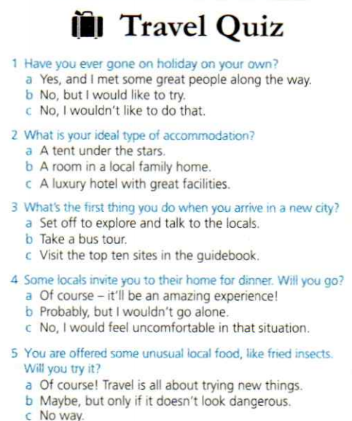
What kind of traveller are you?
Activity 2
Turn to Page 87 to find out your result.

Slide 7
Mostly “a”: You're a true adventurer.
You believe travel is about broadening your mind and growing as a person. You love trying new things, experiencing new places andmeeting new people. The world is one ultimate adventure to you. Bring it on!
Your next destination: the Antarctic,to journey to the South Pole.
Mostly “b”: You're a curious traveller.
While climbing Mount Qomolangma might be a step too far, you have a healthy sense of adventure. Too many risks would take the fun out of travel, but you are still keen to embrace new experiences. Follow your curiosity and see where it takes you next!
Your next destination:Thailand, to visit some islands.
Mostly“c”: You're a traditional tourist.
You prefer to feel safe and comfortable when you travel. There's nothing wrong with this, but don't miss out on new experiences for fear of the unknown. Take a few steps off the well-beaten path and give yourself a bit more room for adventure!
Your next destination: London, to go sightseeing.
a set phrase used to challenge someone.
one that has been worn hard by much use

Slide 8
Starting out
激动人心的；惊人的
高级餐饮
四处行走
度假
食宿
出发
只要...
放马过来吧！
错失
踏平了的
breathtaking
fine dining
get around
go on holiday
accomodation
set off/set out
only if
Bring it on!
miss out on
well-beaten

Slide 9
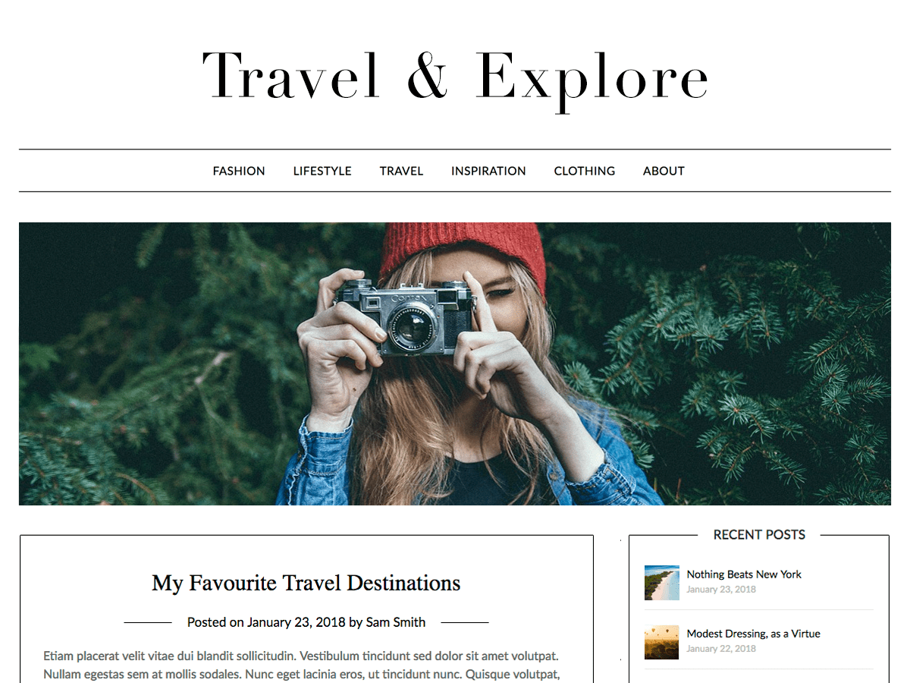
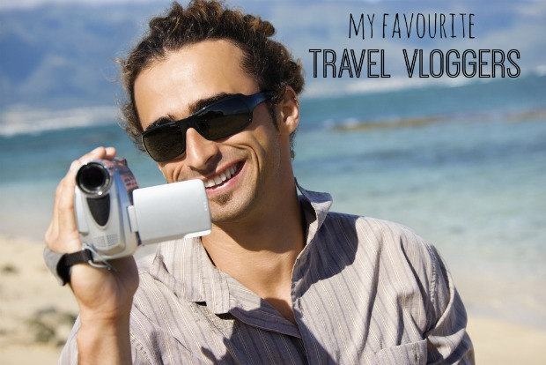
Understanding ideas: Lead in
When we can’t travel by ourselves, what can we do to have a look at the views around the world?
Do you have a favorite travel blogger or vlogger?

Slide 10
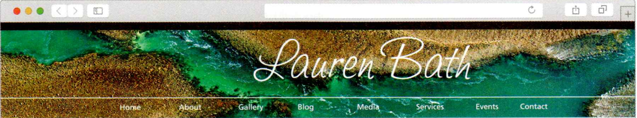
Reading
Activity 3
Read an interview with a travel blogger and write the questions on the lines.
a. What do you love most about Western Australia?
b. What is your connection to Western Australia?
c. Who are you and what do you do?
d. Does your photography support environmental protection?
e. How does your love of nature influence your photography?

Slide 11
Check the answers
1.
________________________________________________
2.
________________________________________________
3.
________________________________________________
4.
________________________________________________
5.
________________________________________________
c. Who are you and what do you do?
b. What is your connection to Western Australia?
a. What do you love most about Western Australia?
e. How does your love of nature influence your photography?
d. Does your photography support environmental protection?

Slide 12
Choose the best description of the interview with Lauren Bath.
1. Why Lauren Bath quit her job as a chef and chose a different profession.
2. Where Lauren Bath loves to travel and how she helps protect the environment.
3. How Lauren Bath turned her hobby into a career and her story of being a blogger.

Slide 13
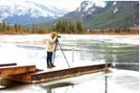
Read for details
Activity 4
Complete the blogger profile with words and expressions from the passage.
Star Blogger
Name Lauren Bath .
Previous job 1__________________
Present job 2 ______________________________
Number of fans 3 ___________________________
Favourite place to visit 4 ______________________
Subject of photos 5 __________________________
chef
professional photo blogger
over 464,000
Western Australia
the natural world and animals

Slide 14
Read for details
Example of important work and its story
Lauren Bath is using her photography to
make people aware of 6 _______________ ______. For example, one of her photos shows a crocodile that is used to passengers 7 ______________________ and is becoming 8___________________. Over time, this could make her 9 _________ to humans. People should stop 10 ___________________.
environmental
issues
throwing food from boats
familiar with humans
a danger
feeding wild animals

Slide 15
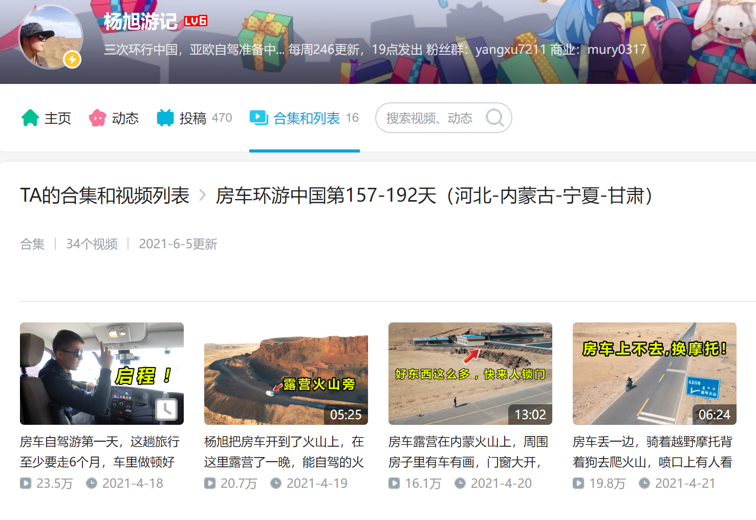
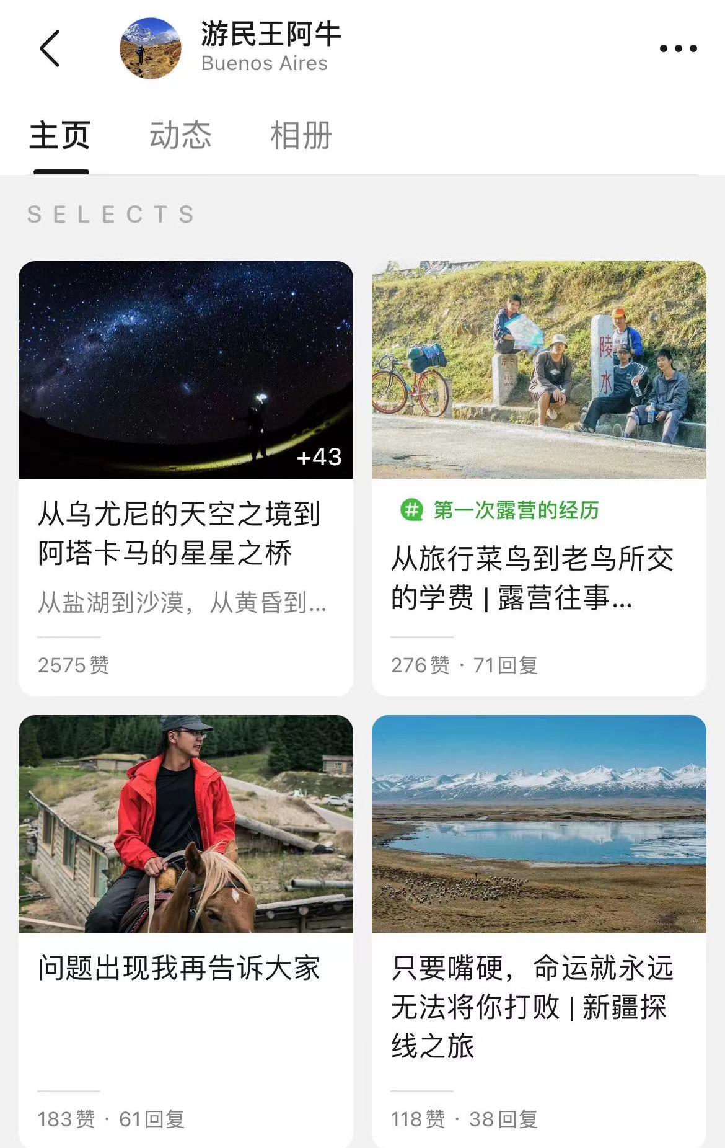
Think and share
Activity 5
Is travel blogger/vlogger your dream job?
If so, how would you like to influence people with your blogs/vlogs?
If not, would you like to do other jobs that involve travel?

Slide 16
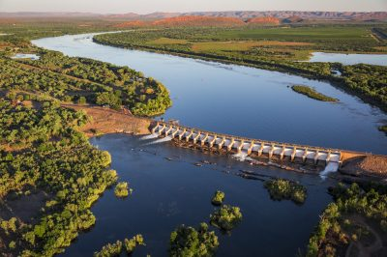
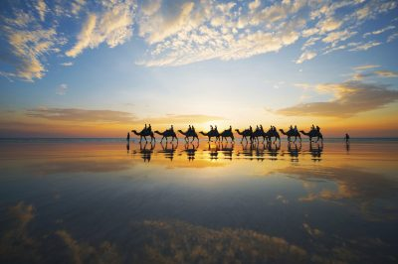
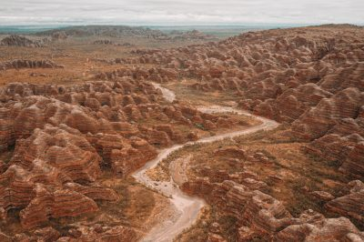
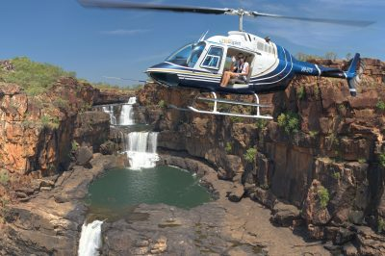
Western Australia
Western Australia (abbreviated as WA) is the largest of all Australian states. The state has about 2.7 inhabitants in 2019, most of whom live in the Perth （柏斯） area.
Kununurra
Broome
The Purnululu National Park
Mitchell River National Park

Slide 17

Perth, Australia

