Slide 1
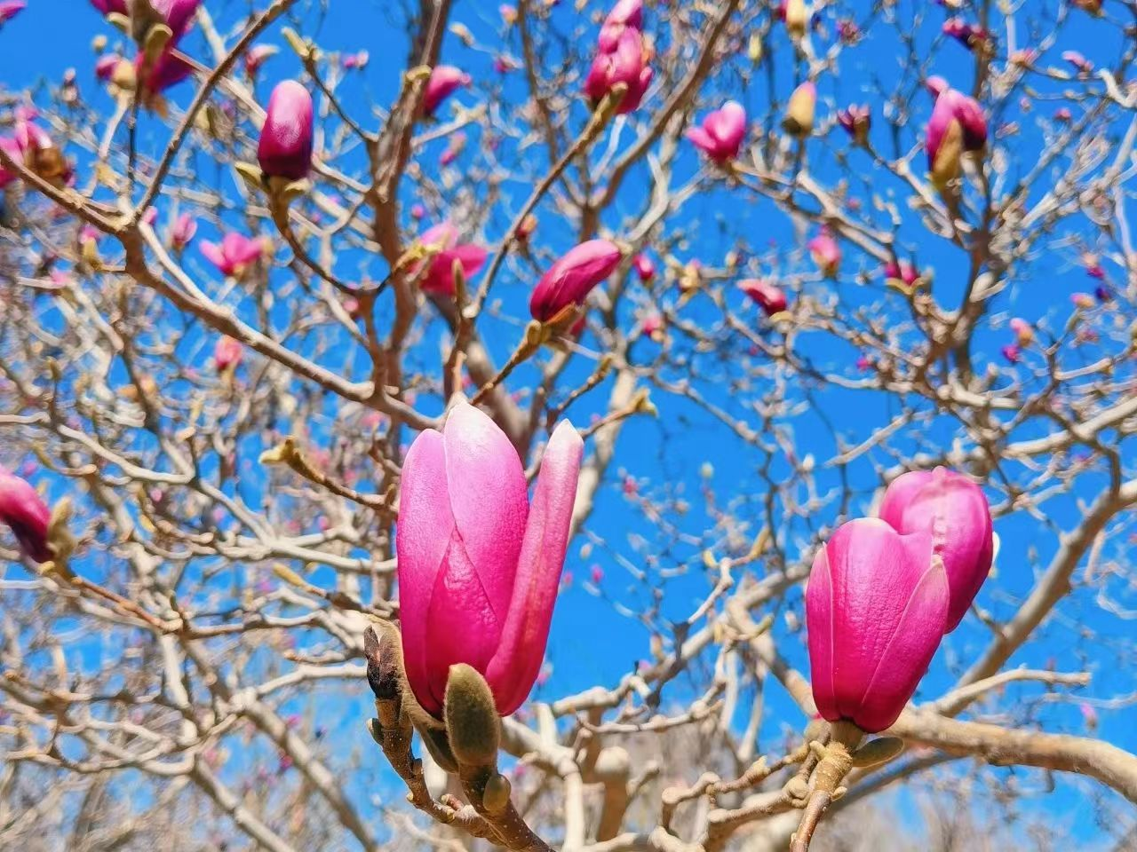

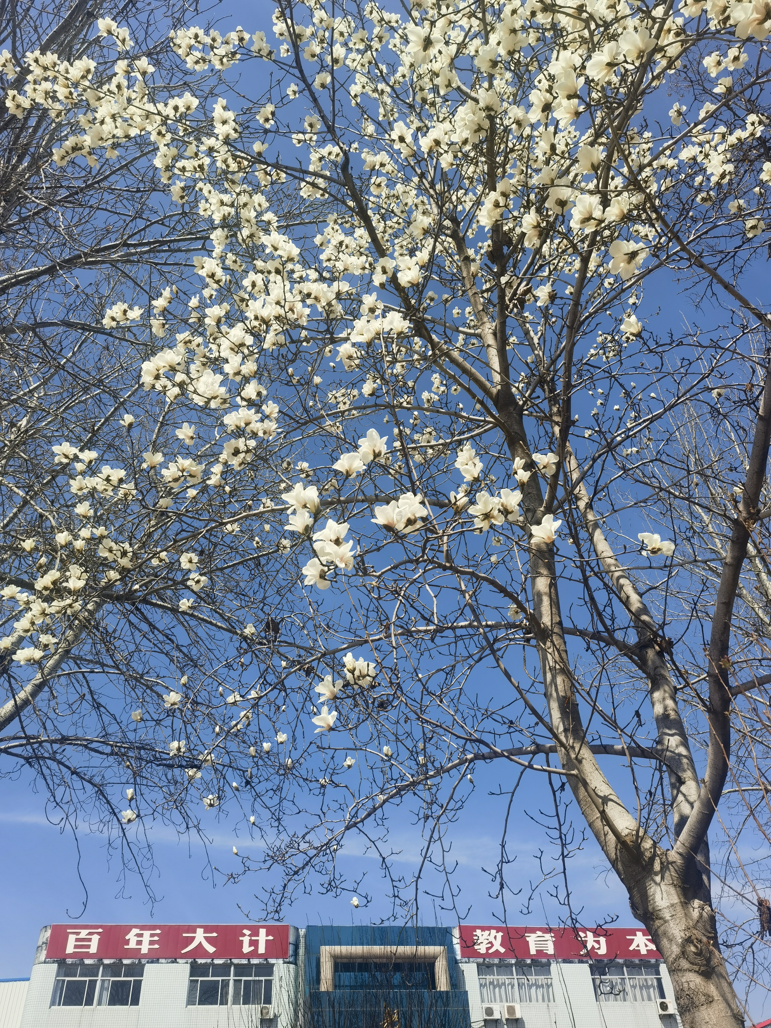


Welcome
----Glad to see you here!
Be active to answer my questions (积极)
Be brave to express your opinions(勇敢)
Be confident to show your talents(自信)

Slide 2
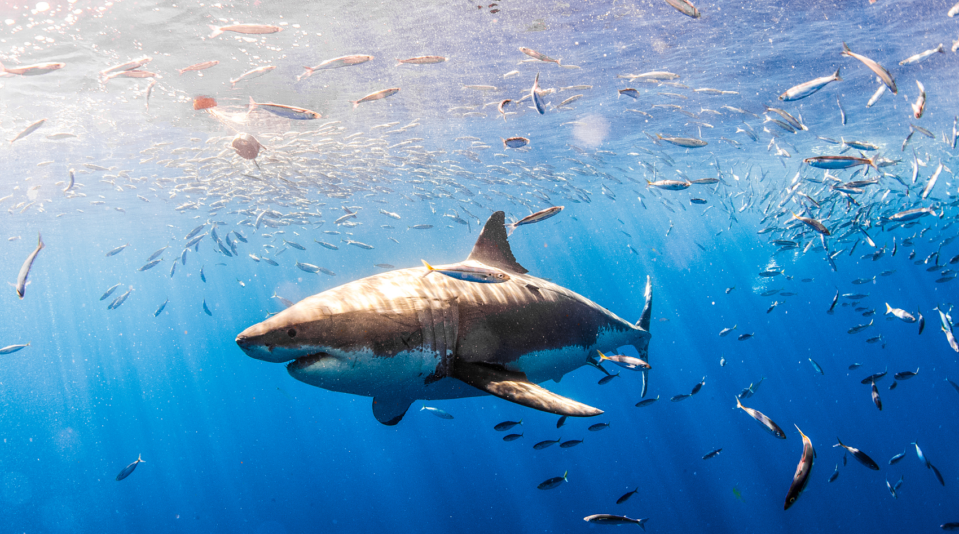
外研社必修二 UNIT6 Earth first
Understanding ideas
SHARKS:
DANGEROUS OR ENDANGERED?
Qiu Xiaoting

Slide 3

Learning objectives
1. To match the main idea with each paragraph and analyse the structure of the passage
2. To figure out how the film Jaws and Peter influenced people’s view on sharks.
3. To explain people's misunderstanding of sharks and raise awareness of shark protection.
4. To make a poster about shark or environmental protection.

Slide 4
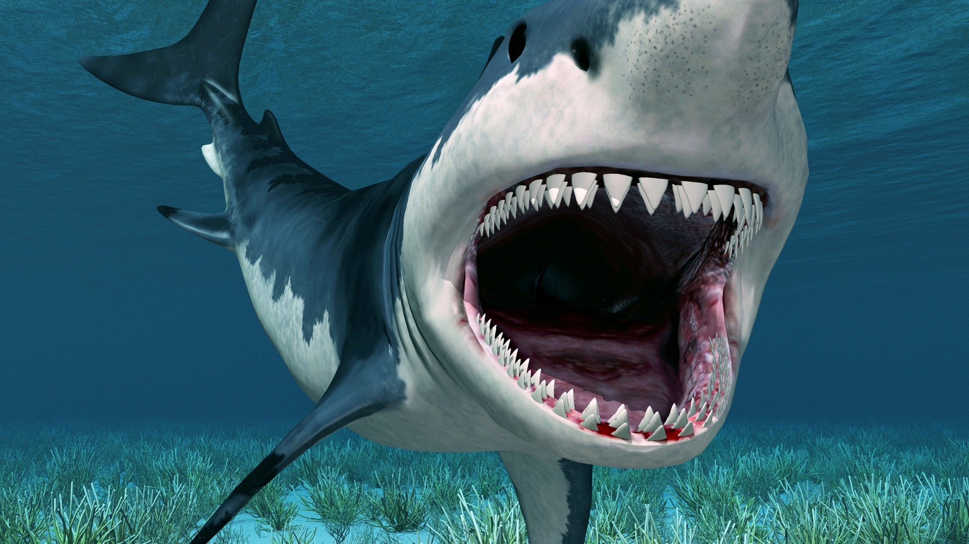

Lead in
What’s your impression of sharks?

Slide 5

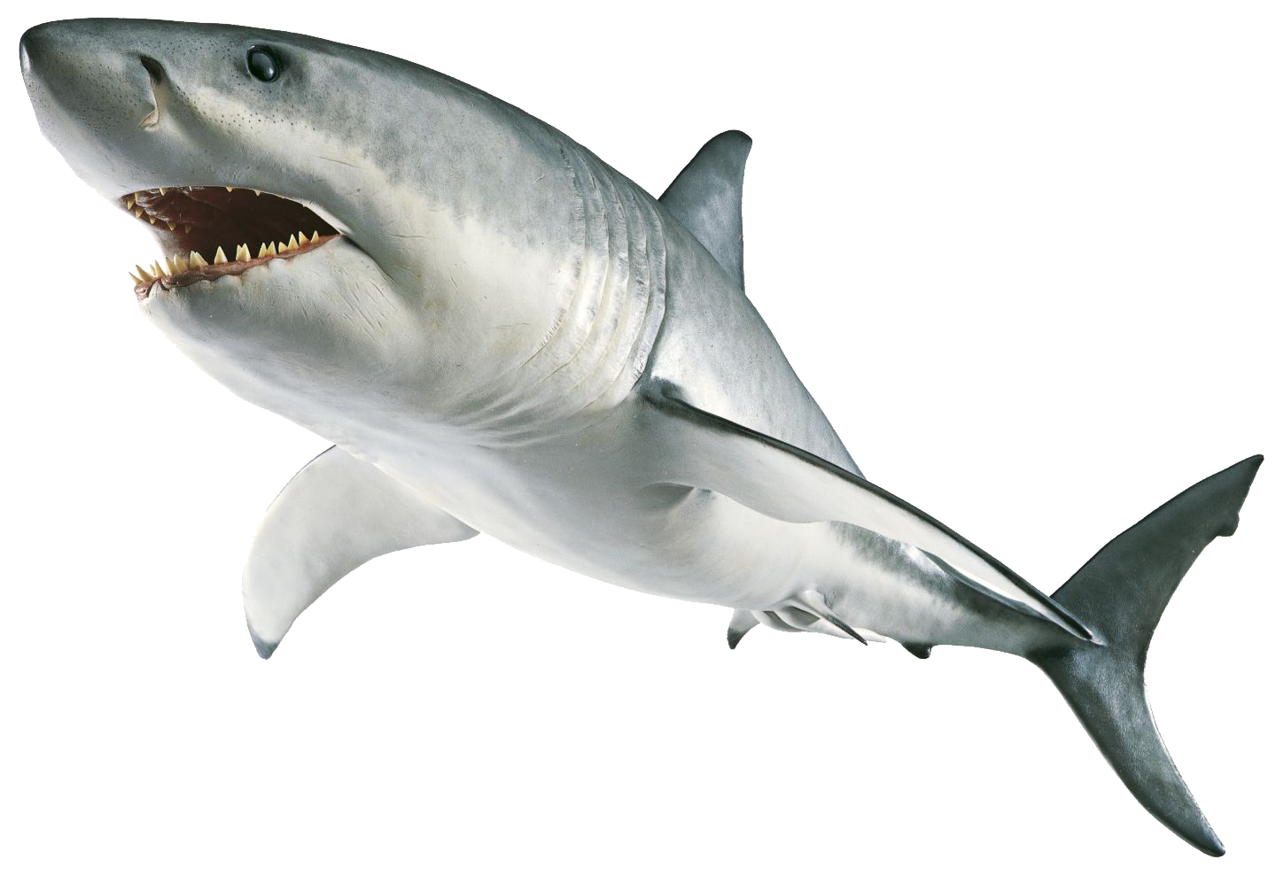
Task 1
Free Talk
What words would you use to describe sharks ? What do you know about sharks ?
huge
endangered
濒危的
man-eating
食人的
cute/adorable
terrifying
吓人的
powerful
dangerous

Slide 6
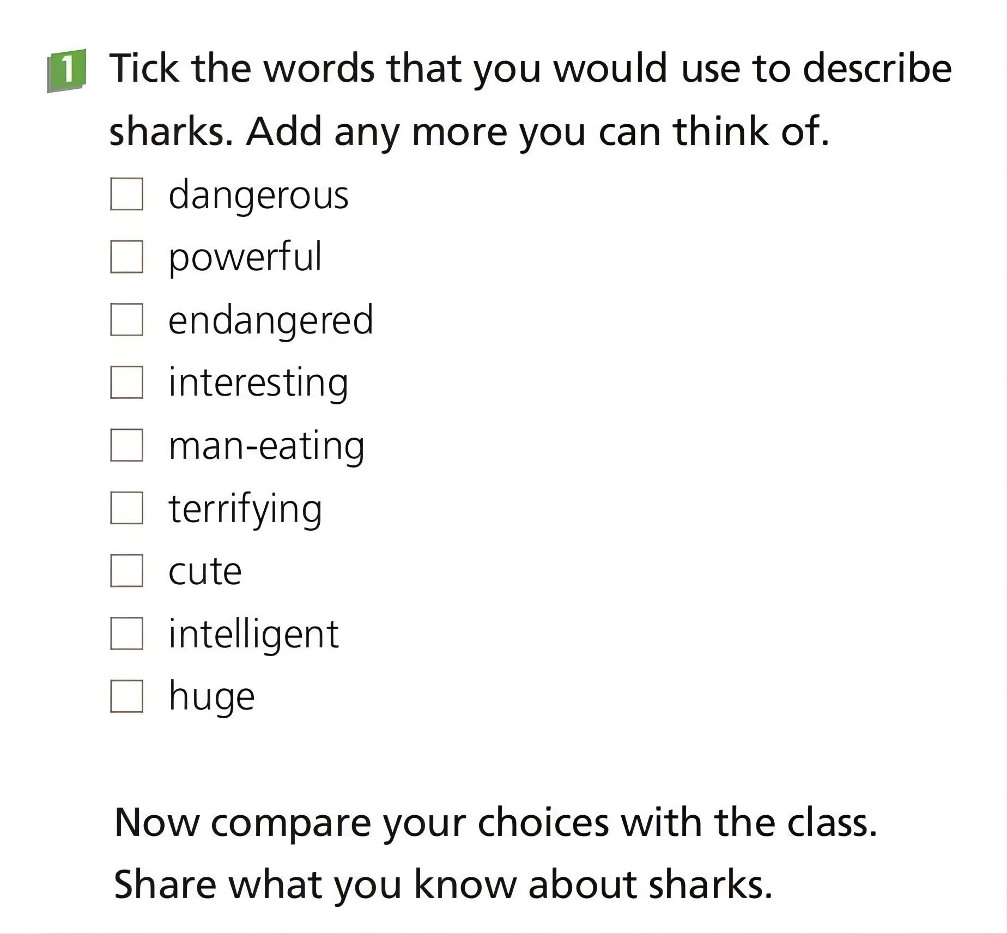
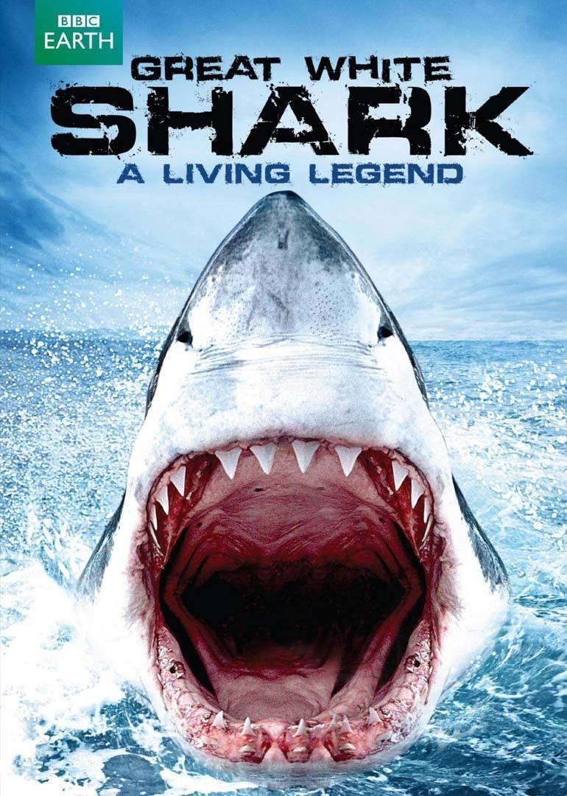

Slide 7
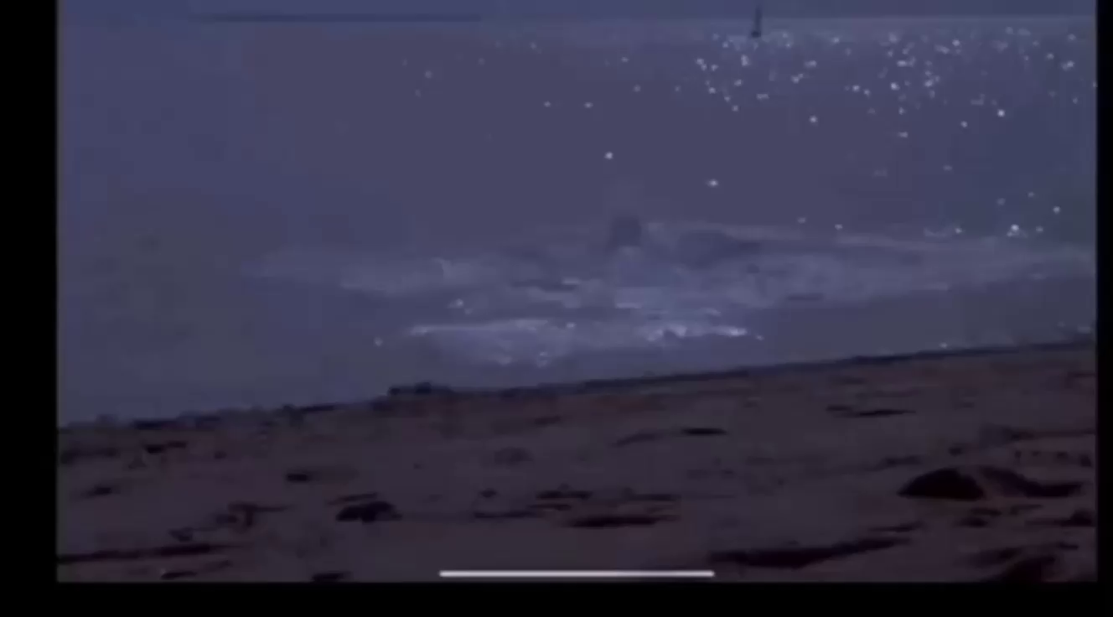
Watch the opening clip of the film Jaws.

Slide 8
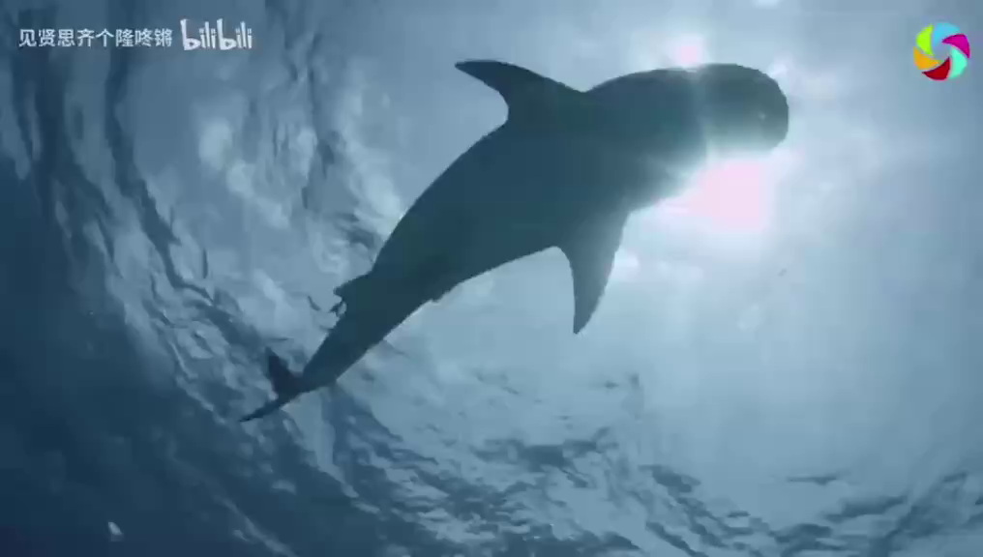
插视频

Slide 9
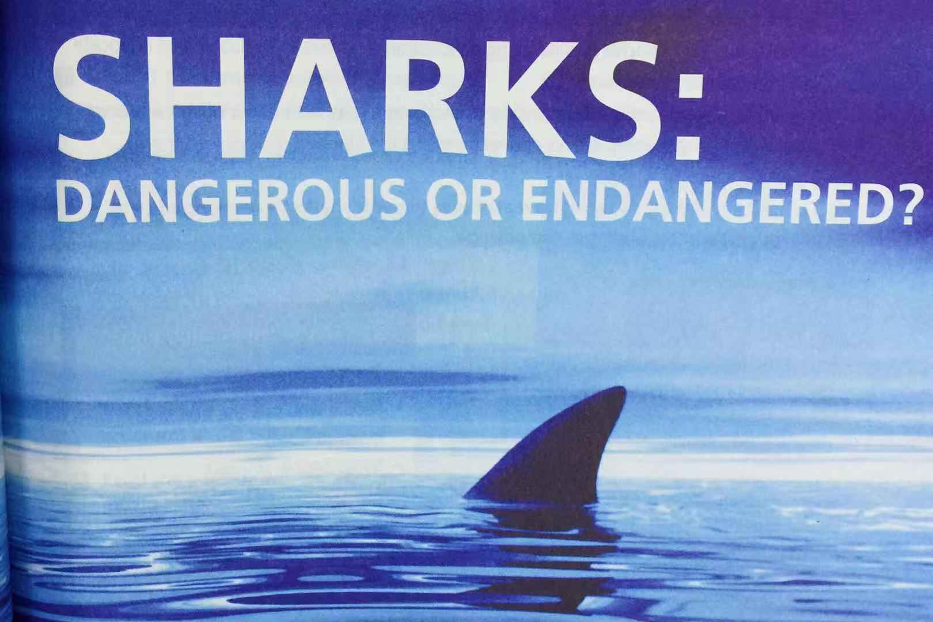
Pre-reading
I. Look at the picture and the title
“en” 使...
fin

Slide 10
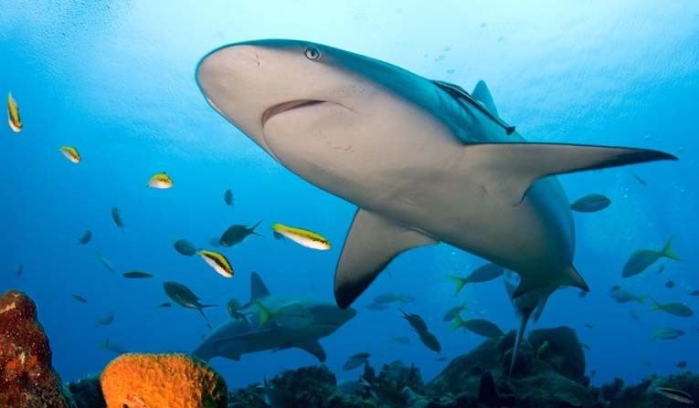
Read the passage and talk about your understanding of the title: Sharks: Dangerous Or Endangered?
People normally thinks sharks are ___________ but
actually they are___________________.
dangerous
endangered / in danger

Slide 11
Activity I Read for main idea and structure

Slide 12
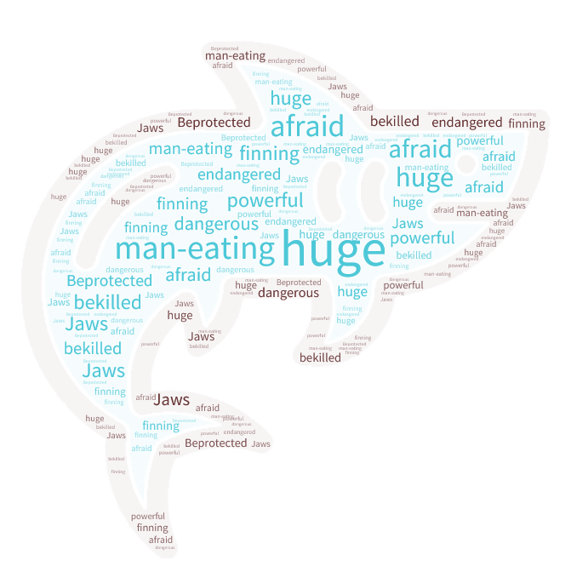

Word cloud
While-reading
II. Read for the main idea
people’s behavior
number
Read the passage quickly and pick out the key words from the word cloud to describe each paragraph.
Find out the sentence to support your choice.
extinction
endangered
protect
dangerous
dangerous
reason
dangerous
dangerous
attitude
protection
kill
finning(割鳍)
Tips:
Focus on the first and last sentence of each paragraph
endangered

Slide 13
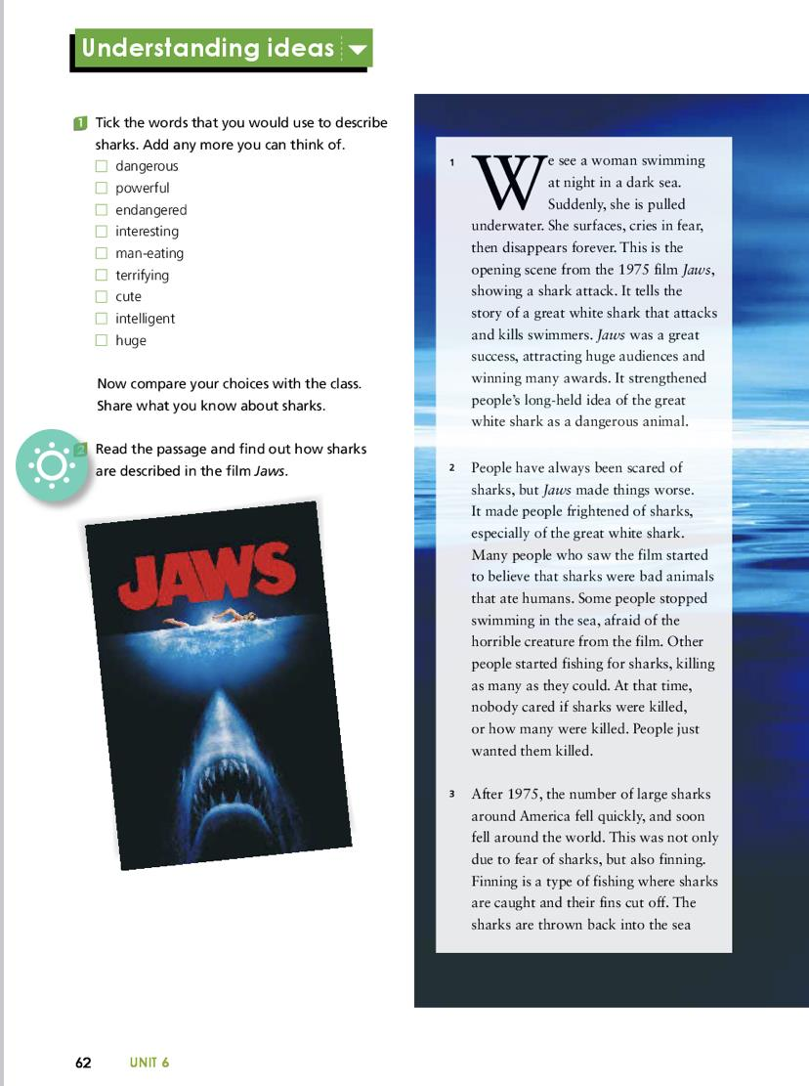
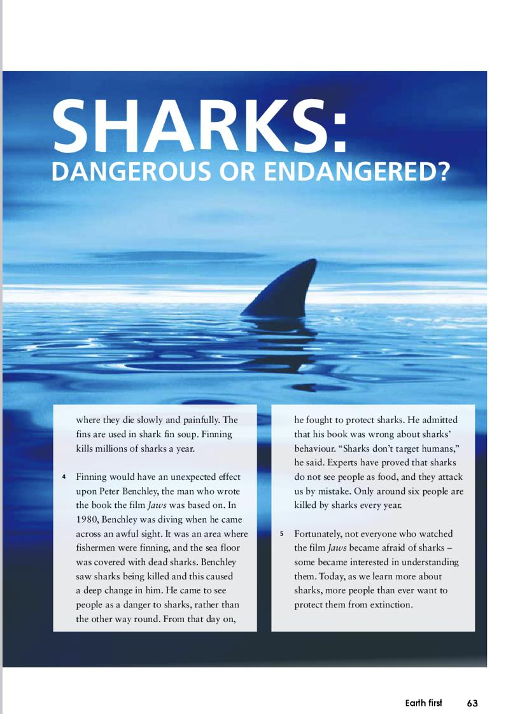
dangerous animal
attitude after the movie
number
behavior
protection

Slide 14

While-reading
Activity 1 Fast-­reading for main ideas
1. Skim the passage and match each paragraph with its main idea.
Para.1 A. Finning kills millions of sharks a year.
Para.2 B. The opening scene from the 1975 film Jaws.
Para.3 C. More people want to protect sharks from extinction.
Para.4 D. Benchley came across an awful sight of dead sharks
and fought to protect sharks.
Para.5 E. Jaws made people more scared of sharks and people
killed as many sharks as they could.

Slide 15
Read for structure
Sharks:
Dangerous or Endangerd?
Para 1-2
Part Ⅱ
Part Ⅰ
Para 3-4
dangerous
endangerd
Part Ⅲ
Para 5
More people want to
protect sharks from extinction

Slide 16
Pre-reading
2 . What type of text is this passage?
A．Narration(记叙文)．
B．Argumentation(议论文)．
C．Exposition(说明文)．
D．Prose(散文)．
√

Slide 17
Activity II Read for details

Slide 18
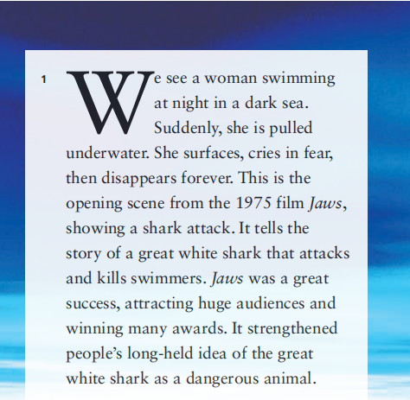

Para 1
1.What is Jaws? Please introduce the film according to para.1.
in 1975
Time:______________________
a shark kills a swimmer
What:_________________________
audiences&awards
Achivement:____________________
strengthened people’s long-held idea
Effects:________________________
2.Why is the movie mentioned here?
A.To give an example.
B.To introduce the topic.
C.To make a summary.

Slide 19
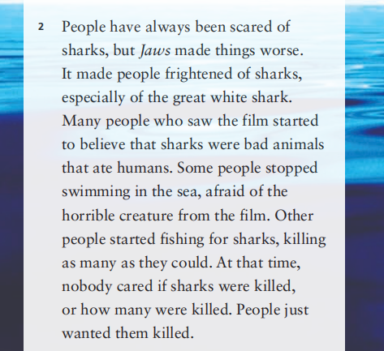

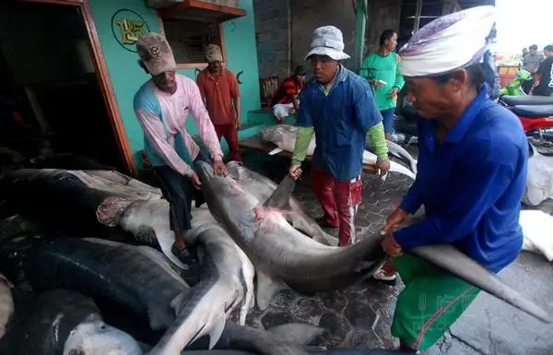
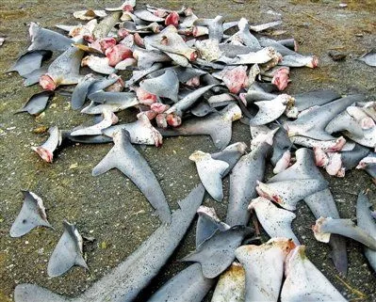
Para 2
1.How did people describe sharks after watching the movie. Circle at least 2 adjectives(形容词) in the text.
2.What is people’s reaction?
Some people stop swimming
Other people start fishing and killing
frightening
bad
horrible

Slide 20
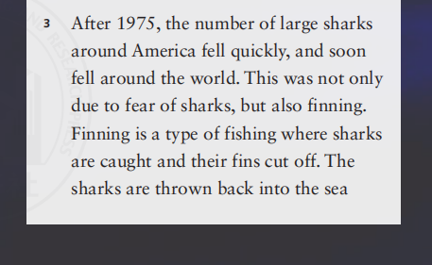
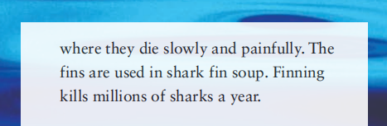
Para 3
1.What happened after 1975? And why?
2. What is finning?
3. What will people do when they are finning?

Slide 21
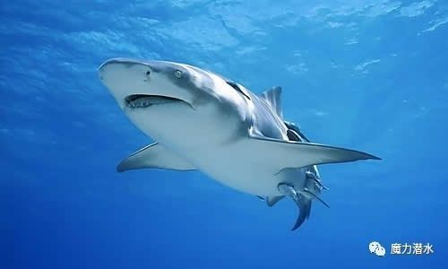
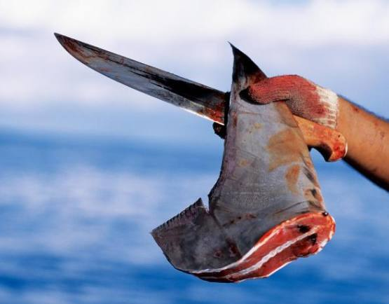
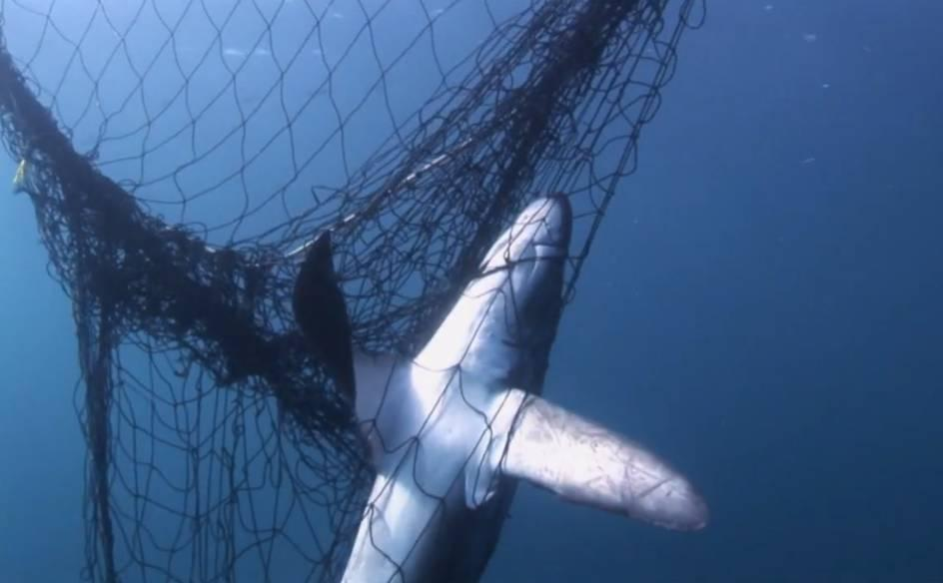
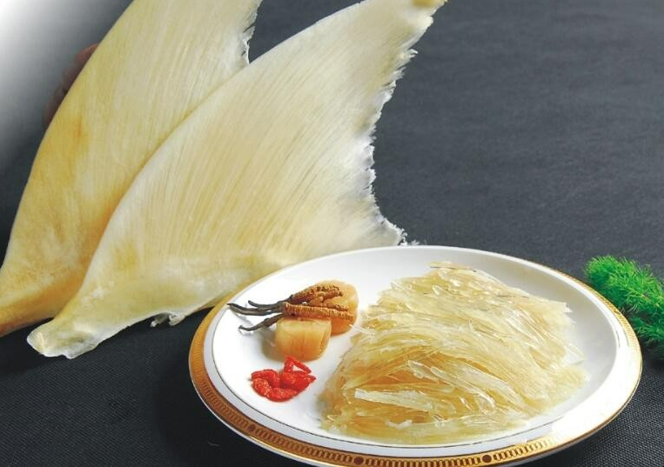
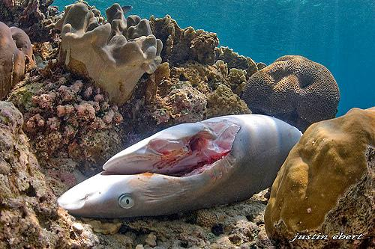
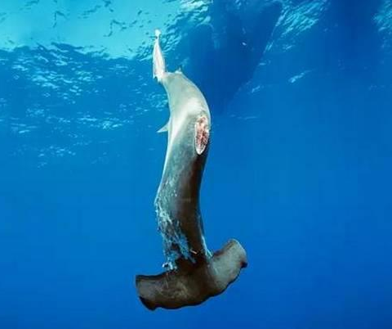
Sharks are caught.
Their fins are cut off.
fin
They die slowly and painfully.
Sharks are thrown into the sea.

Slide 22
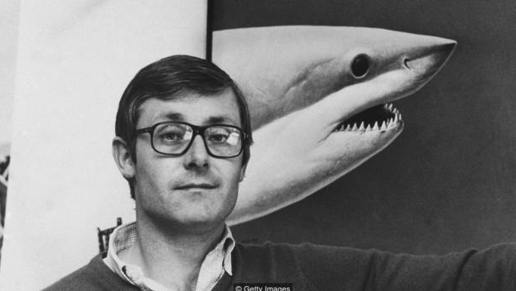
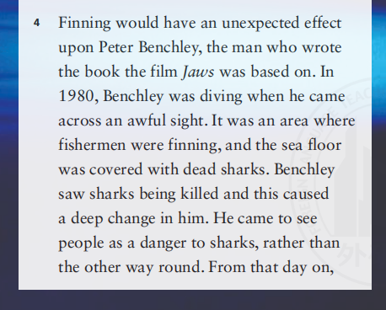

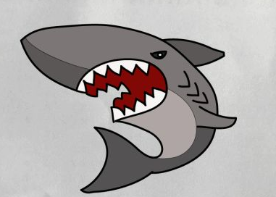
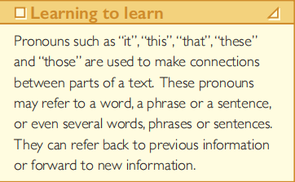
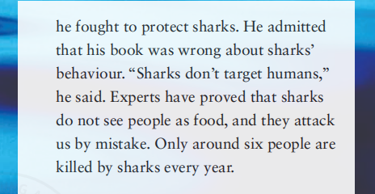
Para 4
1. Who is Peter Benchley?
2. What made Benchley change his attitude to sharks?
3.How do you think Peter felt after diving?
Benchley saw sharks being killed.
pitiful
sad
shocked
unexpected
regretful

Slide 23
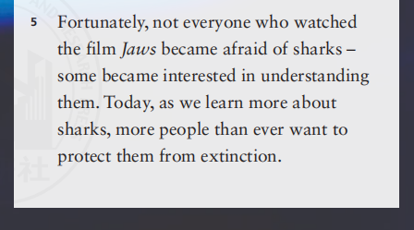
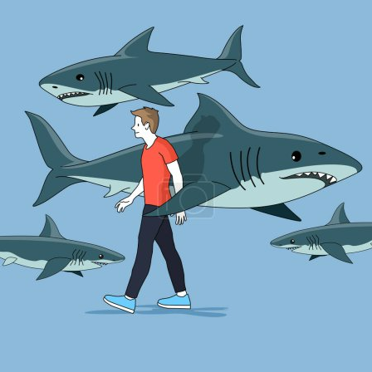
Para 5
1.What is the author’s attitude to the future of shark protection?
Negative?
Positive?
Indifferent?

Slide 24
Read passage again and complete chart with words and phrases.
Before watching the film Jaws
After watching the film Jaws
People have always been scared of sharks because they are considered ______________animals.
People who saw the film believe _____________________________ate humans.
sharks are bad animals that
as dangerous
Some people stopped ____________________,while others started to _______________________.
More people are against finning and wish to protect sharks
swimming in the sea
fish for sharks
Peter admitted that his book ___________about sharks’ behavior and fought ________________ them.
Expert have proved that ________________as food, they attack people by mistake.Some people became interested in ______________________ and more are willing to___________________extinction.
was wrong
to protect
normal fear-frightened
do not see people
more frightened-kill
understanding sharks
protect
protect sharks from

Slide 25

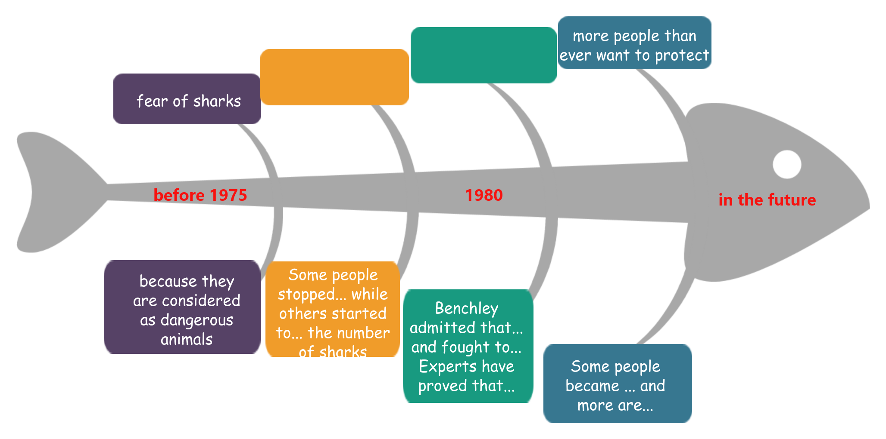

How do people’s attitude change over time?
against finning and want to protect
more
frightened
dangerous & endangered
1975
today

Slide 26
Choose the author’s purpose in writing the article.
1. To criticise Peter Benchley’s misleading description of sharks in his book and promote the protection of sharks.
2. To inform people about sharks and recommend（推荐） the film and the book to them.
3.To explain people’s misunderstanding(误解) of sharks and raise awareness of shark protection.

Slide 27
Activity Ⅲ Critical thinking

Slide 28
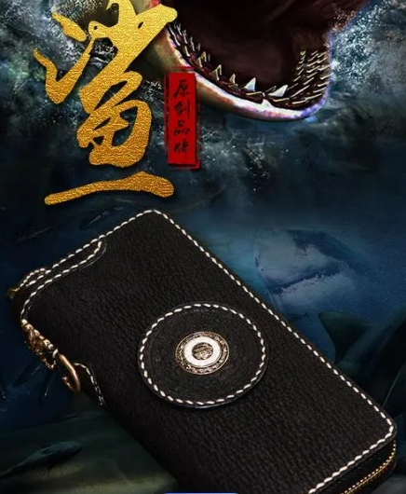


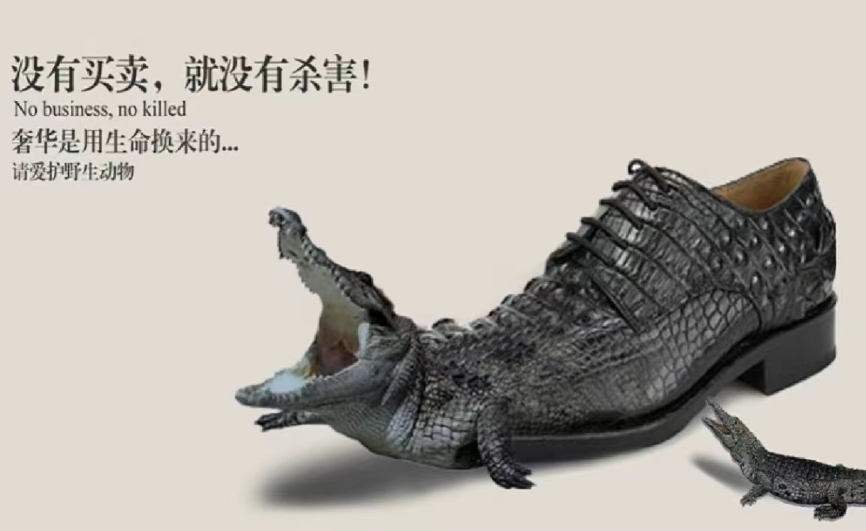
Brainstorming
Critical thinking
As a senior high school student, what can you do to protect sharks?
Don’ts
1. Don’t use shark products.
2. Do not have ocean feast(大餐)/sharp fin soup（鱼翅汤）.
3. Do not drop litter into the sea.
Dos
4. Do voluntary work to protect ocean creatures.
5. Raise people’s awareness of shark protection.
......

Slide 29
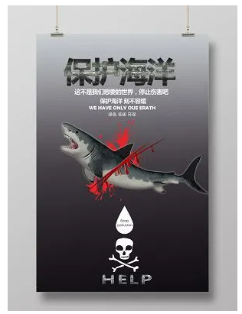
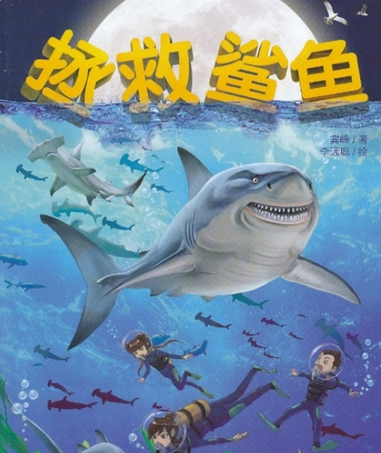
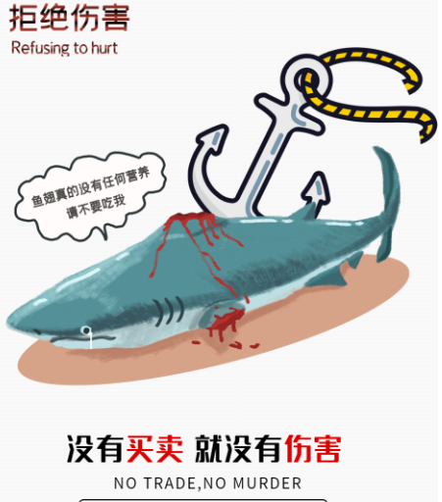
Brainstorming
Critical thinking
Make a poster about shark or environmental protection.

Slide 30
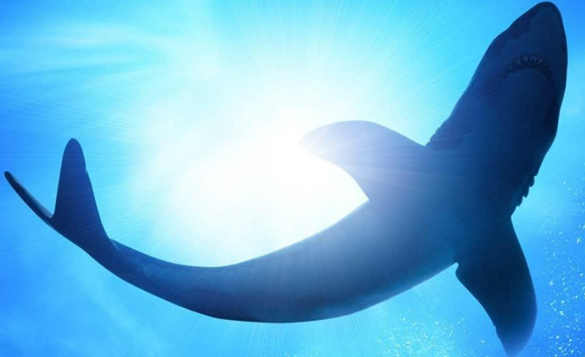
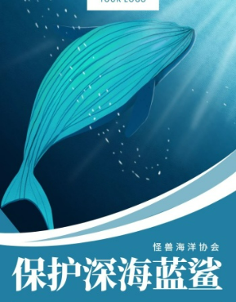
Show Time

Slide 31
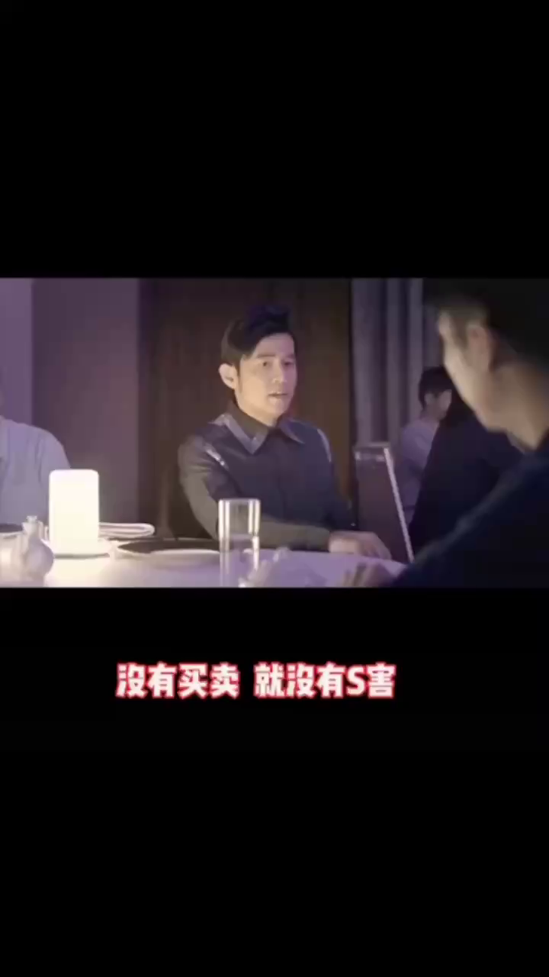

What can you learn after studying this passage?
1. When the buying stops, the killing can too.
2. Live in harmony with every creature.

Slide 32
ActivityⅣ Assignment
What other films or books do you know that feature wild animals? Do they “paint” a good or bad picture of these animals? Say how the animals are described.

Slide 33
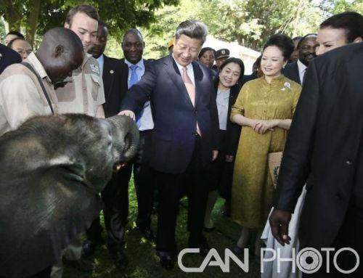
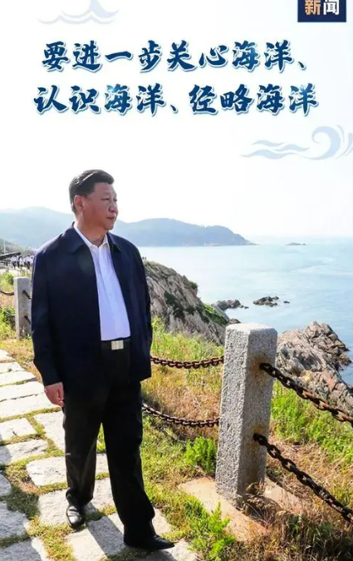
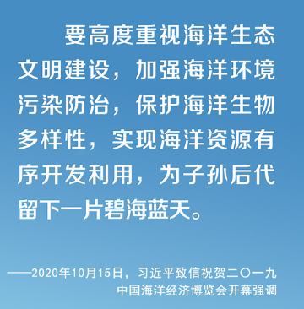
“We should love animals, as we love ourselves. We should live in harmony with every creature. ”
—Xi Jinping.

Slide 34
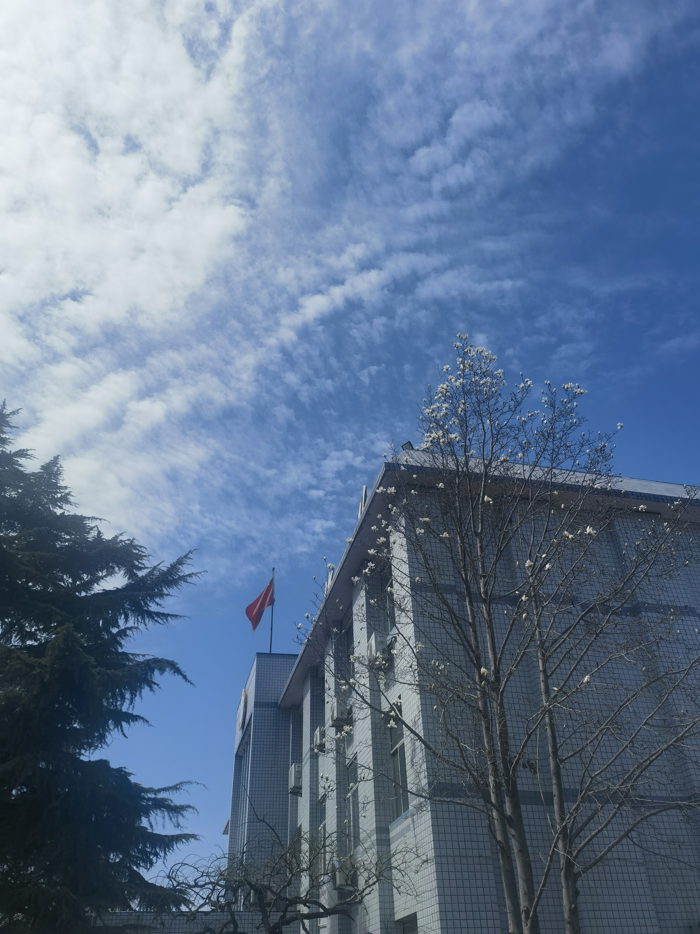
Thank you

