Slide 1

Unit 1 Face values Developing ideas
新标准《英语》高中选择性必修第三册

Slide 2
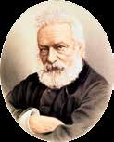
Activity 1 Read the short introduction to Victor Hugo and answer the questions.
1 Why do you think Victor Hugo is known as the “Shakespeare of France”?
2 What do you know about Romanticism? Do some research to
find out more about it.

Slide 3
Activity 2
Read the passage and find out why Quasimodo rescued Esmeralda.
Quasimodo rescued Esmeralda because when Quasimodo was tortured in public, Esmeralda was the only one to show him kindness and mercy.

Slide 4
Activity 3
Underline the sentences that describe Esmeralda and Quasimodo’s appearances and feelings. Write a short paragraph to describe how Esmeralda and Quasimodo see each other.
Esmeralda in Quasimodo's eyes:
Quasimodo thought Esmeralda was graceful and exquisitely beautiful, like a ray of sunshine, a drop of dew or a birdsong.
Quasimodo in Esmeralda's eyes:
Esmeralda thought Quasimodo was repulsive, with knock knees, a hunched back and a single eye; yet beneath his ugliness, he was full of melancholy and gentleness.
Now work in pairs. Read the passage again and find out how Esmeralda’s
feelings towards Quasimodo changed. Share your answers with your
partner.

Slide 5
Think & Share
1 What does the sentence “A tear swam in the eye of Quasimodo, but
did not fall” tell us about Quasimodo’s personality?
2 In what different ways do the two reading passages in this unit raise
our awareness of physical appearance and personal qualities?
On one hand, it shows that Quasimodo is sensitive and gentle; on the other hand, it shows his strength and pride.
The first passage shows the true meaning of beauty. Though how you present yourself to others plays a part, accepting yourself and feeling confident about your physical appearance are most important. The second passage highlights how someone’s physical appearance can actually be a complete contrast to who they are on the inside.

Slide 6
Think & Share
3 What difficulties might people like Quasimodo face in the real world?
How should people treat them?
4 Predict what happens next. Share your ideas with the class. Read the
novel and check your prediction.

Slide 7
Activity 4
Work in groups. Give a talk about the character in the passage that makes the greatest impression on you.
1 Organise your ideas by considering the questions.
· What is the character like?
· Has he / she experieced any emotional changes? If so, what changes are they?
· What can you learn from him / her?
2 Present your ideas in your group.
3 Collect all your group’s ideas and present them to the class.

Slide 8
Activity 4
Now think about whether you can express yourself clearly or understand others in the group talk, and what your strengths or weaknesses are, compared to those of the others in your group.

Slide 9
Writing about a literary work

Slide 10
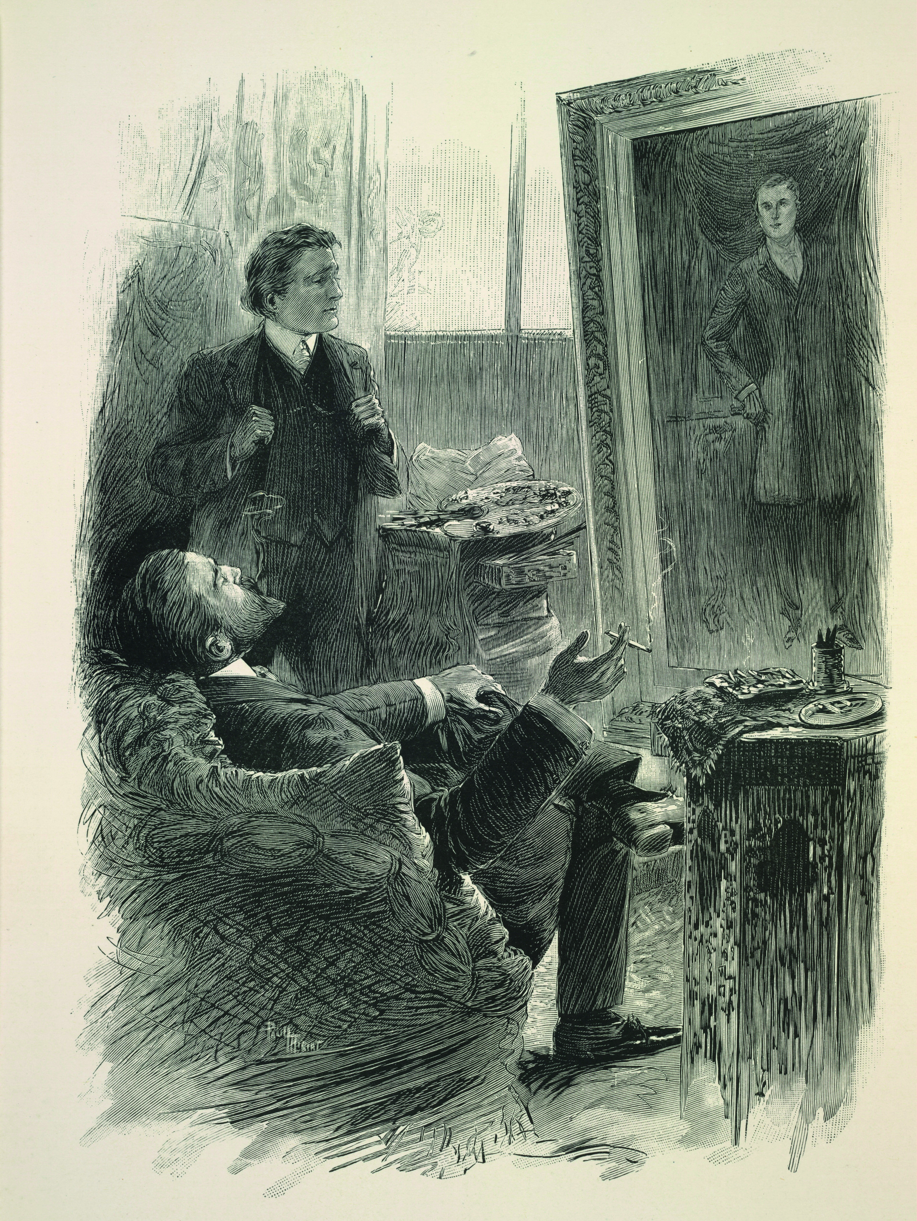
Activity 5 Read the introduction to the novel and answer the questions.
1 What kind of person is Dorian Gray?
2 What message do you think the novel
conveys?

Slide 11
Activity 6
Choose another literary work with a focus on physical appearances and personal qualities, such as The Hunchback of Notre-Dame, and complete the notes.
General introduction:
Plot:
Central theme(s):
Now write about this literary work based on your notes.

Slide 12
Activity 6
Jane Eyre
Jane Eyre, written by Charlotte Brontë and first published in 1847, tells the timeless story of the love between a poor young governess and a rich and mysterious gentleman.
After leaving the orphanage where she has spent most of her childhood, Jane Eyre goes
to work as the governess of the daughter of a wealthy but troubled landowner. As she comes
to know the great house and the people who live and work within it, Jane begins to uncover
the secret responsible for Rochester’s temper and reticence. They fall in love, but just when
their happily ever after seems to be in sight, that secret threatens to tear them apart.
Jane Eyre looks at how people should not be underestimated because of the way they look – Jane might be small and plain, but she is also strong, courageous and independent. Although
she is a woman and from a lower social class than Rochester, she wants to prove herself his
equal in spirit.

Slide 13
Activity 7
Work in pairs. Make improvements to each other's introductions and share them with the class.

Slide 14


