Slide 1

Unit 1 Face values Presenting ideas & Reflection
新标准《英语》高中选择性必修第三册

Slide 2
Presenting ideas

Slide 3
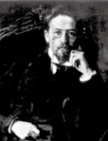
Activity 1
Work in groups. Read the quote and discuss the questions.
A human being should be entirely beautiful: the face, the clothes, the mind, the thoughts.
From Uncle Vanya by Anton Pavlovich Chekhov
1 What is your understanding of the quote?
2 What is your definition of “true beauty” ?
3 What qualities should a “beautiful person” have?

Slide 4
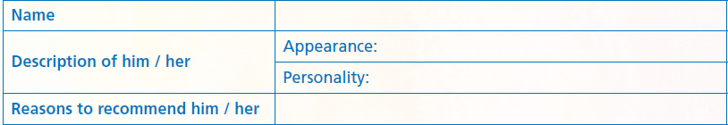
Activity 2
Think of someone you want to recommend as “the most beautiful person you know”. Choose someone you know and complete the table.

Slide 5
Activity 3
Work in groups. Discuss who is “the most beautiful person you know” and agree on the best candidate. Use the information in Activity 2 to help you.

Slide 6
Activity 4
Prepare a short presentation. Consider the following：
1 the structure of your presentation
2 useful words, expressions and structures

Slide 7
Activity 5
Give your presentation and recommend your candidate to the class. Vote for the best presentation.

Slide 8
Reflection

Slide 9
Write a reflection after completing this unit. Consider the following:
1 What is your understanding of true beauty?
2 What text types have you learnt about? What are their features?
3 What words, expressions and structures have you learnt?
4 What improvement have you made in understanding different cultures?
5 What improvement have you made in using learning strategies and
exploring effective ways of learning?
6 What improvement have you made in analysing and solving problems?

Slide 10


