Slide 1

Unit 1 Face values Starting out
新标准《英语》高中选择性必修第三册

Slide 2

Activity 1 Watch the video and answer the questions.
1 How many kinds of Peking Opera masks are mentioned in the
video? What do they represent?
Six.
A red mask represents a hero with positive characteristics such as honesty and loyalty.
A black mask represents a bold but rough character, who is serious, fair and selfless.
A blue mask represents a character who is upright and brave in the face of challenges.
A yellow mask represents a fierce character.
A white mask represents a character who is disloyal, clever and aims to do harm.
Xiaohualian, a black and white mask painted on and round the actor’s nose, represents a character who is funny and entertaining, and who easily wins the audience’s affection.

Slide 3
Activity 1
2 Which Peking Opera mask most suits your personality? Why?

Slide 4
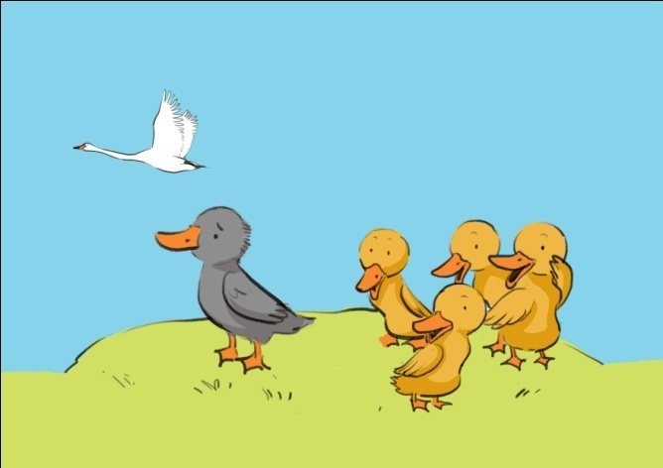
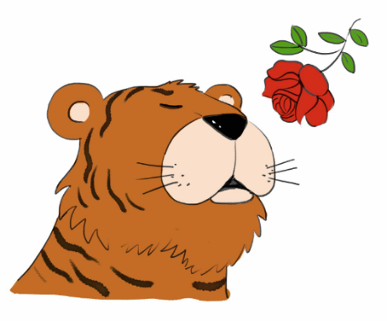
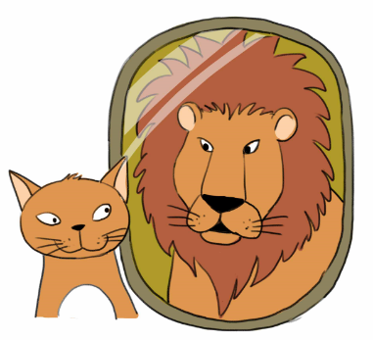
Activity 2 Look at the pictures and answer the questions.
1 What can you see in the three pictures?
In the first picture, there are four yellow ducklings standing together, one grey duckling standing alone and a swan flying in the sky.
In the second picture, there is a tiger who is smelling a red flower.
In the third picture, there is a cat who is looking in the mirror and imagining itself as a lion.

Slide 5
Activity 2
2 What does each of the pictures tell you about the characters?
In the first picture, the grey duckling may feel lonely and different, and unfairly left out by the other ducklings because of the way it looks. Perhaps it dreams of becoming a beautiful and graceful swan one day.
In the second picture, the tiger looks gentle, sweet and thoughtful, showing its delicate and vulnerable side.
In the third picture, even though the cat is small, it sees itself as being strong and powerful, like a lion.

Slide 6
Activity 2
3 What can you learn from the pictures?
Don’t judge someone by their appearance, but look beyond it to find their inner beauty.
It’s okay to show your vulnerable side sometimes.
Don’t let the way you look stop you from achieving your dreams and ambitions.

Slide 7


