Slide 1

Unit 2 A life’s work
Developing ideas
新标准《英语》高中选择性必修第三册

Slide 2

Activity 1 Watch the video and answer the questions.
1 Who was the Forbidden City built for?
2 When did it become home to the Palace Museum?
3 How many works of art are there in the Palace Museum?
4 What do you think makes the Palace Museum unique in the world?
1 The Forbidden City was built for emperors, their families and servants in the Ming and Qing dynasties.
2 It became home to the Palace Museum in 1925.
3 There are around 1.8 million works of art.

Slide 3
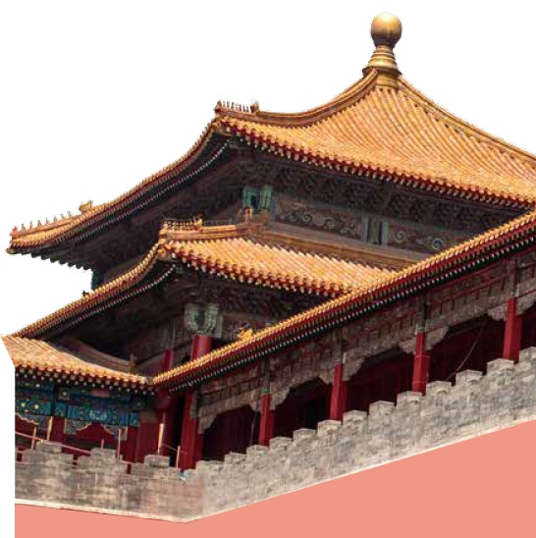
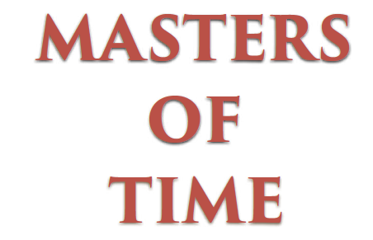
Activity 2 Look at the title and the pictures. Predict what the passage is about.
Now read the passage and check your prediction.

Slide 4
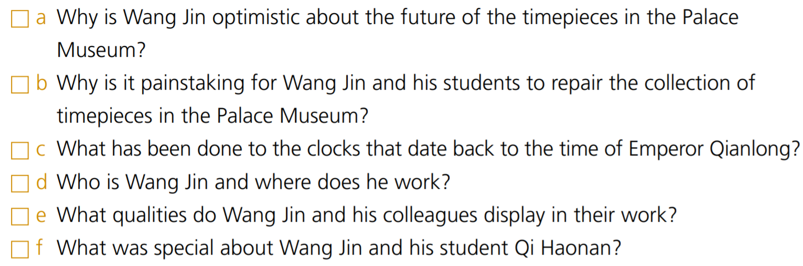
Activity 3 Match the questions to the paragraphs and find out the answers.
5
3
4
1
2

Slide 5
Activity 3
a (Para 5) Because he has passed on his skills to a new generation of artisans, who will not only help preserve traditional skills but also bring innovation to the art of clock repairing so that it stands the test of time.
b (Para 3) Because repairing such a large and important collection of timepieces involves complex work, unique methods of restoration and sourcing difficult-to-find materials, which take a lot of time, care and attention to detail.
c (Para 4) Wang Jin has spent eight months adjusting the gigantic clock, which is about to be wound up and brought back to life.
d (Para 1) He is a clock restoration master, working in Xi San Suo in the Forbidden City.
e (Para 6) They display qualities of skill, patience, modesty and devotion in their work.
f (Para 2) They used to be the only two timepiece restorers in the Palace Museum.

Slide 6
Think & Share
1 What is your understanding of the title, “Master of Time”? What figure of speech does the author use?
2 What is your understanding of the sentence, “This is a race against time that can never be won”? Do you agree with this? Give your reasons.
3 What do Bill Cunningham and Wang Jin in the two reading passages in this unit have in common?
4 What can you do to help to pass on traditional skills and the spirit of craftsmanship?
3 They are both devoted, motivated, passionate and skilled masters in their fields of work.

Slide 7
Activity 4 Work in groups. Give a speech about the spirit of craftsmanship in the Palace Museum.
1 Think about other masters in the Palace Museum. Then discuss the
questions within your group to prepare for your speech. Do further research if
necessary.
Who are the masters?
What fields do they work in?
What specific examples can you give of their work?
What aspects of the spirit of craftsmanship are demonstrated through their work?
How can you develop and display such spirit in daily life?

Slide 8
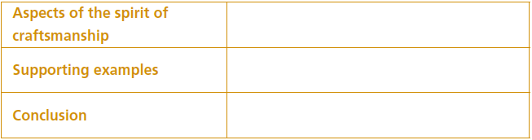
Activity 4
2 Organise your speech by completing the table.

Slide 9
Activity 4 Give your speech to the class.
Now think about your performance in the speech. Vote for the most convincing speech and ask the speaker to share some public speaking skills.

Slide 10
Writing an expository essay

Slide 11
Activity 5 Read the passage and answer the questions.
1 What is the passage about?
2 What qualities of the Lei family are mentioned?
Find examples in the passage to support your answers.
3 What is the conclusion of the passage?
1 The passage is about the Lei family, who for seven generations were behind the marvels of imperial architecture.
2 The qualities mentioned are those of skill, innovation, diligence and humility. This is evident in their buildings surviving for hundreds of years, in their use of a pioneering grid system to plan their projects, in each generation’s conscientious learning of their craft and undertaking ambitious projects, and in their works being more associated with the imperial court than with them.
3 Although the names of those who created these remarkable works may not be known by future generations, their spirit of craftsmanship is everlasting.

Slide 12
Activity 6
Choose one person who demonstrates the spirit of craftsmanship and complete the notes. Do further research if necessary.
Person: ________________________________
Qualities: ______________________________
Examples: ______________________________
Conclusion: _____________________________
Now write an expository essay.

Slide 13
Activity 6
Now write an expository essay.
参考范文：
The vividly coloured, finely shaped figurines of “Clay Figure Zhang” have been seeing a surge in popularity as an authentic and valuable traditional craft.
The nearly 200-year history of “Clay Figure Zhang” began with Zhang Mingshan, who became known for his ability to breathe life and beauty into these painted clay figurines. Born into a poor family, Zhang Mingshan made them as a means of earning a living. He often visited markets where he observed people of all walks of life, and went to theatres to observe those performing on stage. Day in, day out, he used tonnes of clay to mould what he saw, and sometimes added decorative items or new features to the figurines. So vivid and lifelike were they that they attracted crowds of spectators to the stand from which he sold them.
Fortunately, Zhang Mingshan’s craftsmanship has been passed down through his descendents, with these distinctive clay figurines now being crafted by the sixth generation of “Clay Figure Zhang”.

Slide 14
Activity 7
Work in pairs. Make improvements to each other’s essays and share them with the class. Consider how well you have understood how to write expository essays.

Slide 15


