Slide 1

Unit 2 A life’s work Presenting ideas & Reflection
新标准《英语》高中选择性必修第三册

Slide 2
Presenting ideas

Slide 3
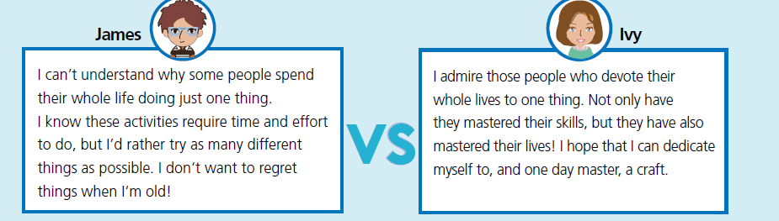
Activity 1 Read the two points of view and answer the questions.
1 What is James trying to express?
2 What is Ivy trying to express?
3 Which person do you agree with?

Slide 4
Activity 2
Work in groups and take sides. Think of arguments to support your point of view and make notes.
Point of view: ________________________________________
Arguments: __________________________________________
Supporting examples: __________________________________

Slide 5
Activity 3 Prepare for a debate. Consider the following:
1 the roles and responsibilities for each member of your group
2 your arguments, opening and summary
3 the opposing arguments you might face and how you can respond to them
4 useful words, expressions and structures

Slide 6
Activity 4
Team up with a group with the opposite point of view and hold a debate.

Slide 7
Reflection

Slide 8
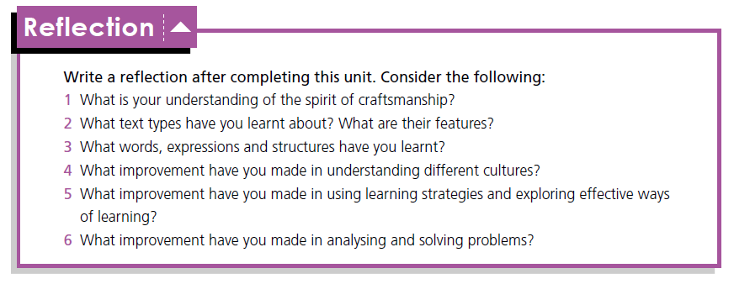

Slide 9


