Slide 1

Unit 2 A life’s work Project
新标准《英语》高中选择性必修第三册

Slide 2
Creating a directory of traditional crafts
Traditional crafts are dying out, being replaced by newer, faster and cheaper technical methods. And yet, some people still love the old ways, seeing them as requiring more skill, resulting in more beauty, and being somehow, more human. In preserving traditional crafts, we are also passing on our history and culture.

Slide 3
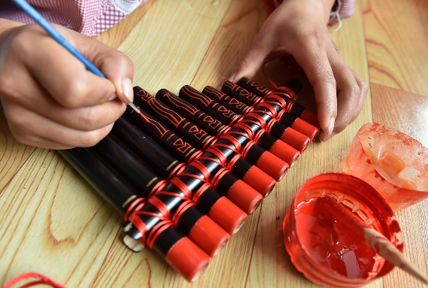
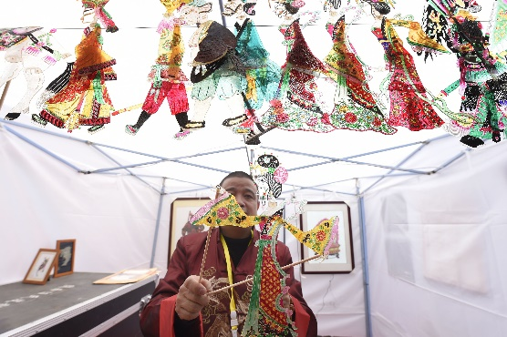
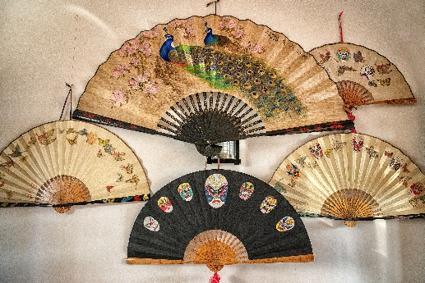
Investigate
Do research online and visit museums, galleries and workshops. Try to interview craftworkers to find out about traditional crafts in your area.

Slide 4
Plan
1 Work in groups. Talk about your findings.
2 Choose one of these crafts for your group to include in the directory.

Slide 5
Create
1 Write a directory entry for your chosen craft. You may include：
• the origin and history of the craft
• how it has developed over time
• where and how it is practised today
• its cultural significance
• who the representative craftworkers are and how they learnt their art
• how the craft demonstrates the spirit of craftsmanship
• the future of the craft
2 Gather any visuals you wish to include.

Slide 6
Present
1 Present your directory entry to the class. Respond to feedback and do further research into the craft if necessary.
2 As a class, collect all the entries to create the directory. Make both print and digital versions of the directory.
3 Give the print version to the school library and upload the digital version online to promote local traditional crafts.

Slide 7
