Slide 1

Unit 2 A life’s work
Starting out
新标准《英语》高中选择性必修第三册

Slide 2

Activity 1
1 How did Cook Ding compare himself to other cooks?
2 What lesson did Lord Wenhui learn from Cook Ding?
1 Cook Ding compared himself to other cooks by comparing how often they had to change their knives.
2 Lord Wenhui learnt that it is important to study the principles of doing things, and to have perseverance, concentration, wisdom and devotion to one’s craft.

Slide 3
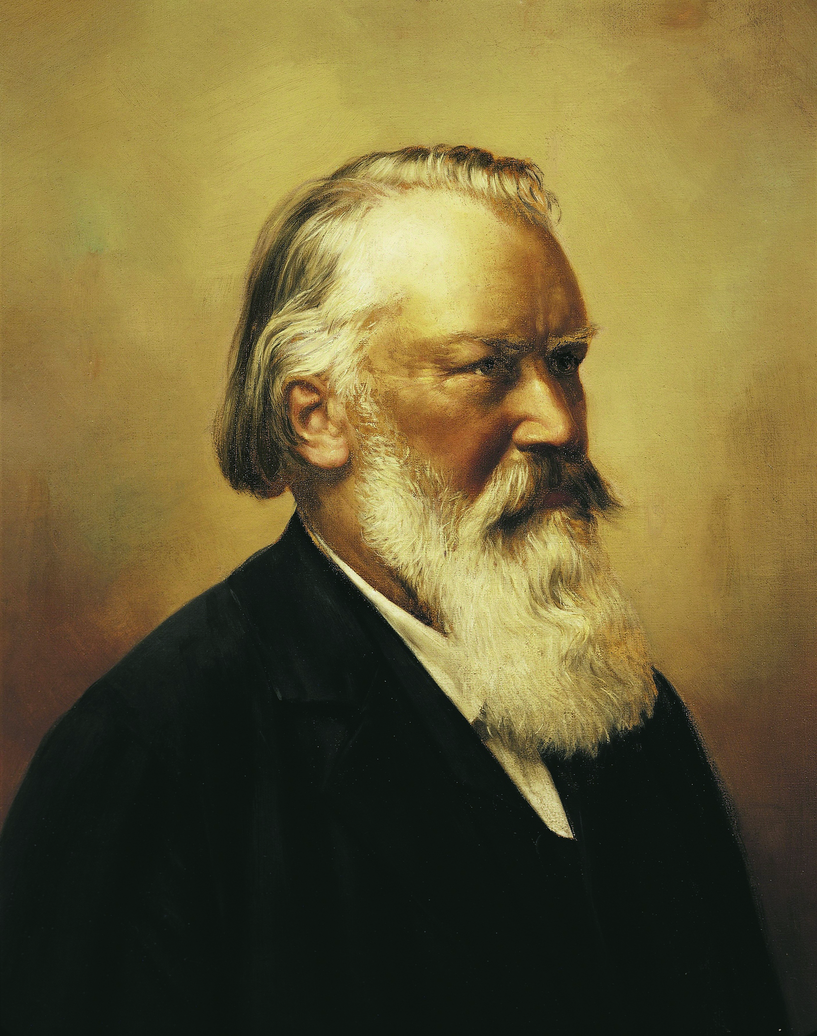
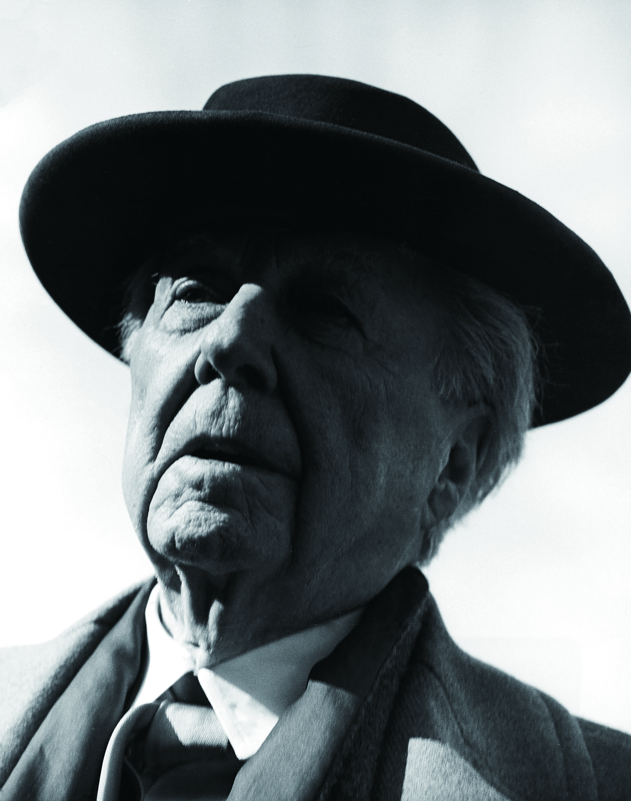
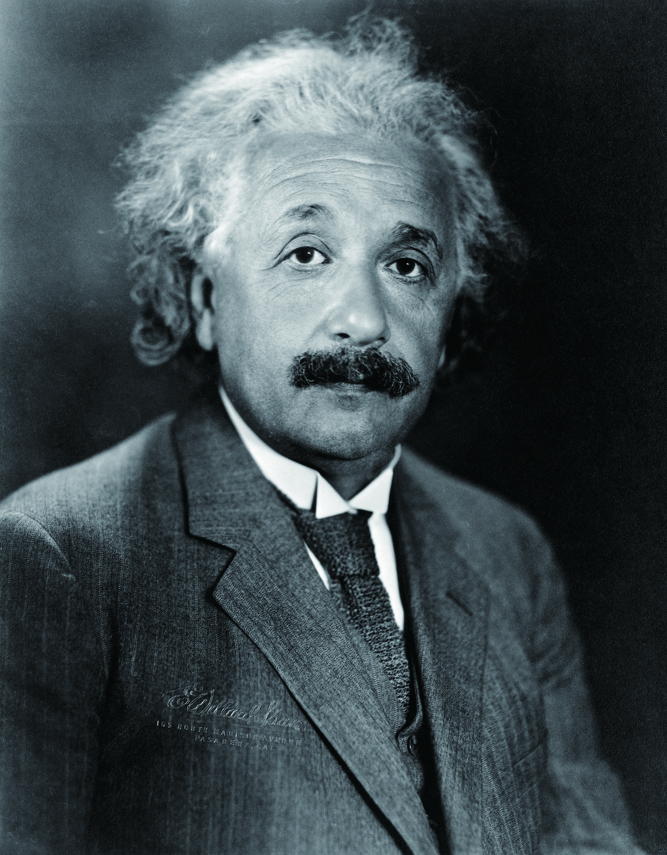
Activity 2
1 What is your understanding of these
quotes? Pay special attention to “the
price of success”, “stay with
problems longer” and “a mere reed
shaken in the wind”.
2 What qualities does each of these
quotes convey?
3 Which of these quotes is the most
meaningful to you? Give your reasons.
2 The quote by Albert Einstein conveys the quality
of perseverance. The quote by Frank Lloyd Wright conveys the quality of commitment. The quote by Johannes Brahms conveys the qualities of skill and aptitude.

Slide 4
