Slide 1

Unit 2 A Life’s work
Understanding ideas
新标准《英语》高中选择性必修第三册

Slide 2
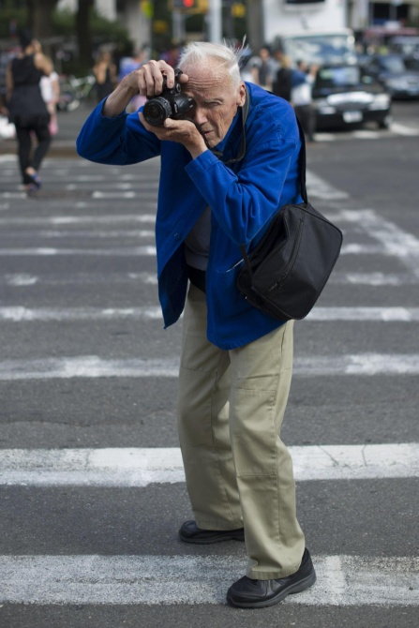

Activity 1
Look at the photos and answer the questions.
1 What differences are there between
these two photographers?
2 What do you think they each want to
show through their works?
3 What does the first picture tell you about
the photographer?
1 The photographer in the first picture is working on the street with a single, easy-to-carry camera. The photographer in the second picture is working in a studio with expensive, technologically advanced equipment.
3 The first picture tells us about the photographer’s approach to his work and his interest in people’s day-to-day lives.
Now read the passage and check your answers.

Slide 3
Activity 2
Choose another suitable title for the passage and give your reasons.
1 Social Butterfly
2 Art and Devotion
3 Follower of Fashion
4 A Life in Photographs

Slide 4
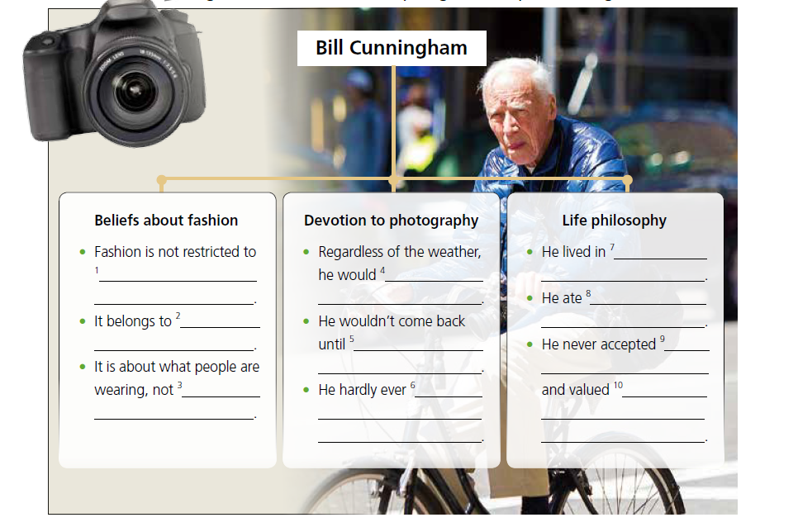
Activity 3
1 high society and big brands
2 the people
3 who they are
4 go out onto the streets of New York
5 he knew he had the right photos
6 took a day off and not once stayed home sick
7 a small apartment with a shared
washroom
8 the same meal of sausages, eggs and coffee
9 the benefits offered to him for being a fashion photographer
10 his integrity and would not be bought by anyone
Now come up with five words or expressions to describe Bill Cunningham. Give your reasons.

Slide 5
Think & Share
1 What is your understanding of Bill Cunningham's words “Money's the cheapest thing”?
2 Why is Bill Cunningham called a “cultural anthropologist”?
3 What can you learn from Bill Cunningham? Share your thoughts with the class.
4 What text types have you learnt about to help you describe people? If you were to write about Bill Cunningham, which would you choose?
2 Bill Cunningham is called a “cultural anthropologist” because his photography captured and created an everlasting record of the life of New York and its people over half a century.

Slide 6


