Slide 1

Unit 2 A life’s work
Using language
新标准《英语》高中选择性必修第三册

Slide 2
Predicative clauses

Slide 3
Activity 1
Look at the sentences from the reading passage and answer the questions.
a This is what makes them so special.
b A simple restaurant was where he usually had the same meal of
sausages, eggs and coffee.
1 What form does the predicative take in sentences (a) and (b)?
2 Why is “what” used in sentence (a) and “where” used in sentence (b)?
3 What other words do you know that can lead a predicative clause?
1 The predicative in sentences (a) and (b) takes the form of a clause.
2 “What” is used in sentence (a) because it acts as the subject of “makes” in the predicative clause. “Where” is used in sentence (b) because it acts as the adverbial in the predicative clause.
3 Other words are who, when, how, why, etc.

Slide 4
Activity 1
Now look for more sentences with predicative clauses in the reading passage, and summarise their uses in your own words.

Slide 5

Activity 2
Listen to the story of Ruth Bancroft and complete the sentences with predicative clauses. Listen again if necessary.
1 One reason why the garden is unique is_______
_______________________________________.
2 Another reason for its uniqueness is__________
_______________________________________.
3 The drought-resistant plants with thick, fleshy
leaves became ___________________________.
4 Although Walnut Creek was not
_______________________________________.
5 It seemed _______________________________
_______________________________________.
6 Those five-star reviews prove________________
________________________________________.
1 that it comprises an array of plants adapted to dry conditions
2 that it is the life’s work of only one woman: Ruth Bancroft
3 what she was most interested in
4 where they grew naturally
5 as though nothing would ever stop her from continuing this work
6 how much visitors admire her garden

Slide 6
Activity 3
Rewrite the underlined sentences using predicative clauses.
The age of eight was when he started training in Peking Opera on a daily basis.
Watching the pigeons as they flew every day was how he developed the expressive eye movements that were so crucial to his art. His hard work and dedication were what made him a leading artist in Peking Opera. His innovations in make-up and costume design, which allowed for more vivid depictions of female characters, were what contributed greatly to the development of Peking Opera.
This lifelong devotion was what has made him one of the most celebrated Peking Opera artists of all time.

Slide 7
Activity 4
Think of another artist and write about their devotion to their art.
Use predicative clauses where appropriate.

Slide 8
The spirit of craftsmanship

Slide 9
Activity 5
Listen to the radio programme and choose its purpose.
1 To introduce famous traditional crafts to the audience.
2 To raise the audience's awareness of preserving traditional crafts.
3 To replace traditional crafts with modern technology.
4 To tell the stories of some famous craftworkers.

Slide 10
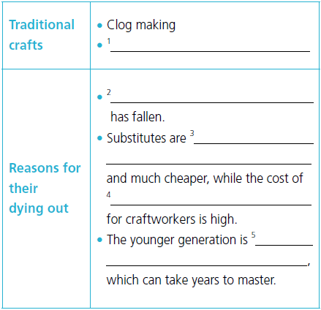
Activity 6
Listen again and complete the table.
1 Basket making with oak
2 The demand for these crafts
3 mass-produced with modern technology
4 the materials involved
5 not interested in learning traditional skills

Slide 11
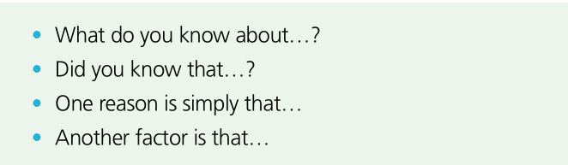

Activity 7
Complete the boxes with the expressions from the radio programme.
One reason is simply
that…
Another factor is that…
What do you know about…?
Did you know that…?

Slide 12
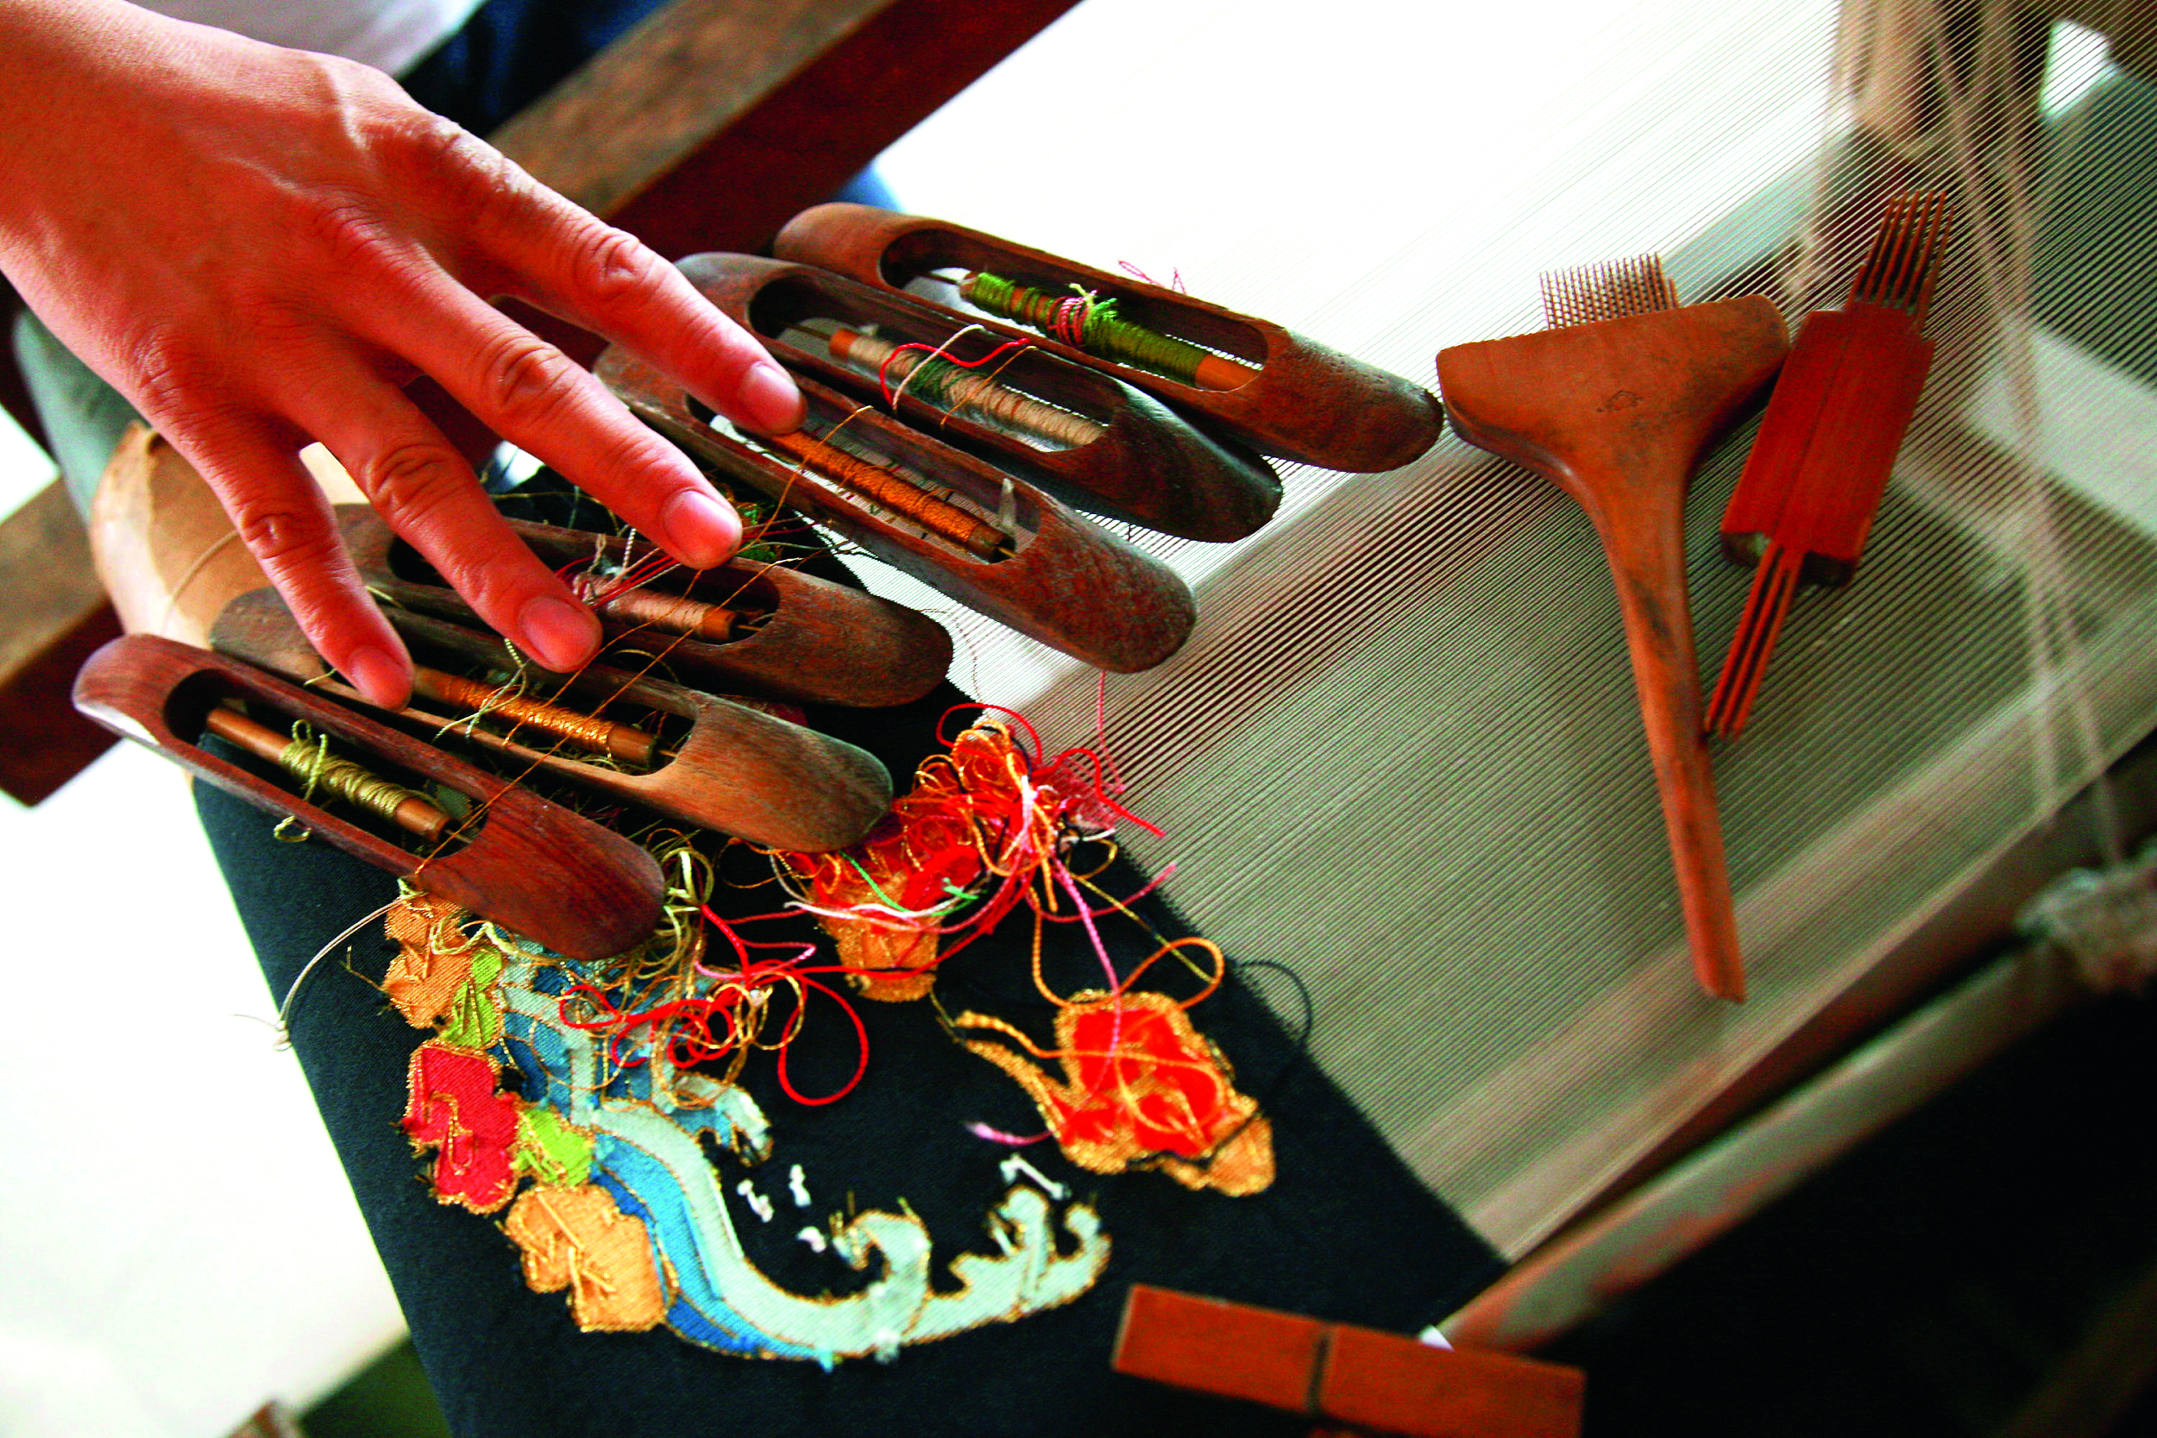
Activity 8
Read the passage and answer the questions.
1 What is currently happening to traditional crafts?
2 Why are people starting to engage more with traditional crafts?
1 Traditional crafts have recently undergone a renaissance.
2 People are starting to engage more with traditional crafts because there is greater public interest in old stories and traditions, as well as a desire for high-quality products. Furthermore, craftsmanship reflects people’s desire for skilled and socially useful work.

Slide 13
Activity 9 Read the passage and answer the questions. Pay attention to the words and expressions in bold.
1 What were the 23 scientists honoured for?
2 What challenges did they meet? How did they overcome them?
1 They were honoured for their extraordinary contributions to the “two bombs, one satellite” project.
2 They endured extreme conditions and being apart from their families for years.
To overcome these challenges, they focused on their responsibilities and dedicated much of their lives to their work.

Slide 14
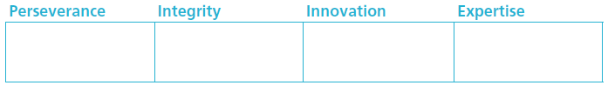
Activity 10
Put the expressions that show different qualities in Activity 9 into the boxes. Add any more you can think of.
refuse to back down
kept on
with great resolution
dedicate much of their lives to
sought no fame
shunned the spotlight
thought outside the box
broke new ground
leading to the breakthrough of
was experienced in
highly accomplished
his crack hand at
won him acclaim

Slide 15
Activity 11
Work in pairs. Talk about other people who show the spirit of craftsmanship using the words and expressions in this section.
Do further research if necessary.
Now comment on each other’s performances in using the words and expressions in this section.

Slide 16


