Slide 1

Unit 3 War and peace Presenting ideas & Reflection
新标准《英语》高中选择性必修第三册

Slide 2
Presenting ideas

Slide 3
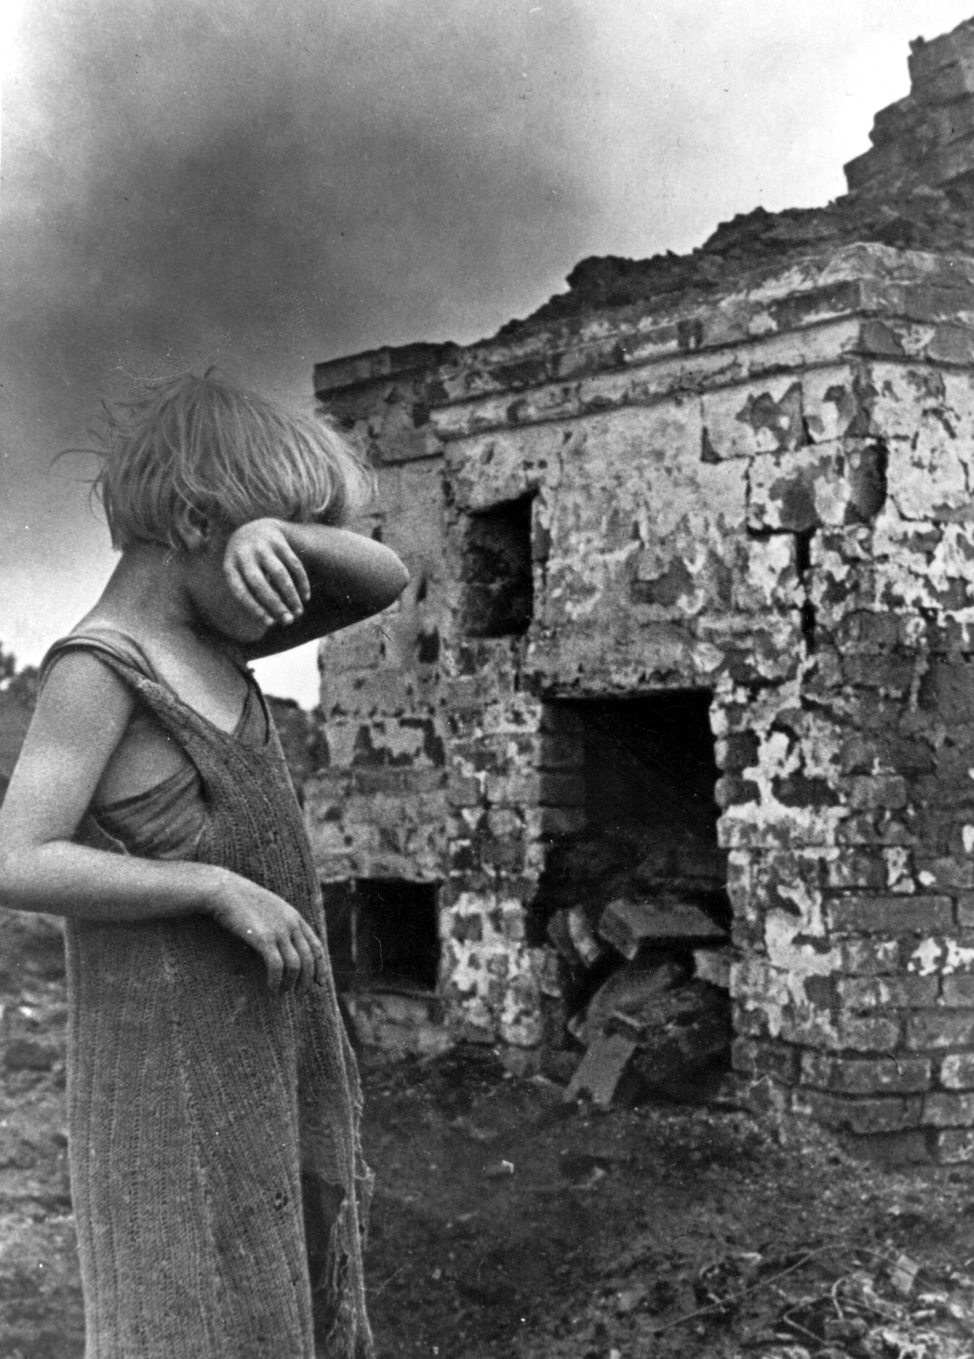
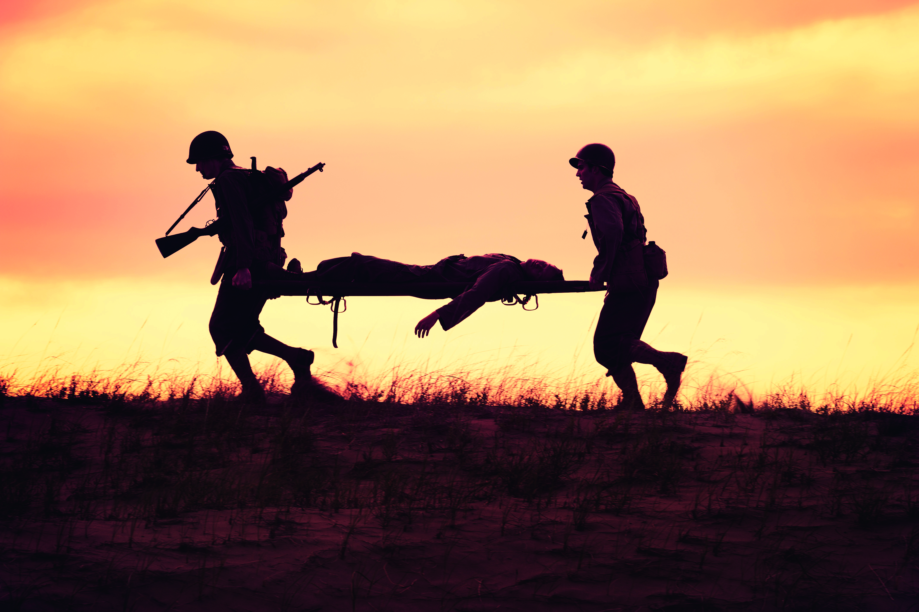
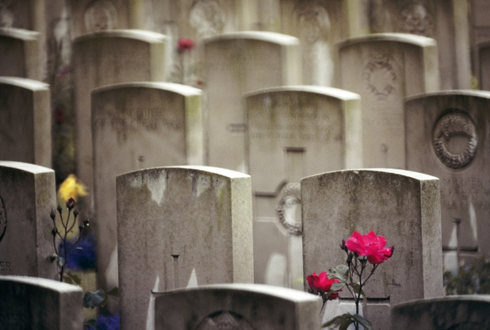
Activity 1
Work in groups. Look at the pictures and answer the questions.
1 What can you see in each picture?
2 What do the pictures tell you about war?
1 In picture one, a distressed child is crying in front of a destroyed building.
In picture two, a dead or injured soldier is carried away by his comrades.
In picture three, there are many graves of the dead.

Slide 4
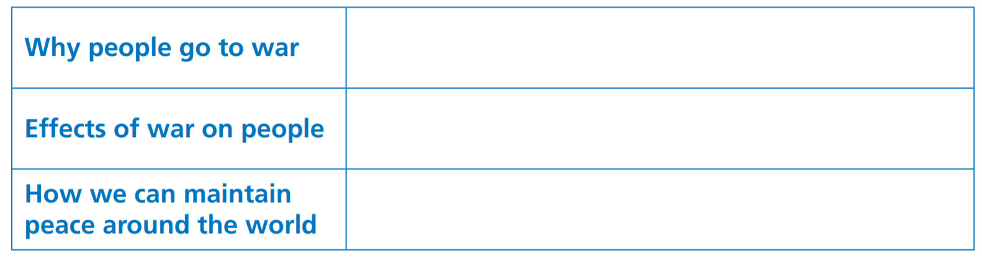
Activity 2
Think about the topics and complete the table. Add examples or details to support your points. Do more research if necessary.

Slide 5
Activity 3
Prepare a short presentation on one of the topics from Activity 2 or think of another relevant topic. Consider the following:
1 the structure of your presentation
2 useful words, expressions and structures

Slide 6
Activity 4
Give your presentation to the class.

Slide 7
Reflection

Slide 8
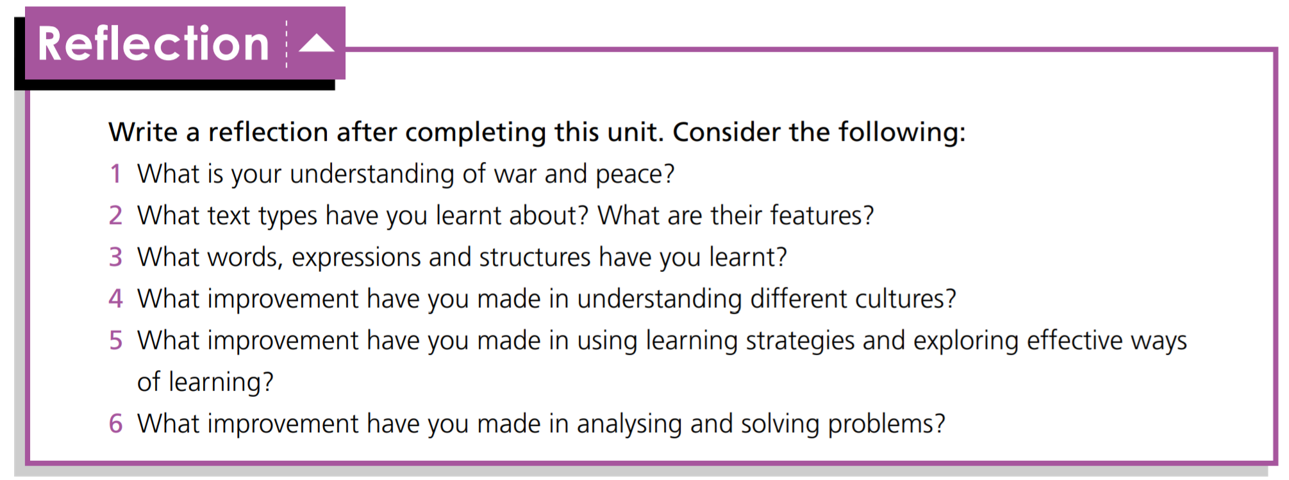

Slide 9


