Slide 1

Unit 3 War and peace Understanding ideas
新标准《英语》高中选择性必修第三册

Slide 2
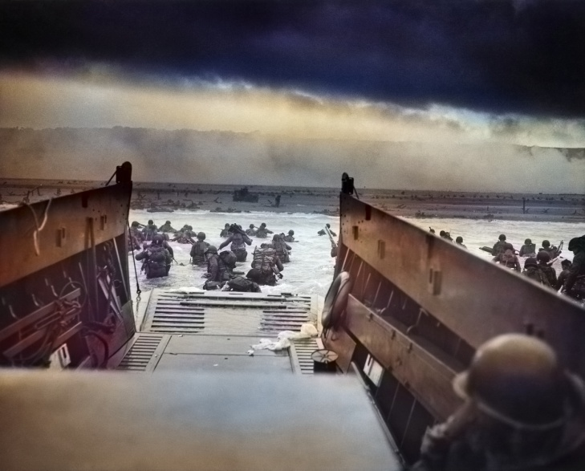
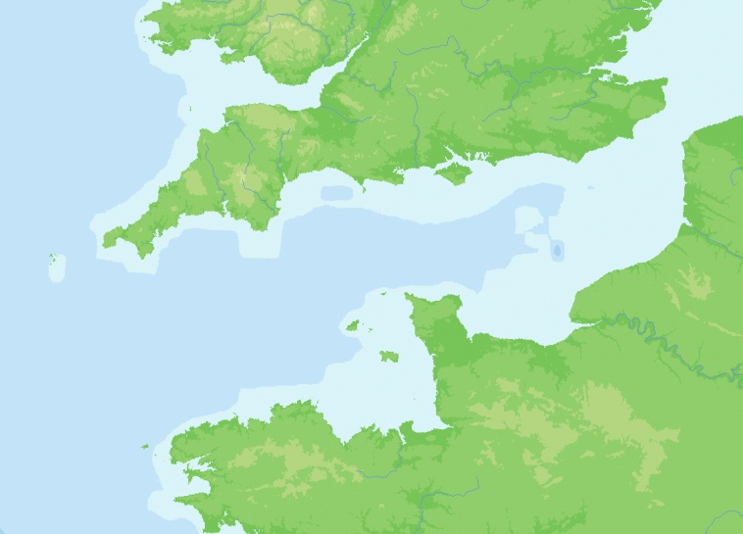
Activity 1
Look at the picture and the map and answer
the questions.
1 What do you think the picture and the map show?
2 What do you expect to read about in the passage?
Share your ideas with the class.
Now read the passage and check your prediction.

Slide 3
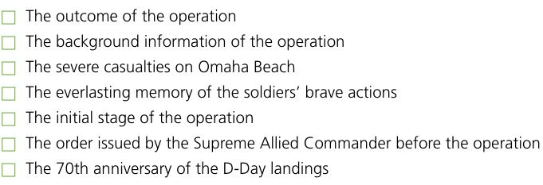
Activity 2
Match the main ideas to the paragraphs and give your reasons.
5
1
4
7
3
2
6

Slide 4
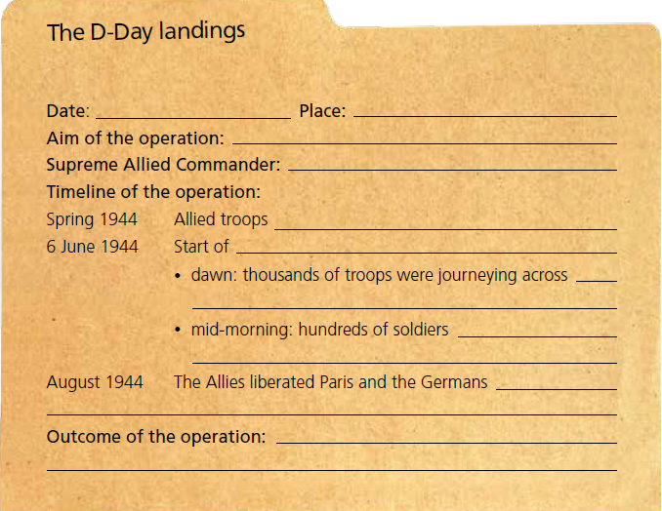
Activity 3 Organise information from the passage and complete the fact file.
6 June, 1944
the Normandy beaches
to reach the Normandy beaches along about 80 kilometers of French coastline
General Eisenhower
gathered in large numbers
the Normandy landings (Operation Overlord)
the English Channel to Normandy
lay dead in the water and amongst the tanks on the beach
were removed from north-west France
despite the high cost in human life, the D-Day landings
were a success and were seen widely as the beginning of the end of the Second World War.

Slide 5
Think & Share
1 What is the historical significance of the D-Day landings?
2 What is your understanding of the poem For the Fallen?
3 How can you use the language you have learnt to describe another event during the Second World War? Share your ideas with the class.
1 The D-Day landings were the largest combined sea, air and land operation in history. The operation was seen widely as the beginning of the end of the Second World War.

Slide 6


