Slide 1

Unit 3 War and peace Using language
新标准《英语》高中选择性必修第三册

Slide 2
Subject-verb agreement (1)

Slide 3
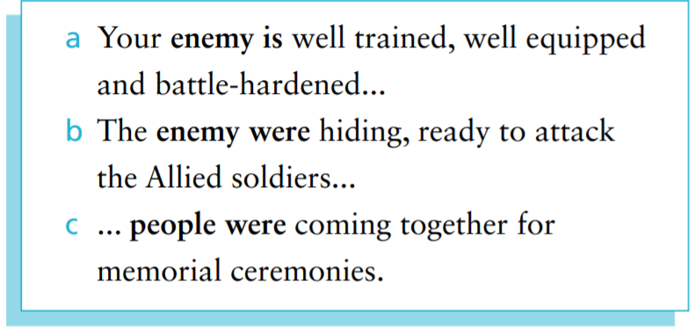
Activity 1 Look at the sentences from the reading passage and answer the questions.

Slide 4
Activity 1 1 In which sentence does the word“enemy”refer to different members? Is it followed by a singular verb or plural verb? 2 In which sentence does the word“enemy”refer to a single unit? Is it followed by a singular verb or plural verb? Do you know any other similar nouns? 3 Is the word“people”usually followed by a singular verb or plural verb? Do you know any other similar nouns?
1 In sentence (b), the word “enemy” refers to different members. It is followed by a
plural verb.
2 In sentence (a), the word “enemy” refers to a single unit. It is followed by a singular verb.
Other similar nouns are family, team, class, crowd, government, etc.
3 The word “people” is usually followed by a plural verb. Other similar nouns are police,
cattle, etc.

Slide 5
Activity 1
Now look for more sentences following this rule in the reading passage, and summarise the use of subject-verb agreement in your own words.

Slide 6
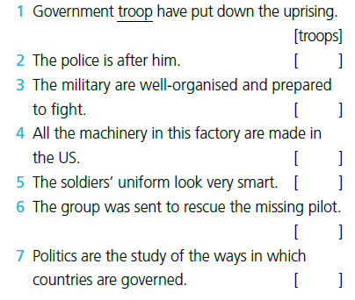
Activity 2
are
√
is
uniforms
√
is

Slide 7
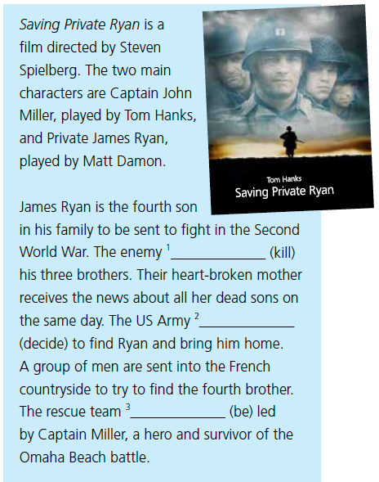
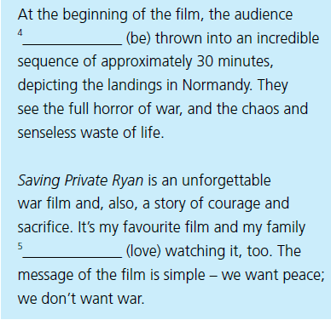
Activity 3
are
kills
decides
love
is

Slide 8
Activity 4
Write a short review of a film you have seen on the theme of war.
Pay attention to subject-verb agreement.

Slide 9
The road to peace

Slide 10

Activity 5
Listen to the interview and answer the questions.
1 Who is being interviewed?
2 What is the relationship between the two interviewees?
3 What are they talking about?
1 Gao Li and Gao Ming.
2 Brother and sister.
3 They are talking about the five-year terror bombing campaign by Japanese forces in Chongqing during the War of Resistance against Japanese Aggression.

Slide 11
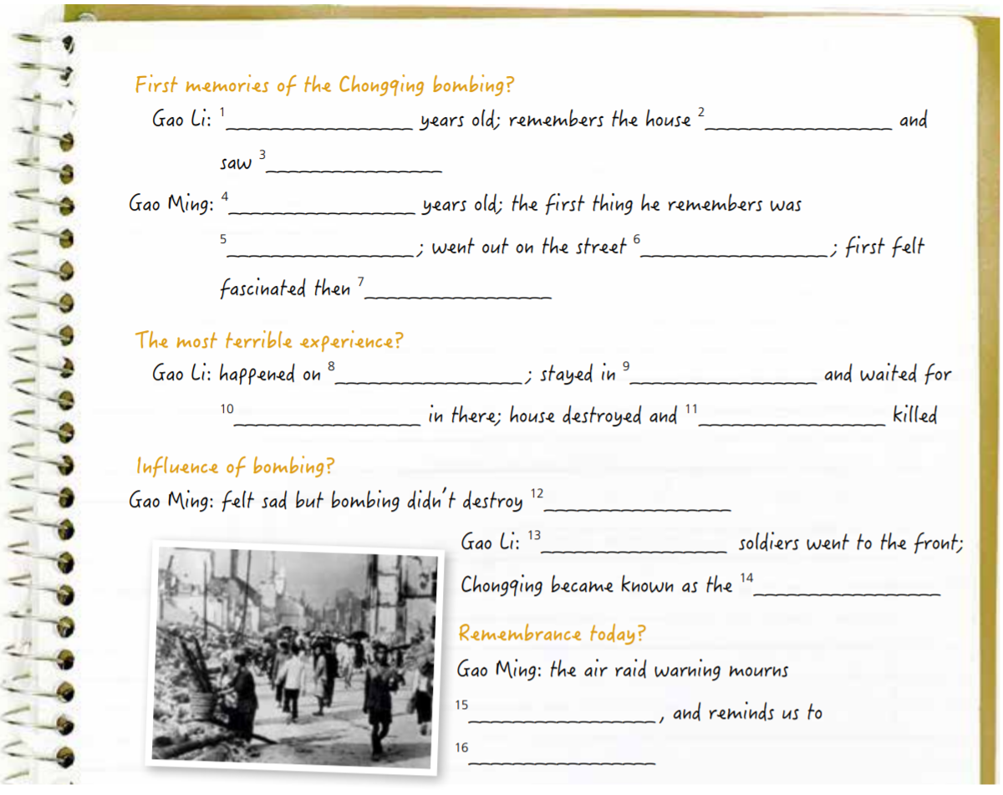
Activity 6 Listen again and complete the interview’s notes.
1 eight / 8
2 shook
3 fires in the distance
4 eleven / 11
5 the bombing planes
6 to watch
7 scared
8 5 June 1941
9 the basement
10 five hours
11 people
12 our fighting spirit
13 around 960,000 of the city’s
14 “city of heroes”
15 those we lost
16 cherish the peace we enjoy today

Slide 12
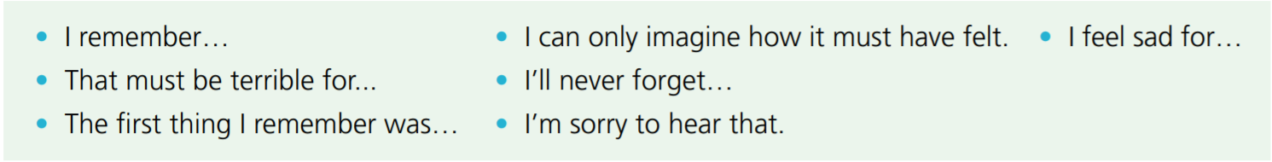
Activity 7
Complete the boxes with the expressions from the interview.
Expressing sympathy Talking about memories
That must be terrible for… I can only imagine how it must have felt. I’m sorry to hear that. I feel sad for… | I remember… The first thing I remember was… I’ll never forget…

Slide 13
Activity 8 Read the introduction to UN peacekeeping and answer the questions. Pay attention to the words and expressions in bold.
1 What is the significance of UN peacekeeping missions?
2 What role is China playing in UN peacekeeping?
1 UN peacekeeping missions aim to give stability to conflict zones and allow governments to reestablish authority.
2 China is playing an increasingly important role in UN peacekeeping and it has trained 8,000 troops who are kept on standby for UN missions.

Slide 14
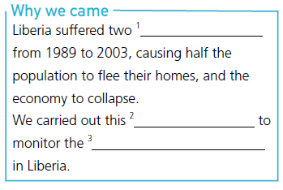
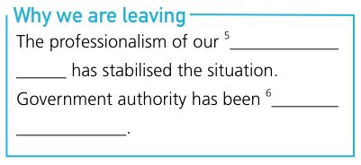
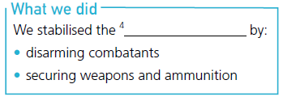
Activity 9 Complete the fact file about UN’s peacekeeping mission in Liberia with the correct form of the words and expressions in Activity 8.
1 civil wars 2 peacekeeping mission
3 peace process 4 conflict zones
5 peacekeeping forces 6 reestablished

Slide 15
Activity 10 Work in pairs. Find out about someone’ s experiences in war. Act out an interview based on the information you have found. Use the words and expressions in this section.
Now think about your performance in this activity. How did you collect useful information? Share your experience with the class.

Slide 16


