Slide 1

Unit 4 A glimpse of the future
Developing ideas
新标准《英语》高中选择性必修第三册

Slide 2

Activity 1
Watch the video and answer the questions.
1 How does Asimov set out the relationship between humans and robots?
He puts forward the Three Laws of Robotics, which ensure that robots should always obey and protect humans.
2 Have you read any of Asimov’s novels? If so, share one story you’ve read with the class. If not, would you like to read them? Why or why not?

Slide 3
Activity 2 Complete the table to compare life on Earth with life on the Moon.
Life on Earth
Wear ordinary clothes and change according to the seasons. Breathe the air freely. Have to make an effort to jump high. Keep pets, such as dogs, cats, etc.
Life on the Moon
_____________________________________________ _____________________________________________ _____________________________________________ _____________________________________________
Wear spacesuits whenever outside.
Breathe from an air supply.
Jump high easily.
Keep robots as pets.

Slide 4
Activity 2 Complete the table to compare life on Earth with life on the Moon.
Now read the passage and find out what life on the Moon is like in the novel.

Slide 5
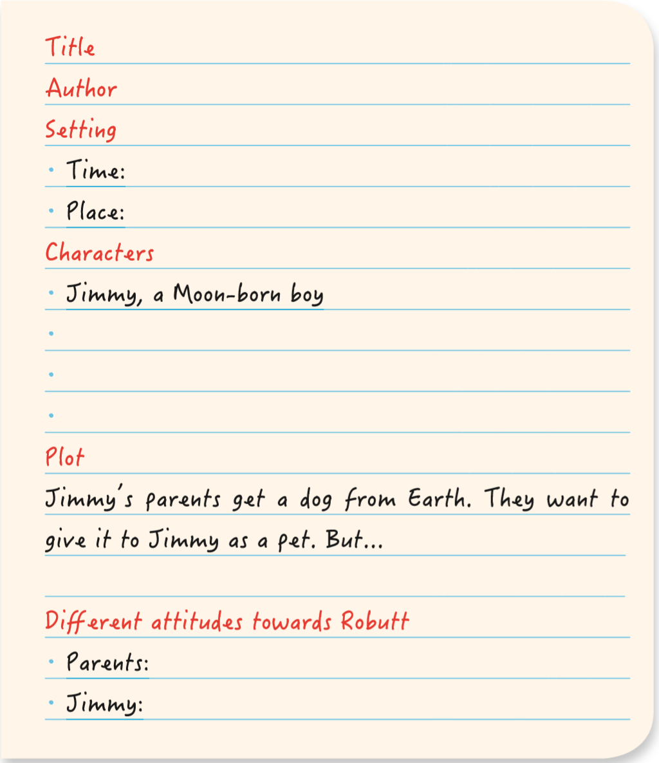
Activity 3 Complete the summary of the story.
A Boy’s Best Friend
Title
Author
Setting
Time:
Place:
Characters
Jimmy, a Moon-born boy
Isaac Asimov
In the future
On the Moon
Mr Anderson, Jimmy’s father
Mrs Anderson, Jimmy’s mother
Robutt, a mechanical dog, Jimmy’s pet

Slide 6
Activity 3 Complete the summary of the story.
Plot
Jimmy’s parents get a dog from Earth. They want to give it to Jimmy as a pet. But… Jimmy already has a robot pet named Robutt. His parents think it would be good for Jimmy to have a real dog, and that he would like it. They want to send Robutt to another family. To his parents’ surprise, Jimmy refuses to accept the real dog, because he loves Robutt and he believes Robutt loves him too. For Jimmy, Robutt is not just a mechanical dog, but a real friend.
Different attitudes towards Robutt
Parents:
Jimmy:
They think Robutt is a mechanical imitation of a real dog.
He loves Robutt and treats him like a real dog.

Slide 7
Think & Share
1 What are the similarities and differences between Robutt and a real dog?
Similarities:
Both are able to respond to orders given by human beings.
Both can outrace human beings.
Both can guide and protect human beings.
Differences: They have different appearances.
A real dog is a living creature, while Robutt is a machine.
A real dog loves human beings as a result of its nature, while Robutt is just adjusted to act as though it loves human beings.

Slide 8
Think & Share
2 Is there any foreshadowing of Jimmy’s final decision? Find clues in the reading passage.
3 What other sci-fi novels about robots can you think of? Share one with the class.
4 The two reading passages in this unit show us different aspects of technology in the future. Which of these do you most expect to encounter in your lifetime?
Yes, there is.
At the beginning of the story, we know Jimmy has never seen a real dog. It also seems that he spends a lot of time with Robutt. Jimmy plays with Robutt enthusiastically, shouting “Come on, Robutt”. In the middle of the passage, we are told that “Jimmy couldn’t go wrong while Robutt was around”, indicating that Robutt protects Jimmy well.

Slide 9
Activity 4 Work in groups. Give a talk on whether it is possible to have a real friendship with a robot.
1 Answer the questions to help to form your point of view.
• Why do Jimmy and his parents have different feelings towards Robutt?
• If you were Jimmy, which one would you choose, Robutt or a real dog?
Because Jimmy was born on the Moon, he has never seen a real dog. He has been getting along well with Robutt, and thus has developed an affection for him. He cannot figure out why a real dog is better than a mechanical dog, despite his father’s explanation. While Jimmy’s parents have seen real dogs before they left Earth. They know what real dogs look like. They think Robutt is just a machine.

Slide 10
Activity 4 Work in groups. Give a talk on whether it is possible to have a real friendship with a robot.
2 Organise the main points you would like to cover and complete the table.
Point of view
Arguments
Supporting details
Conclusion
3 Give your talk to the class.

Slide 11
Activity 4 Work in groups. Give a talk on whether it is possible to have a real friendship with a robot.
Now vote for the best speaker.
Ask them to share their experiences.

Slide 12
Continuing a sci-fi story

Slide 13
Activity 5 Read the story and answer the questions.
1 What happened to the prison and what was the cause?
There was a prison breakout, caused by faulty robotics.
2 What kind of job do you think Carolyn has?
She might be a prison governor.
3 Are there any sentences that might foreshadow what
will happen next? Underline them.

Slide 14
Activity 6 Think about what will happen next, based on the examples of foreshadowing you have underlined. Complete the notes to plan the rest of the story.
Setting
Time:________________________________
Place:________________________________
Characters_____________________________
______________________________________
Plot___________________________________
______________________________________
Ending__________________________________
_________________________________________
Now continue the story.

Slide 15
Activity 7 Share your story with the class.
Now make comments on your partner’s story and see whether the language style is consistent.

Slide 16
参考范文
Carolyn had a long commute to the prison, even by aircar. When she arrived, everything seemed normal, except for a robot lying at the front gate, motionless. It’s an old model, she thought. They broke down now and again. She passed through the gate, noting that everything else was apparently in order.
But just as she closed her office door behind her, a loud alarm sounded. Carolyn’s blood froze. She had only ever heard that sound during drills. It can’t be! she thought. A general systems failure! She looked out of the reinforced glass of her office window into the prison below. Sure enough, the robots were out of control. Most had stopped moving at all. Some spun aimlessly around and around. But others were randomly operating things, including the cell gates, and she could see prisoners rushing out to freedom. “Grab the robots’ weapons and run!” shouted the prisoners.

Slide 17
Carolyn opened her bag and reached for her emergency call device. Her heart sank as she realised she had left it at home. I need to call in the police, she thought. But how? Without the device, she couldn’t communicate. Nothing in the prison would work properly now.
There was a voice behind her. “Looking for one of these?”
Carolyn gasped. “Julius!” There was her secondin-command, holding an emergency caller in his hand. “What are you doing in my office?”
“It should be my office!” snarled Julius. “I’ve worked here for forty years… and the City Commissioners gave you the job as prison governor! But now you’ll pay. You’ll all pay! I can make every robot in every prison in the city go crazy. The prisoners will escape, and the city will burn!”
Then the door burst open, and the room was suddenly flooded with riot police. And there was… Todd!

Slide 18
“I took the aircar over here to bring you this,” he said quietly, winking as he pushed the emergency call device secretly into her hands. “I could see there was trouble, so I activated it to call in the police.”
“It was Julius,” said Carolyn, watching the police bundle Julius out of the door. “He’s gone mad.”
“Sure,” said Todd. “But now we know how easy it is to cause a mass robot breakdown. You’ll have to write a report. Make some recommendations to upgrade the robots.”
“I know.” Carolyn slid from Todd’s hug and walked towards the door. She could see the police rounding up the prisoners. “But right now, I’ve got a prison to run.”

Slide 19


