Slide 1

Unit 4 A glimpse of the future Presenting ideas & Reflection
新标准《英语》高中选择性必修第三册

Slide 2
Presenting ideas

Slide 3
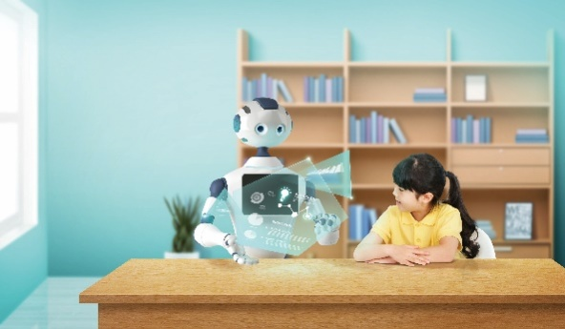
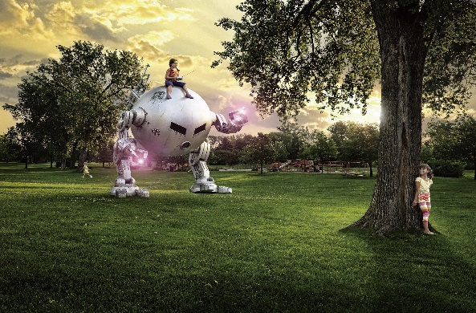
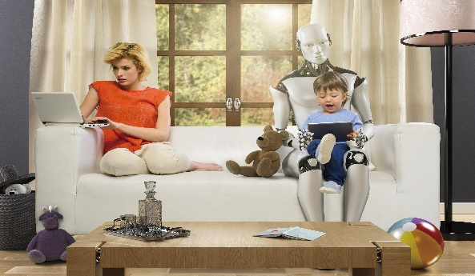
Activity 1 Look at the pictures about the future and answer the questions.
1 What are the people doing in each picture?
Picture 1 The robot is displaying some information to a girl. Perhaps the girl is being taught by the robot.
Picture 2 A girl is sitting on the robot. She looks like she is controlling the robot with a device. She seems to be playing.
Picture 3 The robot is helping a mother look after her child.
2 Imagine and describe their daily lives. Would you like to live like this?

Slide 4
Activity 2
Work in groups. Discuss how other daily activities might be different in the future and complete the table.
Activities | Descriptions
Studying
Eating
Socialising
Having fun
…

Slide 5
Activity 3
Design your own ideal day in the future. Consider the following:
1 Is it a workday or weekend? What activities will you do?
2 Who do you want to spend the day with?
3 In what ways is it different to your present daily life?

Slide 6
Activity 4
Share your ideal day in the future with the class.

Slide 7
Reflection

Slide 8
Write a reflection after completing this unit. Consider the following:
1 What is your understanding of life in the future?
2 What text types have you learnt about? What are their features?
3 What words, expressions and structures have you learnt?
4 What improvement have you made in understanding different cultures?
5 What improvement have you made in using learning strategies and exploring effective ways of learning?
6 What improvement have you made in analysing and solving problems?

Slide 9


