Slide 1

Unit 4 A glimpse of the future Project
新标准《英语》高中选择性必修第三册

Slide 2
Making a poster about a city of the future
What will the cities of the future look like? With advances in science and technology, cities are developing fast. At the same time, we are also facing challenges, such as booming populations and climate change. How can we design cities that will support ever-increasing populations? And how can we make those cities pleasant places to live in?

Slide 3
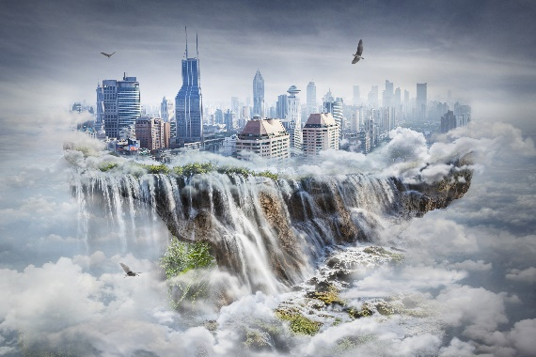
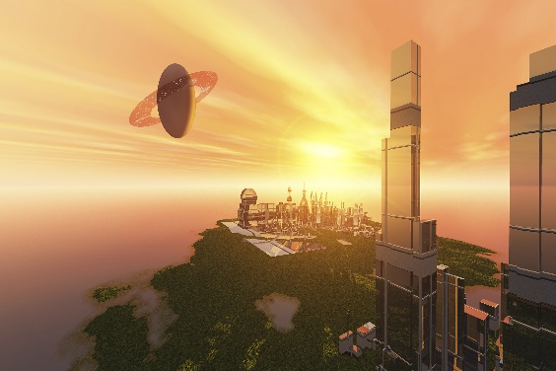

Investigate
1 Do research online or in the library to find out about the key features of a city, including its location, size, industry, transport, etc.
2 Think about the problems cities today are facing.
3 Find depictions of future cities in science fiction novels, films and other materials. What is special about them? Do any of them propose solutions to the problems we are facing today?

Slide 4
Plan
1 Work in groups. Share your research.
2 Decide what kind of city of the future you would like to design. Consider the following:
• Where is your city located, on land, in the air, under the sea or in space?
• How large is your city? What is the population?
• Where and how do its citizens live?
• How do they travel from place to place?
• How are its citizens educated and what other facilities do they need?
• How do the citizens of your future city relax?

Slide 5
Make a poster introducing your city of the future. You may include: • a map of the city • pictures to illustrate certain features • short paragraphs to explain your design
Create

Slide 6
Present
1 Present your poster to the class and describe your city.
2 Develop your poster into a webpage and upload it to the Internet.

Slide 7


