Slide 1

Unit 4 A glimpse of the future
Starting out
新标准《英语》高中选择性必修第三册

Slide 2

Activity 1
Watch the video and answer the questions.
1 What predictions about the future were made? Were they correct?
Correct predictions: flying machines, organ transplantation, “perpetual light”, the atom bomb, space stations would broadcast television signals all over the globe
Incorrect predictions: a world market for maybe five computers, nuclear-powered vacuum cleaners
2 What is your understanding of “the future has unlimited possibilities” ?

Slide 3
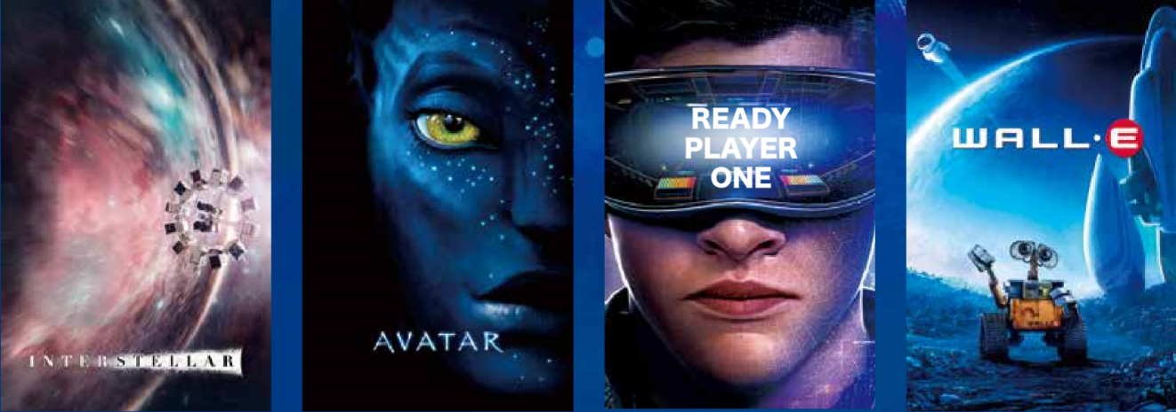
Activity 2 Look at the pictures and answer the questions.
  1 Have you watched any of these films? What stories do they tell about the future of our world?
  2 Do you think the events in these films could come true?
  What do you think the world will be like in the future?

Slide 4


