Slide 1

Unit 4 A glimpse of the future
Understanding ideas
新标准《英语》高中选择性必修第三册

Slide 2
Activity 1
Read the facts about AI and answer the questions.
Milestones in Artificial Intelligence (AI)
1 What can you learn from the timeline?
From the timeline, we can learn that AI technology has developed greatly, and can now outperform humans in some aspects.
2 Are you concerned about developments in AI? Why or why not?
3 How do you think AI will develop in the future?
Mathematician and logician, Alan Turing devised the Turing Test, a test on the ability of machines to show human-like intelligence.
Computer scientist, John McCarthy coined the term “artificial intelligence”.
Shakey, the first mobile robot able to make decisions according to reason, was completed.
The Electrolux Trilobite, the first robotic vacuum cleaner designed for home use, went on sale.
AlphaGo became the first computer program to beat a human professional Go player.
2017 AlphaGo Zero beat the previous version of AlphaGo by 100 games to nil.

Slide 3
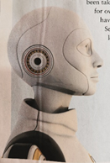
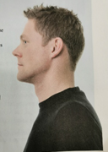
Activity 2
Read the passage to see if it changes your opinion on the future of AI. If so, in what ways?
Artificial Intelligence:
A REAL THREAT?

Slide 4
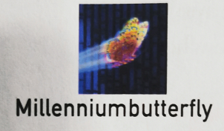


Activity 3
Read the opinions and match them to the persons. Talk about the opinion you agree with.
We all need to learn to live with AI technology whether we like it or are concerned about it. We cannot stop the march of progress.
I admit that more advanced AI could be helpful in
solving the world’s problems, but there is a high level
of risk involved.
I can’t understand why some people worry so much. I hope more breakthroughs in AI will be made soon, so that we can enjoy more and more convenience.

Slide 5
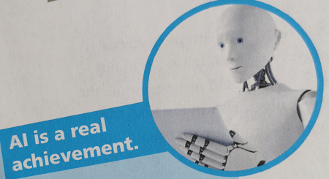
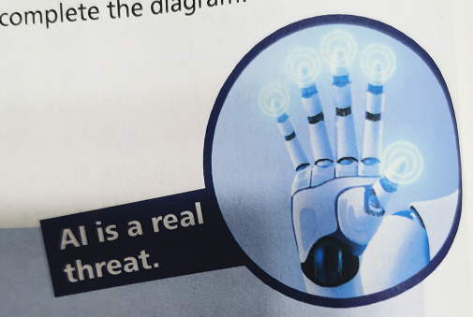
Activity 4
Organise information from the passage and complete the diagram.
· Al can help us save time.
· ¹______________________
· ²______________________
______________________
· ³______________________,
including those too challenging for Human experts.
· Al might wipe out human beings.
· ⁴__________________________
· ⁵__________________________
if it falls into the wrong hands.
AI can make driving safer.
Jobs are at risk due to AI.
AI can make doing day-to-day
things a lot easier.
AI could be dangerous
AI can solve problems

Slide 6
Activity 4
Now come up with more ideas for each point of view and share them with the class.

Slide 7
Think & Share
1 What did Stephen Hawking mean when he said that AI will be “either the best, or the worst thing, ever to happen to humanity”?
He meant that AI could bring us incredible benefits, but only if the technology is managed properly. If we do not manage the technology properly, it could result in human extinction.
2 Do you use AI in your daily life? What other roles can AI play in people’s lives?
3 How does the diagram help you better understand the passage?

Slide 8
