Slide 1

Unit 4 A glimpse of the future
Using language
新标准《英语》高中选择性必修第三册

Slide 2
Subject-verb agreement (2)

Slide 3
Activity 1
Look at the sentences from the reading passage and answer the questions.
a …50 per cent of my time was spent researching new restaurants.
b Every recommendation she gives me is great…
c … almost 50 per cent of US jobs are at risk from automation in the next 20 years.
d …none of us is prepared for the challenges of AI.

Slide 4
Activity 1
Look at the sentences from the reading passage and answer the questions.
1 Why is 50 per cent singular in sentence (a) but plural in sentence (c)?
2 What are the subjects in sentences (b) and (d)?
Are they singular or plural?
Because in sentence (a), the part “50 per cent” is followed by the uncountable noun “time”, while in sentence (c), the part “50 per cent” is followed by the countable noun “job” in its plural form.
In sentence (b), the part “Every recommendation” is the subject. In sentence (d), the part “none of us” is the subject. Both are singular.

Slide 5
Activity 1
Now look for more sentences following this rule in the reading passage, and summarise the use of subject-verb agreement in your own words.

Slide 6
Activity 2
Complete the passage by choosing the singular or plural form.
Nowadays, some companies offer genetic testing for children’s talents. A large number of clients / has been attracted to it. They are parents, eager to know what talents their children may have in the future. The process is simple. Every child provide / a small sample of blood or body tissue. / These are analysed. Each of the children / are given a report showing their possible talents. A recent example cited on the website is that one of the testing companies compare / the talents of twins Bobby and Benny. Bobby was assessed and his talents was / revealed to be mostly scientific: a 66% chance of success in chemistry and 54% in physics was / shown. Meanwhile, Benny’s highest score / shown to be in an arts subject: the test gave him 68% for literary studies. Is genetic testing reliable? Some scientists say that more evidence / are needed.
have
provides
This is
is
compares
were
were
was
were
is

Slide 7
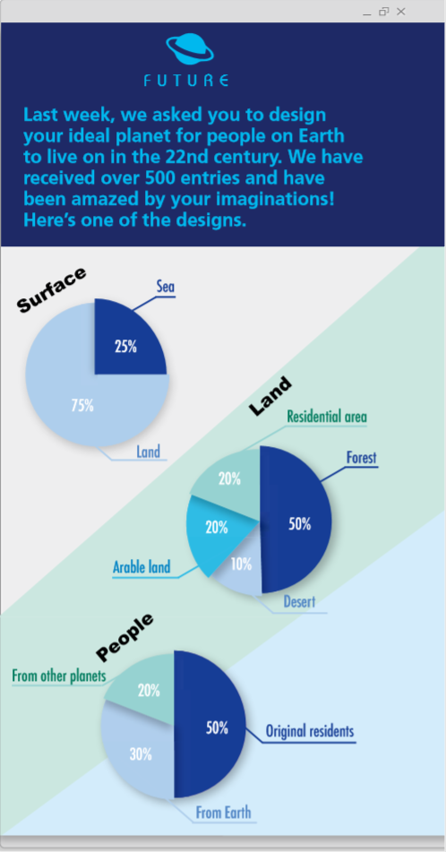
Activity 3
Complete the description according to the charts, paying attention to subject-verb agreement.
Three quarters of the surface is made up of land, while the rest is sea, covering 25% of the surface.
Half of the land is covered with trees. Residential area and arable land both account for the same proportion, 20% of the total land. The rest is desert, covering 10% of the total land.
There are three kinds of people. Fifty per cent of the people are original residents, 30% are from Earth and 20% are from other planets.
Three quarters of the surface is made
up of land, …

Slide 8
Activity 4
Describe another planet for the future, paying attention to subject-verb agreement.

Slide 9
The world of tomorrow

Slide 10

Did You Know?
Time travel could result in a paradox – an event that contradicts itself. For example, if a person travelled back in time and prevented an event, that event would never have happened; there would therefore be no reason for the person to travel back in time to prevent it.

Slide 11

Activity 5
Listen to the conversation and choose its main idea.
1 Time travel is dangerous.
2 Talking to people in the past can change the future.
4 Time travel within your own lifetime should be avoided.
3 Anything you say or do in the past can affect the future.

Slide 12
Activity 6
Listen again and complete the table.
RULE 1 ¹______________________________________________________
• A tourist wants to ²_____________________________________________
__________________because ³____________________________________.
• The guide told her ⁴_____________________________________________.
Don’t talk to anybody.
tell her 8-year-old self to buy shares in companies that
are profitable today
she wants to become rich
not to do that
Be careful not to break anything.
RULE 2 ⁵_______________________________________________________
• The guide said that ⁶_____________________________________________
________________________.
breaking something could also cause a paradox and
change your path through life
Never give anything from our time to someone in the past.
RULE 3 ⁷________________________________________________________
• A tourist wants to ⁸ _______________________________________________.
• The guide told him not to because ⁹ _________________________________
______________________________________________.
give a present to his father
anything that doesn’t belong to that time
might have an impact on someone and cause a paradox

Slide 13
Activity 6 Listen again and complete the table.
Now work in pairs. Take turns to be the guide and explain the rules of time travel.

Slide 14
Activity 7 Complete the boxes with the expressions from the conversation.
• Amazing!
• Wow!
• I can’t wait to...
• So, what you’re saying is that...
• How about...
• Imagine how excited...
• That’s OK, isn’t it?
• Are you serious?
• Let me get this straight. You mean that...
• It’ll be exciting enough to...
Expressing excitement Asking for confirmation
Amazing!
Wow!
I can’t wait to...
Imagine how excited...
It’ll be exciting enough to...
So, what you’re saying is that...
How about...
That’s OK, isn’t it?
Are you serious?
Let me get this straight. You mean that...

Slide 15
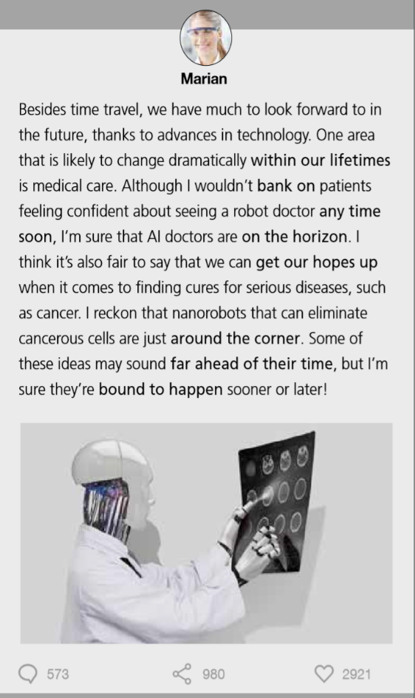
Activity 8 Read the passage and put the expressions in bold into the boxes.
Expressions about time Expressions about expectation
within our lifetimes
any time soon
on the horizon
around the corner
far ahead of their time
bank on
get our hopes up
bound to happen

Slide 16
Activity 9 Complete the passage with the expressions in Activity 8.
Who knows in what exciting ways transport will change ¹_______________________? Trains that travel at the speed of today’s aeroplanes may sound ²________________________, but scientists are already developing “hyperloop” trains that travel at over 1,000 km per hour. And although we can’t ³_________________ flying cars being the norm ⁴_________________, there are plans to introduce flying taxis that will be stationed on rooftops around busy cities. Many cities already have elevated cycle paths and I’m sure that these are ⁵_________________ for many others around the world. As well as faster, safer and more comfortable transport being just ⁶________________________________, we can also ⁷________________ about shorter waiting times, with companies intending to provide on-demand services.
within our lifetimes
far ahead of their time
bank on
any time soon
bound to happen
on the horizon / around the corner
get our hopes up

Slide 17
Activity 10
Work in pairs. Talk about another aspect of life in the future using the expressions you have learnt in this section.
Now think about how effectively your partner used these expressions, and what you could learn from him or her.

Slide 18


