Slide 1
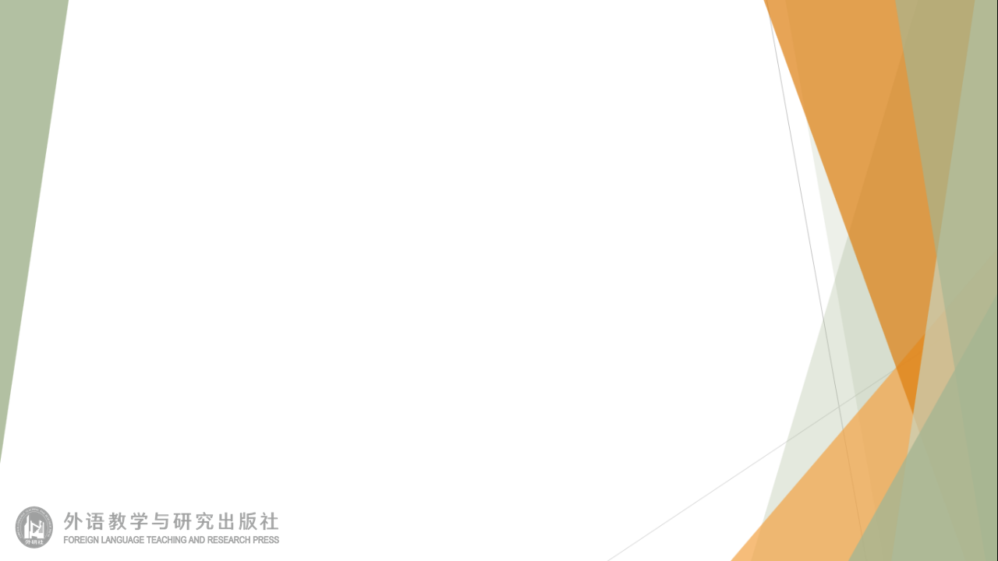
Unit 5 Learning from nature Developing ideas
新标准《英语》高中选择性必修第三册

Slide 2
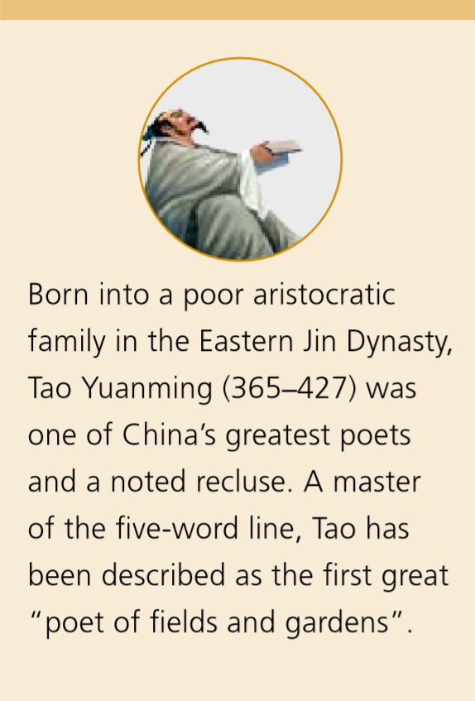
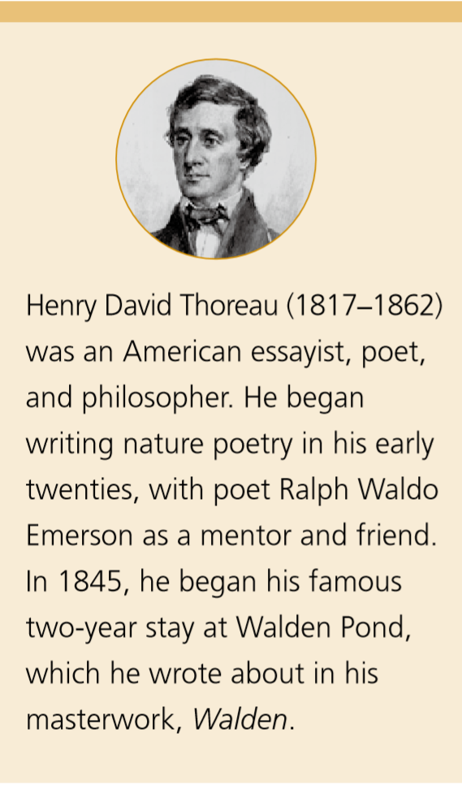
Activity 1 Read the short introductions to Tao Yuanming and Henry David Thoreau and share what else you know about them with the class.

Slide 3
Activity 2 Read the passage and find out what Tao and Thoreau learnt from nature.
Both of them got inspiration from nature for their literary works. Both of them lived simply in nature with few material desires, which helped them to attain their personal fulfillment.

Slide 4
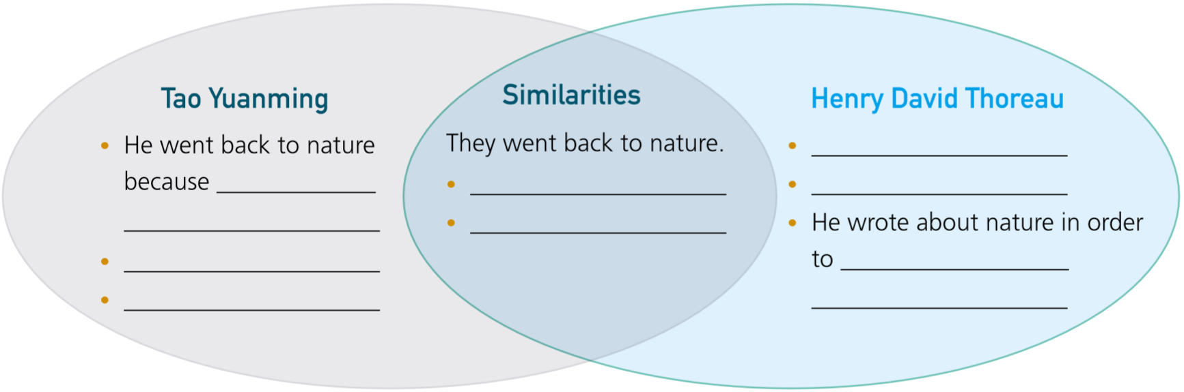
Activity 3
Organise information from the passage and complete the chart.

Slide 5
Activity 3
Organise information from the passage and complete the chart.
Tao Yuanming
Henry David Thoreau
•He went back to nature because he felt conflicted over life at court.
•His return to nature was a reaction to a lifestyle he was opposed to.
•The calm and peaceful life he wrote about is in contrast to and critical of the depressive court life.
•Thoreau’s return to nature was a personal decision to transform the way he lived.
•Thoreau’s description of nature emphasised the beauty and purity of the wild areas around him.
•He wrote about nature in order to convince people that animals and plants had a right to live and prosper, as we do.

Slide 6
Activity 3
Organise information from the passage and complete the chart.
Similarities:
•Both made dramatical transformations to their lives in order to reconnect with nature.
•Both were happy to withdraw from contemporary life, seeking a harmonious relationship with nature in the quietness of their new lives.

Slide 7
Think & Share
1 Why did it take Tao and Thoreau great courage to walk away from their previous lives?
2 Why are their ideas important to our lives today?
3 What do you think about living in nature like Tao and Thoreau? Give your reasons.
Because it was difficult to reject the easy and familiar life they used to live.
Because in today’s modern world, we still need to live harmoniously with nature, and live a simple life. Fewer material desires lead to better personal well-being and fulfilment.

Slide 8
Think & Share
4 Compare the two reading passages in this unit. In what ways does each passage contribute to the unit theme?
Both passages have the common theme of learning from nature. The first passage focuses on the inspirations people get from nature, while the second focuses more on the natural way of living that people still need today. The second passage calls upon us to live in harmony with nature, which is an important message for today.

Slide 9
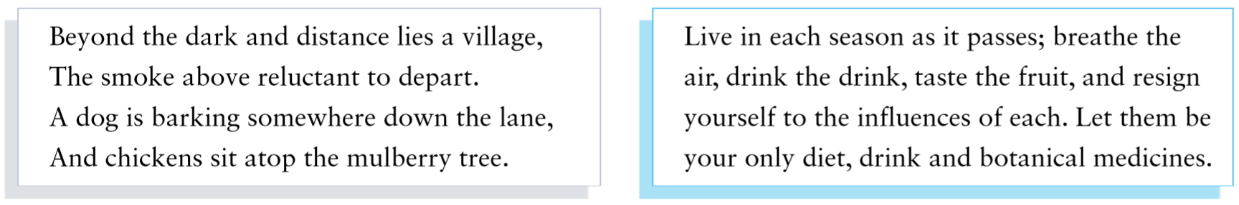
Activity 4 Work in groups. Compare the quotes by Tao and Thoreau.
1 Find the Chinese version of Tao’s poem, and translate Thoreau’s quote into Chinese.

Slide 10
Activity 4
归园田居（其一）
陶渊明
少无适俗韵，性本爱丘山。
误落尘网中，一去十三年。
羁鸟恋旧林，池鱼思故渊。
开荒南野际，守拙归园田。
方宅十余亩，草屋八九间。
榆柳荫后檐，桃李罗堂前。
暧暧远人村，依依墟里烟。
狗吠深巷中，鸡鸣桑树颠。
户庭无尘杂，虚室有余闲。
久在樊笼里，复得返自然。
好好度过每一个季节，
呼吸新鲜的空气，
畅饮美酒，品尝水果，
尽情享受这一切。
让生活中只有饮食和草药。

Slide 11
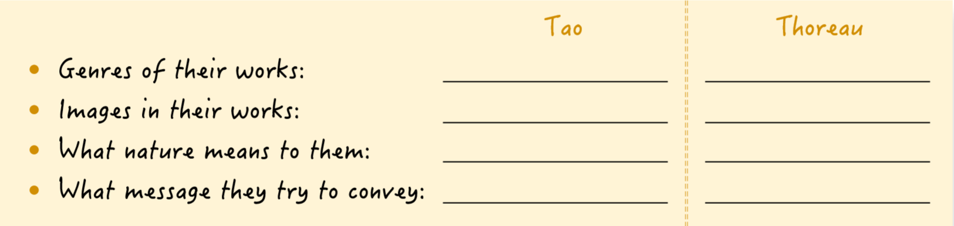
Activity 4
2 Decide which portrayal of nature you prefer and make notes.

Slide 12
Activity 4
3 Organise your thoughts and share them with the class.

Slide 13
Activity 4
Now think about your performance in this activity. How effectively did you compare the two literary works? What additional information did you need to make the comparison?

Slide 14
Writing about a lesson from nature

Slide 15
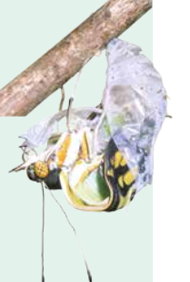
Activity 5 Read the story and answer the questions.
1 What does a butterfly do to get out of its pupa?
2 Why did the man think he needed to help the butterfly?
The butterfly struggles to force its body through the little hole.
Because the butterfly couldn’t get out. The struggle seemed too hard for its weak body.

Slide 16
Activity 5 Read the story and answer the questions.
3 What happened to the butterfly after the man enlarged the hole in the pupa?
4 What is the lesson behind this story? What else can you learn from it?
The butterfly dragged itself around weakly, and then died.
We need struggle to grow strong and survive.

Slide 17
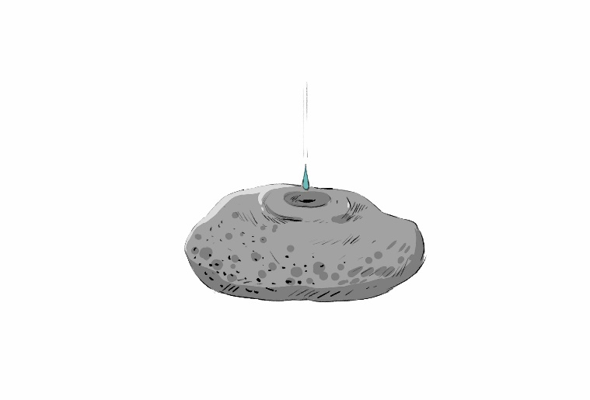
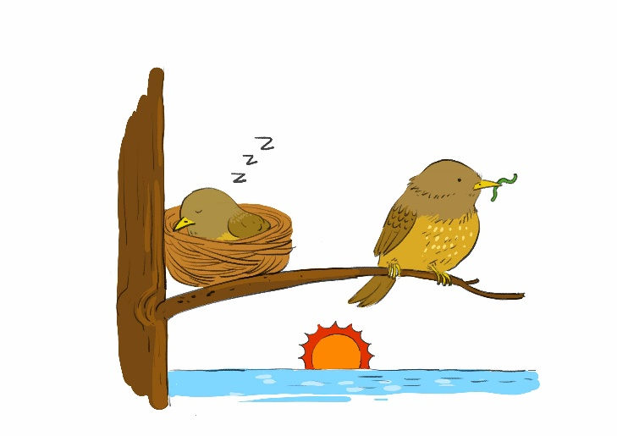
Activity 6 Look at the pictures and think what you can learn from nature.

Slide 18
Activity 7 Work in pairs. Plan your writing. Consider the following:
the topic you wish to write about
whether you will use an extended metaphor
• what lesson it teaches us, and how we can apply this lesson to daily life
• a suitable title for your story
Now write your story.

Slide 19
参考范文
A Lesson from Ants
One day, I was resting in my grandparent’s garden when I saw that the sky was covered with dark clouds; this being a sure sign of rain. All of a sudden, an ant came into my sight. The tiny creature was trying hard to carry a tiny piece of bread to its nest, but its efforts were in vain. Each time the ant picked up the piece of bread, it rolled down its body and fell onto the ground. While I was wondering why the ant was trying so hard to achieve the impossible, it was joined by more ants. This group of ants worked together, and eventually they managed to carry the piece of bread to their nest.
Similarly, we need cooperate and collaborate in order to achieve what seems impossible for us to do as individuals. In order to achieve our goals, we should work together.

Slide 20
Activity 8
Work in pairs. Make improvements to each other’s stories and share them with the class.

Slide 21
