Slide 1

Unit 5 Learning from nature Starting out
新标准《英语》高中选择性必修第三册

Slide 2
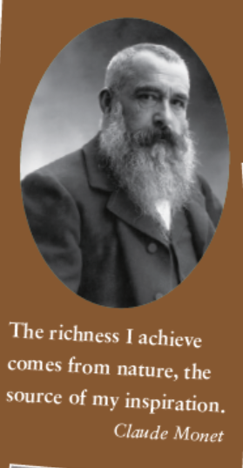
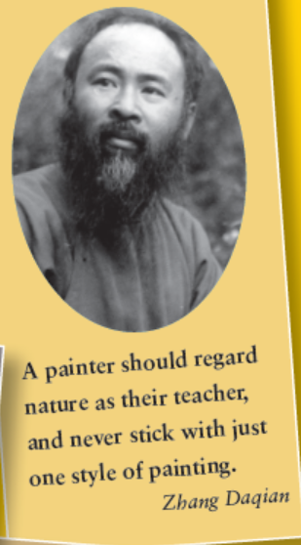
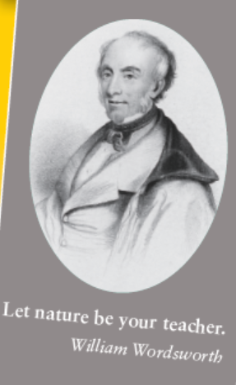
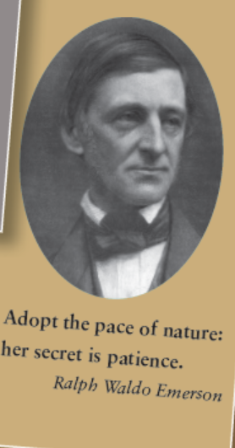
Activity 1 Read the quotes and answer the questions.
1 What is the common message conveyed in these quotes?
The common message conveyed in these quotes is that they have a close relation with nature and they respect nature and get inspirations from nature.
2 Have you ever learnt anything from nature?
Give examples.

Slide 3

Activity 2 Watch the video and answer the questions.
1 What lessons from nature are mentioned in the video?
Trees give us lessons about strength in the face of hard times. Succulents in deserts give us lessons about learning to adapt to the environment. From birds, we learn to spread our wings and fly to reach our full potential. From salmon, we learn the importance of perseverance in order to achieve our goals. Ants teach us to embrace responsibility and always do our best.
2 Which one inspires you the most?

Slide 4
