Slide 1

Unit 5 Learning from nature Understanding ideas
新标准《英语》高中选择性必修第三册

Slide 2
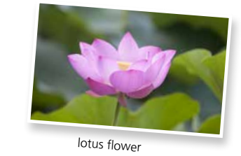
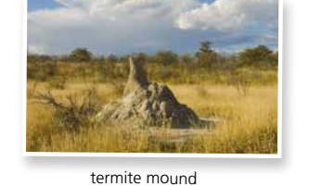
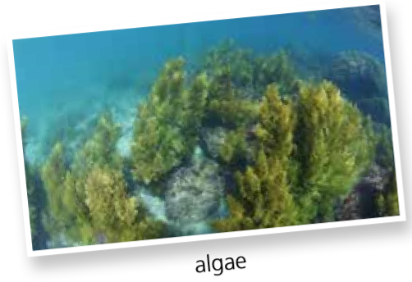
Activity 1 Look at the pictures and answer the questions.
1 What is shown in the pictures?
How much do you know about them?
A lotus flower, a termite mound and algae are shown in the pictures.
2 How could you associate them with architecture ?

Slide 3
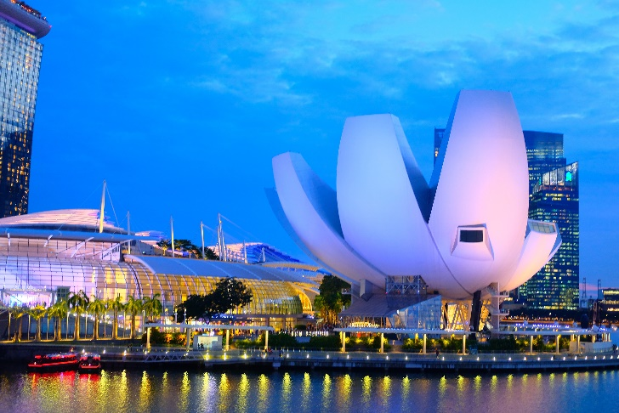
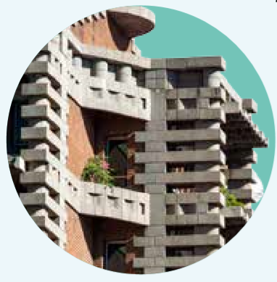
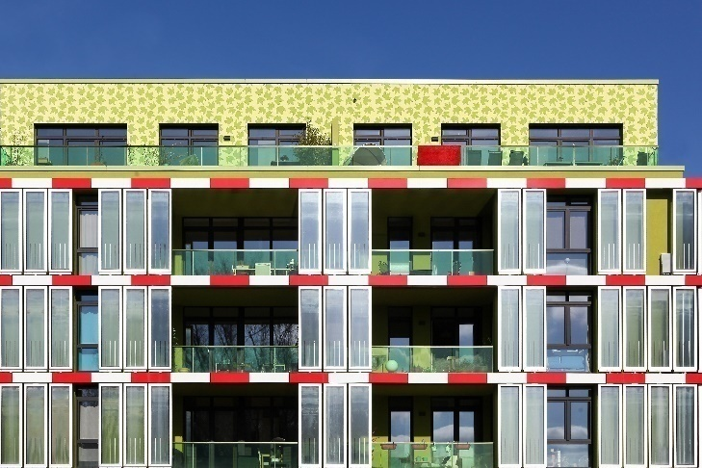
Activity 1
Now read the passage and check your ideas.

Slide 4
Activity 2 Choose the magazine in which you would most likely find the passage. Give your reasons.
1 Extraordinary Architects
2 Lying on Earth
3 Architecture Frontier
4 Natural World

Slide 5
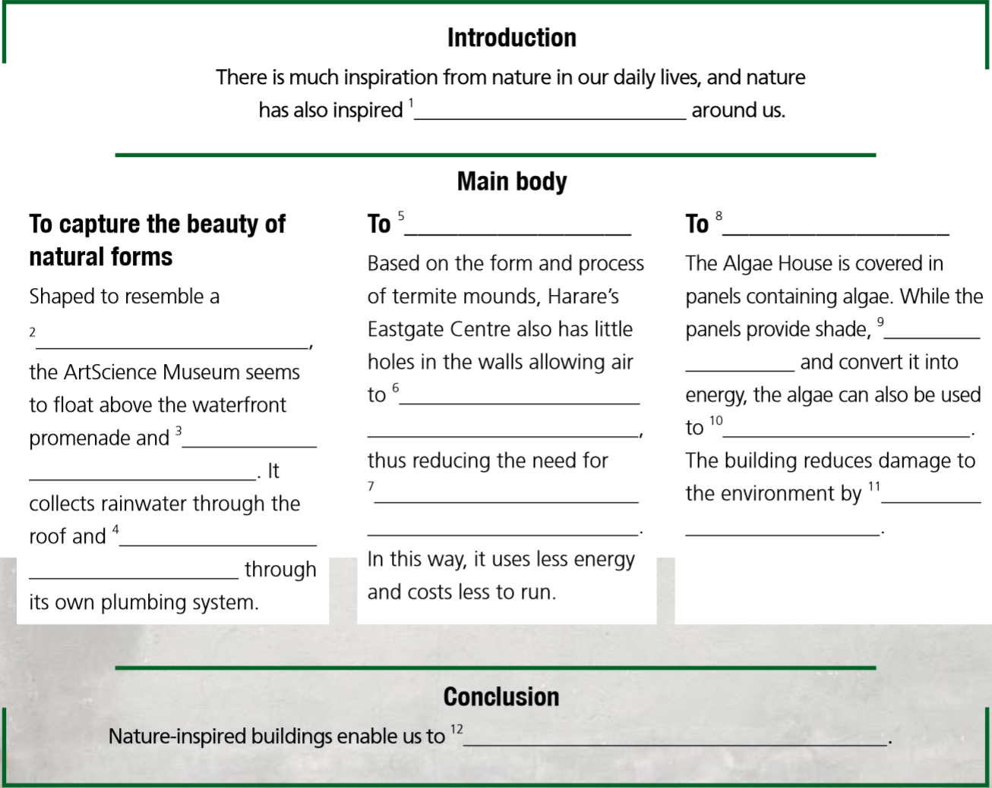
Activity 3 Organise information from the passage and complete the diagram.

Slide 6
Activity 3 Organise information from the passage and complete the diagram.
1 many of the most fascinating designs
2 lotus flower
3 the water that surrounds it
4 the water is then recycled
5 mimic the way nature works
6 move freely in and out of the mounds
7 traditional air conditioning and heating systems
8 make natural organisms part of a building
9 capture heat from the sun
10 produce fuel
11 generating its own renewable energy
12 live in closer harmony with our environment

Slide 7
Activity 3 Organise information from the passage and complete the diagram.
Now work in pairs and talk about other examples of architecture inspired by nature.

Slide 8
Think & Share
1 Which of the three building are you most impressed by why?
2 If you were given a chance to design a building, what inspiration would you take from nature?
3 How did the pictures help your understanding of the passage? Share your ideas with the class.

Slide 9


