Slide 1

Unit 5 Learning from nature
Using language
新标准《英语》高中选择性必修第三册

Slide 2
Review: non-finite forms as subject, object and predicative

Slide 3
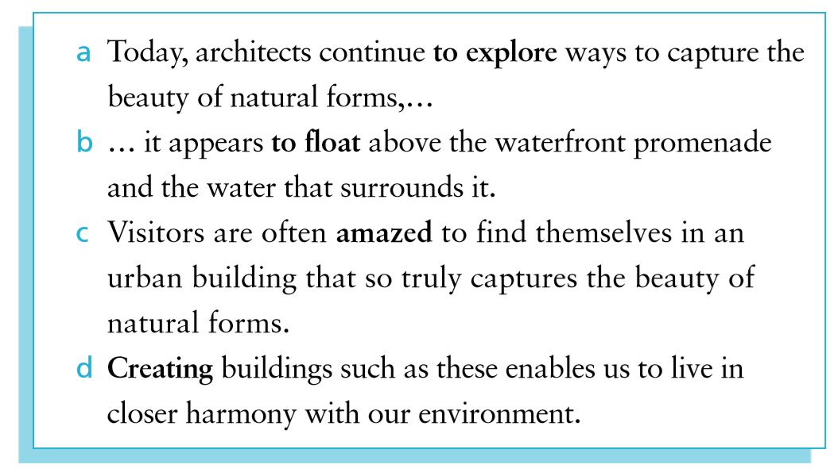
Activity 1 Look at the sentences from the reading passage and answer the questions.

Slide 4
1 Look at the “to do” structures in sentences (a) and (b). Do they serve the same function in each sentence?
2 In sentence (c), is the -ed form used as an adjective or a past participle? Why does the author use the -ed form other than the -ing form?
3 What is the function of the -ing form in sentence (d)?
No, they don’t. “To explore” in sentence (a) serves as object and “to float” in sentence (b) serves as predicative.
The -ed form is used as an adjective. The author wants to describe the visitors’ feeling, so the -ed form is used.
The -ing form is used as subject.

Slide 5
Activity 1 Look at the sentences from the reading passage and answer the questions.
Now look for more sentences with these structures in the reading passage.

Slide 6
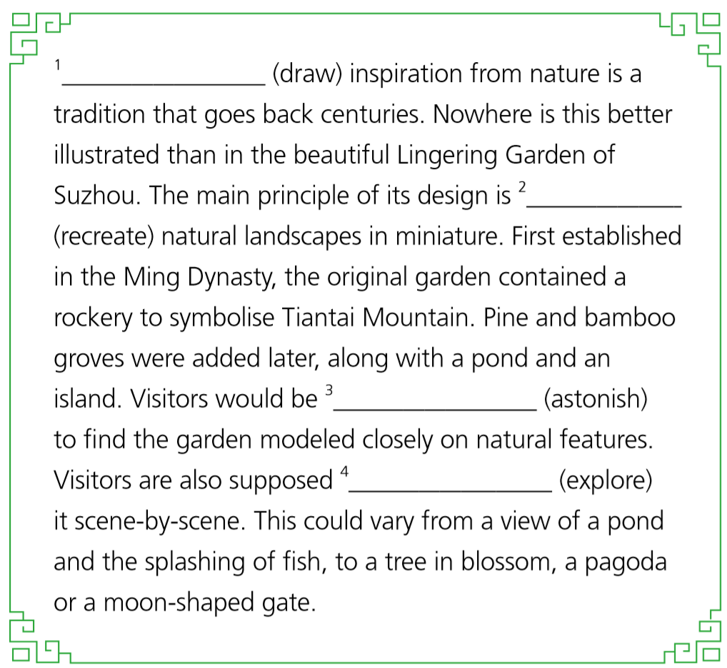
Activity 2 Complete the passage with the correct form of the verbs in brackets.
1 Drawing
2 to recreate / recreating
3 astonished
4 to explore

Slide 7
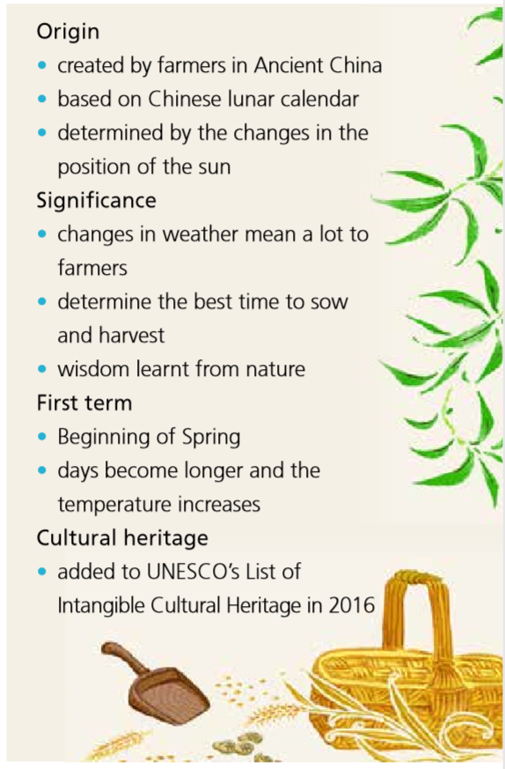
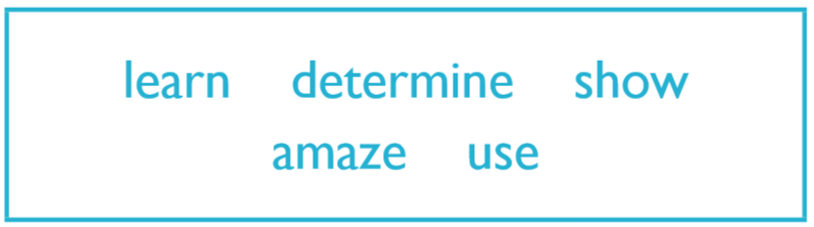
Activity 3
Read the information below and write a
paragraph introducing the 24 Solar
Terms with the words in the box.
Learning from nature’s wisdom led farmers in Ancient China to create the 24 Solar Terms…

Slide 8
Activity 3
Learning from nature’s wisdom led farmers in Ancient China to create the 24 Solar Terms, which were based on observation of changes of seasons, astronomy and other natural phenomena. Indicating changes in weather conditions, the 24 Solar Terms remain of particular importance to farmers for guiding their practices. The first term is known as “Beginning of Spring”, and marks when the days become longer and the temperature begins to increase. Nowadays, the 24 Solar Terms not only apply to farming, but also guide Chinese people in everyday life. So varied are the functions of the Solar Terms and their contributions to cultural identity, that in 2016, they were added to UNESCO’s List of Intangible Cultural Heritage.

Slide 9
Activity 4
夏至 the Summer Solstice (10th solar term)
小暑 Lesser Heat (11th solar term)
大暑 Greater Heat (12th solar term)
立秋 the Beginning of Autumn (13th solar term)
处暑 the End of Heat (14th solar term)
白露 White Dew (15th solar term)
秋分 the Autumn Equinox (16th solar term)
寒露 Cold Dew (17th solar term)
霜降 Frost's Descent (18th solar term)
立冬 the Beginning of Winter (19th solar term)
小雪 Lesser Snow (20th solar term)
大雪 Greater Snow (21st solar term)
冬至 the Winter Solstice (22nd solar term)
小寒 Lesser Cold (23rd solar term)
大寒 Greater Cold (24th solar term)
Work in pairs. Talk about one of the Solar Terms using the structures you have learnt in this unit where appropriate.
立春 the Beginning of Spring (1st solar term)
雨水 Rain Water (2nd solar term)
惊蛰 the Waking of Insects (3rd solar term)
春分 the Spring Equinox (4th solar term)
清明 Pure Brightness (5th solar term)
谷雨 Grain Rain (6th solar term)
立夏 the Beginning of Summer (7th solar term)
小满 Lesser Fullness of Grain (8th solar term)
芒种 Grain in Beard (9th solar term)

Slide 10
Inspiration from animals

Slide 11
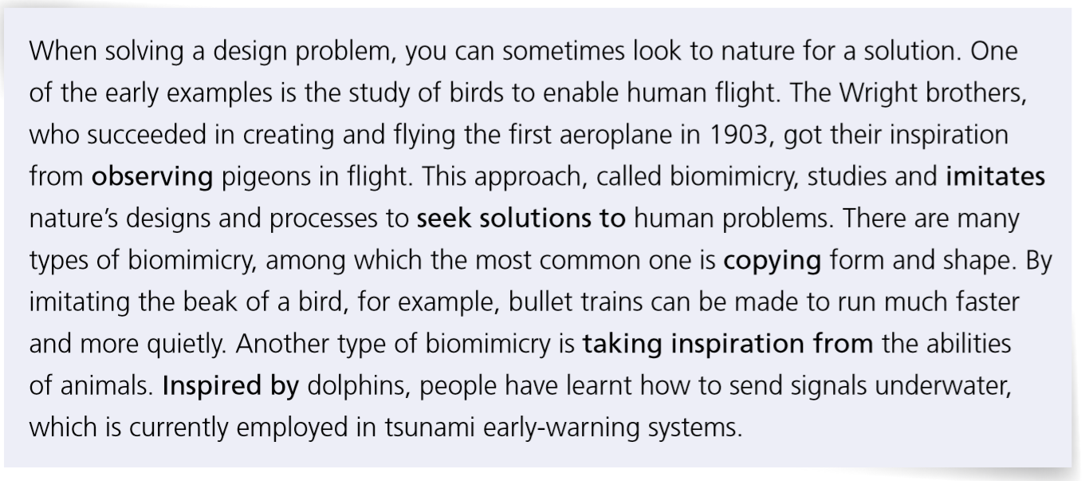
Activity 5 Read the passage about biomimicry and answer the questions. Pay attention to the words and expressions in bold.

Slide 12
1 What are the types of biomimicry mentioned in the passage? What else do you know about them?
One is copying form and shape. Another one is taking inspiration from the abilities of animals.
2 What other examples of biomimicry can you think of? Share them with the class.

Slide 13
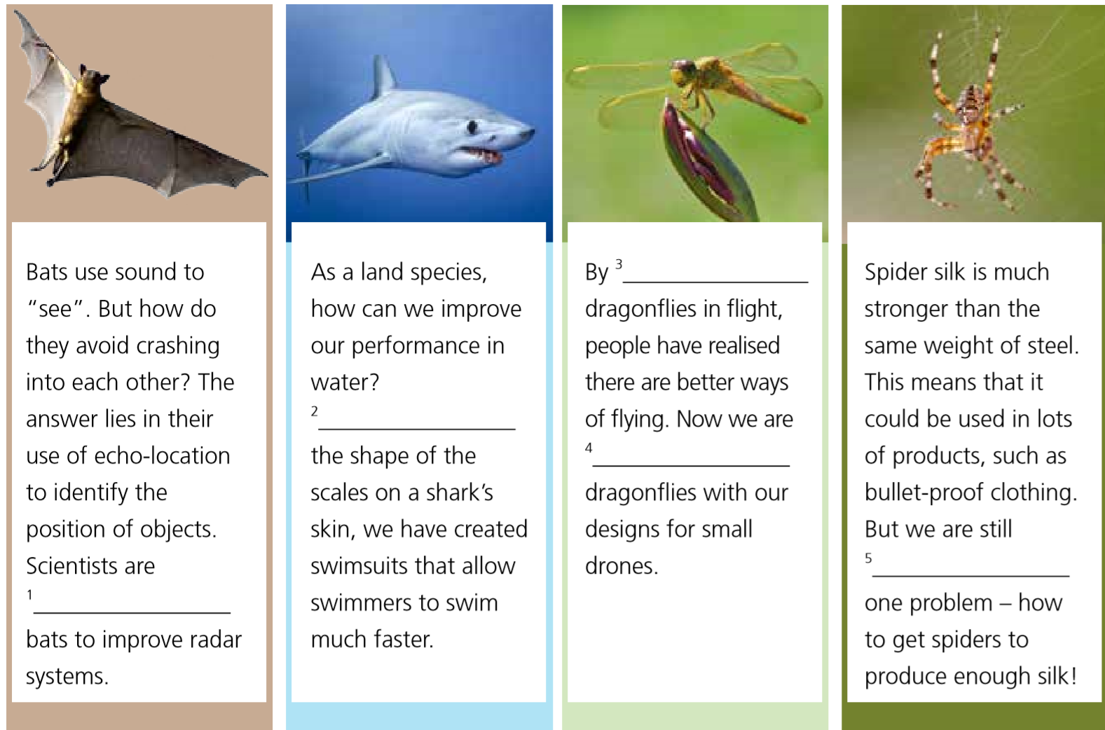
Activity 6 Complete the information with the words and expressions in Activity 5.
1 taking inspiration from
2 Copying
3 observing
4 inspired by
5 seeking solutions to

Slide 14
Activity 7
Work in pairs. Talk about in what others ways we can learn from animals. Give reasons.

Slide 15
Activity 8 Read the passage and answer the questions.
1 Why were Chinese martial artists inspired by animal movements?
2 What were Hua Tuo’s achivements?
Because many Chinese martial artists admired the natural instincts, senses and fighting abilities that other animals possess in order to survive in the wild.
Hua Tuo created Wu Qin Xi. He was the first physician to use anesthesia during surgery in China. He was known as the best physician of his time and he was an expert in acupuncture.

Slide 16

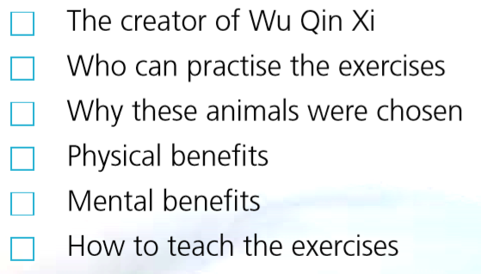
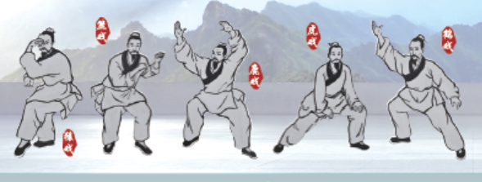
Activity 9 Listen to the conversation about Wu Qin Xi and tick the topics mentioned by the speakers.
✔
✔
✔

Slide 17
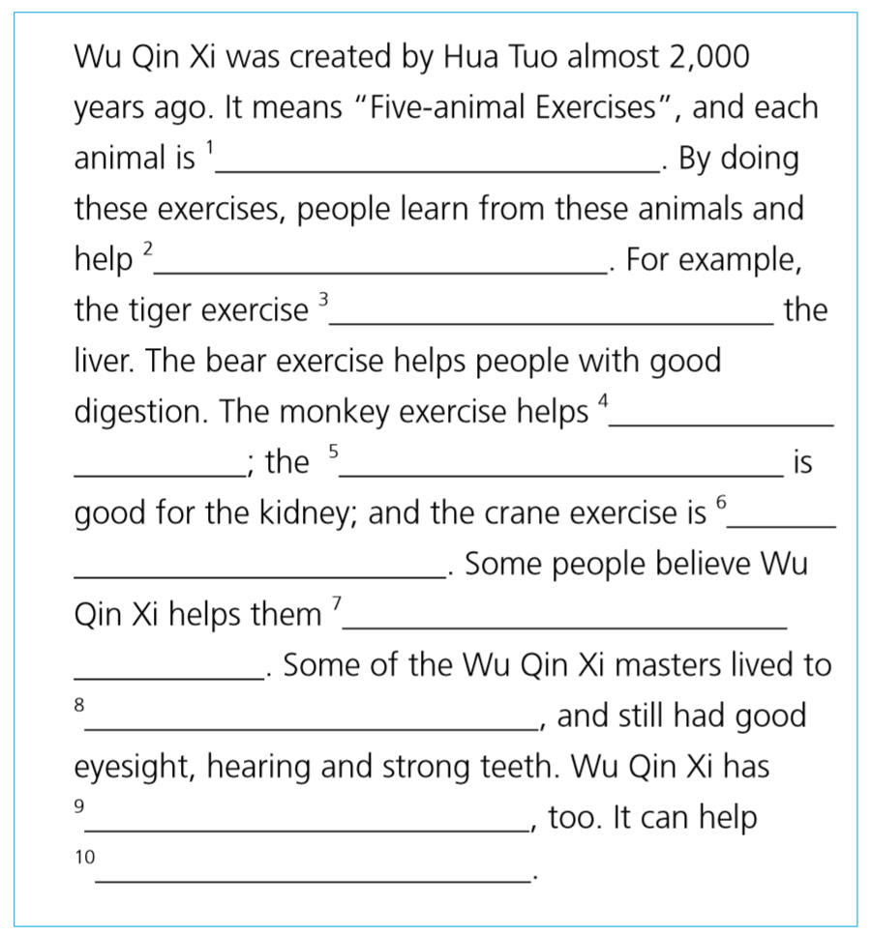
Activity 10 Listen again and complete the introduction to Wu Qin Xi.
1 identified with a form of exercise
2 the / their organs to work better
3 does good to
4 the heart to work well
5 deer exercise
6 good for the lung
7 to live to an advanced age
8 more than 90 years of age
9 mental benefits
10 to relax the mind and improve concentration

Slide 18
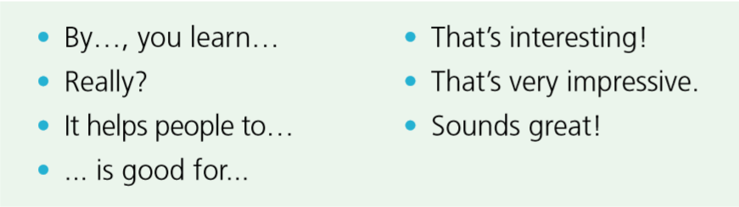
Activity 11 Complete the boxes with the expressions from the conversation.
Talking about benefits
Showing interest
By…, you learn…
It helps people to…
…is good for…
Really?
That’s interesting!
That’s very impressive.
Sounds great!

Slide 19
Activity 12
Work in pairs. Think about other exercises inspired by animals. Discuss how they were created and their benefits, using the words and expressions in this section.
Now think about your performance. How well can you use the language you have learnt to talk about traditional Chinese exercises?

Slide 20
