Slide 1

Unit 6 Nature in words
新标准《英语》高中选择性必修第三册
Developing ideas

Slide 2
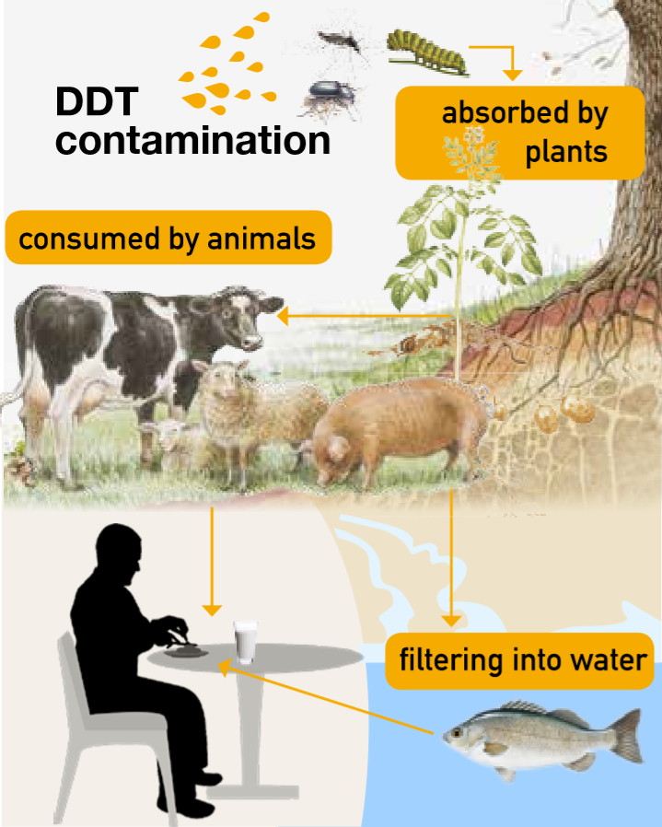
Activity 1
Look at the infographic below and answer the questions.
Facts about DDT:
• DDT was first produced in 1874 and was later used as pesticide.
• It stays in the environment.
• It is highly poisonous to living organism, including humans.
• Now banned in many countries, it is still used in some for malaria control.

Slide 3
Activity 1 Look at the infographic below and answer the questions.
1 How does DDT reach the human body in the food chain?
When DDT is sprayed onto plants in order to kill insects, it is absorbed by the plants and subsequently consumed by animals; humans in turn eat those animals. DDT also leaks through the soil and into rivers and lakes, where it contaminates fish consumed by humans.

Slide 4
Activity 1 Look at the infographic below and answer the questions.
2 What harm does DDT cause?
DDT is highly poisonous to living organism, including humans.

Slide 5
Activity 2
Read the book review on Silent Spring, a book that led to the
banning of DDT. Predict what will be mentioned in the passage.

Slide 6
Activity 2
Now read the passage and check your prediction.
It is a book review on Silent Spring, so the following parts may be mentioned this this passage:
1) basic information about the book, including the author, year of publication, theme and main idea; 2) the reason why this book is published; 3) features of the writing; 4) comments on this book; 5) influence of this book.

Slide 7
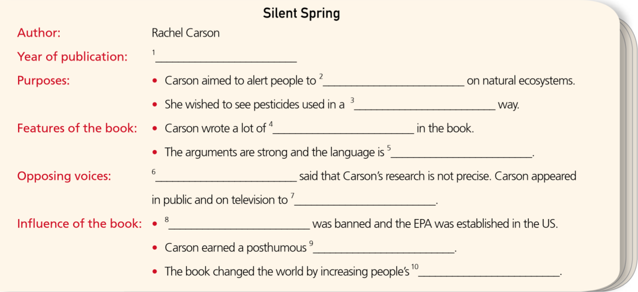
Activity 3
Organise information from the passage and complete the notes about Silent Spring.
1 1962
2 the damaging effects of human activity
3 more responsible, limited and carefully monitored
4 scientific information, examples and research
5 beautiful and elegant
6 The pesticide industry
7 defend her claims
8 The use of DDT
9 Presidential Medal of Freedom
10 environmental awareness
Now work in pairs. Talk about which aspects of the book review make you wantto read the book.

Slide 8
Think & Share
1 Why was Silent Spring so successful?
Silent Spring was so successful because it alerted the general public to the dangers of DDT. It planted important new ideas in the public mind, such as that spraying chemicals to control insect populations has an impact on other wildlife, and that the chemicals got into the food chain.

Slide 9
Think & Share
2 What is the moral lesson behind “A Fable for Tomorrow”?
The moral lesson is that financial profit should not come at the expense of the environment and the creatures living in it.

Slide 10
Think & Share
3 Why did some people challenge Carson’s findings?
Some people challenged Carson’s findings because they were concerned about the negative impact they would have on business in the pesticide industry.

Slide 11
Think & Share
4 In what different ways do First Snow and Silent Spring raise people’s awareness of nature?
First Snow shows the beauty of nature—and in particular the snow—through its words and imagery, while Silent Spring describes an unnatural spring without the beauty of birdsong. They each raise people’s awareness of nature by highlighting the interplay between nature and human behaviour.

Slide 12
Activity 4 Work in groups. Write an award speech for Rachel Carson.
1 Read the passage again and make notes about Rachel Carson’s contributions to environmental protection.
Consider the following:
• her most influential work • what points she tried to make
• difficulties she met with • her personal qualities

Slide 13
Activity 4
2 Rachel Carson received her Presidential Medal of Freedom posthumously in 1980. Read the excerpt from President Carter’s award speech and note the language features.
Never silent herself in the face of destructive trends, Rachel Carson fed a spring of awareness across America and beyond. Always concerned, always eloquent, she created a tide of environmental consciousness that has not ebbed.

Slide 14
Activity 4
3 Write your own award speech of about 100 words and share it with the class.
Now think about your performance in group discussion. Were you able to make an objective judgement about Rachel Carson?

Slide 15
Writing a poem about nature

Slide 16
Activity 5
Read the poems and tick the correct box(es) for each question.
Which poem… | a | b | c
…uses its shape to help convey message?
…has rhyming words at the end of lines?
…uses metaphor?
…uses simile?
…uses personification?
√
√
√
√
√
√
√

Slide 17

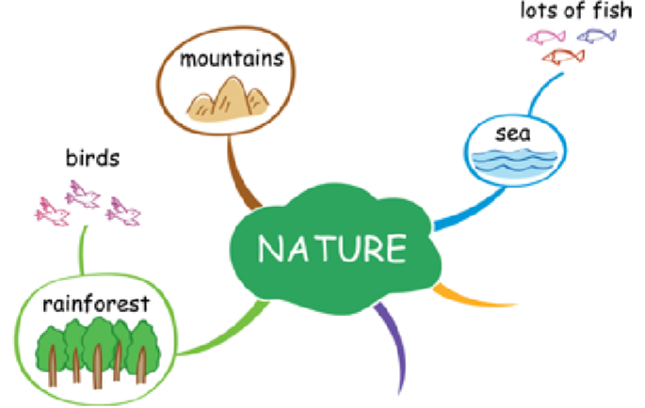
Activity 6
Think about words and expressions related to nature and add them to the mind map.

Slide 18
Activity 7
Work in pairs. Plan a poem. Consider the following:
• what your poem will be about
• what kind of poem you are going to write
• what figures of speech you will use
• what words you can use for that rhyme (if using rhyme)

Slide 19
Activity 7 Work in pairs. Plan a poem. Consider the following:
Now write your poem.
There once was a boy who thought,
He could eat all the sweets he had bought.
He gobbled them down,
Then started to frown,
’Cause he’d eaten more than he ought.

Slide 20
Activity 8
Work in pairs. Make improvements to each other’s poems and share them with the class.
Now discuss the similarities and differences between Chinese and English poems.

Slide 21
