Slide 1

Unit 6 Nature in words
新标准《英语》高中选择性必修第三册
Presenting ideas & Reflection

Slide 2

Activity 1
Work in groups. Share with each other a book about nature you have read. Consider the following:
Now plan your own book about nature based on your research. Think about the questions and make notes.

Slide 3
Activity 1
What is the theme of your book？
What is the genre of your book？
What content will you include in your book？
What makes your book interesting？

Slide 4
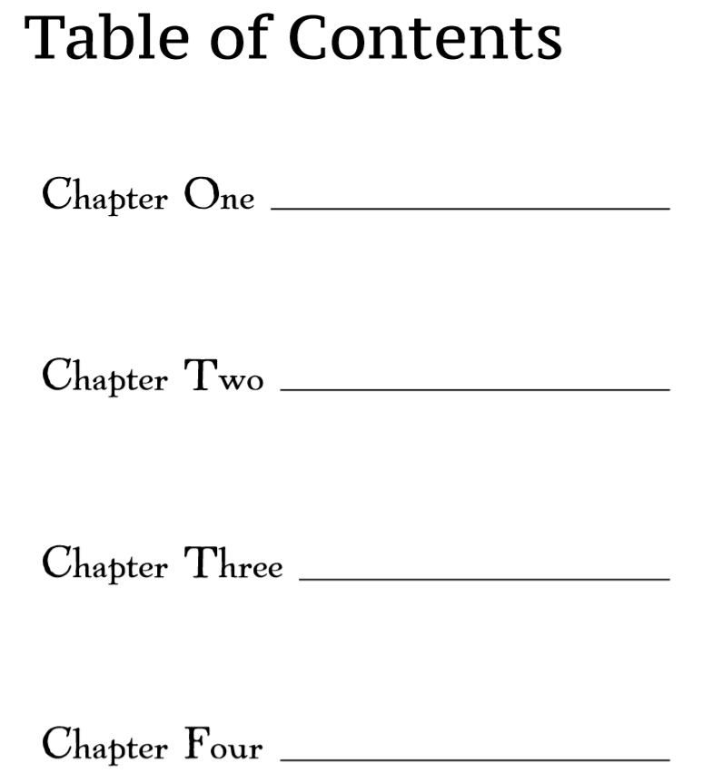
Activity 2
Discuss how many chapters the book will have and make a brief table of contents.

Slide 5
Activity 3
Think of a catchy title for your book and design a book cover if possible.

Slide 6
Activity 4
Prepare a short introduction to the book.
Consider the following:
1 the structure of your introduction
2 useful words, expressions and structures

Slide 7
Activity 5
Give your introduction to the class. Vote for the most creative book about nature.

Slide 8
Reflection
Write a reflection after completing this unit. Consider the following:
1 What is your understanding of nature in literature?
2 What text types have you learnt about? What are their features?
3 What words, expressions and structures have you learnt?
4 What improvement have you made in understanding different cultures?
5 What improvement have you made in using learning strategies and exploring effective ways of learning?
6 What improvement have you made in analysing and solving problems?

Slide 9


