Slide 1

Unit 6 Nature in words
新标准《英语》高中选择性必修第三册
Understanding ideas

Slide 2
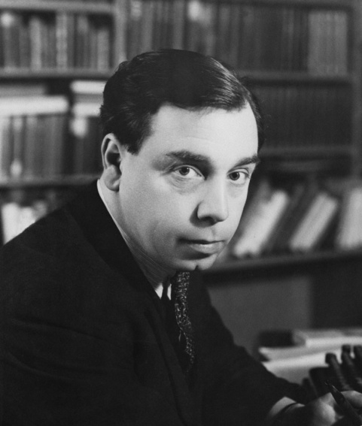
Activity 1 Read the short introduction to the author of First Snow and answer the questions.
1 What careers did Priestley have in his lifetime?
Priestly joined the army in World War I before going on to study at Cambridge University. After graduation, he worked as a freelance writer and radio presenter.
2 What kind of person do you think Priestley was? Do more research if necessary.

Slide 3
Activity 2
Describe snow in your own words. Then read the passage and underline the expressions the author uses to describe the first snow.
The expressions used by the author to describe the first snow: an event, so fantastically carpeted, a magical event, a cold place of dead white and pale blues, faintly flushed, artfully disposed, a cold sparkle of white and blue, falling heavily, in great soft flakes…

Slide 4
Activity 3
Choose the author’s purpose in writing the passage and give your reasons.
1 By describing the magical scenery of the first snow, the author encourages readers to come to England and experience its beauty for themselves.
2 By depicting the beautiful, near-magical scenery of the first snow, the author wants to convey his love for snow.
3 By recalling his memories as a child during the first snow, the author expresses his longing for the innocent happiness of childhood.

Slide 5
Activity 4
The author uses picturesque language to depict the first snow. Complete the diagram with the expressions you have underlined in the passage.
Timeline
Scenery
The world became a ¹__________________________________. The light
coming through the windows seemed quite strange, and it made the
familiar business of splashing and shaving and brushing and dressing very strange too.
When I got up this
morning...
cold place of dead white and pale blues
delicate pinks
The sun came out...
The snow became ²_________________. My dining-room
window changed into 3______________________________. The little plum tree outside, with snow ⁴______________________________, stood in full sunlight.
a lovely Japanese print
lining its branches and artfully
disposed along its trunk

Slide 6
Activity 4
Timeline
Scenery
Everything was a ⁵______________________________. The ground ⁶______________________________, the sky was ⁷___________________
_______, and all the trees ⁸________________________________. The entire scene looked ⁹______________________________.
An hour or two later...
cold sparkle of white and blue
went on and on
thick grey
so many black and threatening shapes
like a cruel grassland
falling heavily in great soft flakes
Now...
The snow is ¹⁰______________________________.
The roofs are ¹¹______________________________.
The trees are ¹²______________________________.
I can see the children flattening their noses against the window.
thick
all bending

Slide 7
Activity 4
Now work in pairs and talk about how the author organises the structure of the passage.

Slide 8
Think & Share
1 Why does the author mention Jane Austen at the beginning of the passage?
By referencing the characters of Jane Austen, who is known for her witty, perceptive observations of early 19th century English country life, the author is emphasising the irony and self-awareness with which he goes on to make his statement about the first snow.

Slide 9
Think & Share
2 What images does the author use to enhance the description of snow?
Images used by the author to enhance the description of snow: a cold place of dead white and pale blues, flushing the snow with delicate pinks, a cold sparkle of white and blue, falling heavily, in great soft flakes…

Slide 10
Think & Share
3 What other literary works about snow do you know? Share them with the class.
4 Have you encountered any difficulties in understanding this passage? Can you use visualisation to better understand the passage?

Slide 11


