Slide 1

Unit 6 Nature in words
新标准《英语》高中选择性必修第三册
Using language

Slide 2
Review: non-finite forms as attributive, adverbial and complement

Slide 3
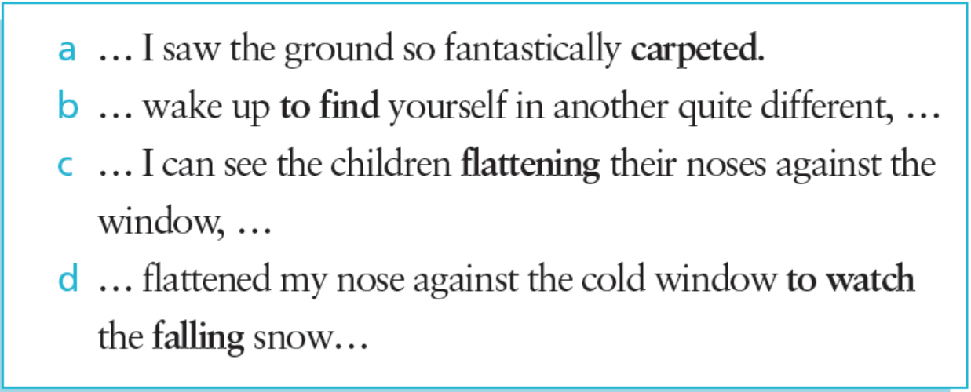
Activity 1 Look at the sentences from the reading passage and answer the questions.
1 What is the difference between the verbs in bold in sentences (a) and (c)?
“Carpeted” in sentence (a) is a past participle used as complement and “flattening” in sentence (c) is a present participle used as complement.

Slide 4
Activity 1
2 In sentence (b), does “to find” indicate purpose or result?
In sentence (b), “to find”indicates result.
3 In sentence (d), does “to watch” indicate purpose or result? What is the function of “falling”?
In sentence (d), “to watch” indicates purpose; “falling” is an attributive used to describe the snow.

Slide 5
Activity 2 Complete the passage with the correct form of the verbs in brackets.
The Lake Poets were a small group of poets
¹ (live) in the Lake District of England
in the late 18th and early 19th centuries. The
Lake District, ² (know) for its beauty,
is in the north-west of England. The first of the
poets ³ (come) there was Robert Southey, one of the most ⁴ (respect)
poets of his time. He was followed by William
Wordsworth, perhaps Britain’s most ⁵
(celebrate) 19th century poet, and then Samuel
Coleridge, who had written the ⁶
(pioneer) work Lyrical Ballads with Wordsworth.
Soon, ⁷ (draw) both by its natural
beauty and a desire to be near these famous
poets, other poets came ⁸ (live) in the
Lake District. All of these poets were seen as part
of the Romantic Movement.
living
known
to come / coming
respected
celebrated
pioneering
drawn
to live

Slide 6
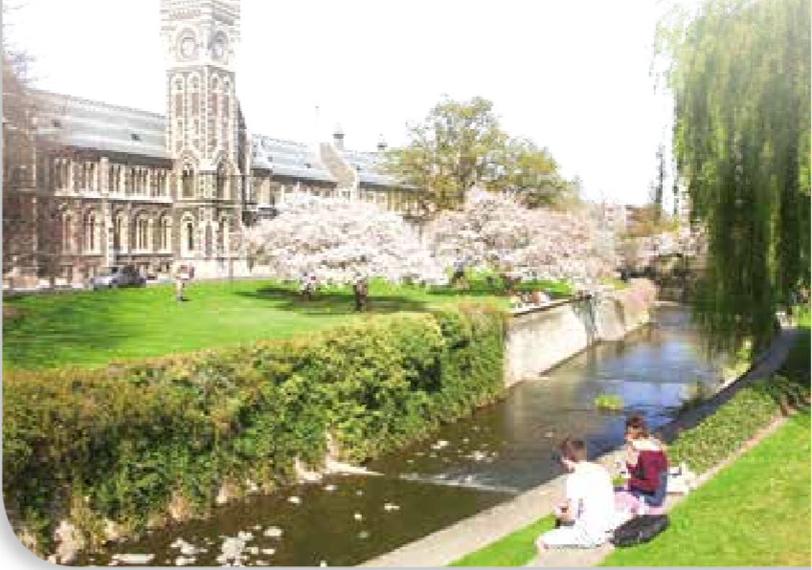
Activity 3 Look at the pictures and complete the travel journal entry with the words in the box. Use the structures you have learnt in this unit where appropriate.
find blow go see
fall relax enjoy run
Today, whilst walking along a peaceful
river running through a university
campus, I was amazed to find…

Slide 7
Activity 4
Work in pairs. Talk about a travel experience of your own that brought you closer to nature, using the structures you have learnt in this unit where appropriate.

Slide 8
Describing nature

Slide 9
Activity 5 Read the paragraph and answer the questions. Pay attention to the words in bold.
1 What does this paragraph mainly describe?
This paragraph mainly describes the beautiful appearance in the month of August.
2 What aspects does the author describe?
The author describes the skies, fields, flowers, orchards, trees, wheat and the quality of the light.

Slide 10
Activity 6
Put the words in Activity 5 into the boxes. Find out what they are used
to describe.
Sound
Colour
Action
clear,
green,
rich,
golden
blooming, bend, bow, piled, waving, sweeps, tinges, makes
loud
Shape
Smell
Sensation
fresh,
bleak,
gentle,
soft,
pleasant
thick clusters,
graceful sheaves
fresh,
sweet-smelling

Slide 11
Activity 6 Put the words in Activity 5 into the boxes. Find out what they are used to describe.
Now think of more words in each category and add them to the boxes. Then describe nature during your favourite season with the words you have learnt.

Slide 12

Activity 7 Listen to the conversation and answer the questions.
1 What book was the man reading?
The man was reading a book called Landmarks.
2 Why was the man annoyed?
3 What was the girl’s opinion?

Slide 13
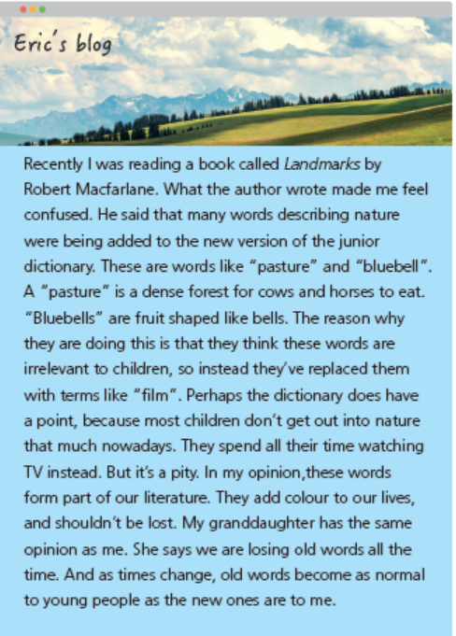
Activity 8
Listen to the conversation again and correct the mistakes in the man’s blog.
“annoyed” instead of “confused”
“now missing from” instead of “being added to”
“field of grass” instead of “dense forest”
“blue flowers” instead of “fruit”
“blog” instead of “film”
“on computers” instead of “watching TV”
“history” instead of “literature”
“a different opinion from” instead of “the same opinion
as”
“new words become as normal to young people as the old ones are to me” instead of “old words become as normal to young people as the new ones are to me”
Now work in pairs and act out the conversation.

Slide 14
Activity 9 Complete the boxes with the expressions from the conversation.
Giving examples
Giving explanations
• … such as…
• The main reason…
• …, for instance.
• Two reasons, I think.
• Consider…
The main reason…
… such as…
Two reasons, I think.
…, for instance.
Consider…

Slide 15
Activity 10
Work in pairs. Talk about your opinions of the issue discussed in
Activity 8 using the expressions in this section.
Now think about your performance. Have you actively participated in the discussion? What can you do to improve your performance?

Slide 16


