Slide 1

外研版英语 选择性必修第四册
Unit 1 Looking forwards
Period 1 Starting out & Understanding ideas

Slide 2

Watch the vidoe
1 | Who is mentioned ?
2 | His initial life choice
 | His final life's path
3 | Why he changed his decision
Lu Xun
To study Western medicine and become a doctor.
Abandoning his medical studies and taking up writing.
Because he realized that the people in China were more in need of treatment for their minds than their bodies. The more important thing was to change people’s spirit, and the best way to achieve this was through literature.

Slide 3
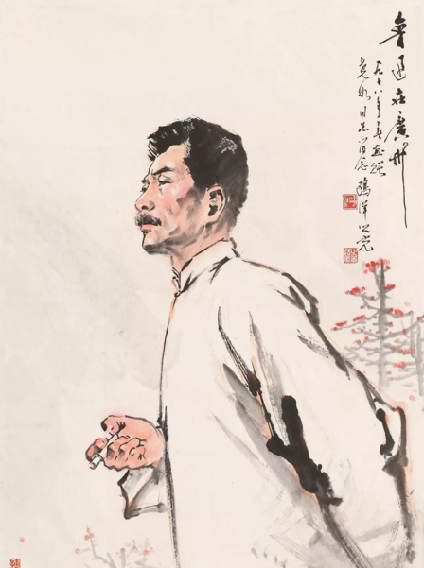
A most recognisable figure among writers of the 20th century.
◎ a student of Western medicine in his early life.
◎ abandoned medical studies and took up writing.
◎ He thought people from a weak and backward country would suffer or witness suffering.
◎ dedicated his life to teaching and inspiring young people to strive for a better future for China.

Slide 4
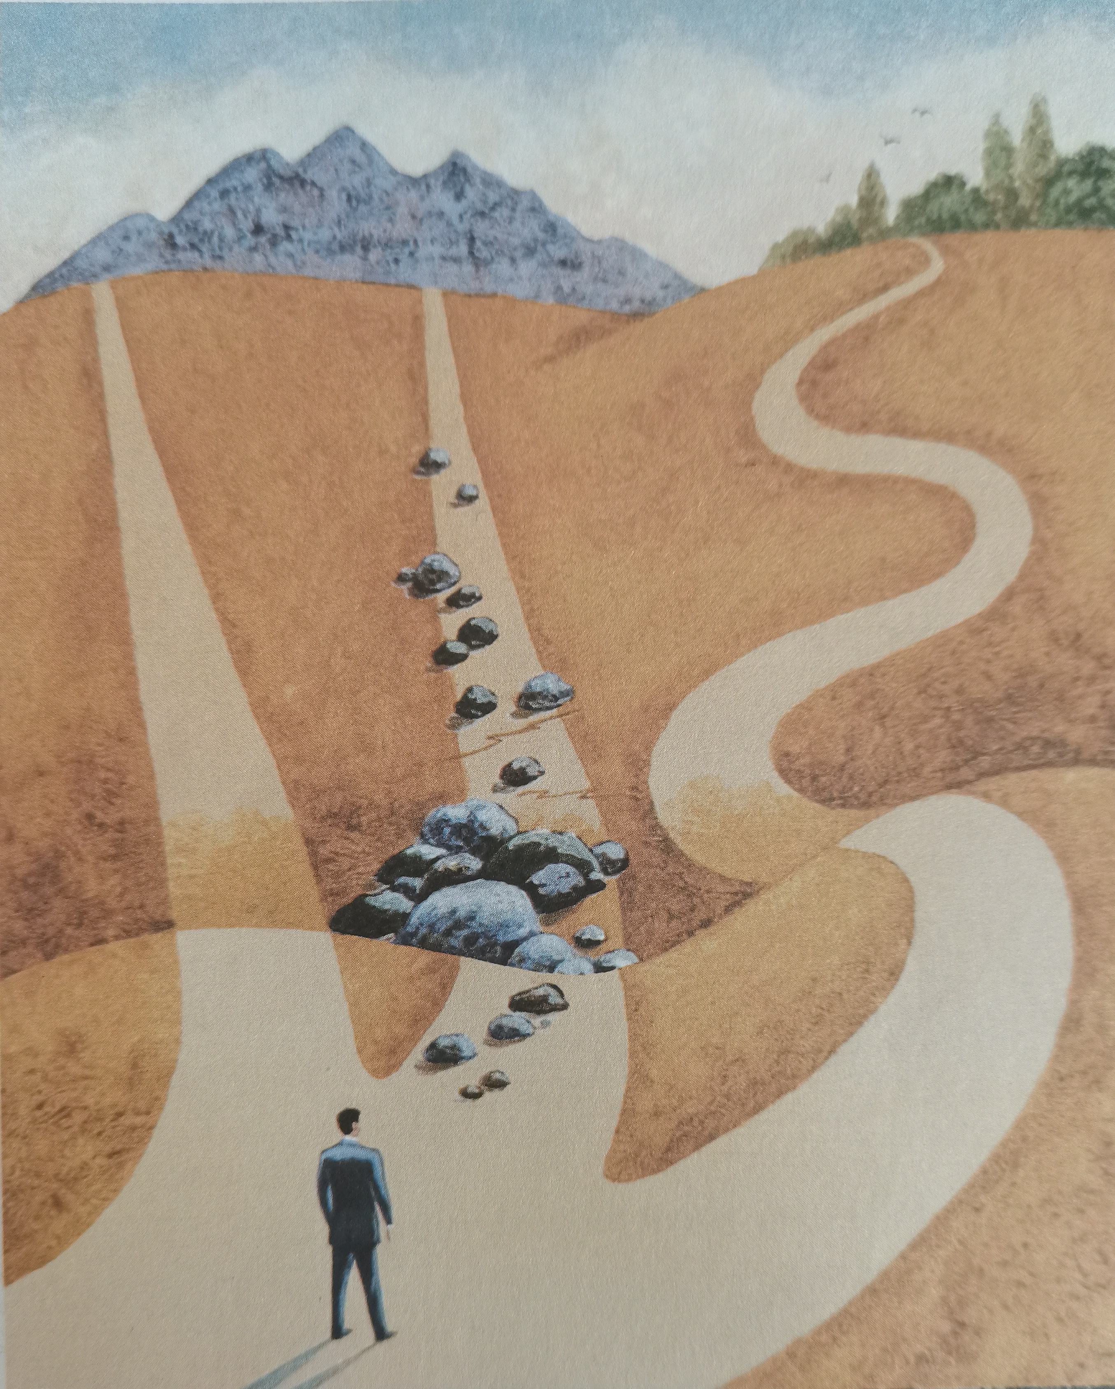
Look, think and say
▼ What can you see in the picture?
We can see three different paths in the picture. One man is standing in front of the three paths. He may be thinking about which about which one he should follow.

Slide 5
Different life's paths
▼ What are differences between the paths?
◎ The path on the left is very straight and smooth.
◎ The path in the middle is straight, but there are many rocks on it.
◎ The path on the right has many twists and turns. The two straights paths reach a mountain, while the winding one reaches a forest.
▼ How will you face your future life’s path?
◎ Whatever unexpected things may waiting for me, I should have a positive attitude towards life and try my best to create a better future.

Slide 6
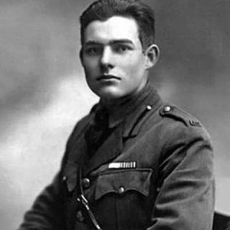
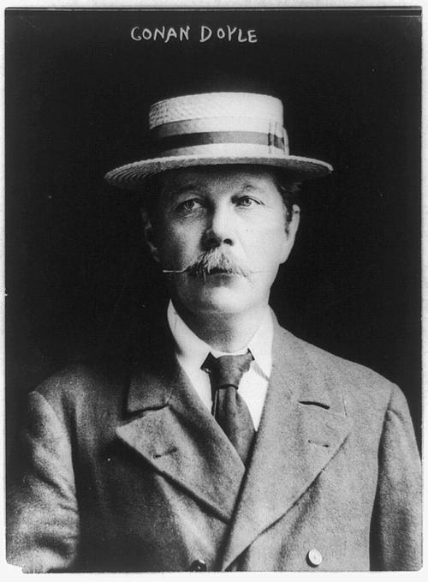
Facing the Future
Understanding ideas
▼ Predict the text is mainly about.
A. Different at the jobs people might do in the future.
B. Stories about different people's future.
C. Various possibilities for future development.
D. Fixed future for everyone.
Suggested answer: B .
Ernest Hemingway
Conan Doyle

Slide 7
Reading comprehension 1
Parts | Paragraphs | The main idea of each part
Part 1
Part 2
Part 3
Part 4
Para 1, 2
Different people may approach their future in contrasting ways.
Para 3
Hemingway was single-minded in his ambition to write and achieved great success in his careers.
Para 4, 5
Conan Doyle changed his original life’s choice and abandoned medicine for literature and achieved great success.
Facing the future, people should be prepared for the unexpected whatever difficulty they meet with in our life.
Para 6

Slide 8
Reading comprehension 2
1. What do you know about Ernest Hemingway according to the passage?
A. The old Man and the Sea got him to win the Nobel Prize in Literature.
B. His novels were based on the American Civil War.
C. He once served as a trainee in a newspaper in Cuba.
D. He was deep into writing ever since his early boyhood.
Answer: D

Slide 9
2. Arthur Conan Doyle _______________________.
A. was best known for his historical novels
B. was born Scotland in 1899
C. began to write his detective novels when he worked as a doctor
D. had an ambition to become a writer of detective novels
Answer: C

Slide 10
3. What can we infer from the passage？
A. Having plans in place for the future is a guarantee that they will become reality.
B. Whatever difficulty we meet with in our life, we should be prepared for the unexpected.
C. Hemingway had richer experience than Arthur Doyle in writing.
D. Both aauthors mentioned in the passage were fond of composing detective novles.
Answer: B

Slide 11
4. What can you learn from Paragraph 5?
A. Doyle managed to achieve his dream of write historical novels.
B. Doyle quitted medicial studies and only took up writing ultimately.
C. Readers spoke highly of Doyle's detective novels and were deep into the character of Sherlock Holmes.
D. Doyle's historical novels made him well-known to the public.
Answer: C

Slide 12
Reading comprehension 3
Match the questions to the paragraphs.
 | a | What is possibly the most important concern in life?
 | b | What was Doyle’s main writing ambition?
 | c | What can you do when faced with uncertainty about the future?
 | d | What is the relationship between one’s plan and the future?
 | e | Why was Doyle disappointed with the success of his Holmes stories?
 | f | What did Hemingway do to achieve his ambition to become a writer?
1
4
6
2
5
3

Slide 13
Reading comprehension 4
Ernest Hemingway
He was born in the US in 1899
He ①________________________________________since boyhood.
He wrote ②_____________________________
He won ③ ________________________________________________
had been single-minded in his ambition to write.
novels and short stories.
the Pulitzer Prize for Fiction and the Nobel Prize in Literature.

Slide 14
Arthur Conan Doyle
He was born in Scotland in 1859.
He first worked as ⑥______________ but⑦________________________________________________
He created ⑧___________________ Sherlock Holmes
He had wanted to be remembered for ⑨__________________ but ⑩___________________________________________.
a doctor
his main ambition was to become a writer of historical novels.
his fictional detective
his historical novels
he is best known for Sherlock Holmes to this day.

Slide 15
Similarities
They both ④_________________________
They shared ⑤_________________________________________
were ultimately successful.
the same ambitious and energetic approach to life.

Slide 16
Read and paraphrase
“So, whatever twists and turns you might encounter, takes a leaf out of the books of these two authors and be prepared for the unexpected.”
1. What do you know about “figures of speech”? What figure of speech is used in the expression “take a leaf of the book”?
2. What effect is the author aiming to achieve by using it?
Common figures of speech include “simile, metaphor, irony(反语), personification(拟人), pun(双关) etc.” Metaphor and pun are used in the expression above.
The author aims to maintain the readers' interest by using this figure of speech, and perhaps to end up a lighter note by using a pun.

Slide 17
Think & Share
1. What is your understanding of Steve Job’s words at the end of the passage?
2. What can you learn about facing the future from the two author?
What we went through in the past can be connected with your future.
On the way to success, we should get prepared for the unexpected and something may not turn out as planned.

Slide 18
Think & Share
3. What will you do to prepare yourself for the future?
I will keep up a good state mind and get prepared for the unexpected because I know everything can't turn out as expected.

Slide 19
Language appreciation
1. As many of us already know, having plans in place for the future is no guarantee that they will become reality.
[句式分析] 语境中，as引导非限制性定语从句；主句中，动名词短语having plans in place for the future充当主语，名词guarantee后接that引导的同位语从句，解释说明其具体内容
[尝试翻译] 正如我们许多人已经知道的那样，为未来制定计划并不能保证它们将成为现实。

Slide 20
Language appreciation
2. Having set himself this goal, he wrote novels and short stories based on his personal experiences of the the First World War, the Spanish Civil War, bullfighting and deep-sea fishing, among-st others.
[句式分析] having set himself this goal 为现在分词的完成式，在句子中作状语，表示动作set发生在谓语动作之前；而过去分词短语based on...充当其前面名词的后置定语，相当于定语从句 that/which were based on...
[尝试翻译] 为自己设定了这个目标后，他根据自己在第一次世界大战、西班牙内战、斗牛和深海捕鱼等方面的个人经历写了许多小说和短篇故事。

Slide 21
Language appreciation
3. Though both of the these men were ultimately successful, their paths to success were very different, their futures not necessarily turning out exactly as they planned.
[句式分析] 语境中，though 引导让步状语从句，“their futures not necessarily turning out exactly as they planned”为“名词+现在分词turning out”构成独立主格结构，其中 as they planned是as引导的方式状语从句。
[尝试翻译] 虽然这两个人最终都取得了成功，但他们通往成功的道路却截然不同，他们的未来并不一定如他们所计划的那样。

Slide 22
Language points
1. in the face of | 8. long to do ath
2. come one's way | 9. in desperation
3. in place | 10. kill off
4. be based on | 11. under immense pressure
5. in this respect | 12. turn out
6. by contrast | 13. twists and turns
7. to this day | 14. take a leaf out of one's books

Slide 23
Assignments for this period
1. Review the vocabulary and the language ponits of the text.
2. Listen to and read the text again.
3. Write a summary of the passage.

Slide 24
感谢您的观看

