Slide 1

外研版英语 选择性必修第四册
Unit 1 Looking forwards
Period 2 Using language

Slide 2
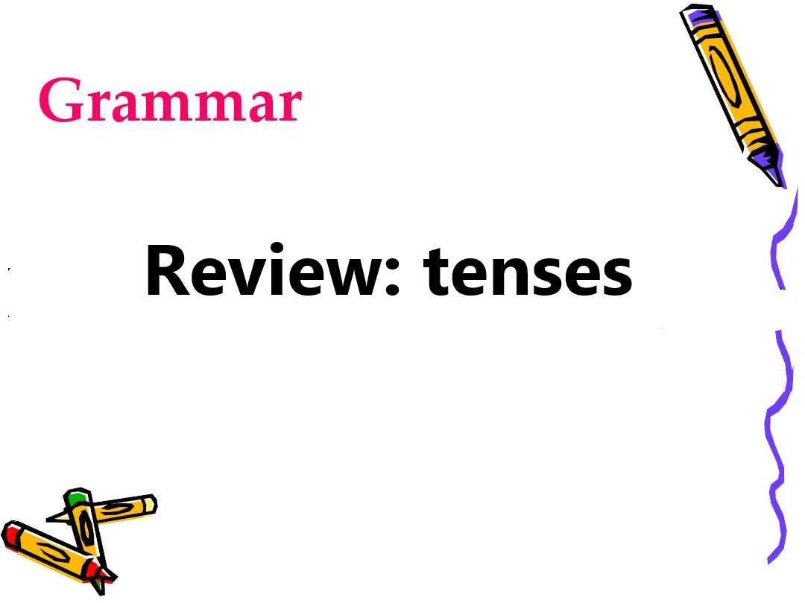
Part 1 Grammar

Slide 3
Different tenses, different usages
have done (现在完成时)
will be doing (将来进行时)
would do (过去将来时)
An action that started in the past and may still be going on or have just stopped.
An action or event taking place over a participate period in the future.
An intended future action or event as seen from the past.

Slide 4
had done (过去完成时)
was/were doing (过去进行时)
has/have been doing (现在完成进行时)
An action completed in the past before another past action.
An on-going situation at or around a particular time in the past.
An action that happened in a period of time up to the present.

Slide 5
Practice1
1. Mr Black had quitted his well-paid job and _______________(serve) as a volunteer in the club when I met him last month.
2. The number of medical schools reached 18 in the 1990s and ________________ (remain) around ever since.
3. By about 6000BC, people ________________(discover) the best crops to grow and animals to raise.
4. They were not sure how the Americans ____________(react) to the new type of music.
5. If you look at all sides of the situation, you will find a solution that _________(suit) everyone.
was serving
has remained
had discovered
would react
suits

Slide 6
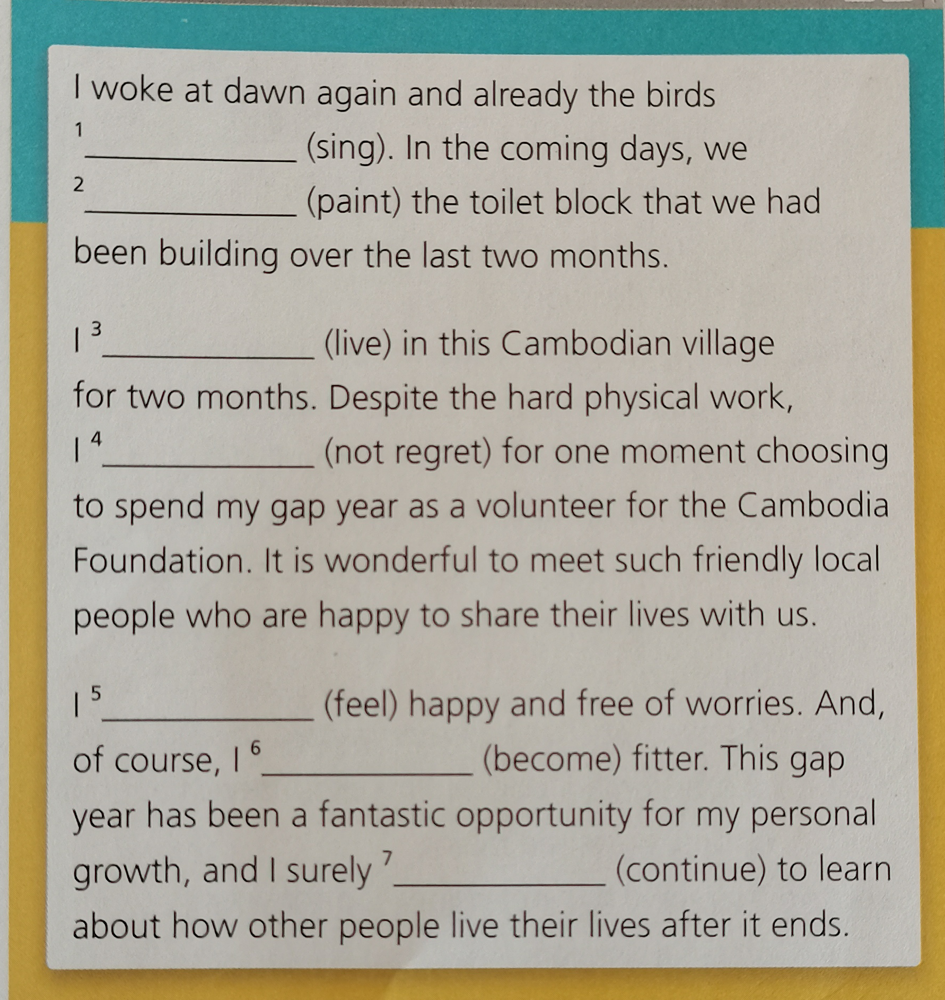
Practice 2
1.
2.
3.
4.
5.
6.
7.
were singing
would paint
have lived/
have been living
don't regret
am feeling
have become
will continue

Slide 7
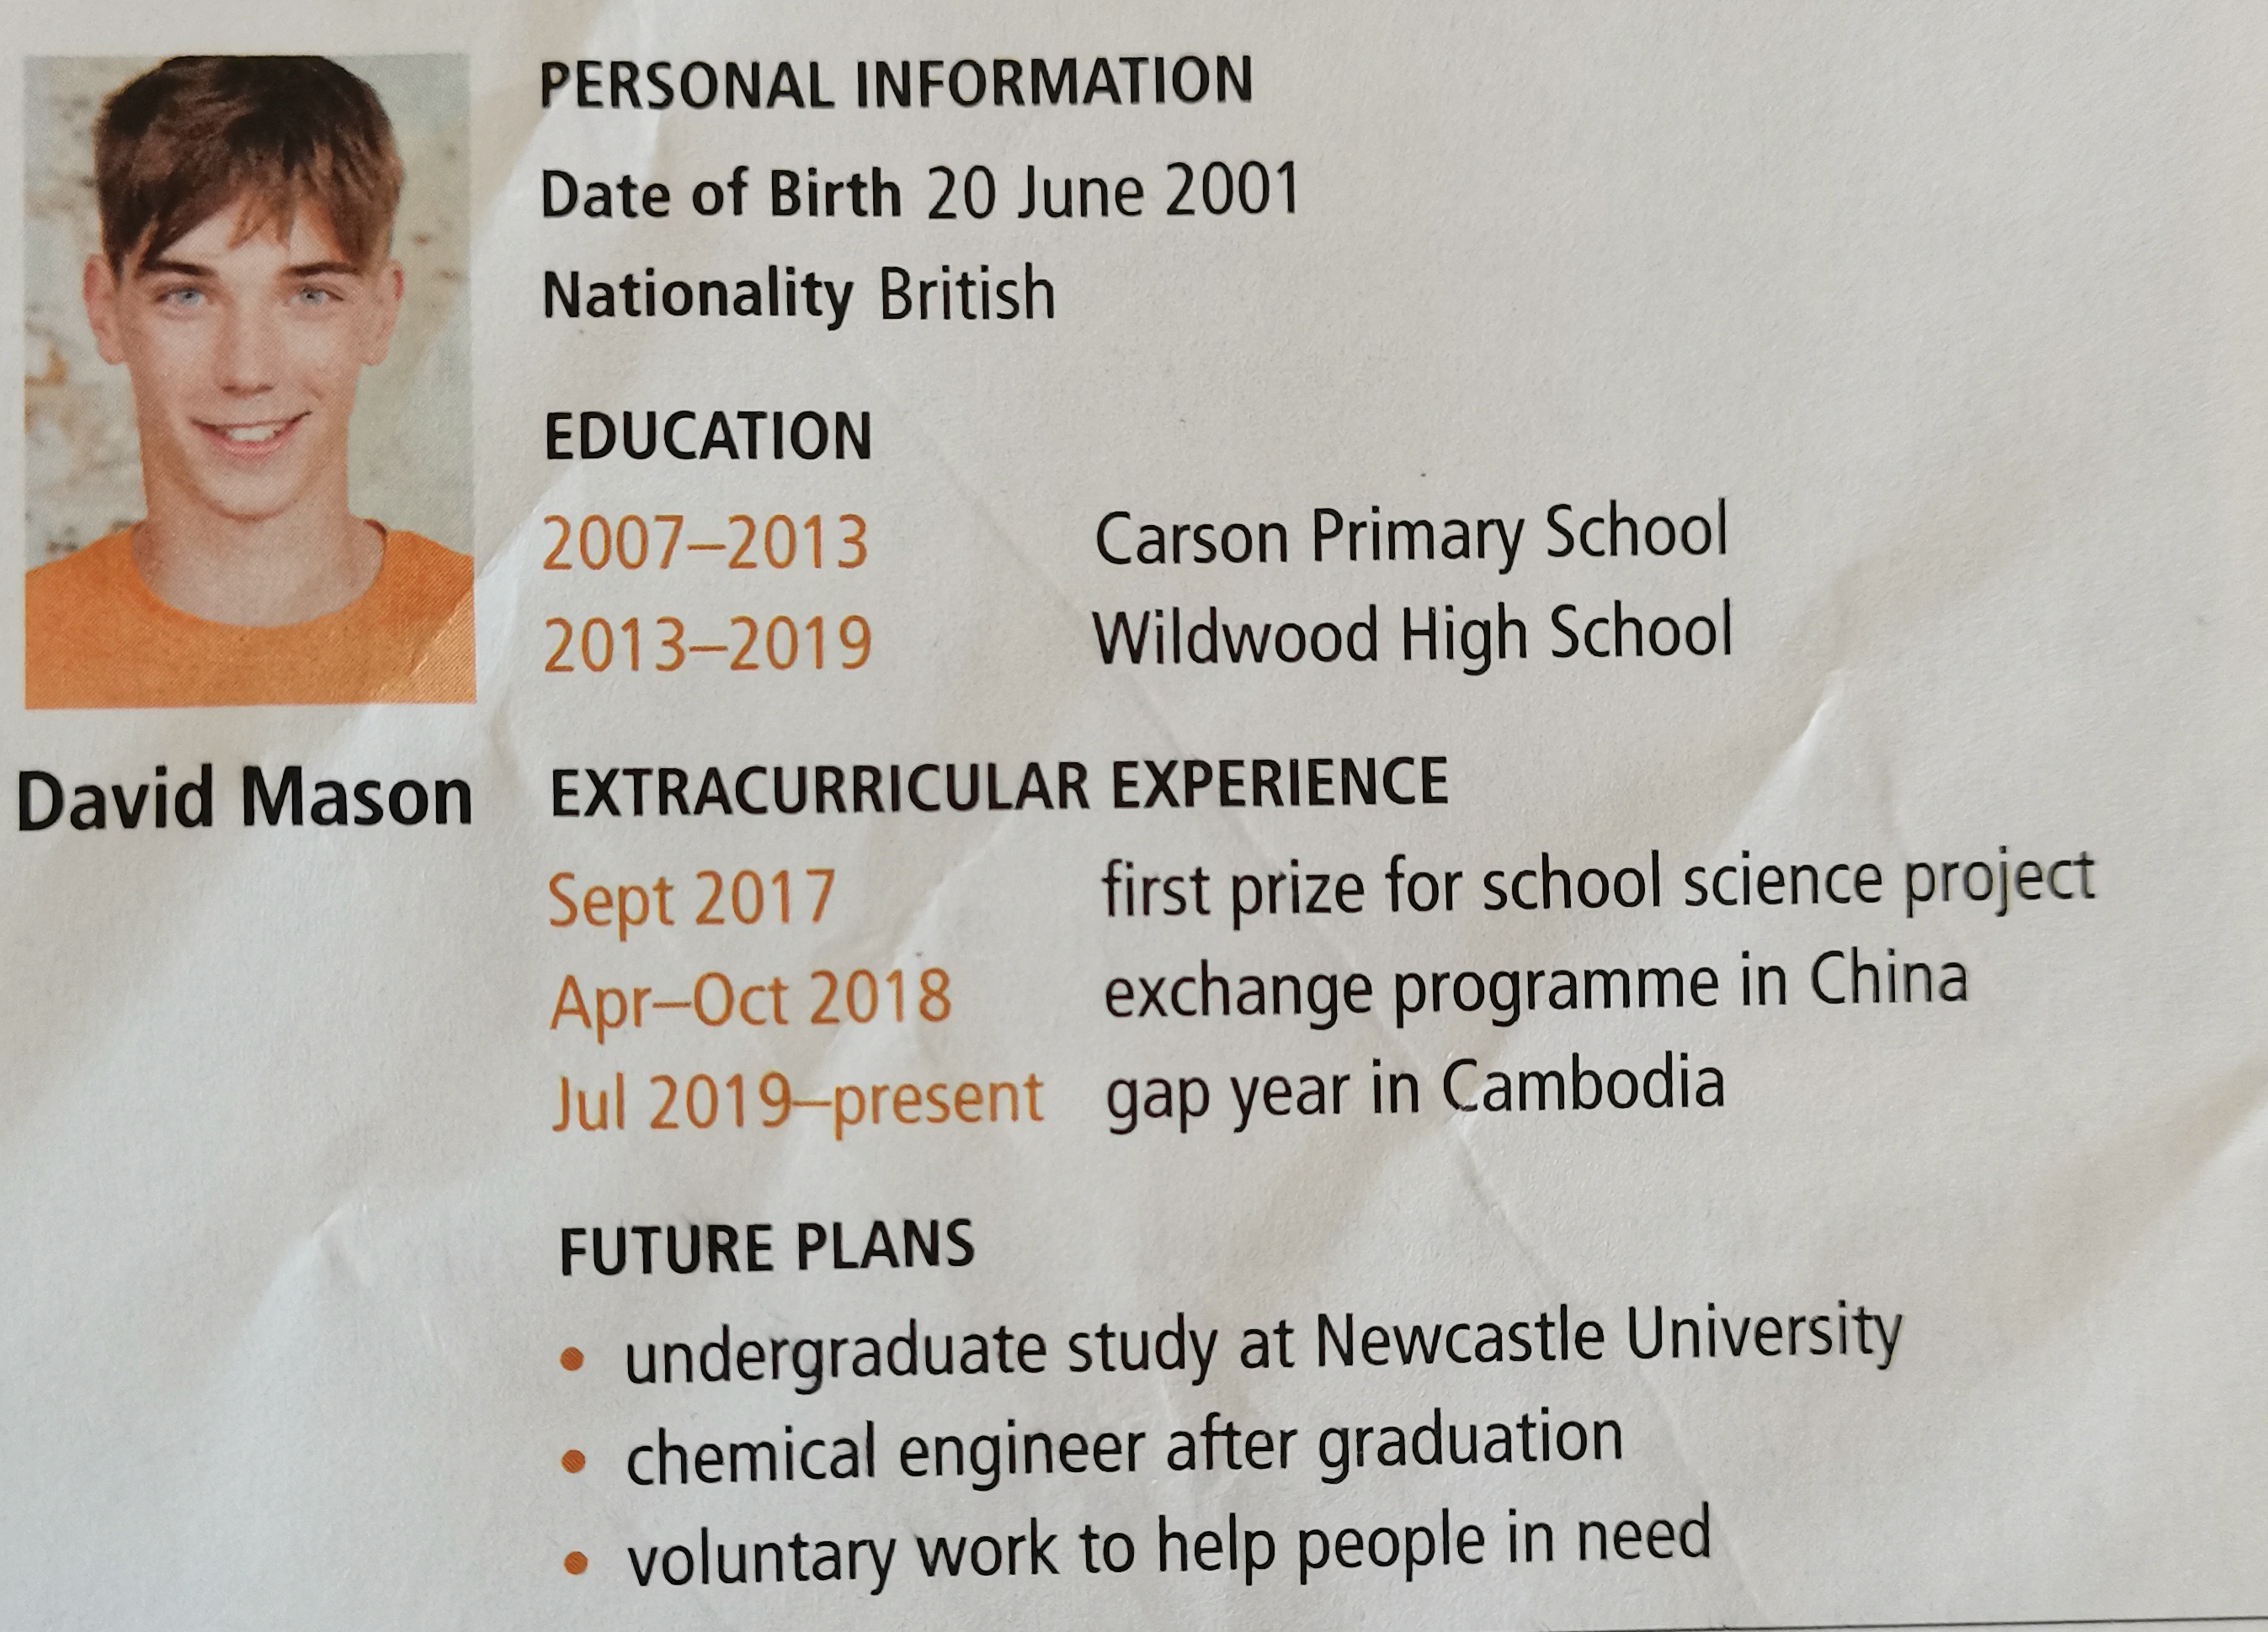
Practice 3

Slide 8
Talk about David's life
David was born 20th June, 2001 in Britain. He studied in Carson Primary School from 2007 to 2013 and in Wild-wood High School from 2013 to 2019. He is an excellent person and has his personal experience. For example, he won the first prize for school science project in September 2017. And he participated in an exchange program in China from April to October in 2018. He chose to spend his gap year in Cambodia in July 2019 and has been there up to to now.
He has already made his future plans. He will continue his undergraduate study at Newcastle University. After graduation, he will work as a chemical engineer and do some voluntary work to help people in need.

Slide 9
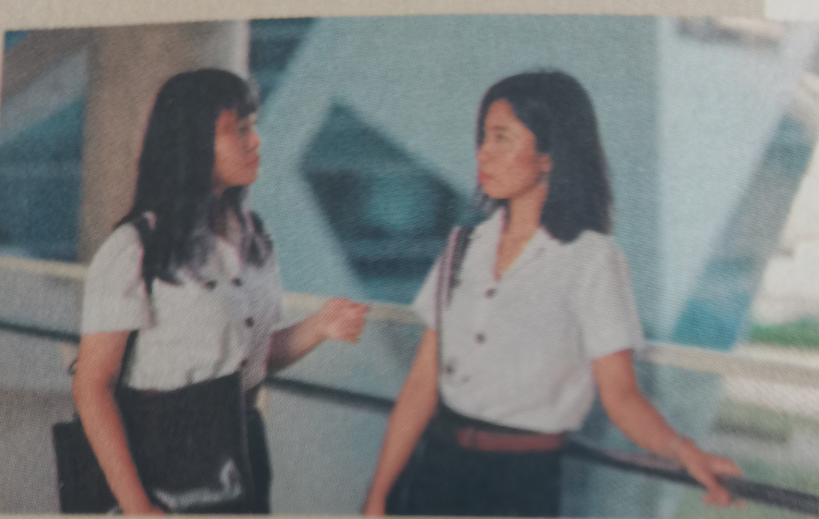
Li Ling's choices & decisions
Li Ling: I'm facing a difficult decision. I've been recommended for admission to study physics at my dream university. ......
but I had already decided to take the college entrance exam and apply to the Medical School there. I can't make up the mind what the right thing to do is.
Jenny：
I think it would be a great pity to pass up the opportunity to be admitted without taking the exam. ......

Slide 10
Talk about choices & decisions
1. What difficult decisions is Li Ling facing? Why is she feeling worried?
She has been recommended for admission to study physics at her dream university. However, she had already decided to take the college entrance exam and apply to the Medical School there. She doesn’t know whether she can make the right decision.
2. What does Jenny suggest to her?
Put off making a decision until she has spoken to her high school adviser.

Slide 11
3. What would you do when faced with a difficult decision?
Possible answer:
I will weigh up the possible options and turn to my parents and teachers for help before making the final decision.

Slide 12
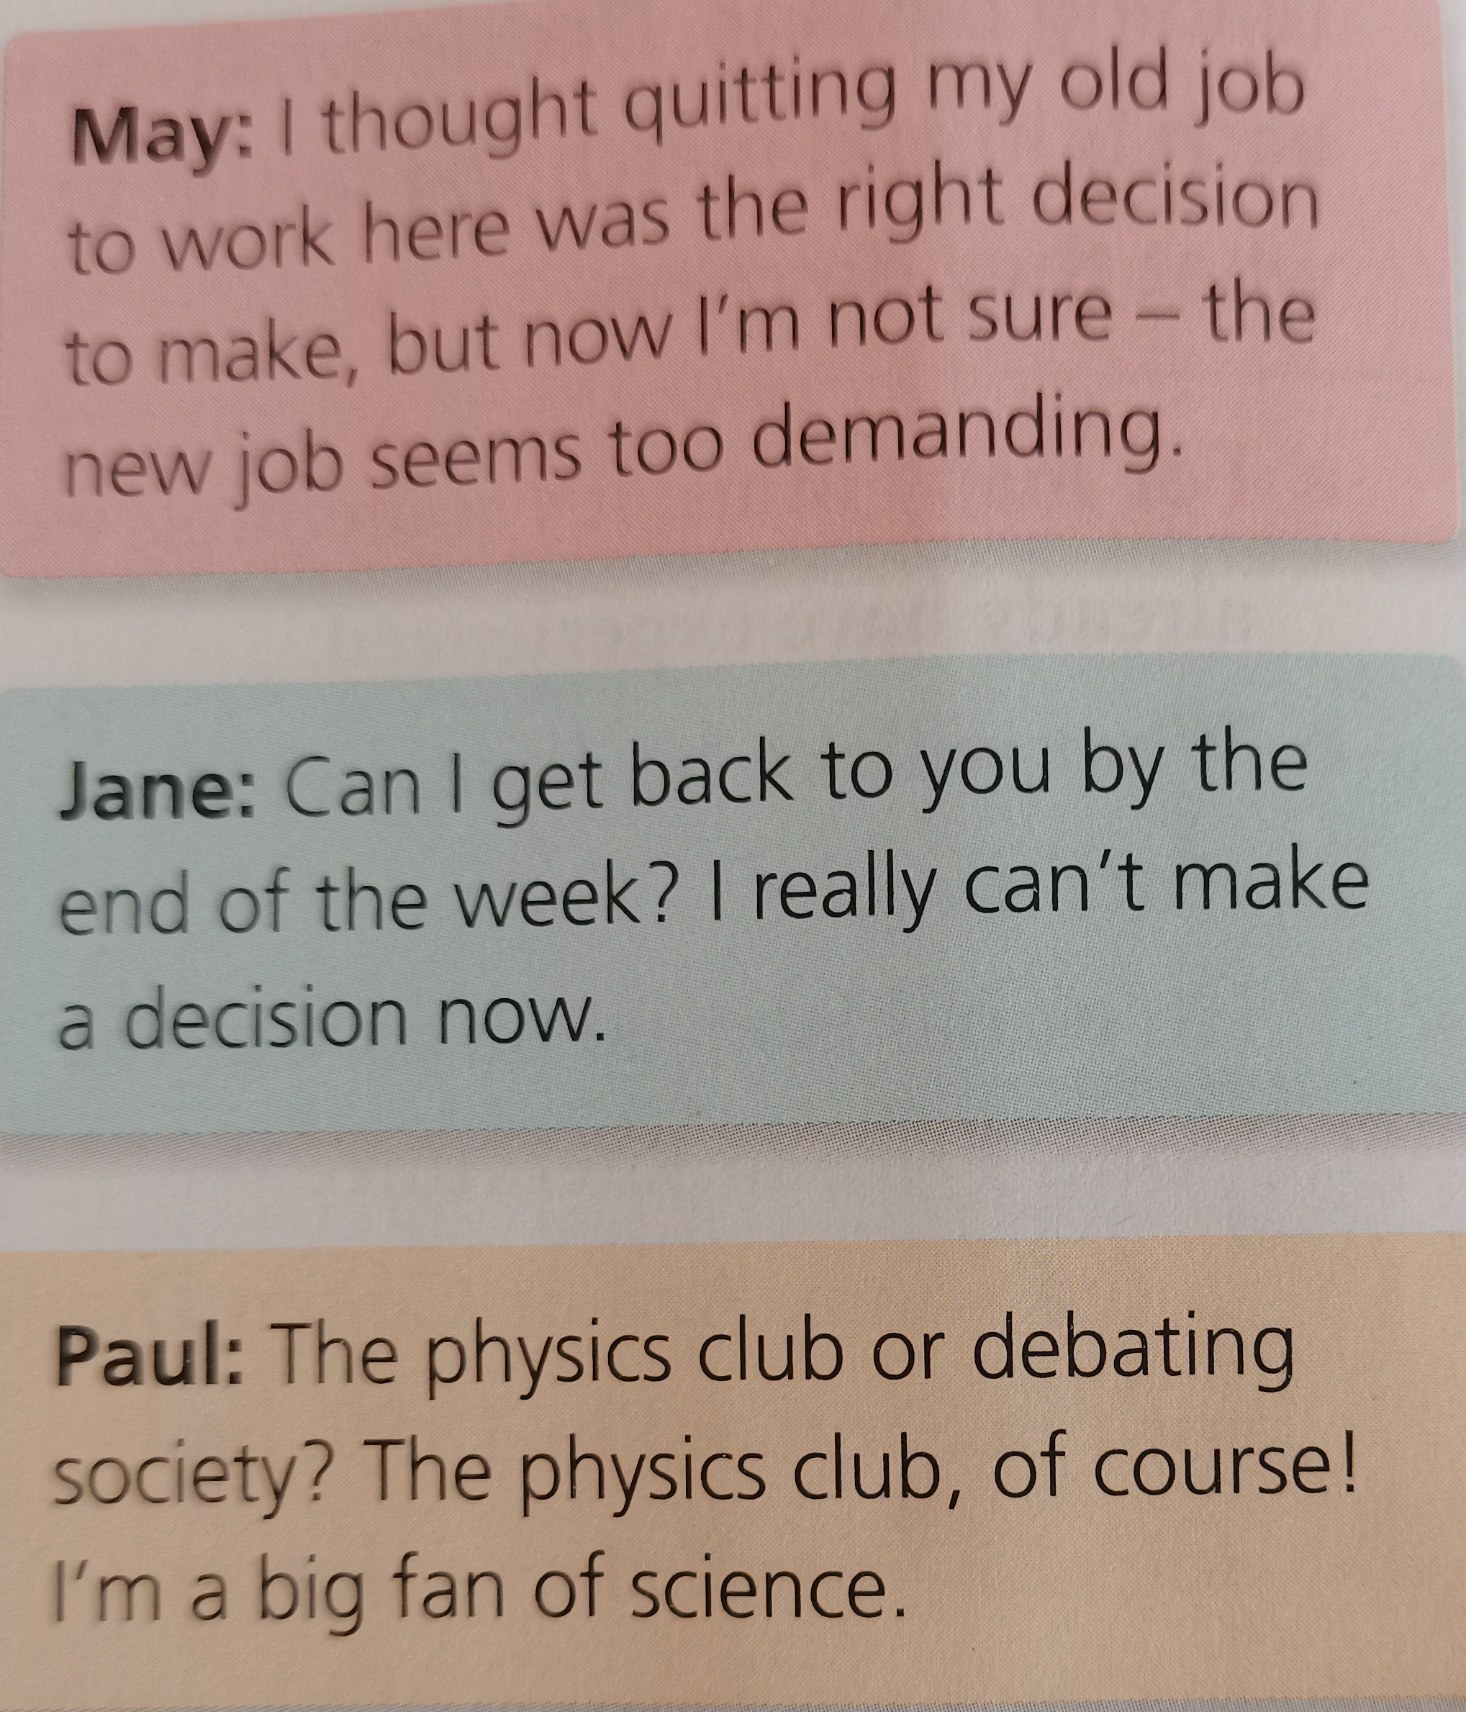
Different persons, different decisions
Mary is _______________________
Jane is __________________________
Paul finds it easy to___________________________
having second thoughts
to put off making a decision.
make up his mind.

Slide 13
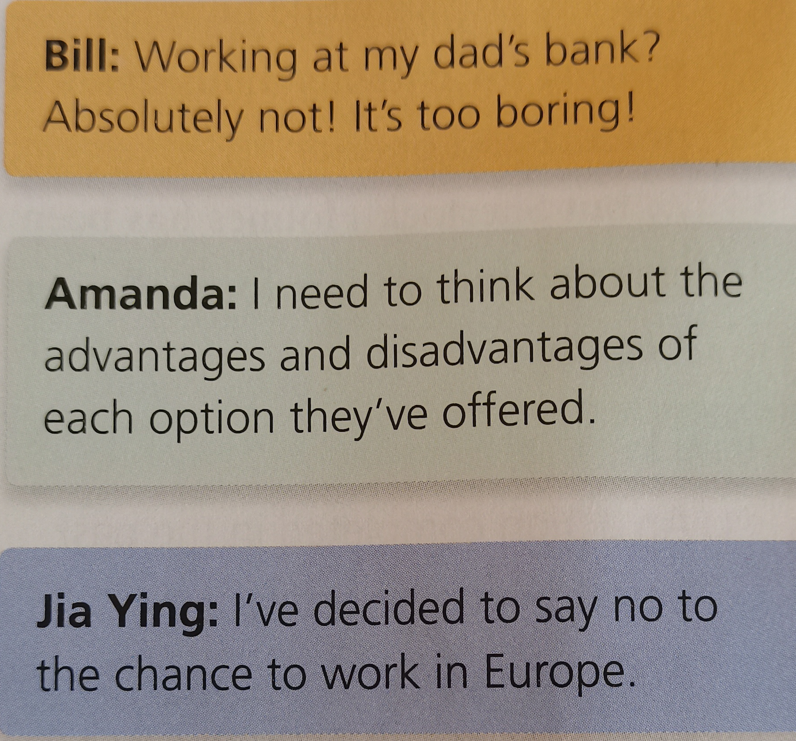
Bill is _____________________________
Amanda wants to ___________________
She has decided to______________________
rejecting anything out of hand.
weigh up the options.
pass up the opportunity.

Slide 14
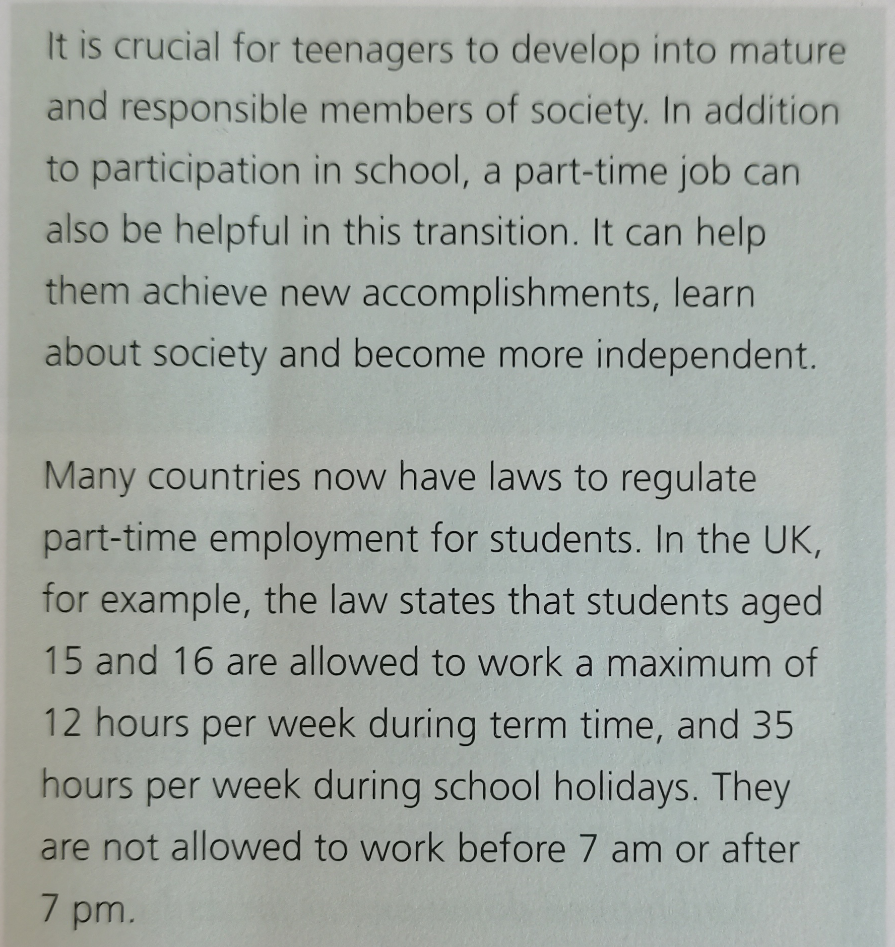
Part-time employment for teenagers

Slide 15
1. What can students achieve via part-time jobs?
Part-time jobs can be helpful for teenagers to develop into mature and responsible members of society, which can help them achieve new accomplishments, learn about society and become more independent.
2. What regulations are in place for students doing part-time jobs in the UK?
Students aged 15 and 16 are allowed to work a maximum of 12 hours per week during term time, and 35 hours per week during school holidays. They are not allowed to work before 7am or after 7pm.
3. Have you ever had a part-time job? Why did you do it?
Yes, I wanted to earn some pocket money and at the same time gain some experience for my future.

Slide 16
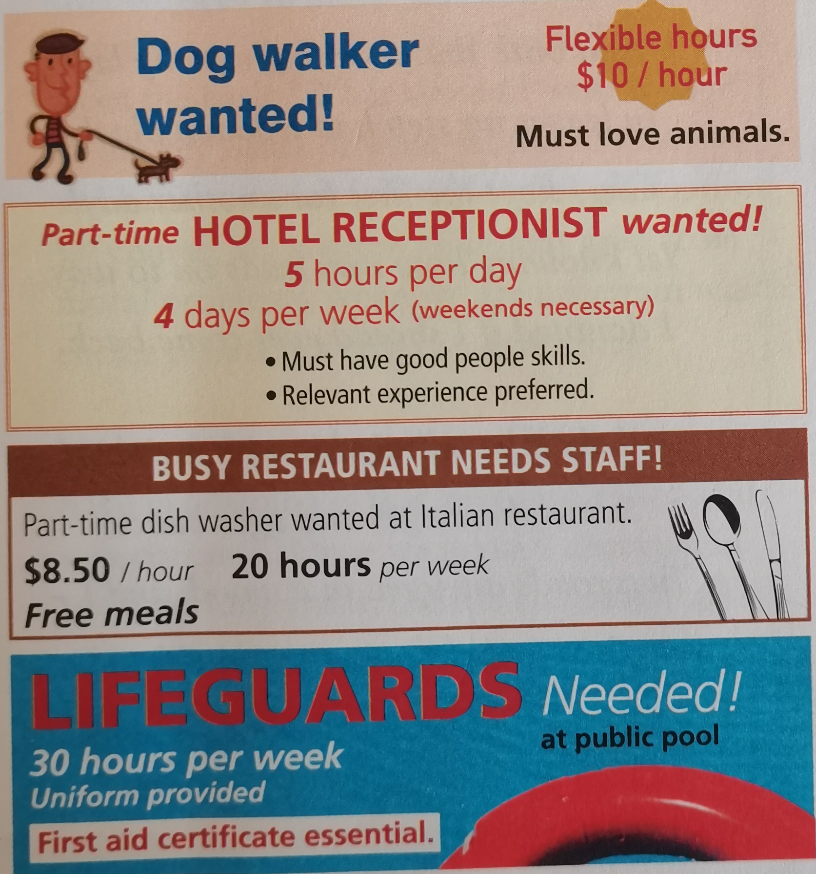
Listening
Rechard's choice of job
What job did Recard apply for?

Slide 17
Listen again
Why did Richard apply for this job? Because he has always been interested in ¹___________________________________
What did Richard do in his previous holidays? He worked in a youth hostel in Vietnam ² __________________________________ He worked ³ _________________ in Bali. He ⁴ ________________________ in Thailand.

Slide 18
Why does Richard believe he is suitable for the job? Because he is a ⁵ ___________________ and outgoing person, and feels happy when ⁶ ___________.His ⁷ ___________ have made him a flexible individual. ⁸ ________________ is relevant.
Why did Richard do part-time jobs? Because he ⁹ ______________ his holiday time. Because the experiences would ¹⁰ _________________________.

Slide 19
Asking polite questions & Giving reasons
A Would you mind...? | E May I ask why...?
B The reason is... | F It’s because...
C Could you tell me...? | G I’d say it’s due to...
D ..., if you wouldn’t mind. | H Would you explain...?
 | I It’s a result of...
Asking polite questions | Giving reasons
A/ C/ D/ E/ H
B/ F/ G/ I

Slide 20
Language appreciation
1. But what if I don’t do well enough in the exam to get into the Medical School?
[句式分析] What if...? 意为：如果...怎么办？ 这是约定俗成的省略形式，该结构中if引导假设条件从句，而主句采用省略表示邀请或建议。
[尝试翻译] 但是如果我没有考好，考不进入医学院怎么办?

Slide 21
Language appreciation
2. I think it would be a great pity to pass up the opportunity to be admitted without taking the exam.
[句式分析] I think 后接宾语从句。it为从句的形式主语，真正的主语为不定式短语to pass up the opportunity to be admitted without taking the exam，其中的不定式短语to be admitted作名词opportunity的后置定语。
[尝试翻译] 我认为不参加考试就放弃被录取的机会将是非常遗憾的。

Slide 22
Language points
1. make up one's mind | 7. What's up?
2. pass up | 8. What if...?
3. have second thoughts | 9. in addition to...
4. put off | 10. a maximum of ...
5. reject... out of hand | 11. up to the present
6. weigh up | 12. at dawn

Slide 23
Assignments for this period
1. Review the vocabulary and the language ponits of the text.
2. Listen to the interview on Page 7 again.
3. Review different tenses.

Slide 24
感谢您的观看

