Slide 1

外研版英语 选择性必修第四册
Unit 1 Looking forwards
Period 3 Developing ideas & Presenting ideas

Slide 2
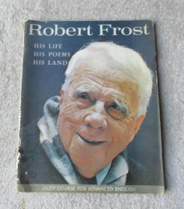
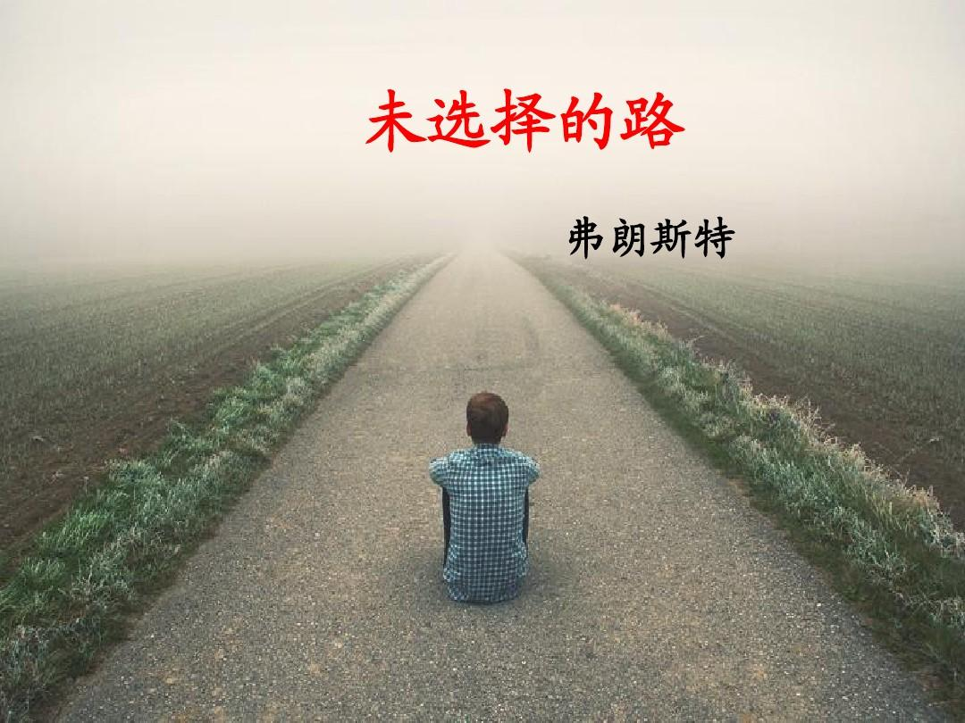
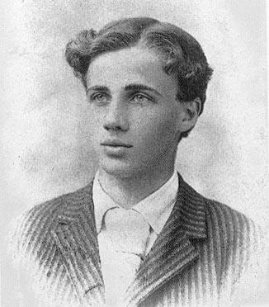
Robert Frost
(1874-1963)
The Road Not Taken

Slide 3
Nationality
Masterpiece of poetry
Poetic features
An America's most famous poet
Mountain Interval (The Road Not Taken)
◎ His poetry is famous for its natural themes and his colloquial approach to American language.
◎ His poetry generally has a regular rhythm and rhyme, and is easy to read aloud and remember.
◎ He often used simple setting in his poems to explore complex personal and social themes.

Slide 4
Another poem written by Robert Frost
Neither Out Far Nor In Deep
The people along the sand. All turn and look one day. They turn their back on the land. They look at the sea all day. As long as it takes to pass A ship keeps raising its hull; Reflects a standing gull. | The land may vary more; But wherever the truth may be-- The water comes ashore, And the people look at the sea, They cannot look out far. They cannot look in deep. But when was that ever a bar To any watch they keep?

Slide 5
Part One: reading the poem
Summary of the poem
A traveller in the wood comes to a fork in the road and he feels sorry for ¹ _____________. After close observation, he decides to choose the one which ² _____________________, though ³ __________________________________. He tells himself ⁴ ______________________ some day, but he doubts ⁵_______________________. He imagines that, many years in the future, he will tell this story with a sign, saying that his choice has ⁶ ___________________.
not travelling both
is grassy and want wear
the passing there has worn them about the same
The Road Not Taken
the will keep the first
if he should ever come back
made all the difference

Slide 6
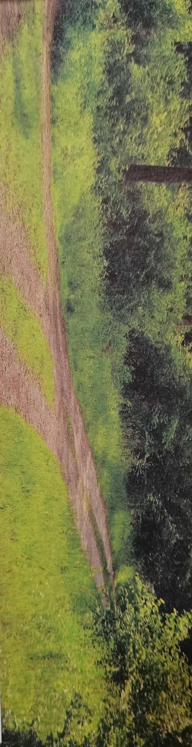
Reading comprehension: Appreciation & interpretation
1. According to the 1st paragraph, which of the following statements is true?
A. The poem The Road Not Taken often appears on television commercials.
B. Speakers hardly quote lines of the poem The Road Not Taken in the public speech.
C. The poem The Road Not Taken is well known just for its thoughtful insights into nature.
D. Among American poetry, The Road Not Taken is the most popular with readers.
Answer: (A)

Slide 7
2. What does the author think of the choice we make according to the passage?
A. It is necessary for us to doubt the choice we have already made.
B. All we can do after making a choice is look forward without regret.
C. We can go back though we have make a choice in all circumstances.
D. All the choices we made can lead to a specific consequence.
Answer: (B)

Slide 8
4. Except the part of the poem, what does the text mainly talk about?
A. The explanation and interpretation of the poem The Road Not Taken.
B. The reason why the poem The Road Not Taken was composed.
C. The purpose of Frost’s writing the poem The Road Not Taken.
D. The reason why the poem The Road Not Taken is so popular.
Answer: (A)

Slide 9
Appreciation and interpretation
◎ It is one of the most famous American poems of all time.
◎ The diverged roads in the poem symbolize
7 ________________________________________________________.
◎ Once we have taken a road, we might wonder
8 ________________________________________. Instead of looking back with regret, we should 9 _________________________________________.
the choice that we face and the decision that we need to make
which choice results in doing the right thing
be facing our future with energy and optimism

Slide 10
Think & Share
1. Why do you think the writer looks back on his decision “with a sigh” ?
2. What are the rhyming words in this poem? What effect do they have?
Because he doesn’t know whether he has made the right choice.
◎ wood/ stood/ could; both/ undergrowth; fair/ wear/ there;
claim/ same/; lay/ day/ way; black/ back; sigh/ I/ by; hence/ difference.
◎ They can read smoothly.

Slide 11
Think & Share
3. What is the most difficult choice you have ever had to make? What did you choose to do?
4. What effect will the poem on you when you face decisions in the future?
When I decided whether to learn literal arts or science at the senior high school, I feel extremely disturbed. At last, I chose to major in science.
No matter which road I may choose, I will never regret.

Slide 12
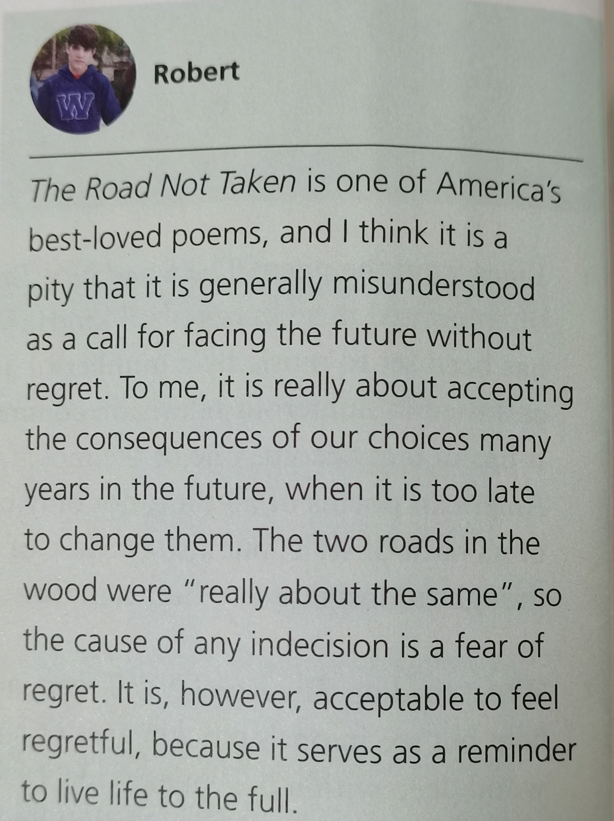
Post reading: compare two interpretations
Discuss and report
◎ What points do the two interpretations share?
◎ What are the major differences between the two interpretations?
◎ Which interpretation seems more convincing to you? Why?

Slide 13
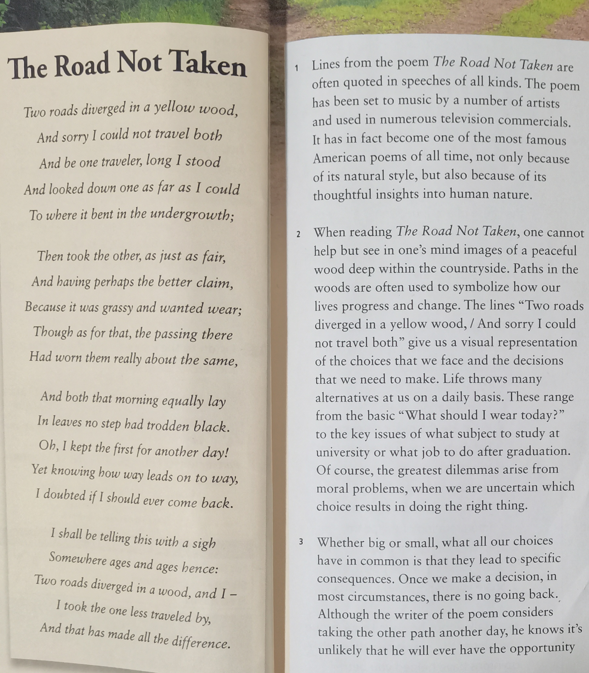
Points in common
Differences
Your opinion
The poem The Road Not Taken is one of America's best-loved poems and it's about choice.
The one in the text interprets the poem as a call for the future without regret.
The 2nd interpretation maintains the poem is really about accepting the consequences of our choices years in the future when it's too late to change then.
I think the one in the text is more convincing. For one thing, its analysis accords with my past experience.
For another thing, the text enables me to learn how to make a decision more widely in the future.

Slide 14

Part Two: Writing an application letter
A job advertisement
How to write an application letter?

Slide 15
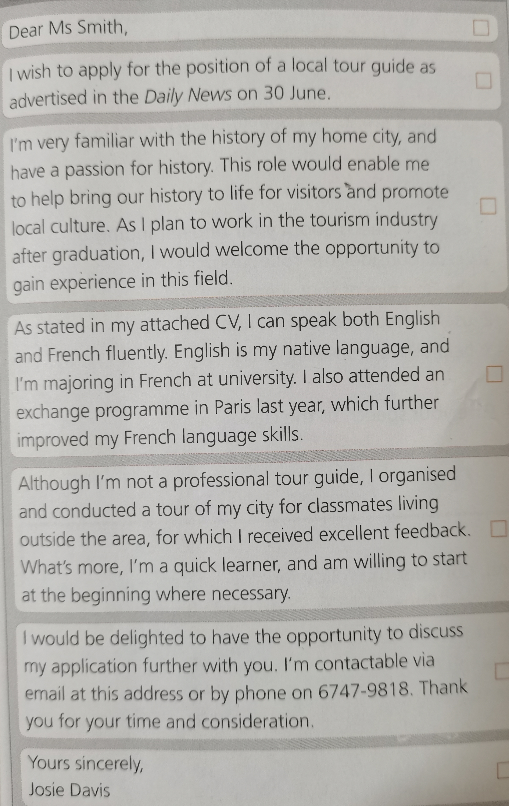
The structure of an application letter
1
2
3
4
5
6
7
a Stating relevant past experience
b Ending by restating interest & contacts
c Stating qualifications required
d Formal signing off
e Formal greeting
f Stating personal interest & career choice
g Stating purpose of the letter, including position applied for and how applicant came to know about it
Answer: 1-e 2-g 3-f 4-c 5-a 6-b 7-d

Slide 16

Practice writing
Here is an job advertisement

Slide 17
Possible version
Dear Sir or Madam,
I am writing to apply for the position of the office assistant advertised on the Internet. The following are my advantages.
I once worked in the local newspaper as an assistant so I have the previous experience. Not only do I have an interest in online technology, but also I have got well-prepared for a variety of tasks, including document filing, photocopying and arranging refreshments. Because I have a good command of English, which makes it easy for me to communicate with others.
I am confident that I am the best fit for the position. I would really appreciate it if you could take my application into consideration and I am looking forward to receiving your reply as early as possible.
Yours sincerely,
Li Hua

Slide 18
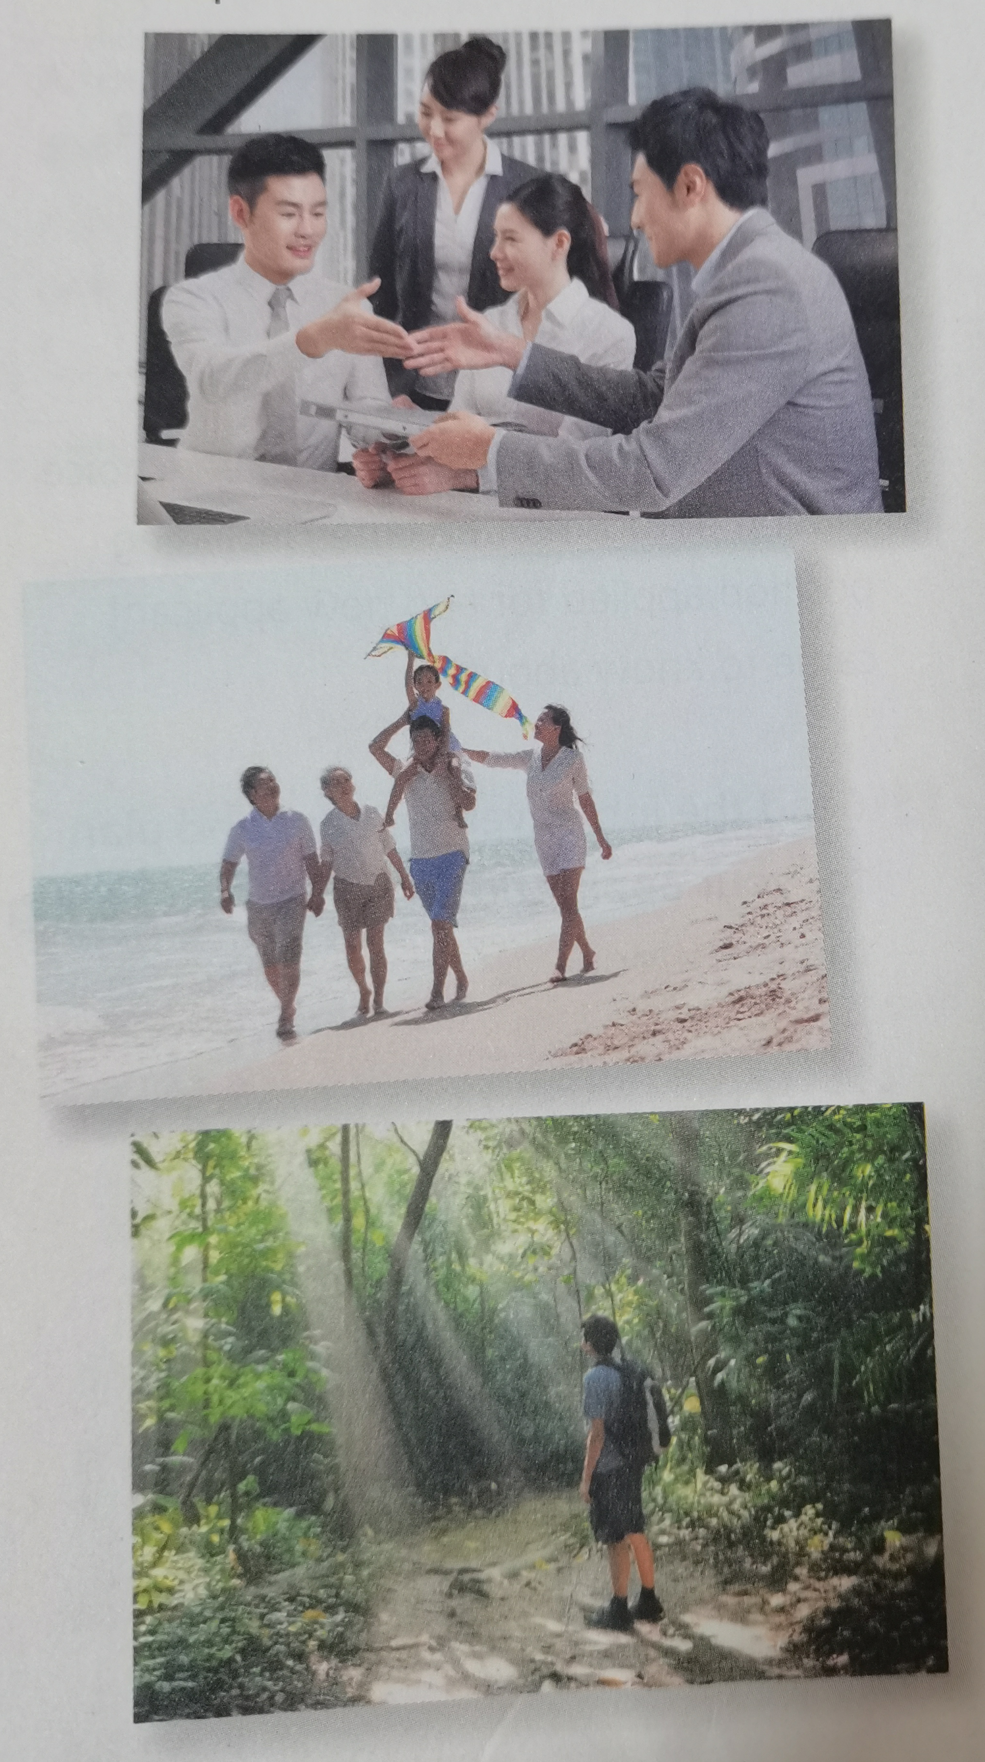
Part Three: Presenting ideas
What kind of life does each picture show?
The 1st picture shows a successful business life.
The 2nd picture shows a happy family.
The 3rd one shows a life close to nature.

Slide 19
Discuss your understanding of success.
Everyone wants to succeed in their life. As a teenager, I believe I can achieve success in my life. What's the most important is doing well in school.
Education will help you be a productive member in society. Try my best for excellence in school: listen to the teachers, do your homework, study, and get good grades. Doing so will help me get into a better university, which will enable me to have a bright future.

Slide 20
Language appreciation
1. Whether big or small, what all our choices have in common is that they lead to specific consequences.
[句式分析] whether ... or...意为“不管...还是...”, 引导让步状语， what all our choices have in common 是what引导的主语从句， what 在从句中作表语；that引导表语从句。
[尝试翻译] 无论大小，我们所有的选择都有一个共同点，那就是它们都会导致特定的结果。

Slide 21
Language appreciation
2. Like the writer, all we can do is look backwards “with a sigh” and imagine what could have been.
[句式分析] we can do 为省略关系词that的定语从句，修饰先行词all；look backwards “with a sigh” and imagine 为省略不定式符号to的动词不定式短语作表语；what could have been是what引导的宾语从句，作imagine的宾语。
[尝试翻译] 和作者一样，我们所能做的就是叹息着回顾过去，想象本来会发生什么。

Slide 22
Language appreciation
3. This sigh, this wondering whether we made the right choice, is understandable.
[句式分析] This sigh, this wondering whether we made the right choice在句子中作主语，其中whether引导同位语从句，解释说明动名词wondering的具体内容。
[尝试翻译] 这种叹息，这种怀疑我们是否做出了正确的选择，是可以理解的。

Slide 23
Language points
1. in the face of | 8. long to do ath
2. come one's way | 9. in desperation
3. in place | 10. kill off
4. be based on | 11. under immense pressure
5. in this respect | 12. turn out
6. by contrast | 13. twists and turns
7. to this day | 14. take a leaf out of one's books

Slide 24
Assignments for this period
1. Review the vocabulary and the language ponits of the text.
2. Consolidate how to write an application letter.
3. Polish your writing-- an application letter written in class.

Slide 25
感谢您的观看

