Slide 1

外研版高中英语 选择性必修第四册
Unit 2 Lessons in life
Period 1 Starting out & Understanding ideas

Slide 2

Watch the vidoe and fill in the form.
1 | Life in the story is compared to _________
2 | Rocks | ➞
 | Pebbles | ➞
 | Sand | ➞
 | Tea | ➞
3 | What are the “rocks” in your life?
a jar.
the most important things in our life.
the other important things we need to keep our life going.
all the little things in life.
the time we can have a cup of tea and a talk with a good friend.

Slide 3
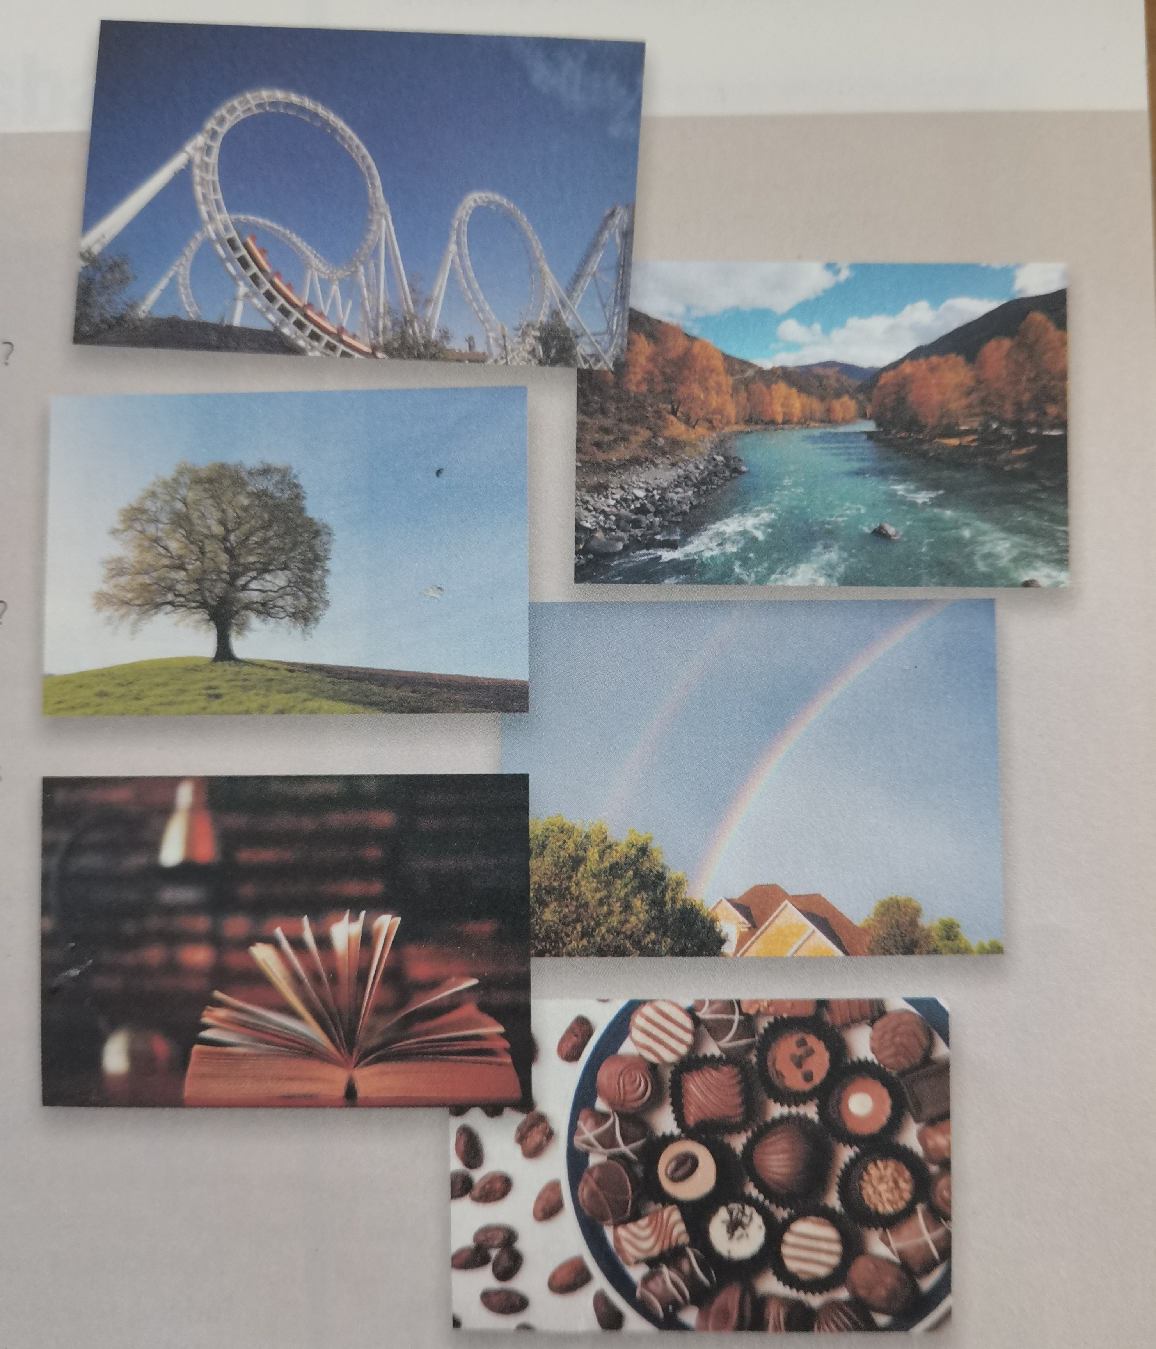
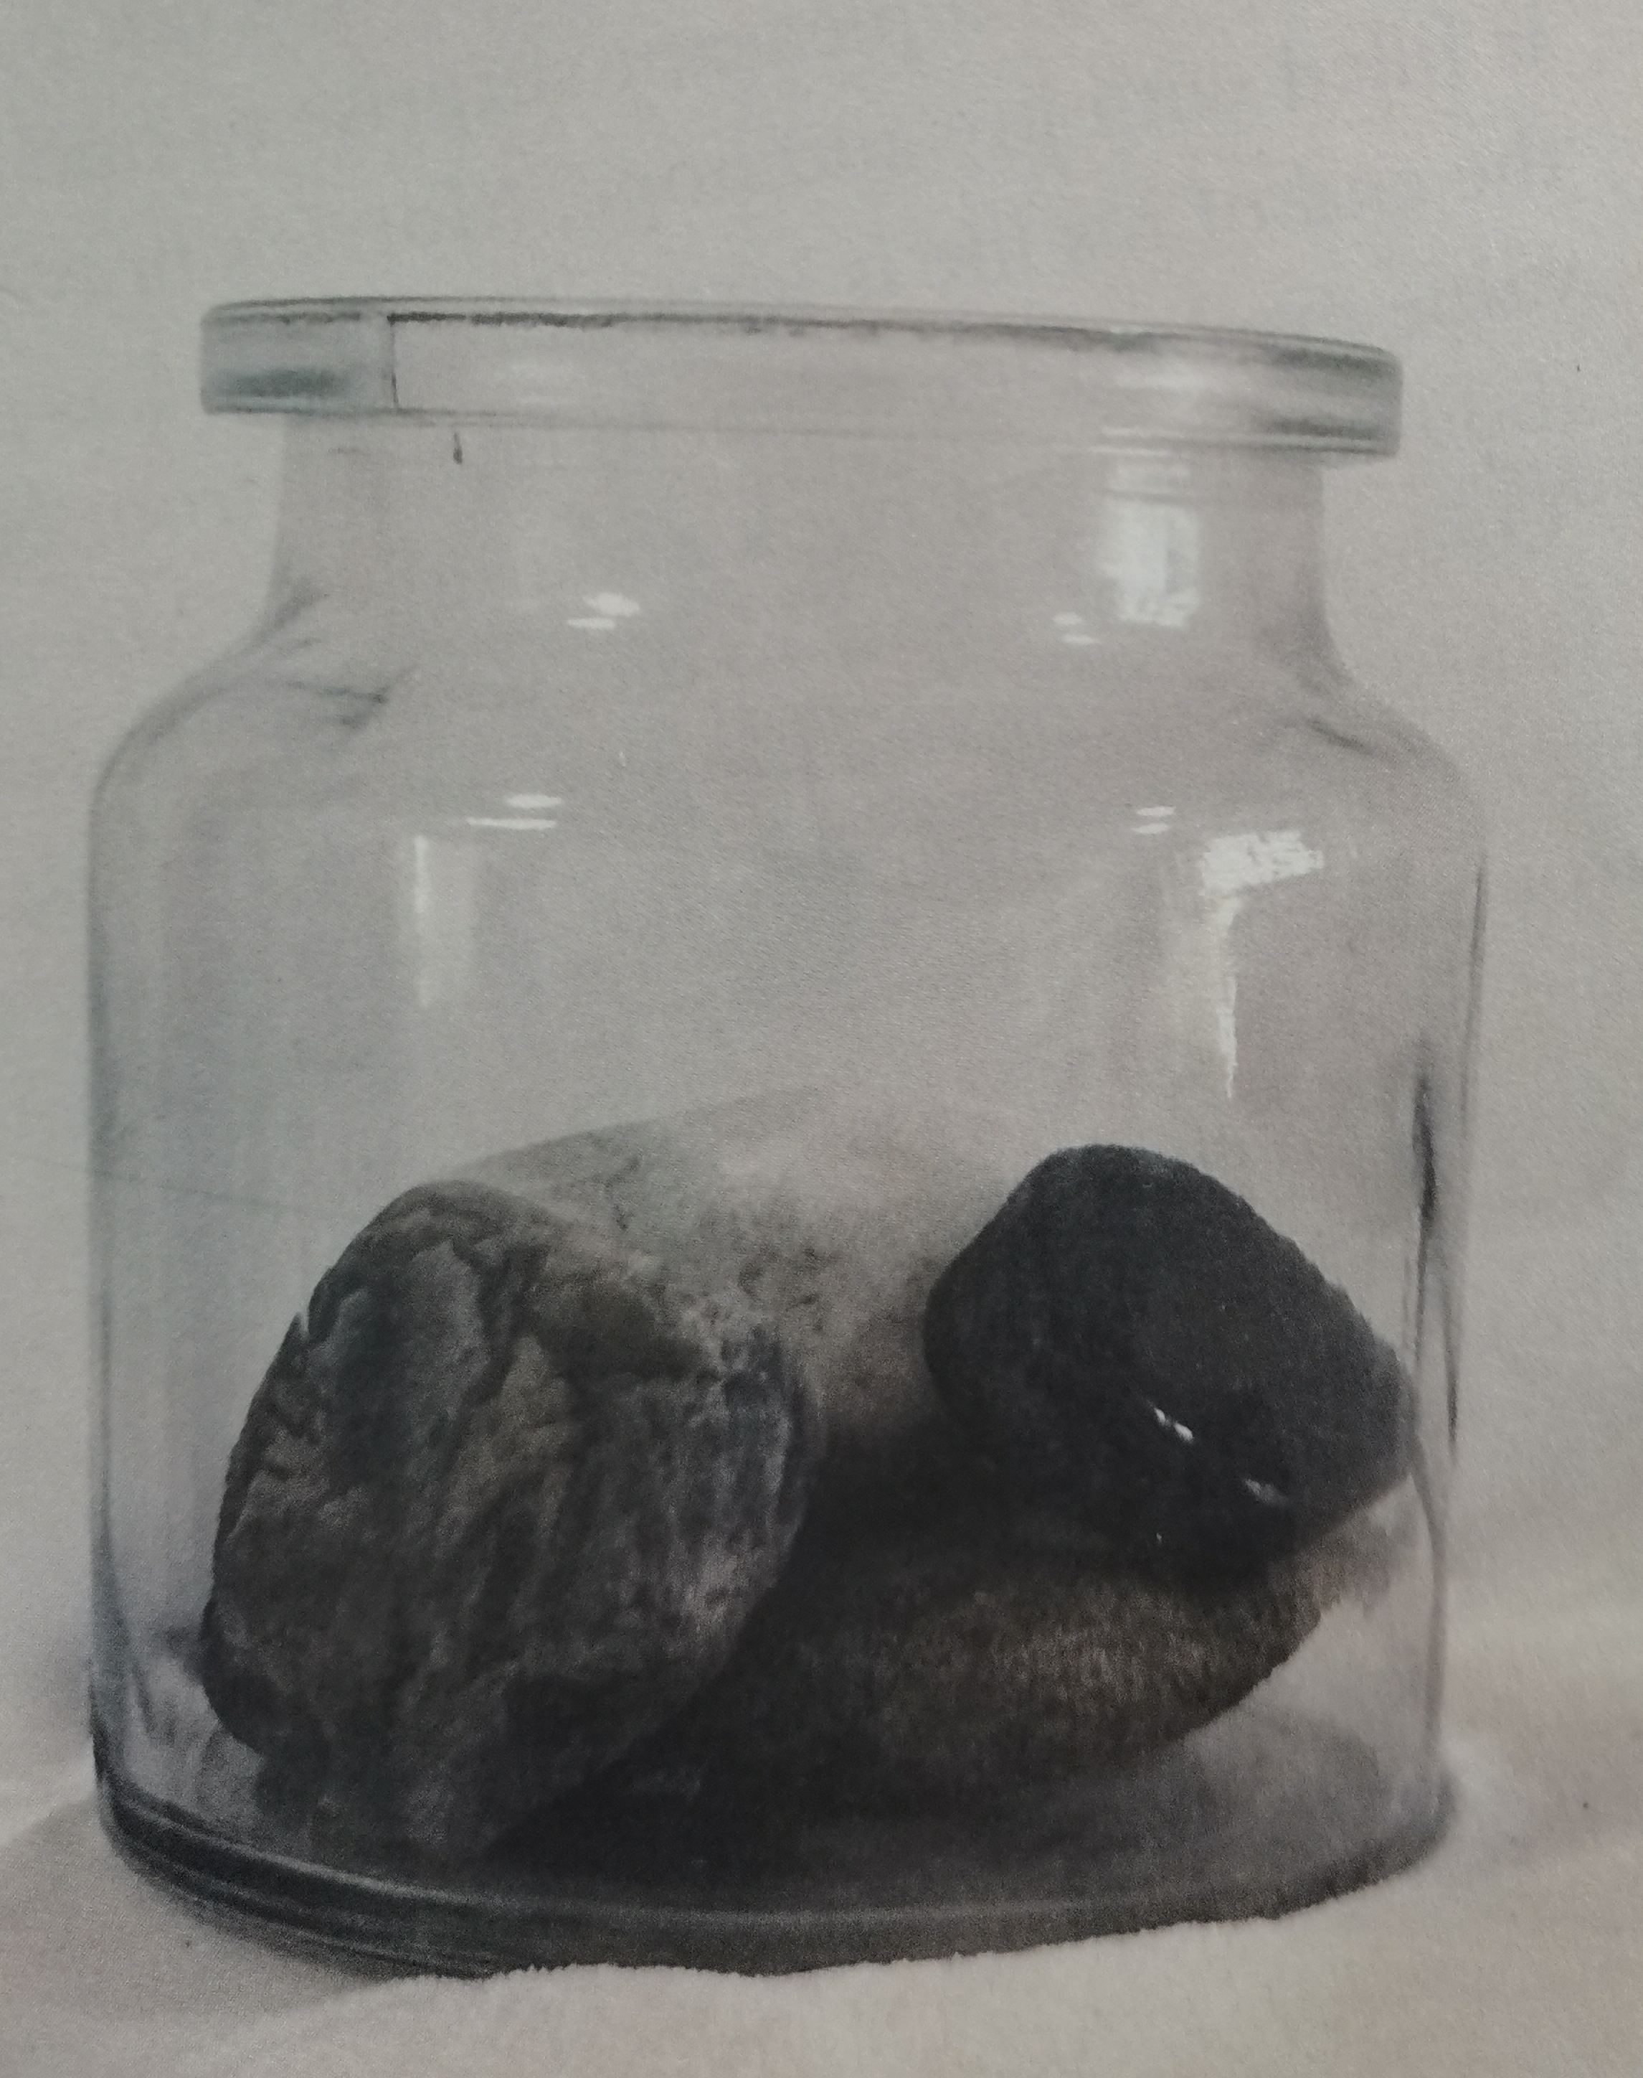
Look, think and say
things used as metaphors for life

Slide 4
Discuss the things used as metaphors
things in the picture | metaphors for life (possible answers)
a roller coaster ➞
a tree ➞
a rainbow ➞
a river ➞
an unfolded book ➞
ups and downs of busy life
living and growing independently in life
a symbol of good fortune
going on and finding a way out along the road ahead
studying hard and enrich your spiritual life

Slide 5
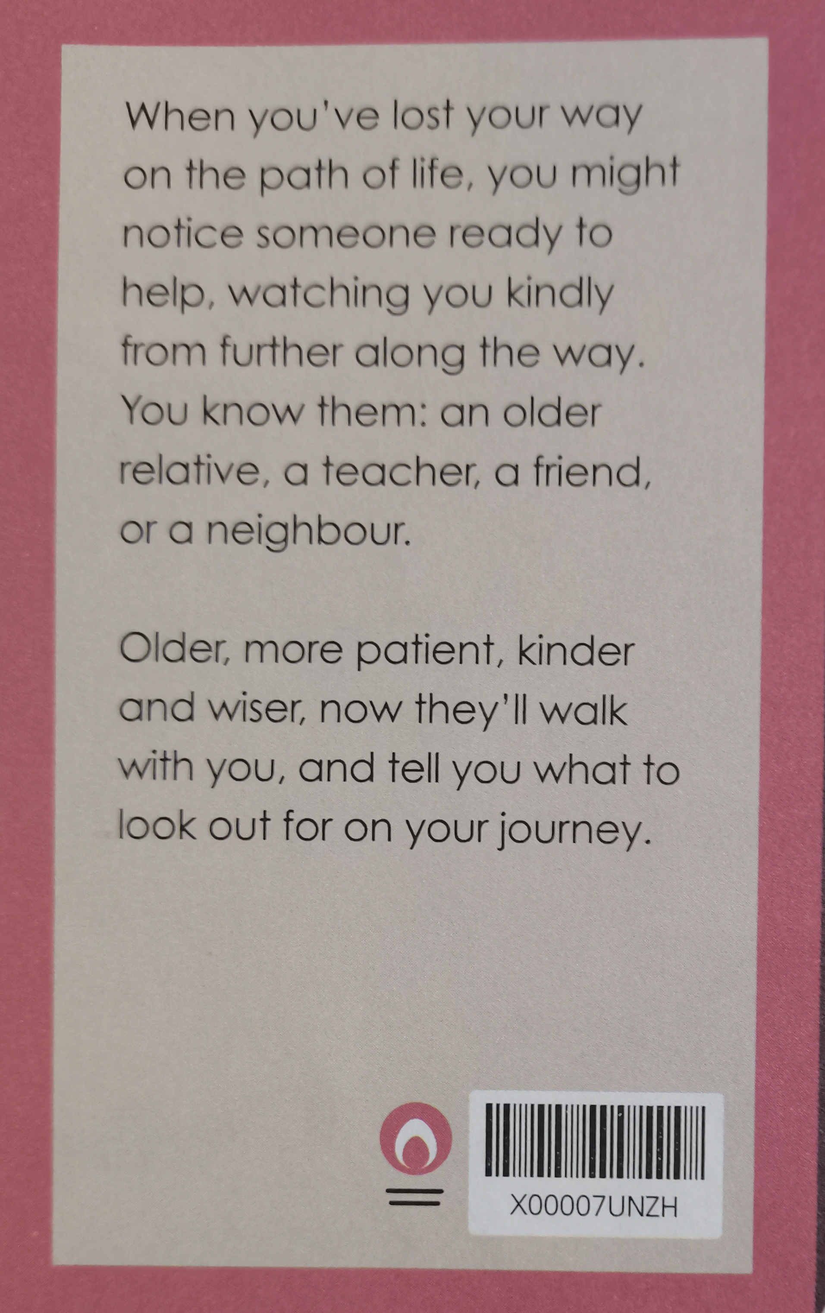
A review of the book, Tuesday with Morrie
1. What metaphor for life is used in the reviews?
Life is seen as path or journey.

Slide 6
2. When people are described as “watching you kindly from further along the way”, what does this mean?
It means that they will be with you and support you on your life journey.

Slide 7
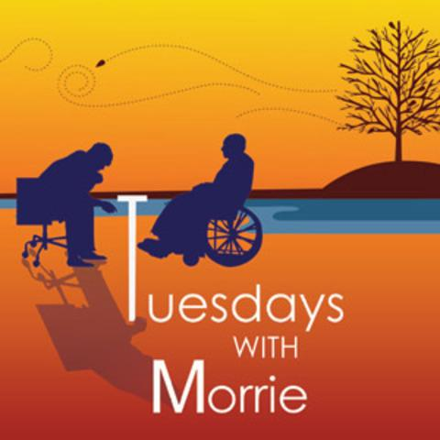
Tuesdays with Morrie
Reading
1. What changed Mitch's attitude towards the meaning of life?
A. That he was reunited with his relations.
B. That the weekly communication with his teacher.
C. That a serious disease happened to him.
D. That the weekly visit to his teacher in hospital.
( 1. D )
2. Mary recommends the book because ______________.
A. it is one of the favorite books.
B. it is a best-seller.
C. it differs from other books.
D. it tells the principle of life.
(2.C)

Slide 8
3. Which of the following statements is ture according to the passage?
A. The book focuses on dying in a pessimistic tone.
B. The book mainly centres upon dying with joy and hope.
C. The book has nothing in common with the otherworks.
D. The book is never popular with readers because it is about dying.
(3. B)
4. Who does not like the book very much?
A. Amy Wang. B. Vivian.
C. Arthur K. D. Marty.
(4. D)

Slide 9
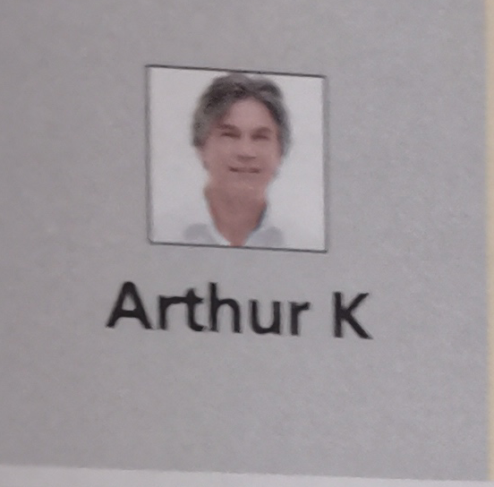
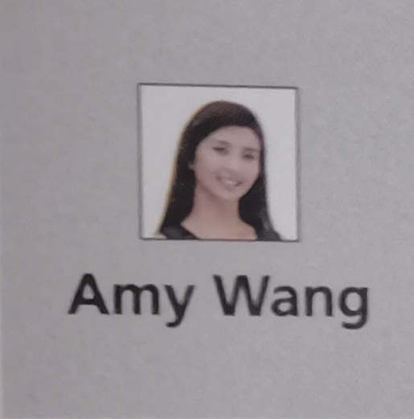
Different readers, different comments on the book
Readers | Stars given | Reasons for his or her decision
Arthur K | ✭✭✭✭✭ ➞
Army Wang | ✭✭✭✭✭ ➞
He thinks highly of it, thinking it is inspirational and has made value his own life more. Besides, it encourages us to appreciate what we have and to make the most of each day.
She feels she has been a deeper insight into the words and can see things from a different point of view. It helps her establish her values.

Slide 10
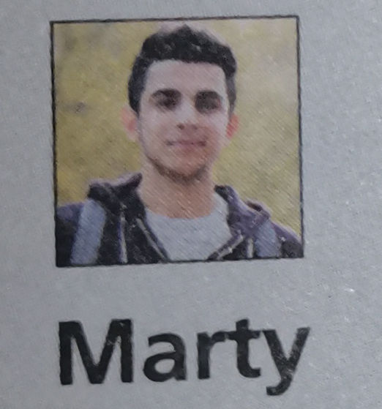
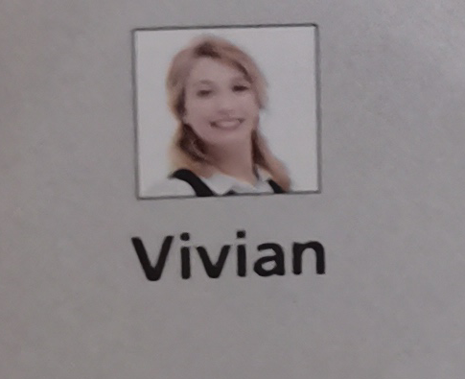
Different readers, different comments on the book
Readers | Stars given | Reasons for his or her decision
 | ✭✭✭ ➞
 | ✭✭✭✭✭ ➞
He doesn’t think highly of it but feels it did teach him a lesson or two and it made him stop to think.
She was moved by the book, which made her think about her won life and the friends she had lost touch with.

Slide 11
Choose the topics mentioned and the evidence
joy and hope | art | friendship | love | death | values | power | sorrow
Your choice | The evidence you find in the passage
➞
➞
This book is about dying, but it is not pessimistic. Indeed, it was a pleasure surprise to find that this book is filled with joy and hope.
Joy & hope, death
It’s up to us to find out what is important in our lives and establish our values.
Values

Slide 12
joy and hope | art | friendship | love | death | values | power | sorrow
Your choice | The evidence you find in the passage
The book made me stop and think about how much I am influenced by popular culture and the importance of creating my own values based on love and open communication.
Love ➞
Love, friendship
➞
Morrie’s reflections on love and friendship made me think about my life and all the good friends that I’ve lost touch with along the way. It made me realize just how much I miss much.

Slide 13
Organize information from the passage
Readers | What she or he likes | What lessons they learned
 | It’s a pleasant surprise to find that ¹ | As people learn how to die, ² ______________________________. He was encouraged to ³ ______________________________ and make the most of each day.
they learn how to live
this book is filled with joy and hope.
appreciate what he had

Slide 14
Readers | What she or he likes | What lessons they learned
 | She thinks the book should be on ⁴ _____________________. And she felt she was given ⁵ | People should choose ⁶ ______________________________. themselves. She felt as if she had been woken up from a long sleep and finally ⁷ _______________________________.
all school reading lists
the big things-how we think, what we value
a deeper insight into the word.
opened her eyes to the world

Slide 15
Readers | What she or he likes | What lessons they learned
 | His first impression was that the book just ⁸ Nonetheless, he would recommend it because ⁹ ________________________ | The book made him stop and think about ¹⁰ and the importance of ¹¹
how much he was influenced by popular culture.
made up of a collection of over-emotional thoughts and messages, many of which are repeated.
creating his own values based on love and open communication
it is something that's a bit different.

Slide 16
Readers | What she or he likes | What lessons they learned
 | The book made her cry because Morrie’s reflection on ¹² made her think about ¹³ | People should always keep in touch ¹⁴ She was aware that people want to ¹⁵ knowing that ¹⁶
with the good people they meet as they go through life.
love and friendship
her life and all the good friends that she has lost touch with along the way.
die feeling that they have lived life to the full.
they are loved and have loved others as much as they could.

Slide 17
Think & Share
Think back the key information and share their answers to the questions given
① According to Morrie, what are “the big things” in life?
The big things in life are how we think, what we value.
② What is your understanding of Auden’s words: “Love each other or perish”?
We should be love who we love and who loves us, or elsethe life is meaningless.

Slide 18
Think & Share
③ How do you usually learn lessons about life? Though experience or learning from other people?
Both I learn from one friend who earned lots of money at the cost of his own health that we should value our won life and those who love us.
④ Can you critically evaluate other people's opinions and make your own judgments?
Yes. I think that knowing necessary information can effectively, critically acquire, evaluate information and creatively use information based on facts.

Slide 19
Language appreciation
1. Despite its widespread recognition, my first impression was that Tuesday with Morries is just made up of a collection of over-emotional thoughts and messages, many of which are repeated.
[句式分析] that至句尾为that引导的表语从句；many of which引导非限制性定语从句，关系词which指先行词thoughts and messages. 其中短语 be made up of 意为“由...组成或构成”。
[尝试翻译] 尽管它被广泛认可，但我的第一印象是《与莫瑞斯在一起的周二》只是由一系列过度情绪化的想法和信息组成的，其中很多都是重复的。

Slide 20
Language appreciation
2. But thinking back, it did teach me a lesson or two.
[句式分析] 现在分词thinking back作状语；本句谓语部分did teach采用了特有的强调结构：助动词did+ 动词原形。对句子的谓语进行强调，其一般结构为“助动词do/does/did+动词原形”。
[尝试翻译] 但回想起来，这确实给了我一两个教训。

Slide 21
Language appreciation
3. Like Mitch, Morrie makes you aware that you want to die feeling that you have lived life to the full, knowing that you are loved and have loved others as much as you could.
[句式分析] make you aware为“动词+宾语+宾语补足语”；aware that you ...中的that引导宾语从句， feeling that you have...中feeling为现在分词作状语，现在分词 knowing that you have...作伴随状语。
[尝试翻译] 像米奇一样，莫里让你意识到你想要死去，感觉你已经活得充实，知道你被爱着，并且尽你所能地爱着别人。

Slide 22
Language points
1. be reunited with | 8. point of view
2. anticipate doing... | 9. open one's eyes to..
3. get distracted by... | 10. be influenced by...
4. get through | 11. keep in touch with...
5. lose touch with... | 12. teach sb a lesson
6. to the full | 13. be made up of ...
7. result in... | 14. make the most of...

Slide 23
Assignments for this period
1. Review the basic usage of the new words and expressions learned in this period.
2. Further understand the passage by reading and listening more.
3. Writing a 60-word summary of the passage.

Slide 24
感谢您的观看

