Slide 1

外研版(2019)高中英语 选择性必修第四册
Unit 2 Lessons in life
Period 3 Developing ideas & Presenting ideas

Slide 2
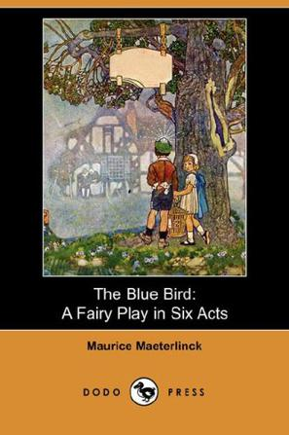
About The Blue Bird
Author | Belhian playwright Maurice Maeterlinck
Main characters | TylTyl, Mytyl and the Blue Bird
Plot | TylTyl and Mytyl are sent to search for the Blue Bird of Happiness. The children’s adventure takes them through magical palces bfore finally finding the Blue Bird.
Influence | It has been widely translated and adapted across the world. In 1921, it was performed in Shanghai as the first foreign play staged in China.

Slide 3
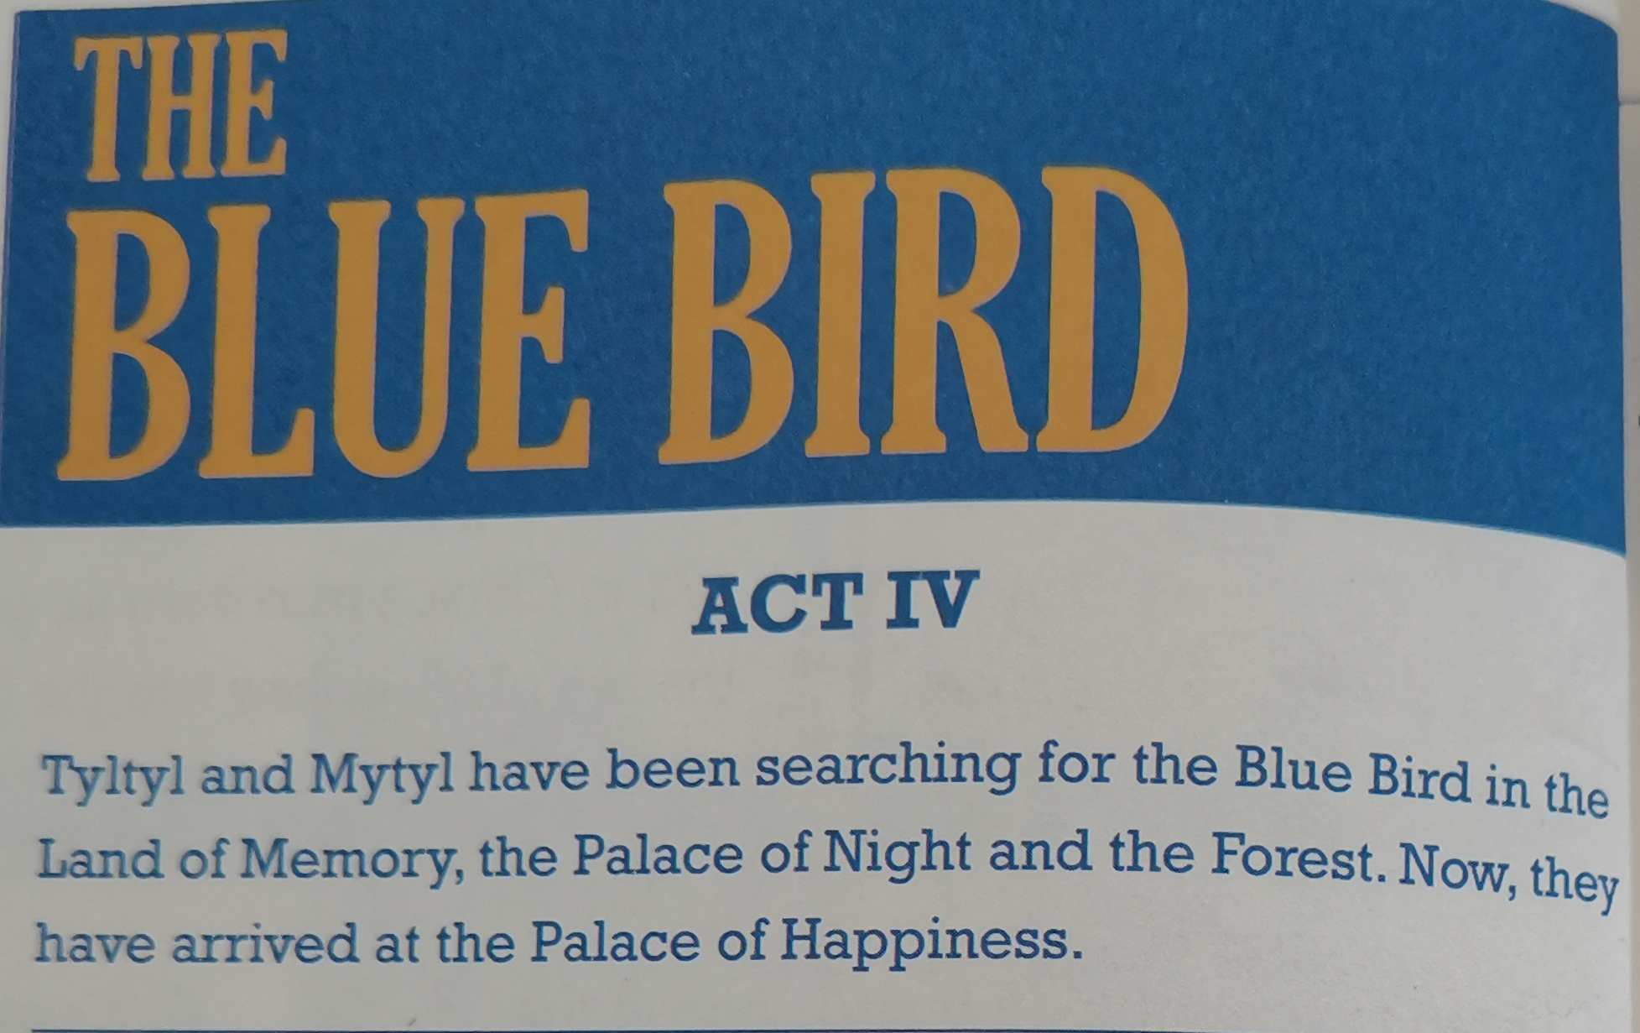
Wecome to the staged play!!!

Slide 4
Reading comprehension 1
1. Which of the following can best describe the boys according to the text?
A. Stubborn B. Foolish C. Caring D. Cold-hearted
Suggested answer: C .
2. How do the Happiness feel when they meet with Tyltyl and Mytyl?
A. Delighted B. Awkward C. Depressed D. Annoyed
Suggested answer: A .

Slide 5
Reading comprehension1
3. What are the boys doing at the Palace of Happiness?
A. They are searching for the Happiness.
B. They are searching for the Blue Bird.
C. They are playing with the Blue Bird.
D. They are playing with the Happiness.
Suggested answer: B .

Slide 6
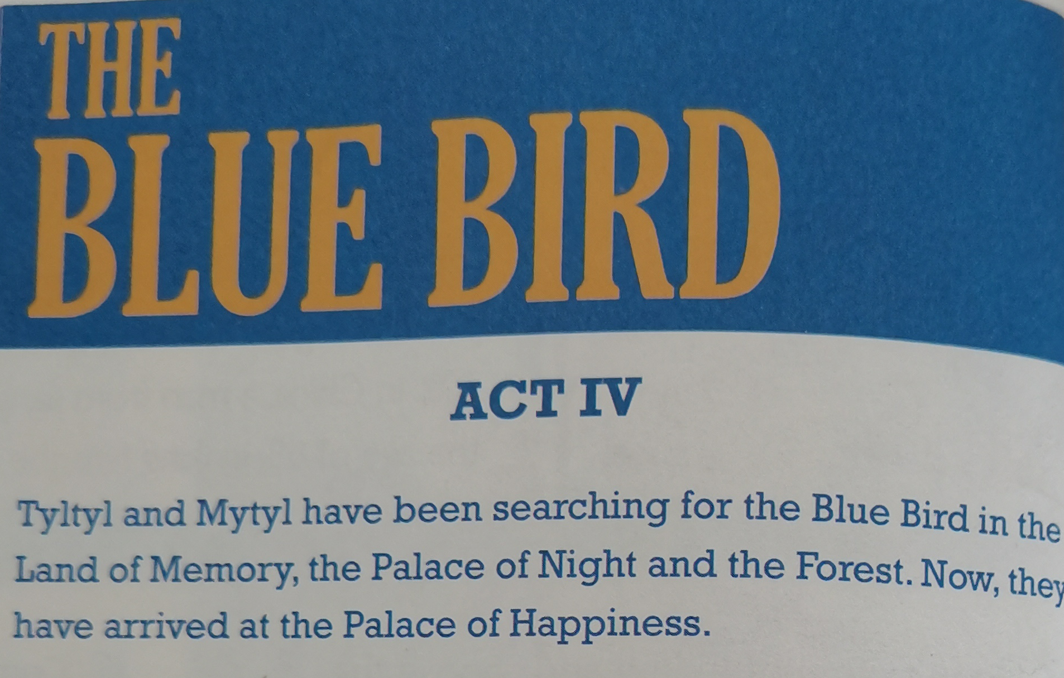
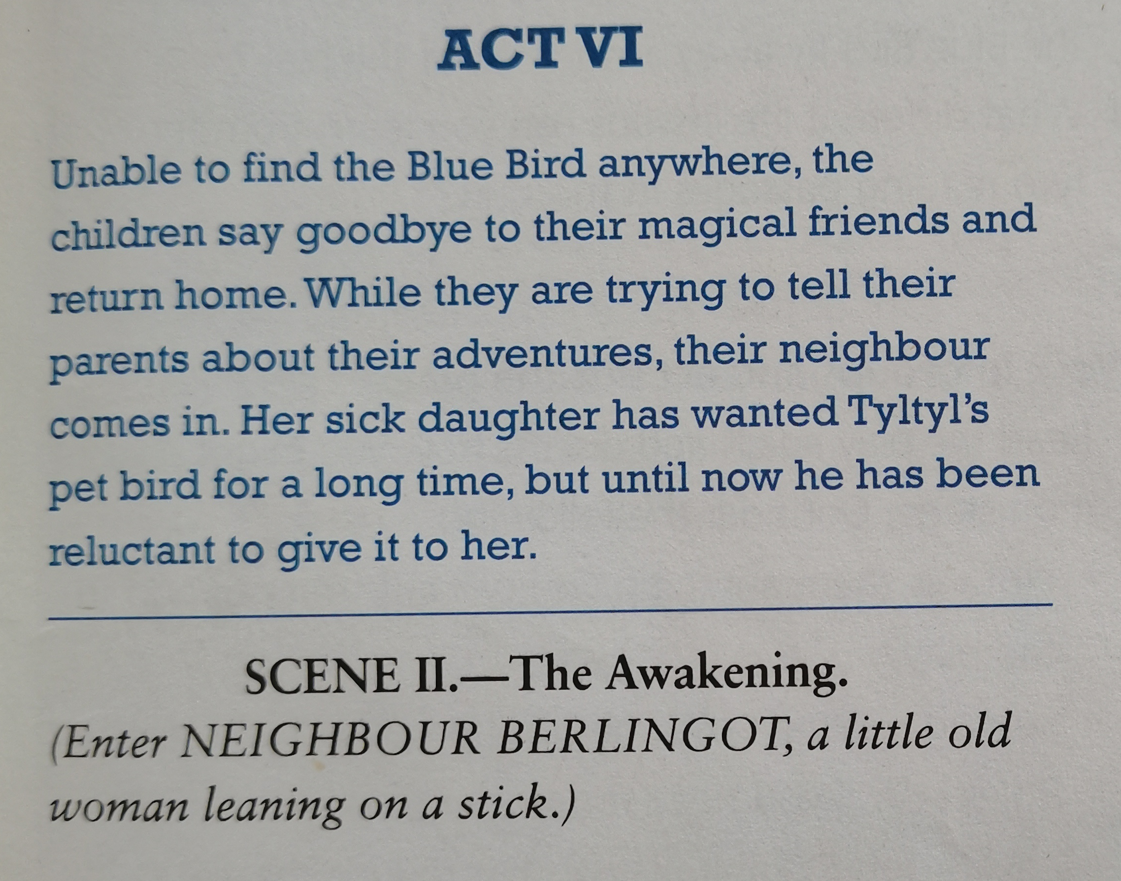
Come to the stage with me！
SCENEИ. --The Palace of Happiness.
A troop of Happinessees rushed into the ball, singing, “There they are! They see us!” They dance merrily around the Children, then the one who appears to be the chief goes up to ...

Slide 7
Reading comprehension 2
Table 1:
ACT IV SCEN II
 | Characters:
 | Setting:
 | Plot:
Tyltyl, Mytyl and a troop of happiness
Tyltyl and Mytyl have been searching for the Blue Bird and they have arrived at the Palace of Happiness.
The children come to the Palace of Happiness and are welcome by a troop of Happiness and are welcomed by a troop of Happiness, the chief of whom tells them that happiness is always around them. But they still can‘t get the answer.

Slide 8
Reading comprehension 2
Table 2:
ACT IV SCEN II
 | Characters:
 | Setting:
 | Plot:
Tyltyl, Maummy Tyl, the neighbour, the sick little girl.
Unable to find the Blue Bird, they return home and their neighbour comes in.
The children return home without finding the Blue Bird, only to find their dove becomes bluer and give it to the sick little girl, which makes her happy. But at last it flies away...

Slide 9
Learning to learn: what is a typical play?
The basic elements of a play
a
b
c
Acts and scenes
Characters in different acts and scenes
Settings and costumes

Slide 10
Post reading: Think & Share
1. Why can’t Tyltyl recognize any of the Happiness?
In my aspects, although the Happinesses are always with him, they live in his life and can’t see or feel them.
2. Are there any Happiness in your home? What are they?
Yes. My home is crammed with Happiness, such as the Happiness of Being Well, of Pure Air, of Loving One’s Parents, of the Blue Sky, of the Forest and so on.

Slide 11
Post reading: Think & Share
3. What does the author want to express by making the Blue Bird fly away at the end of the play?
If we don’t value it or place too much emphasis on it, it may be lost but it can be found again. So we should be grateful for what we have.
4. What different life lessons can you learn from the two reading passages in this unit?
From the first one, we know that happiness is always around us, while it can’t fly away and be found again from the second one.

Slide 12
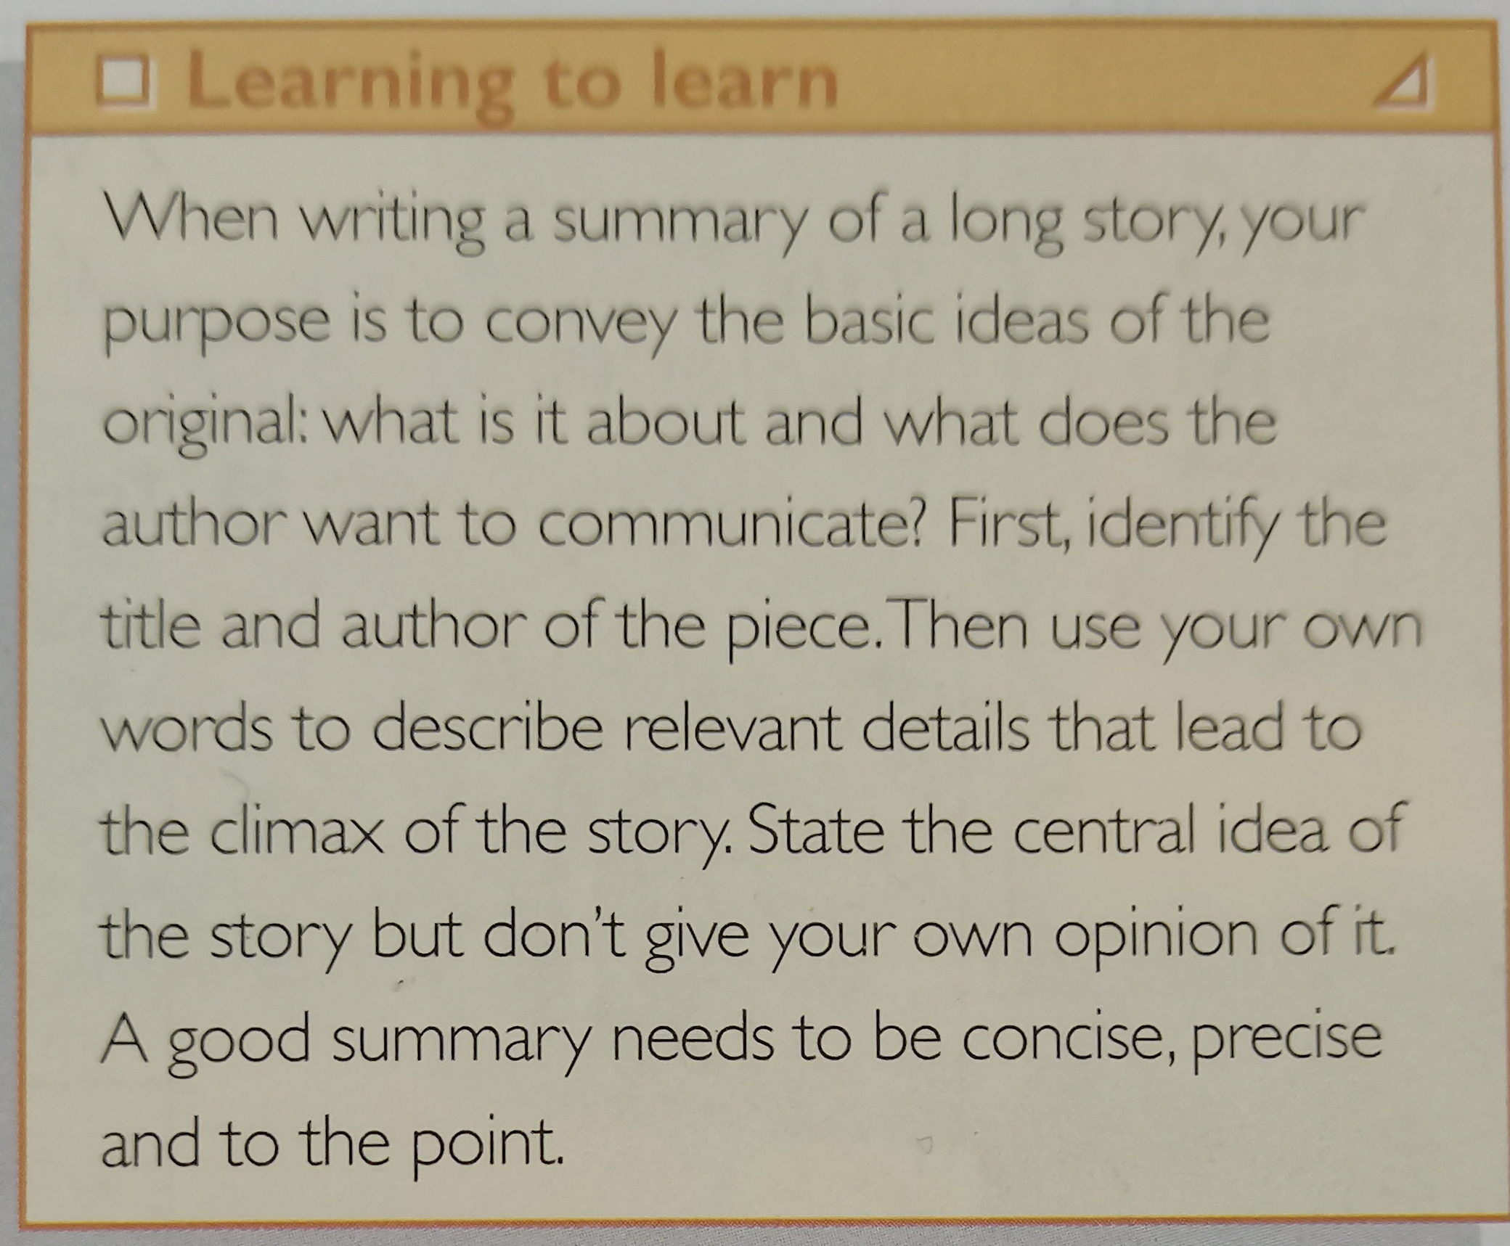
Part 2 Writing a summary
1 | title and author
2 | Main characters
3 | Plot
4 | Conclusion

Slide 13
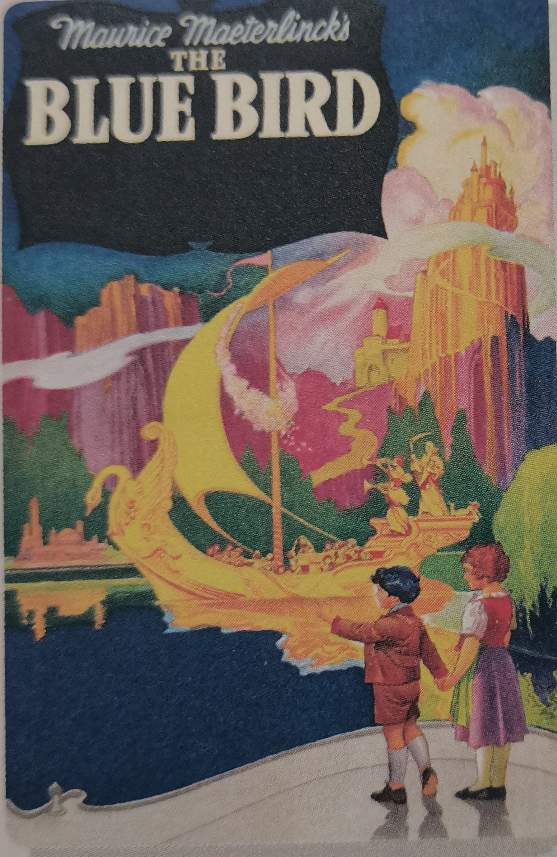
The summary of The Blue Bird
The Blue Bird is a six-act fairy play written by Maurice Maeterlinck. It’s a story about Tyltyl and and Mytyl’s adventures as they search for the the Blue Bird of Happiness. AS the children of a poor woodcutter, they are secretly observing a party at the home of their wealthy landlords when a fairy appears. She uses a magic diamond to bring animals (their dog and act), objects (sugar and bread) and elements (light, fire, water) in their home to life. Together, they set off on a dangerous journey in search of the Blue Bird.
Paragrph 1 | The main idea of the paragraph
It introduces the main charaters, setting and start of the play.

Slide 14
The summary of The Blue Bird
Tyltyl and Mytyl go to many magical places and encounter numerous characters such as their departed grandparents, trees that hate mankind, the greedy and ugly luxuries, and children waiting to be born. Although they try very hard to find the Blue Bird, the birds they find either change color or die. They children return home at last, and Tyltyl discovers the Blue Bird has been there all the time! He gives the bird to the neighbor's little girl, curing her illness. But in the end, the bird flies away, and Tyltyl asks the audience to search for it.
Question | What is the climax of the play?
The children return at last, and Tyltyl discovers the Blue Bird has been there all the time.

Slide 15
The summary of The Blue Bird
The central idea of the play is that happiness is to be found not in luxuries such as waelth, but in simple things that are found in family life, and in acts of friendship and kindness.
Question | What is the theme of the play?
Happiness is to be found not in luxuries such as wealth, but in simple things that are found in family life, and in acts of friendship and kindness.

Slide 16
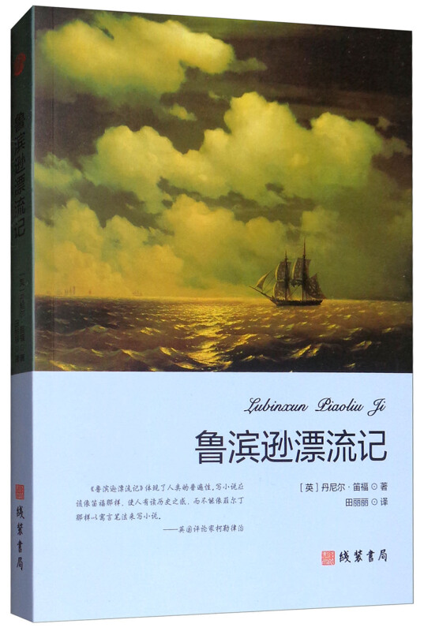
Robinson Crusoe by Daniel Defoe
笛福是英国18世纪启蒙文学的重要作家，他的代表作《鲁滨孙漂流记》写于1719年，是一部流传很广、影响很大的文学名著，一问世即风靡全球而又历久不衰，在世界各地拥有一代又一代的读者。小说从初版至今，已出了几百版，几乎译成了世界上所有的各种文字。
小说主人公鲁滨孙出身于一个商人之家，他父亲常用知足常乐的思想教育他，但他决心舍弃安逸舒适的平庸生活，到海外的新世界去见识一番。后来，他瞒着父亲出海，第一次就遇到大风浪，船只沉没，他好不容易才捡回一条性命；第二次出海到非洲经商，赚了一笔钱；第三次出海，又被海盗掳去，逃出后来到巴西，在那里买了一个庄园，成了庄园主。但他仍不死心，再次出航，结果船只在中途遇到风暴而触礁，船上所有人全部遇难，只有他一个人幸免，只身漂流到了一个荒无人烟的小岛上。

Slide 17
Organize your summary of Robinson Crusoe
Title and author of the play | ✩
Main character(s) | ✩
Start of the play | ✩
climax | ✩
Conclusion | ✩
Robinson Crusoe written by Daniel Defoe
Robinson Crusoe, savages, a young native called Friday, captain of a ship
Robinson Crusoe went sailing and his ship went under the sea.
Crusoe helped the captain and returned to England.
Look for what’s good for you even in desperate situations and always be optimistic and enthusiastic about life.

Slide 18
Write a summary of Robinson Crusoe
Robinson Crusoe is a novel written by the English author Daniel Defoe, which is a widely influential literary masterpiece. It has been popular all over the world and has been read by generations all over the world.
It gives an account of Robinson Crusoe, an Englishman whose boat goes under the sea. Finally, he finds himself on a lonely island. He isn’t panicked but sets out to build a hut as a shelter, as well as growing his own food. On the beach, he once finds strange frighting footprints and savages eating people, while makes him very terrified. He once rescues a young native; he calls him Friday and they becomes close friends.
Four years later, an English ship appears, and the captain gets Crusoe’s help. As a reward, the captain takes Crusoe and Friday back to English.

Slide 19


Part 3 Presenting ideas
Talk about the following works
It is one of Charles Dickens’s best known works. It was the first of author’s works to realistically describe the impoverished London underworld and to illustrate his belief that poverty leads to crime. It has been adapted for film several times.
It is one of the tragedies written by William Shakespeare. It depicts the aging King Lear decides to divide his kingdom among three daughters, allocating each a portion in preparation to her declarations of love.

Slide 20

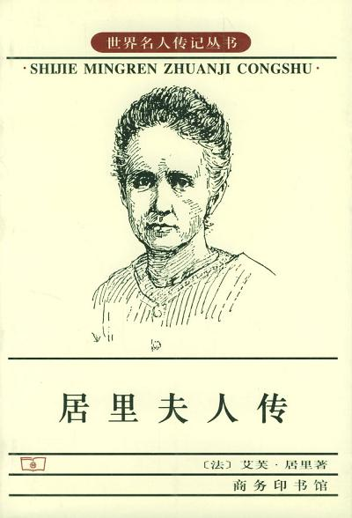
Part 3 Presenting ideas
It is a collection of sayings and ideas attributed to the Chinese philosopher Confucius and his followers. It was probably compiled by the succeeding generations of Confucius followers.
The biography is a book about Madame Curie written by Eve Curie. It ells readers in detail the life of Madame Curie, who was the first woman to win a Nobel Prize, and she was the only written to win the award in two different fields.

Slide 21
Part 3 Presenting ideas
Think of one literary works from which you have learned life lessons.
Madame Curie-- A Biography
General information
Main idea
Life lessons in the work
This is a biography written by Eve Curie.
It tells readers in detail the life of Madame Curie, who was the first woman to win a Noble Prize and was the only woman to win the reward in two different fields.
Madame Curie was a determined woman and set a good example to all the women who are eager to achieve life goals.

Slide 22
Language appreciation
1. Unable to find the Blue Bird anywhere, the children say goodbye to their magical friends and return home.
[句式分析] 形容词短语 Unable to find the Blue Bird anywhere原因状语，用来说明主语的状态，语境中相当于状语从句：Because the children are unable to find the Blue Bird anywhere.
[尝试翻译] 由于到处都找不到蓝鸟，孩子们告别了他们神奇的朋友们，回到了家。

Slide 23
Language appreciation
2. You will see him every time you go to the window...
[句式分析] every time 意为“每次”， 本语境中作连词，引导时间状语从句。类似的可以引导时间状语从句的还有：the first/second time(第一次/第二次); any time（任何时候）; the moment/ minute/instant=as soon as（一...就...）, 等等。
[尝试翻译] 你每次走到窗口都能看到他。

Slide 24
Language appreciation
3. When writing a summary of a play, your purpose is to convey the basic ideas of the original...
[句式分析] 当状语从句的主语与主句的主语一致时，常常可以省略从句的主语，同时将从句的谓语改变为非谓语动词形式，从句的主谓构成主动关系时，常常用现在分词；若构成被动关系时，常常保留过去分词。本语境中，动词write与暗示性逻辑主语you构成主动关系，故采用现在分词writing。
[尝试翻译] 当你写一个剧本的总结时，你的目的是传达原文的基本思想......

Slide 25
Language points
1 | burst out | 8 | the majority of
2 | be crammed with | 9 | in one’s hesitation
3 | learn against | 10 | in search of
4 | to the point | 11 | be reluctant to do sth
5 | set off | 12 | be pleased with
6 | search for | 13 | be so kind as to do sth
7 | a troop of | 14 | appear to do sth

Slide 26
Assignments for this period
1. Review new words , phrases and useful expressions learned in this period.
2. Think back about how to write a summary of a play.
3. Polish your writing-- a summary of a play.

Slide 27
感谢您的观看

