Slide 1

外研版高中英语 选择性必修第四册
Unit 3 The world meets China
Period 1 Staring out & Undertanding ideas

Slide 2
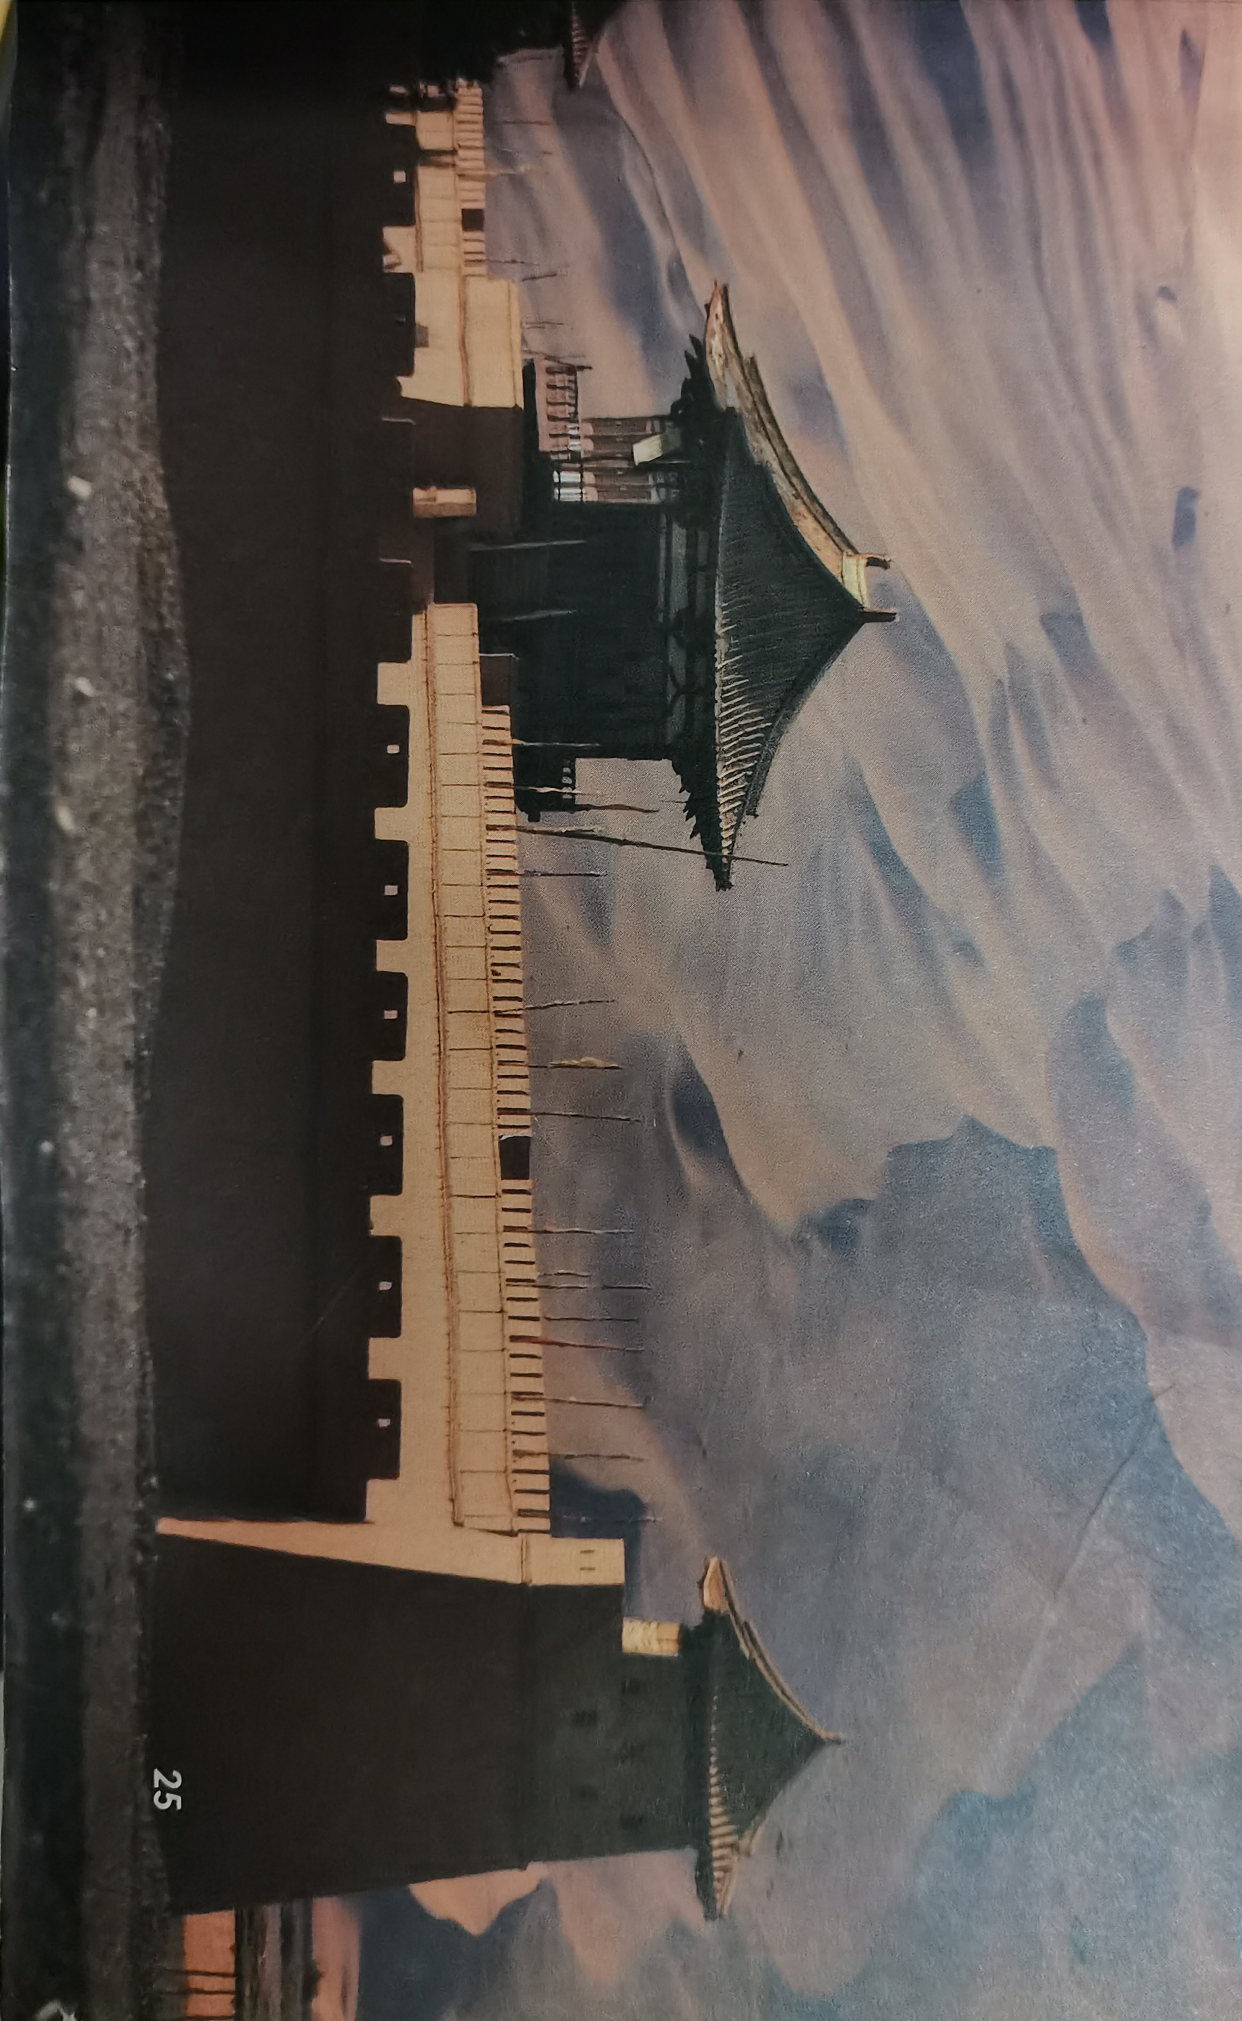
Let’s go to Gansu and visit Dunhuang

Slide 3

Part One Starting out
1 | What is the video about?
2 | How did the road get its name?
The video is about the historical importance of the ancient Silk Road and its revival through the Belt and Road initiative.
It got its name because a lot of trade along the road was in Chinese silk.

Slide 4
Part One Starting out
3 | What is remarkable about the road?
The road is remarkable firstly because it lasted around 1700 years from the Han Dynasty until the Ming Dynasty. Secondly, it’s a unique and important cultural crossroads between the East and West.

Slide 5
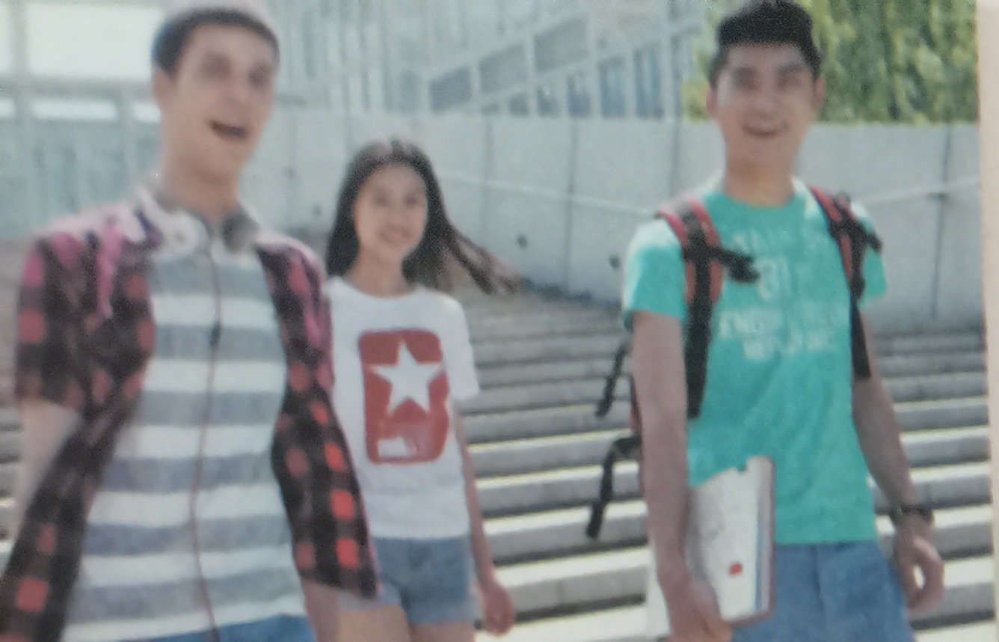
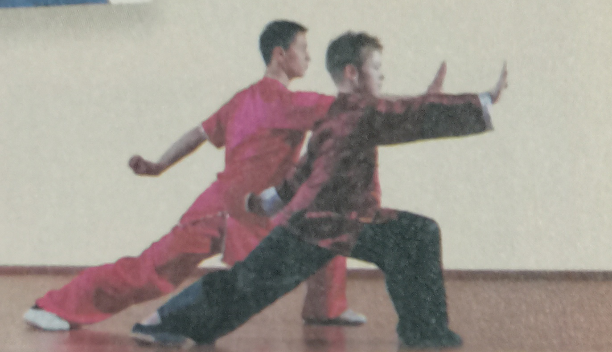
Look and say
Picture 1
The picture shows Chinese and foreign students are walking through their school.
Picture 2
It shows Chinese and foreigners are doing body-building exercise eg. tai chi.

Slide 6
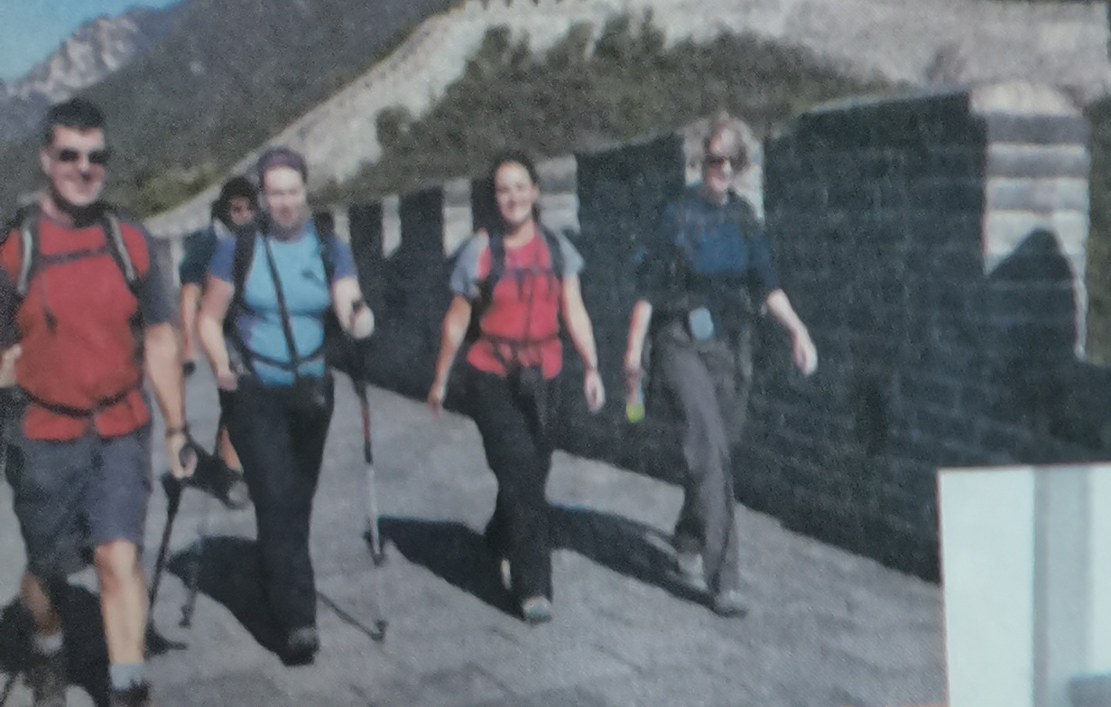
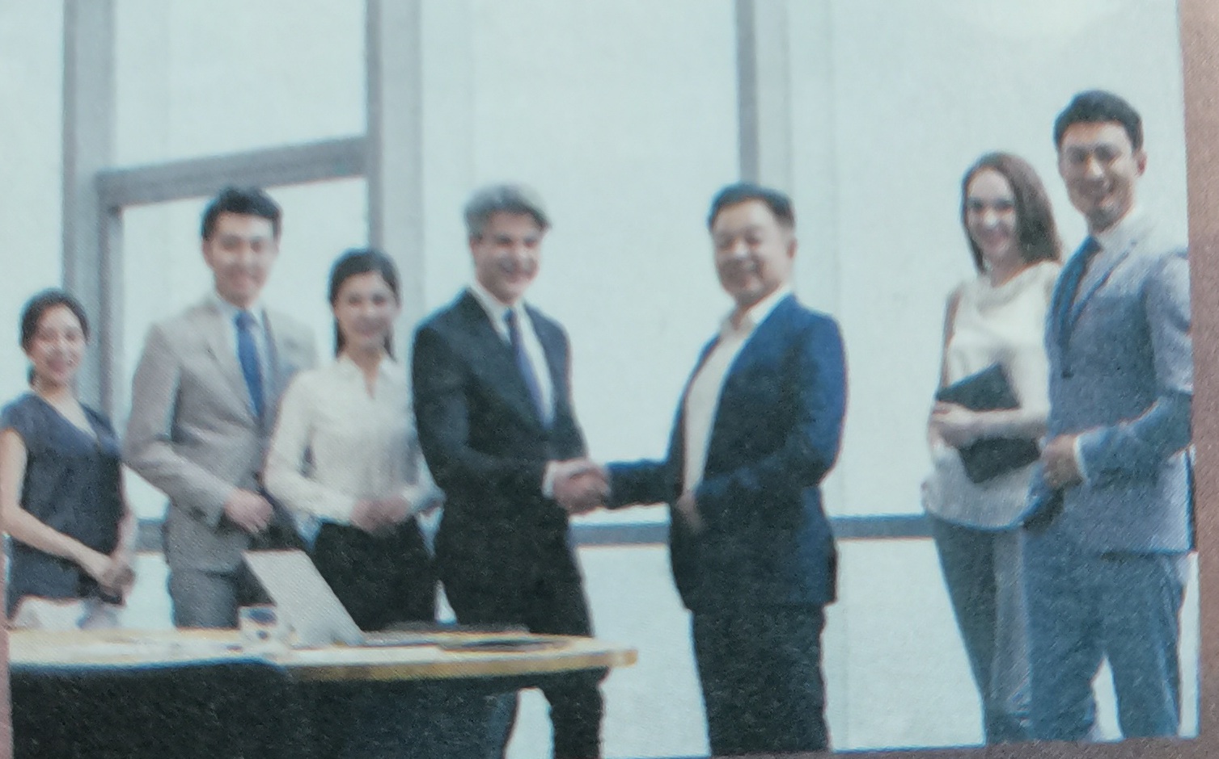
Look and say
Picture 3
A group of foreign tourists are exploring the Great Wall of China.
Picture 4
The picture shows a foreign business man is shaking hands with a Chinese one.

Slide 7
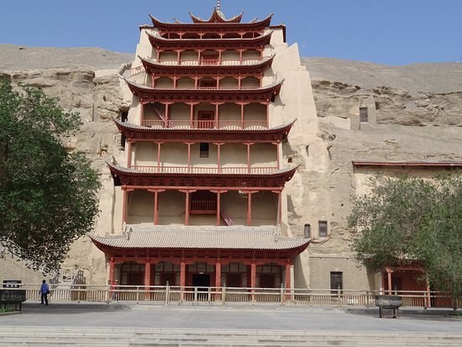
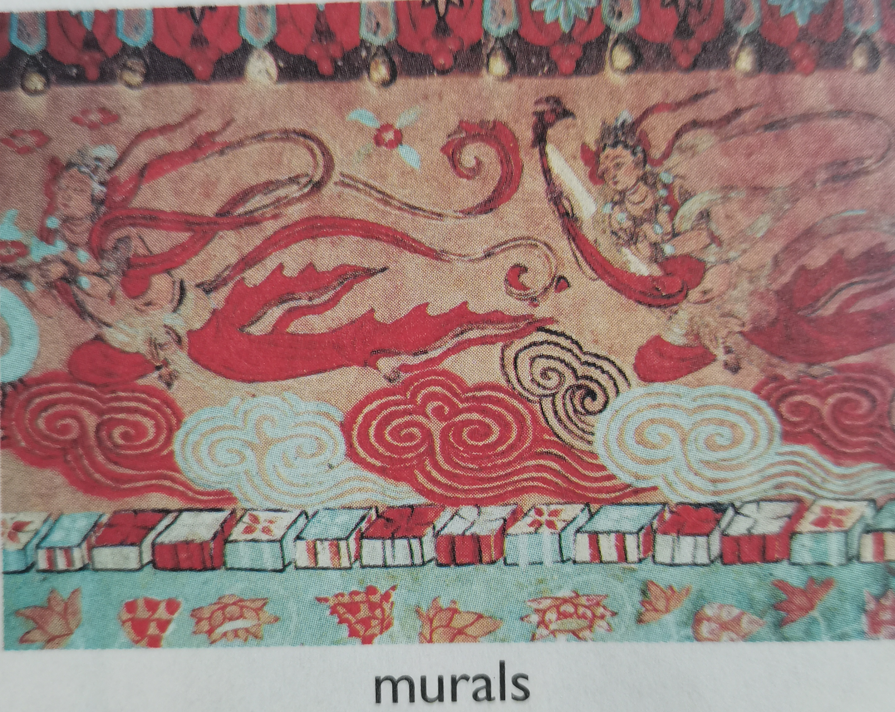
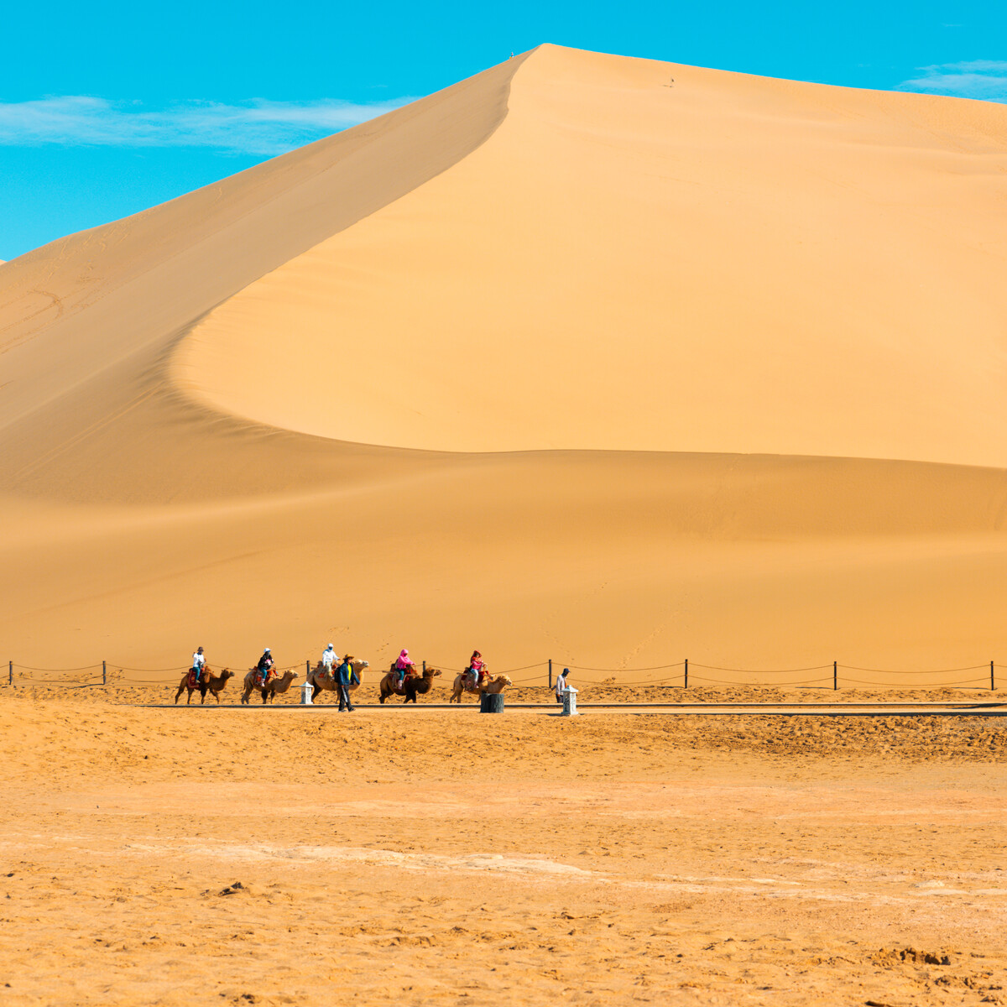
Part Two Reading--Understanding ideas ▼
Mingsha Moutain
Mogao Grottoes

Slide 8
Welcome to Dunhuanng
1. What makes Dunhuang unique,Mogao Grottoes, murals or Mingsha Mountain? Why?
Possible answer:
Dunhuang is unique because of the Mogao Grottoes, its incredibly detailed, colourful murals and Mingsha Mountain, which is rarely seen in any other place.

Slide 9
Welcome to Dunhuanng
2. What else do you know about Dunhuang?
Possible answer:
As far as I’m concerned, Dunhuang is a place where many cultures meet and collide, where Chinese, Indian, Greek and Islamic cultures meet. Dunhuang is a temple of art. The murals and sculptures from the 4th to the 11th centuries give people a very powerful artistic experience.

Slide 10
Reading comprehension
1. Which of the following is true about Library Cave?
A. It is the greatest finding of the 20th century.
B. It was discovered by archaeologists.
C. It is far from other caves in good condition.
D. Its treasures dates from 405AD to 1002AD.
Answer: _______
D

Slide 11
Reading comprehension
2. Why is Dunhuan the ideal place for the 2017 Silk Road International Cultural Expo?
A. it meets the theme B. its location is important
C. it is prosperous as before D. it attracts visitor at home and abroad.
Answer: ______
A
3. where is the passage most probably from?
A. A travel brochure B. A tour commentary C. A blog D. A lecture
Answer: _______
B

Slide 12
Reading comprehension
4. The best summary of the passage is __________________________.
A. The Silk Road was an ancient trade route between East and West, which passed through Dunhuang.
B. The Silk Road city of Dunhuang has a splendid history and is once again a meeting place for people from around the world.
C. In Dunhuang there are grottoes, murals and other sights that attract tourists from all over the world.
D. Dunhuang as a new place of interest is attracting visitors at home and abroad.
Answer: ________
B

Slide 13
Analyze the structure of the passage
Parts | Paragraphs | The main idea of each part
Part 1 | Para 1/2
Part 2 | Para 3/4/5
Part 3 | Para 6
Dunhuang’s great history and its present-day status as a world-class tourist destination.
Dunhuang’s tourist attractions with a long history and splendid culture such as murals and the Library Cave.
The Belt and Road Initiative is bringing Dunhuang to life once more.

Slide 14
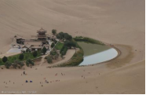
Feed back key information from the text
Dunhuang
Location: Gansu Province
Significance: ▼UNESCO-protected heritage sites ▼¹ ________________________________________________ ▼² ________________________________________________
Caves in Mogao Grottoes
The caves were carved out of the rock ³ _______________________________________
long and glorious history
a centre of cultural and commercial exchange
over a period of 1000 years

Slide 15
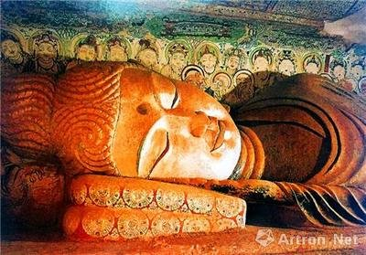
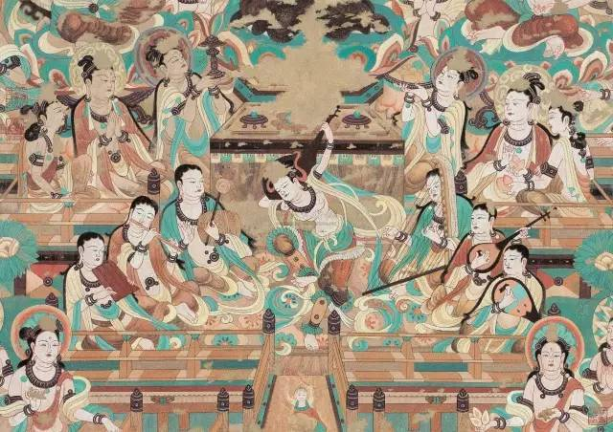
Statues The statues include elements from ⁴ __________________________________.
Murals ▼Coverage: ⁵ ___________________________________________________. ▼Topics: ⁶ ______________________________________________________.
Ancient Greece, India and Iran
45000 square meters
from religious stories to scenes of everyday life

Slide 16
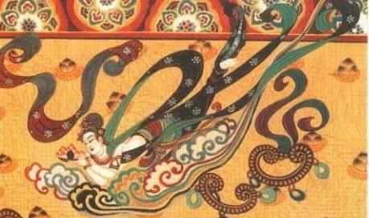
Apsaras ▼Also called ⁷ _____________________, they represent ⁸_______________________________. ▼Apsaras painted during the Tang Dynasty are a reflection of the ⁹ _______________________________________ during that time.
heavenly musicians, singers and dancers
Flying Immortals
confidence and optimism of people

Slide 17
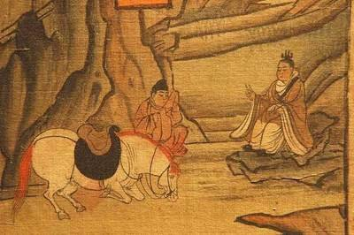

Library Cave ▼ Discovered inside were ¹⁰ ______________________________________________________ ▼ These give us ¹¹ ________________________________________________________________
Dunhuang has once again become ¹² ______________________________.
thousands of manuscripts, paintings and scrolls & silk embroideries
a picture of Dunhuang when it was at the very centre of the Silk Road trade
a global crossroads

Slide 18
Post reading Think & share
1. In what ways is present-day Dunhuang influenced by its past?
Its long and glorious history, its cultural and commercial value and a flourishing trade in goods.
2. What would you most like to visit in Dunhuang? Why?
The famous Library Cave, where is hidden abundant cultural heritages.

Slide 19
Language appreciation
1. If you look up, you can see the paintings and other artworks that are testimony to how the Silk Road brought East and West together.
[句式分析] that are testimony to how the Silk Road brought East and West together 是关系代词that引导的定语 从句，修饰先行词the paintings and other artworks；其中how the Silk Road brought East and West together为how 引导的 宾语 从句并充当介词to 宾语.
[尝试翻译] 如果你抬头看，你会看到绘画和其他艺术品，它们证明了丝绸之路是如何把东西方联系在一起的。

Slide 20
Language appreciation
2. In a sealed cave, now known as the famous Library Cave, were hidden thousands of manuscripts, paintings and scrolls as well as silk embroideries.
[句式分析] 本句采用一个完全倒装句，其结构为 “介词短语+谓语+主语” ，正常句序是“hidden thousands of manuscripts, paintings and scrolls as well as silk embroideries were in a sealed cave..... ”；其中过去分词短语now known as the famous Library Cave 作后置 定语 修饰说明名词短语a sealed cave.
[尝试翻译] 在一个封闭的洞穴里，现在被称为著名的图书馆洞穴，隐藏着成千上万的手稿，绘画和卷轴以及丝绸刺绣。

Slide 21
Language appreciation
3. Given that the theme of the Expo was to promote cultural exchange and strengthen mutual cooperation between the countries along the Silk Road, Dunhuang was the ideal place.
[句式分析] given that-从句，given 为介词, 意为 “考虑到...，鉴于...” ,常常用来引导原因状语 从句。
[尝试翻译] 鉴于本届世博会的主题是促进丝绸之路沿线国家之间的文化交流和加强相互合作，敦煌是一个理想的地方。

Slide 22
Language points
1. in detail | 8. date from...
2. a stone’ s throw | 9. reach a peak
3. to name just a few | 10. side-by-side
4. fade from ... | 11. once more
5. bring... to life | 12. seal up
6. given that... | 13. be testimony to ...
7. vary from...to... | 14. the Silk Road

Slide 23
Assignments for this period
1. Review the basic usage of the new words and expressions learned in this period.
2. Further understand the passage by reading and listening more.
3. Writing a 60-word summary of the passage.

Slide 24
感谢您的观看

