Slide 1

外研版高中英语 选择性必修第四册
Unit 3 The world meets China
Period 2 Using language

Slide 2
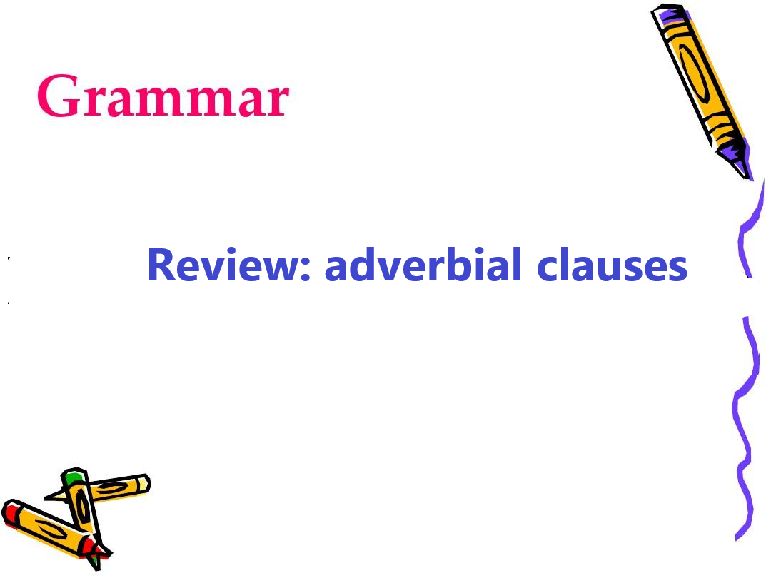
Part 1 Grammar

Slide 3
Common subordinating conjunctions 1
time
place
reason
result
condition
when/ while/ as/ since/ before/ after/ until/ till/ as soon as/ .....
the second/ the minute/ the instant/ every time/....
immediately/ instantly/ directly...
where/ wherever
because/ as/ since/ in that/ now that....
so that / so that/ such...that....
if/ unless/ in case/ on condition that/ supposing that/ providing that...

Slide 4
Common subordinating conjunctions 2
comparison
concession
purpose
manner
than/ not so... as..../ as.....as....
although/ though/ as / even though= even if/ no matter wh-....
so that/ in order that/ lest（以免）/ in case...
as if / as though/ as (按照)

Slide 5
Recognize and classify the adverbial clasues
1 |  | You can only imagine how travelers felt when they saw the oasis of Dunhuang ahead of them.
2 |  | If you look up, you can see the paintings and other artworks.
3 |  | ...Dunhuang was not as prosperous as it used to be.
4 |  | Given that the theme of the Expo was to promote cultural exchange, Dunhuang was the ideal place
time
condition
comparison
reason

Slide 6
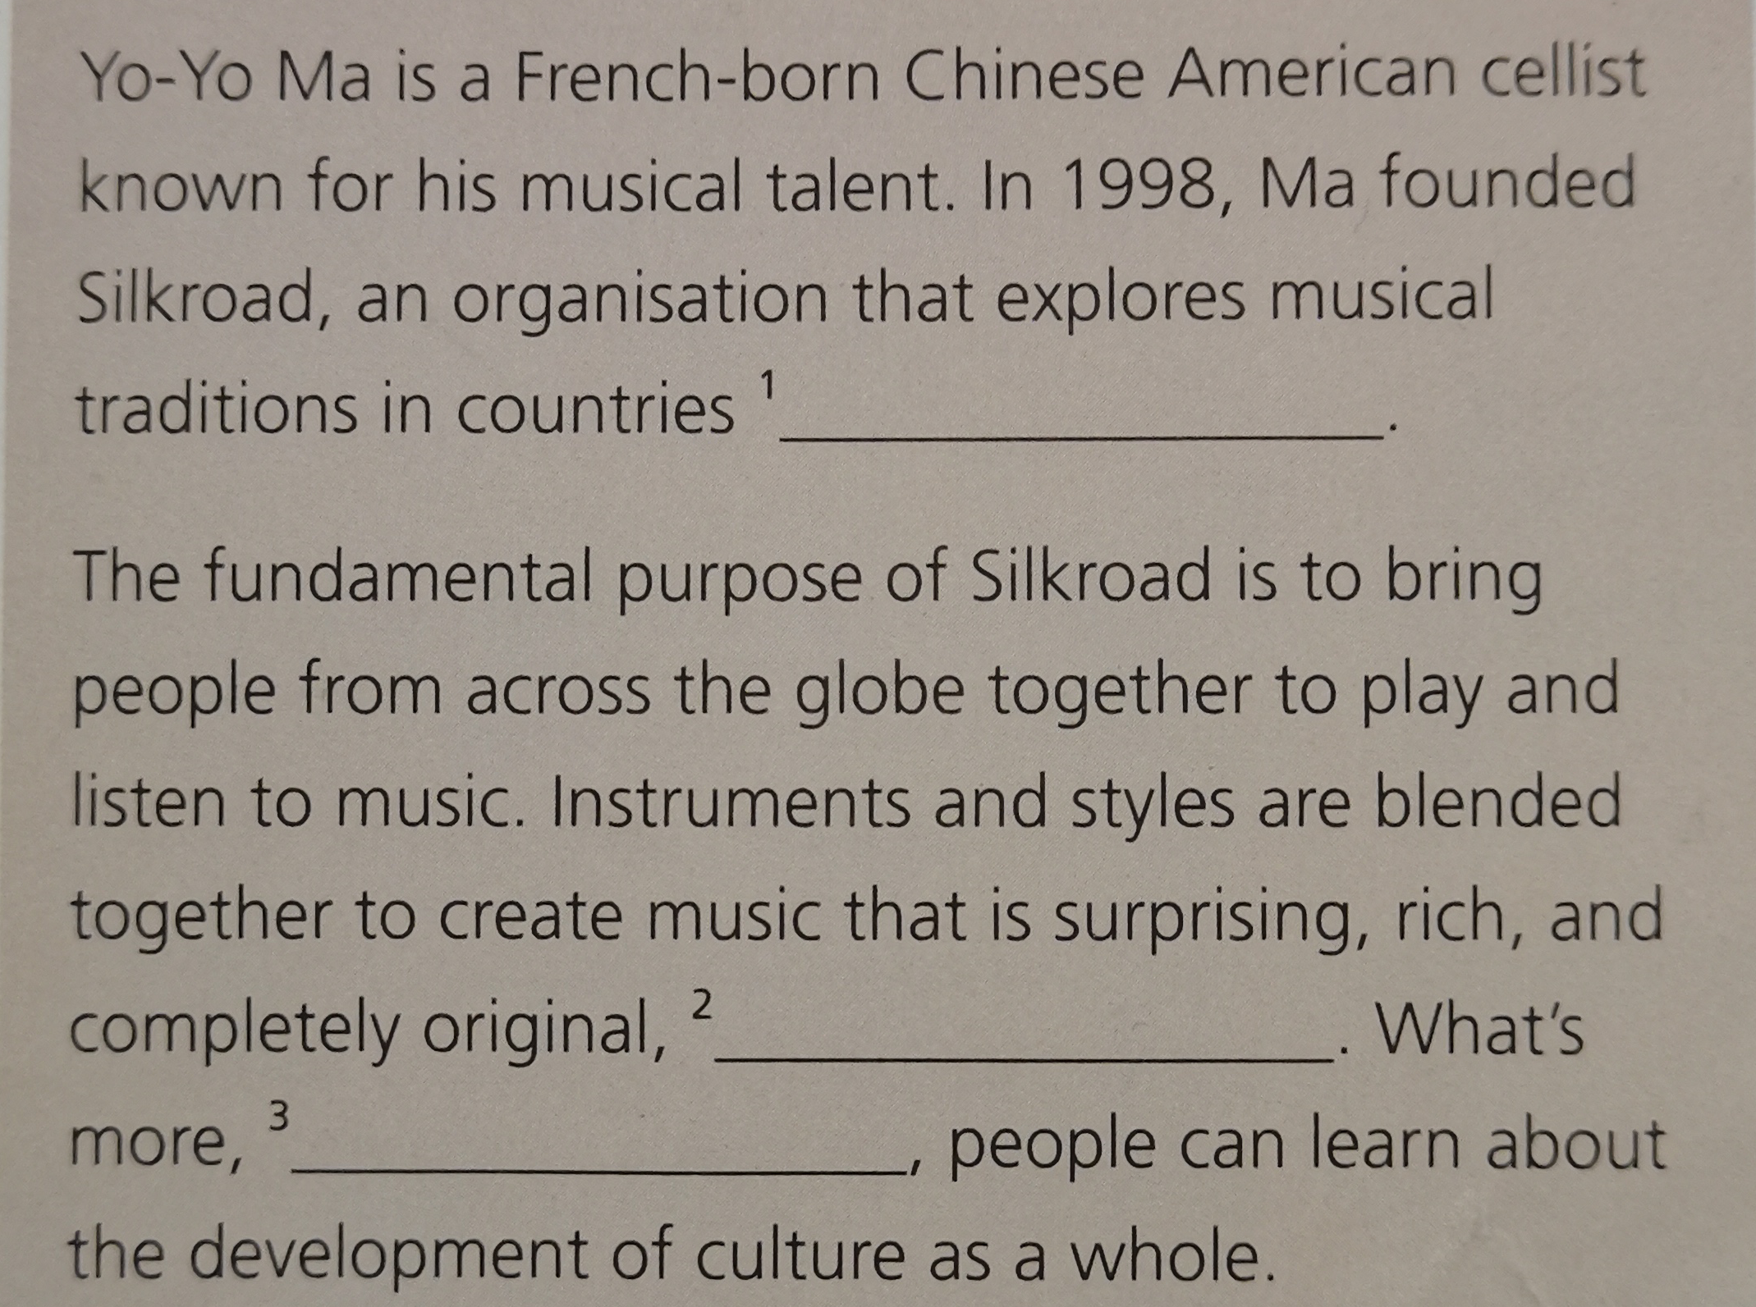
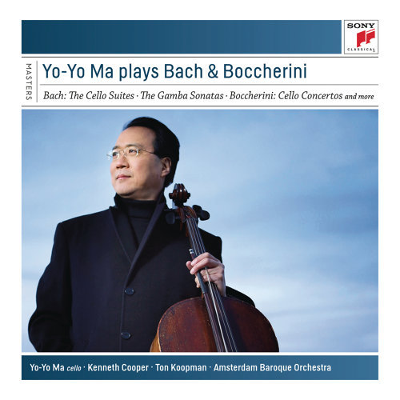
Practice 1
so that people can learn about different cultures | →
As the traditional is mixed with the modern | →
no matter what culture it comes from | →
1
2
3

Slide 7
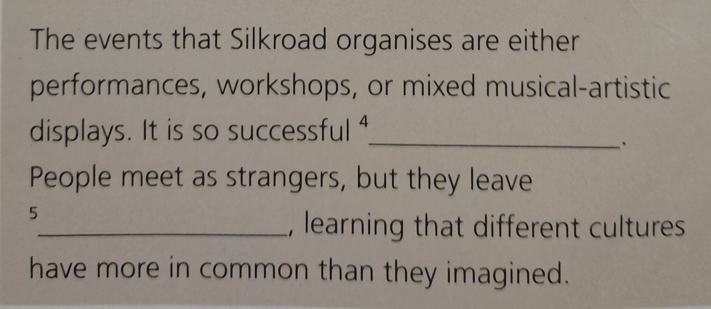
Yo-Yo Ma, a French-born Chinese American cellist
that over 15000 people each year attend them | →
as if they are neighbors | →
4
5

Slide 8

Practice 2 China’s High Speed Rail--HSR
Describe China’s High Speed Rail(HSR)
◎ In 2008, China’s HSR service started.
◎ In 2015, a major breakthrough in technology was made, using independent R&D.
◎ Now, China cooperates with dozens of countries in the world to develop HSR services overseas.
Since HSR service started in China in 2008, it has undergone rapid growth...

Slide 9
Describe China’s High Speed Rail(HSR)
Since HSR service started in China in 2008, it has undergone rapid growth. The experience of train travel becomes much more efficient and enjoyable than before because journeys are not only much faster but also comfortable.
China’s HSR had another technological leap when a major breakthrough was made in 2015, using independent R&D. travelers have have become so accustomed to the incredible speed of HSR that many of us have already forgotten the old, slow trains of just a decade ago.
Now, China cooperates with dozens of countries around the world in order to share its groundbreaking technology and develop HSR services overseas.

Slide 10

Focus on vocabulary about cultural exchange
The 2nd century BC: Zhang Qian, a diplomat,...
1. give a reliable account of
2. get information on...
The 1st century AD: Gan Yang, a military envoy,...

Slide 11
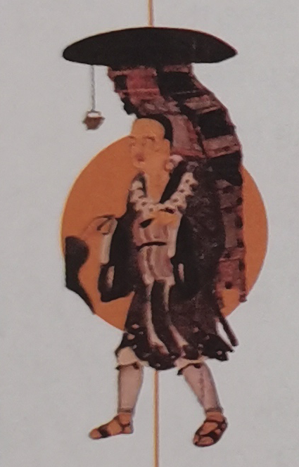
The 7th century: Xuanzang, a Chinese monk, scholar and traveller,...
3. translate...from...
4. promote exchange and understanding
The 8th century: Chinese monk Jianzhen,...

Slide 12
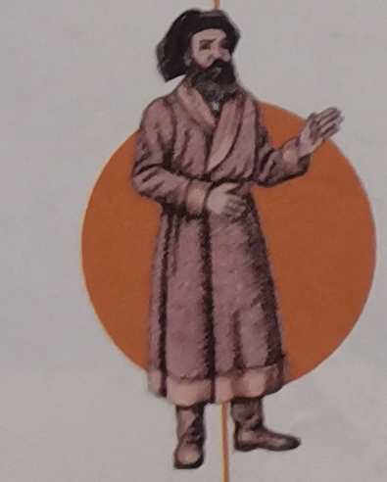
The 13th century: Marco Polo travelled,...
5. bring knowledge of...
6. lead to a legacy...
The 15t century: Zheng He sailed to,...

Slide 13
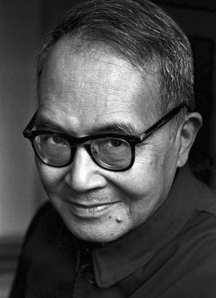
A renowned literary& scholar,Qian Zhongzhu
1 | His translations and writings ¹__________________ of cultural exchange between China and the West that continues to this day.
2 | He spent two years at Oxford University, where he studied and ² _______________________ English literature.
3 | This made him an excellent translator, who ³ ___________________________________ between Western and Chinese academics.
led to a legacy
got information on
promoted exchange and understanding

Slide 14
A renowned literary& scholar,Qian Zhongzhu
4 | Selected and Annotated Song Dynasty Poetry was one of the many works he ⁴ _______________________ Chinese to English.
5 | These books helped ⁵ ________________________ Chinese literature to the West.
translated from
bring knowledge of

Slide 15
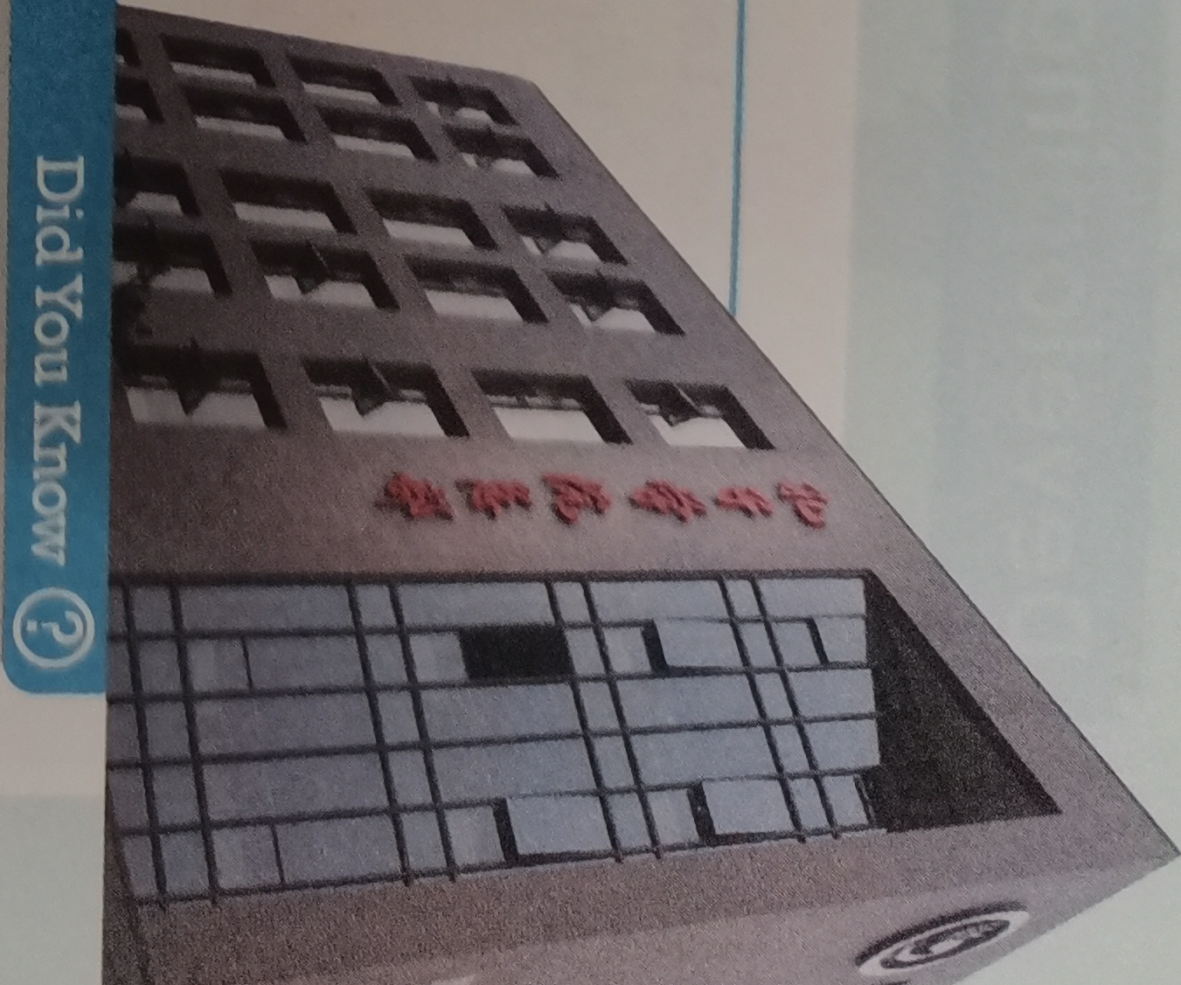
Before listening
The Confucius Institute is a non-profit educational organisation run by the Chinese Ministy of Education, aiming to promote Chinese language and culture abroad and to encourage cultural exchange.
The first institute opened in 2004, and today there are over 500 institutes around the world . In addition to Chinese language courses, the institutes also support activities, such as art exhibitions, concerts and film festivals.

Slide 16
Listen and understand the topics it covers
a | The reason why Liang Ran decided to work for the
b | The working environment at the Institute.
c | The troubles he had during teaching.
d | A special moment from his time at the Institute.
e | What he learned from his students.
f | The friends he made in New York.
Suggested answer: __________
a /d /e

Slide 17
Listen again and finish the task
1/2 | Liang Ran spent ¹__________________________ abroad working as a teacher at ²_____________________________________.
3 | He said it was a difficult decision, because it would mean ³ __________________________.
4 | He also wanted to ⁴ _____________________________________________.
A whole year
the Confucius Institute.in New York
delaying his studies
experience life abroad and learn Western culture

Slide 18
5 | At first, Liang was surprised at ⁵________________________________, as they were quite varied.
6 | One challenge they met was that they ⁶ _________________________________, so Liang had to give them a lot of support.
7/8 | When students learned about traditional Chinese dancing and ⁷________________. Liang said their ⁸ ________________ was amazing.
9/10 | Through teaching Chinese, he ⁹ ____________________________________, and though interesting with students, he ¹⁰_____________________________.
the different ages of the students
had difficulty with Chinese characters
Chinese costumes
enthusiasm
became even more proud of China
learned more about the world

Slide 19
Post listening give reasons and draw conclusions.
1 the reason why .... is that... | 2 that was due to.. | 3 on the whole,...
4 to sum up,... | 5 in short,...
Giving reasons:
Drawing conclusions:
1/ 2
3/ 4/ 5

Slide 20
Language appreciation
1. Gan Ying, a military envoy, exploded the Persian Gulf and became the first Chinese to get information on Europe.
[句式分析] a military envoy充当主语Gan Ying的 同位语 (成分)；the first Chinese to get information采用结构“the +序数词+名词+ 带to不定式”，其中不定式作名词的 后置定语 （成分）。
[尝试翻译] 军事使者甘莹考察了波斯湾，成为第一个获得欧洲情报的中国人。

Slide 21
Language appreciation
2. The Confucius Institute is a non-profit educational organization run by the Chinese Ministry of Education, aiming to promote Chinese language and culture abroad and encourage cultural exchange.
[句式分析] run by the Chinese Ministry of Education为过去分词短语作 后置定语 （成分），“run”意为“管理，经营”与其前面的名词organization构成 被动 关系；“aiming to promote Chinese language”为现在分词短语作状语，所给动词aim与其前面的句子构成 主动语态 关系。
[尝试翻译] 孔子学院是由中国教育部主办的非营利性教育组织，旨在向海外推广中国语言和文化，鼓励文化交流。

Slide 22
Language appreciation
3. One of Qian’s great achievements was to produce comparative studies of classical Chinese texts, which made these works more accessible to Western readers.
[句式分析] to produce comparative studies of classical Chinese texts 为不定式短语作表语， which引导非限定性定语从句，从句中采用make +宾语+形容词作宾语补足语
[尝试翻译] 钱钟书的伟大成就之一是对中国古典文本进行比较研究，使这些作品更容易为西方读者所理解。

Slide 23
Language points
1. due to... | 8. get information on...
2. on the whole | 9. work as ...
3. to sum up | 10. at first
4. in short | 11. be surprised at...
5. translate... from... | 12. interact with ...
6. bring knowledge of... | 13. promote exchange and understanding...
7. lead to a legacy of | 14. give an account of ...

Slide 24
Assignments for this period
1. Review the new words and expressions learned in this period.
2. Review the usages of the adverbial clauses.
3. Describe a Chinese innovation that has had a great impact both at home and abroad.

Slide 25
感谢您的观看

