Slide 1

外研版(2019)高中英语 选择性必修第四册
Unit 3 The world meets China
Period 3 Developing ideas & Presenting ideas

Slide 2
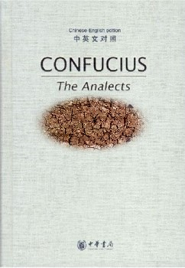
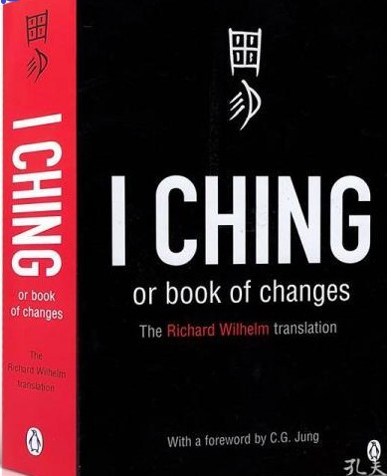
Part One Developing ideas
《论 语》
《孙子兵法》

Slide 3
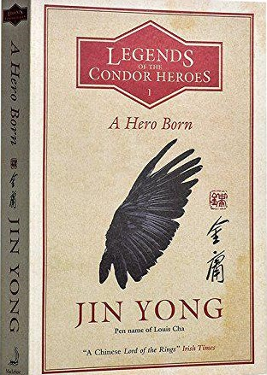

《射雕英雄传》
《三体》

Slide 4
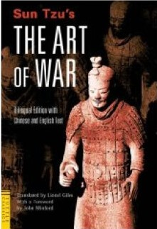
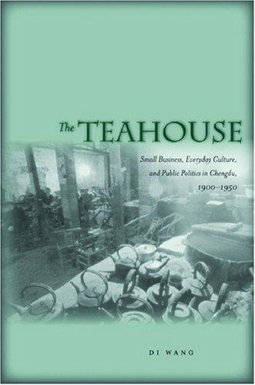
《易经》
《茶馆》

Slide 5
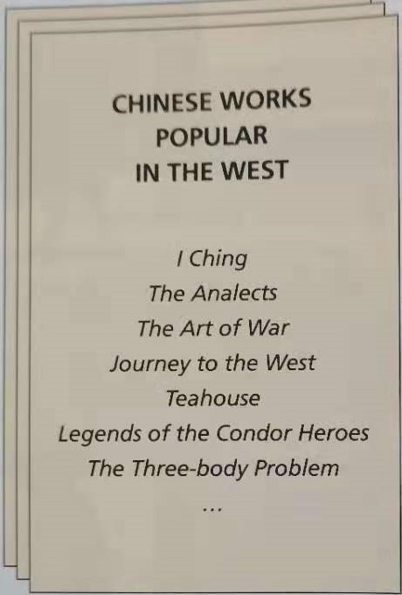
Chinese Works popular outside of China
1. Why do you think these works are popular in the world?
Possible answer:
On the one hand, the Chinese classical works contains the unique wisdom and great civilization of the Chinese nation, which interest foreigners and enrich their minds;
on the other hand, unique writing styles and contents of modern works help foreigners have a better understanding of China and Chinese, including distinctive arts, local customs and culture and so on.

Slide 6
More popular examples of Chinese works
《红楼梦》 | Dream of the Red Chamber
《三国演义》 | Romance of the Three KingdomsThirty-six
《三十六计》 | The Stratagems
《史记》 | Shi Ji or Record of the Grand Historian
....... | .....

Slide 7
Reading comprehension(一)
1.Which work is not mentioned in the passage? Answer: ______A. Journey to the West B. Thirty-six Stratagems C. Dream of the Three Kingdoms. D. The Romance of the Three Kingdoms.
C
2. Which of the following is not true according to the passage? Answer: _____A. Thirty-six Stratagems sells well in Bulgaria. B. People in the Netherlands like to learn about Chinese culture. C. The works of Mo Yan are popular with the French. D. Chinese literary works don’t really attract Egyptian.
D

Slide 8
3. Which is wrong according to the passage? Answer: ______A. Petko prefera classical Chinese literature. B. Annelous chooses the works to translate only if they are spoken of by Sinologists. C. Joachim chooses the works to translate based on his own taste. D. Mai doesn’t care the popularity of the writer.
B

Slide 9
Reading comprehension (二)
Read the passage and put the three questions onto the right line in the text. 1 Which works by Chinese writers are popular in your country? 2 How did you get interested in Chinese literature? 3 How do you select works to translate?
Answer:
Q 1: _______ → How did you get interested in Chinese literature?
Q 2: _______ → How do you select works to translate?
Q 3: _______ →Which works by Chinese writers are popular in your country?
2
3
1

Slide 10
Opinions & Evidence
1.Petko’s opinion | I wish that people could learn to love Chinese culture as much as I do especially stories from classical literature.
Evidence
He particularly like classical Chinese literature, especially works from the Ming & Qing dynasties,such as Dream of the Red Chamber and The Romance of the Three Kingdoms.

Slide 11
Opinions & Evidence
2. Annelous’s opinion | Studying Chinese language was what first got me interested in its culture. If only there was greater awareness of Chinese language and literature in my country.
Evidence
When he started high school, he began reading books about Chinese history and culture, and this inspired me to choose Chinese Studies as my academic.

Slide 12
Opinions & Evidence
3.Joachim’s opinion | It’s important to read what interests you, not just what is recommended by other people. The same goes for the literature that I translate.
Evidence
He just go with what he like and what he is interested in. He has translated several short stories by Mo Yan....

Slide 13
Opinions & Evidence
4. Mai’s opinion | I feel that my culture has a lot in common with Chinese culture. I care more about what writers have to say than who they are.
Evidence
He thinks Egypt and China are closely connected and both have a lot in common. because of this, Chinese literary works really strike a chord in the hearts of Egyptian readers.

Slide 14
Think and Share
Work in groups and discuss the following questions. 1. What work would you like to recommend as an introduction to Chinese literature? Why ?
Possible answer:
I’d like to recommend the novel The Romance of the Three Kingdoms, which presents enormous battle scenes and military stratagems of Ancient China.

Slide 15
Think and Share
2. How do you promote Chinese literature throughout the world?
① What types of literary works do you think should be promoted? (fiction/ drama/ or poetry)
② By what methods could this be done? (translation/ advertising/or film adaptation)
① Peking Opera, I think should be promoted in that it is an important form of traditional Chinese culture, in which a variety of artistic elements have been used as a symbol of traditional Chinese culture. ② It is advised that this kind of art should be spread by live-streaming through mass media.

Slide 16
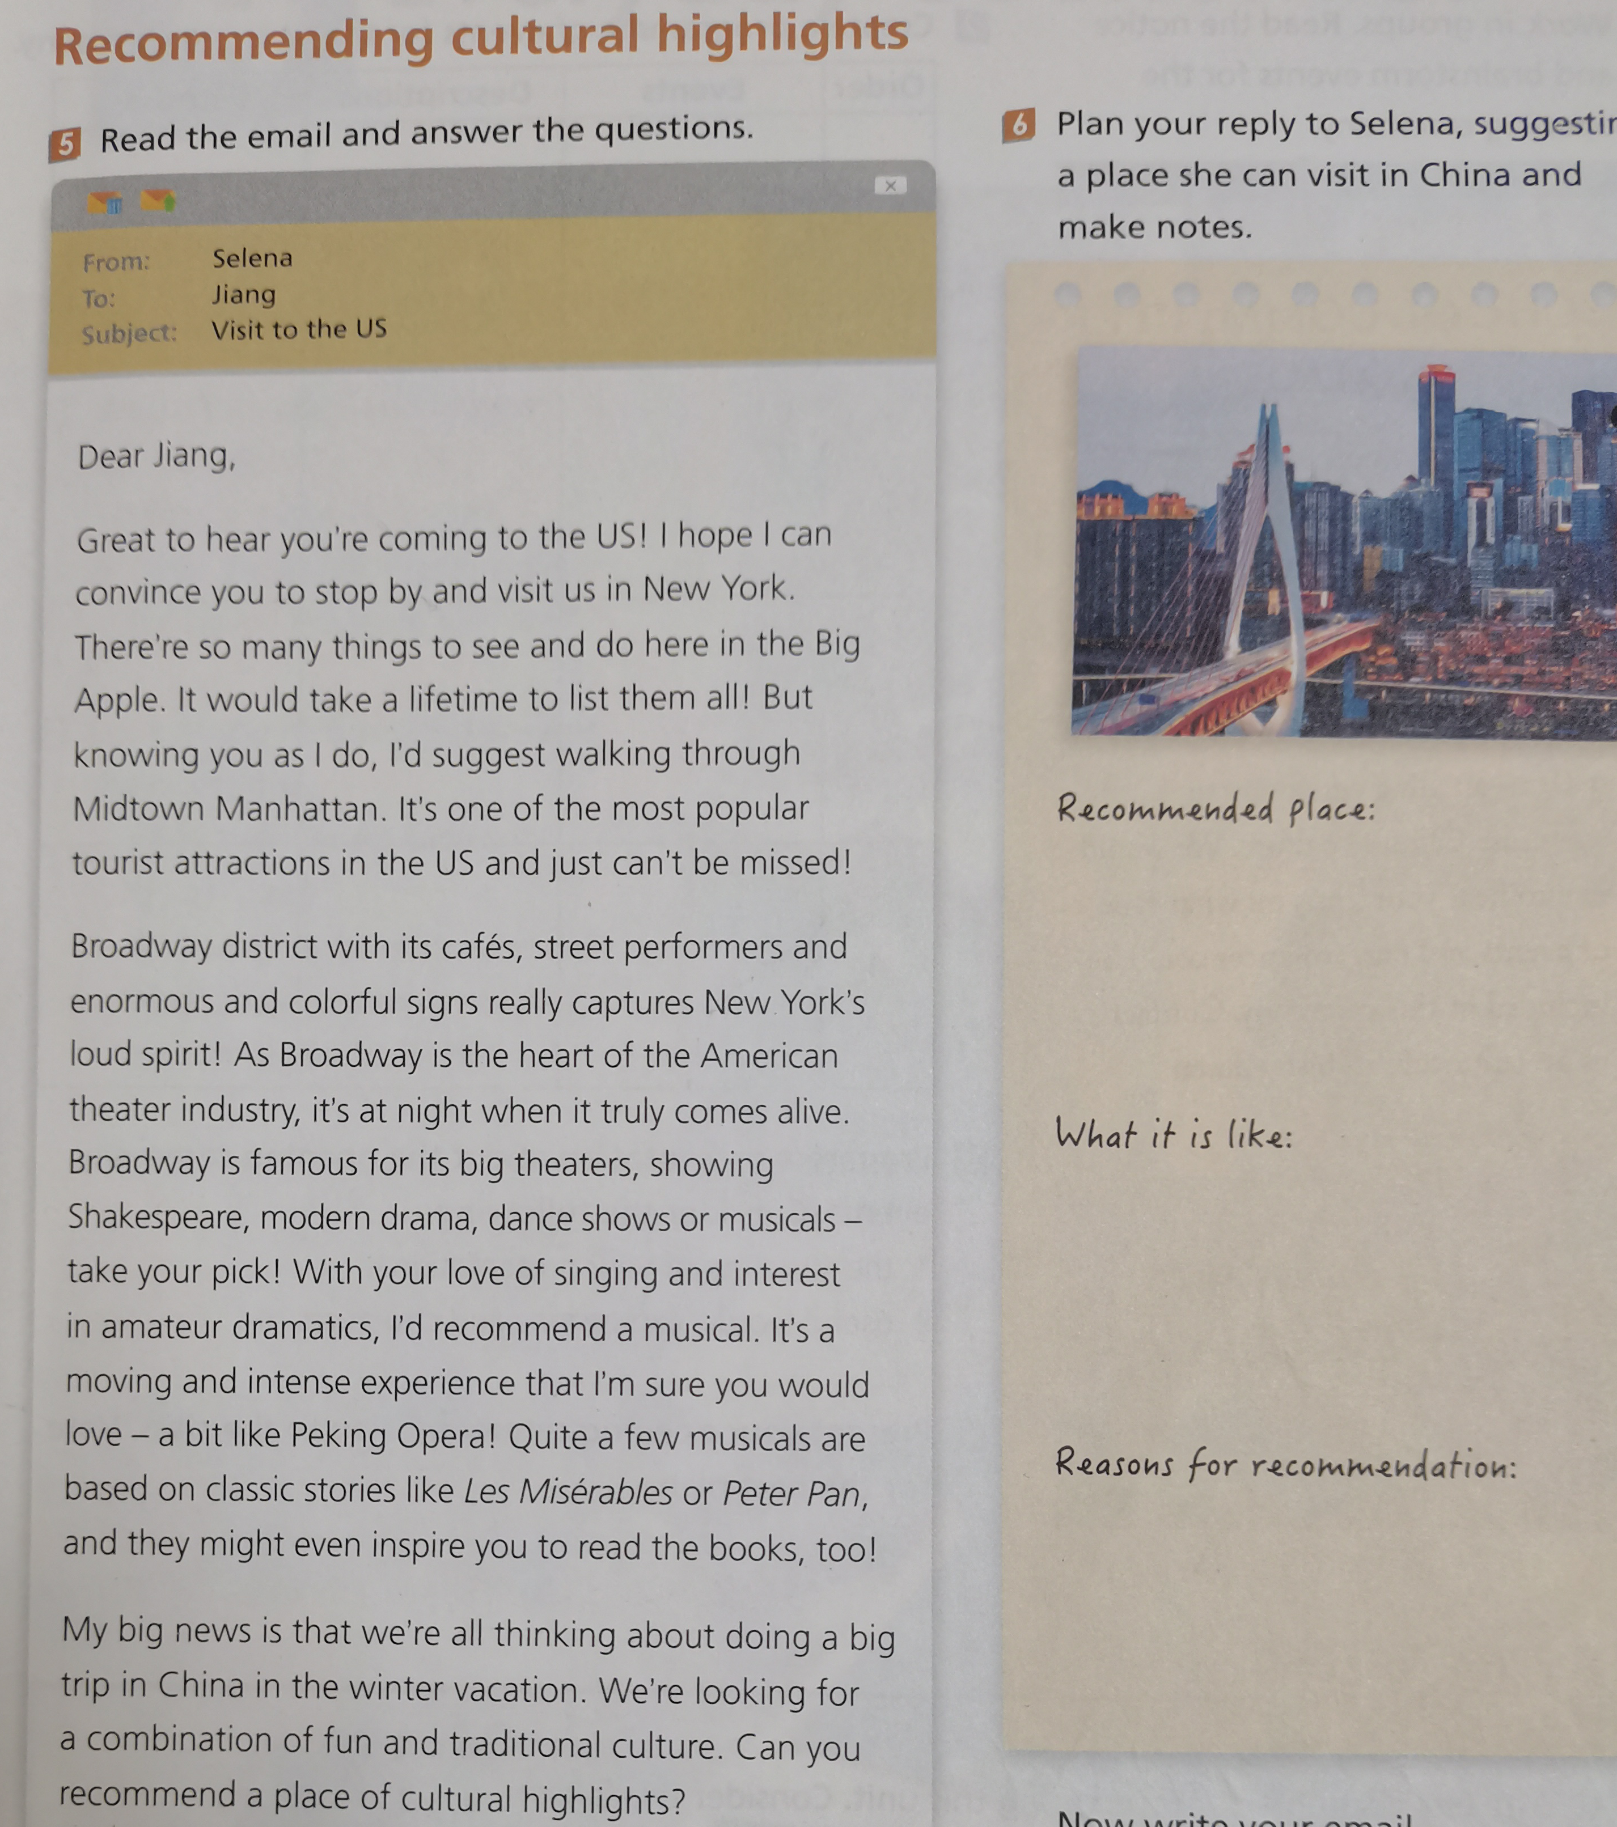
Part Two Writing

Slide 17
Outline your writing
Recommended place
What it is like
Reason for recommendation
The city of Chongqing, China
a distinctive hilly city
Unique mountain with...

Slide 18
Share your writing with the class.
Dear Selena, Thank you for all your recommendations, which have definitely inspired me to include New York in my trip. I can’t wait to see you there! I’m so excited to hear that you’re coming to China. I can easily suggested places for you to visit because there are so many interesting ones. First of all, I must recommend my own city, Chongqing. Located in the south-west, it would give you an experience of urban China different to that of any other Chinese city.

Slide 19
Share your writing with the class.
Chongqing is a hilly city with a unique landscape so the best way to travel around is by light rail. Most of the light rail is above ground, so it’s a great way to get a feeling for the place. Chongqing is also the perfect spot to see the amazingly clear line where the emerald waters of the Jialing River and those of the sandy Yangtze River meet. The city is beautiful at night, with its shining lights reflected on the rivers. The most spectacular nighttime views are from one of the surrounding mountain tops.

Slide 20
Share your writing with the class.
Last but not least, you absolutely mustn’t miss out on Chongqing food--it’s spicy. However, I promise that after trying our local hot pot, you’ll be hooked. There are loads of other things to see and I’d be very happy to show you around!See you soon in New York!

Slide 21
Presenting ideas
Read the notice on Page 36 and brainstorm events for the opening ceremony.
Useful expressions
host an event/ a ceremony/... | will involve/attend/...
last for (time...) | will begin with an opening ceremony to...
Include different activities and performances | aiming to enhance....

Slide 22
Presenting ideas
Create a programme of events for the opening ceremony.
Events
Descriptions
Purposes
An International Cultural Exchange for senior students
...last for one week, and will involve overseas coming to our school.....
an opening ceremony to show Chinese culture

Slide 23
Language appreciation
1. I fell in love with Dream of the Red Chamber the first time I read it, and was determined to translate it into Bulgarian.
[句式分析] “the first time I read it” 是the first time充当连接词，引导的 时间状语 从句，意为当第一次做某事的时候。 注意区别于介词短语“for the first time”仅仅作时间状语。另外固定句型 “This is the first time +从句（从句常常用 现在完成 时态）”
[尝试翻译] 我第一次读《红楼梦》就爱上了它，并决心要把它译成保加利亚文。

Slide 24
Language appreciation
2. I just go with what I like and what I am interested in.
[句式分析] what I like and what I am interested in 是and 连接的两个并列的 宾语 从句，作介词with的宾语 ，引导词what分别在从句中充当动词like和介词in的 宾语 。
[尝试翻译] 我只做我喜欢和感兴趣的事情。

Slide 25
Language appreciation
3. When you consider that here the best a writer can usually hope for is to sell a few hundred copies of their work, Thirty-six Stratagems is a best-seller in Bulgaria!
[句式分析] When you consider that... 是when引导的时间状语从句，其中含有一个that 引导的宾语从句，a writer can usually hope for作 定语 从句修饰先行词the best； 不定式短语to sell a few...下句子中作表语 ，不定式作表语表示一次性动作或者将要发生的动作。
[尝试翻译] 你想想看，在保加利亚，一个作家能指望的最好的作品通常就是卖出几百本。《三十六计》在保加利亚是一本畅销书。

Slide 26
Language points
1 | be prior to... | 7 | hope for...
2 | be exposed to... | 8 | have...in common
3 | keep an eye on... | 9 | strike a chord
4 | on the whole | 10 | show Chinese culture
5 | think highly of ... | 11 | a combination of
6 | be familiar to sb | 12 | do research into ...

Slide 27
Assignments for this period
1. Review new words , phrases and useful expressions learned in this period.
2. Think back how to recommend culture highlights.
3. Polish your writing -recommending cultural attraction to your friend.

Slide 28
感谢您的观看

