Slide 1

外研版高中英语 选择性必修第四册
Unit 4 Everyday economics
Period 1 Staring out & Understanding ideas

Slide 2
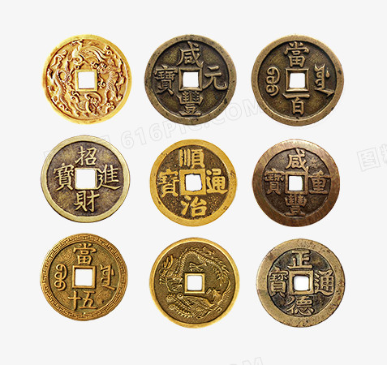
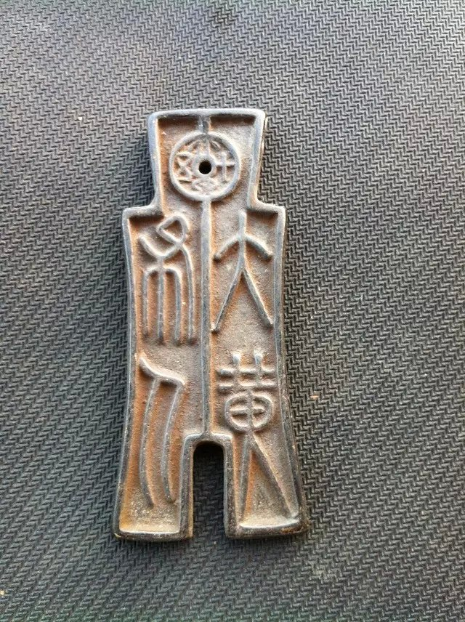
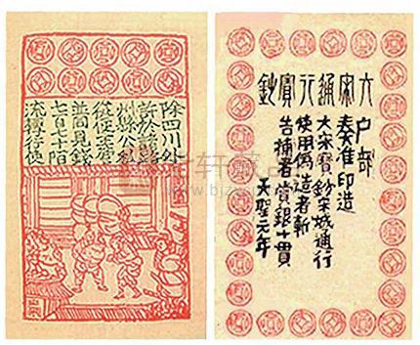
Part One Starting out
ancient coin
Chinese copper coins
jiaozi used in the Song Dynasty

Slide 3

Watch the video
1. What is the video about?
The video is about the development of currency.
2.What stages are mentioned in the video?
There are different stages in the development of currency.

Slide 4
The development of Chinese currency
 | Time | currency
1 | Long before
2 | Around the 11th century BC
3 | the Qin Dynasty
A batter system is a way to exchange goods and service for other goods and services
Chinese people started to use small pieces of bronze to trade things. Coins of different shapes were used.
The coins were standardizedstarted to take a circular shape with a square hole through the middle

Slide 5
The development of Chinese currency
 | Time | currency
4 | the year 1000,
5 | The Song Dynasty
6 | Today
The Chinese began to use paper money
jiaozi, which is said to be not only the first example of paper currency used in China, but also in the world.
We have a modern system of coins and paper notes, but this is continuing to change and develop to other forms.

Slide 6
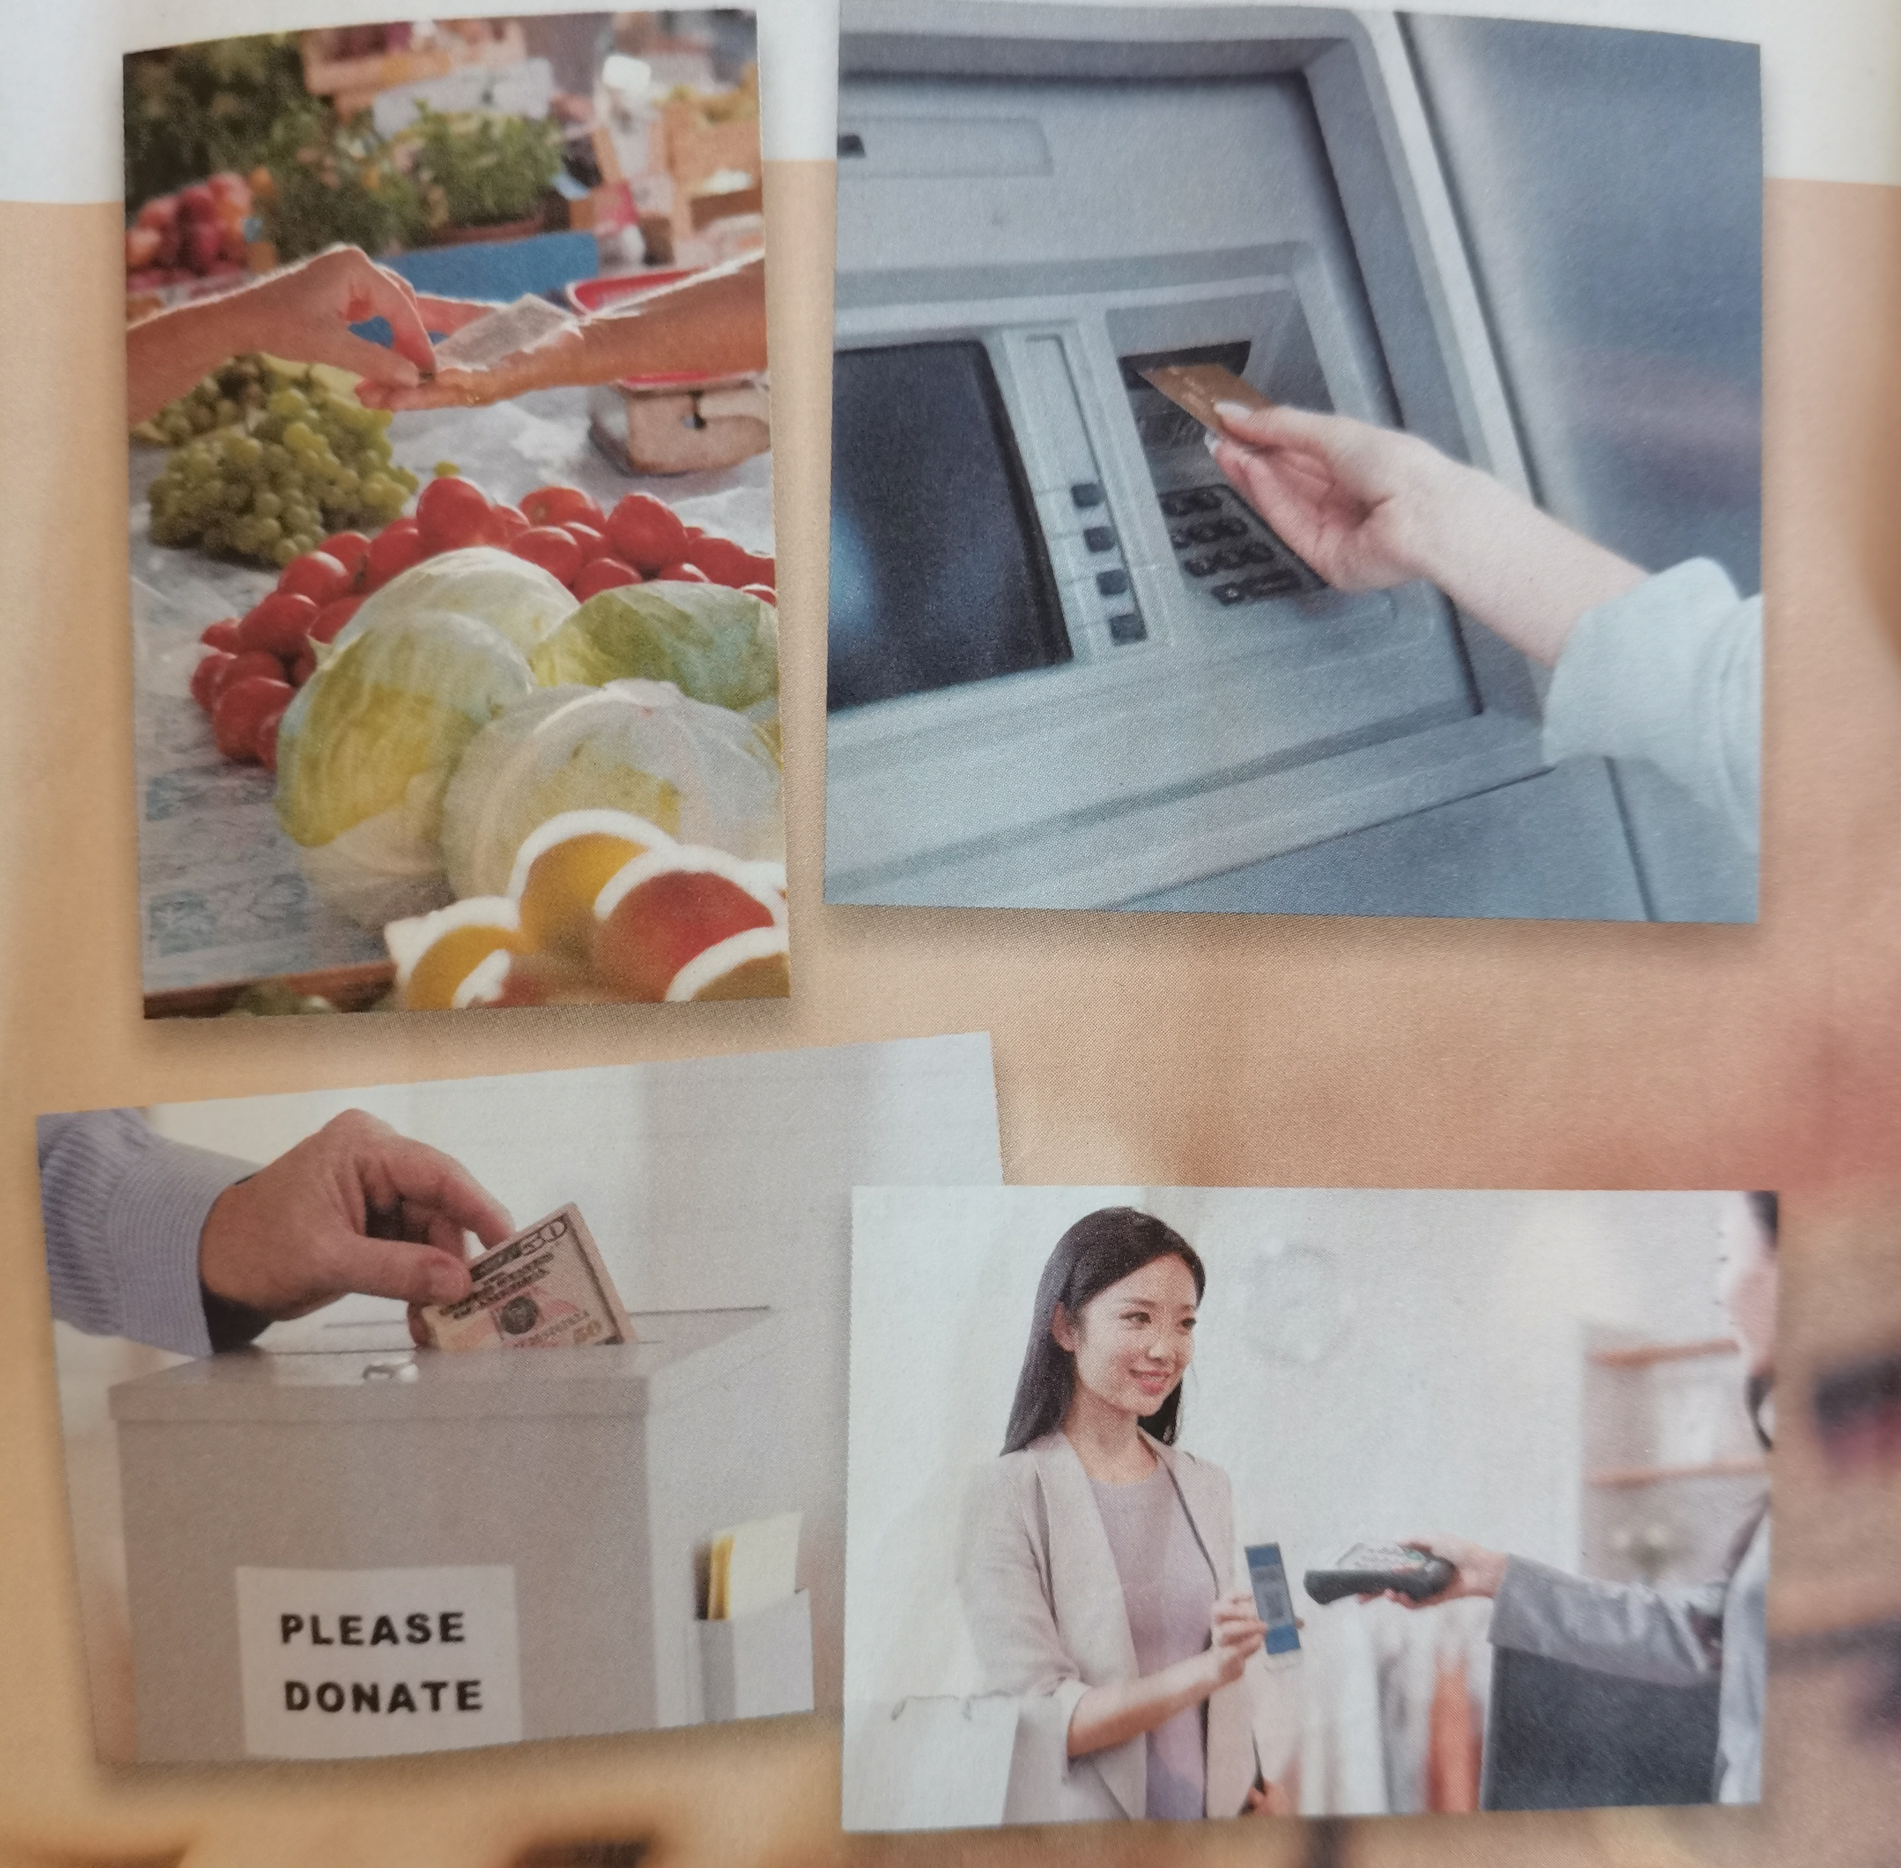
Talk about daily economic activities
Picture 1
Picture 3
Picture 2
Picture 4

Slide 7




Pictures | What activities? | What they have in common?
Paying coins for vegetables
The pictures show types of economic behaviors and they are related to currency of various forms.
Donating money to people in need
Using an ATM card
Paying through an app on a smartphone

Slide 8
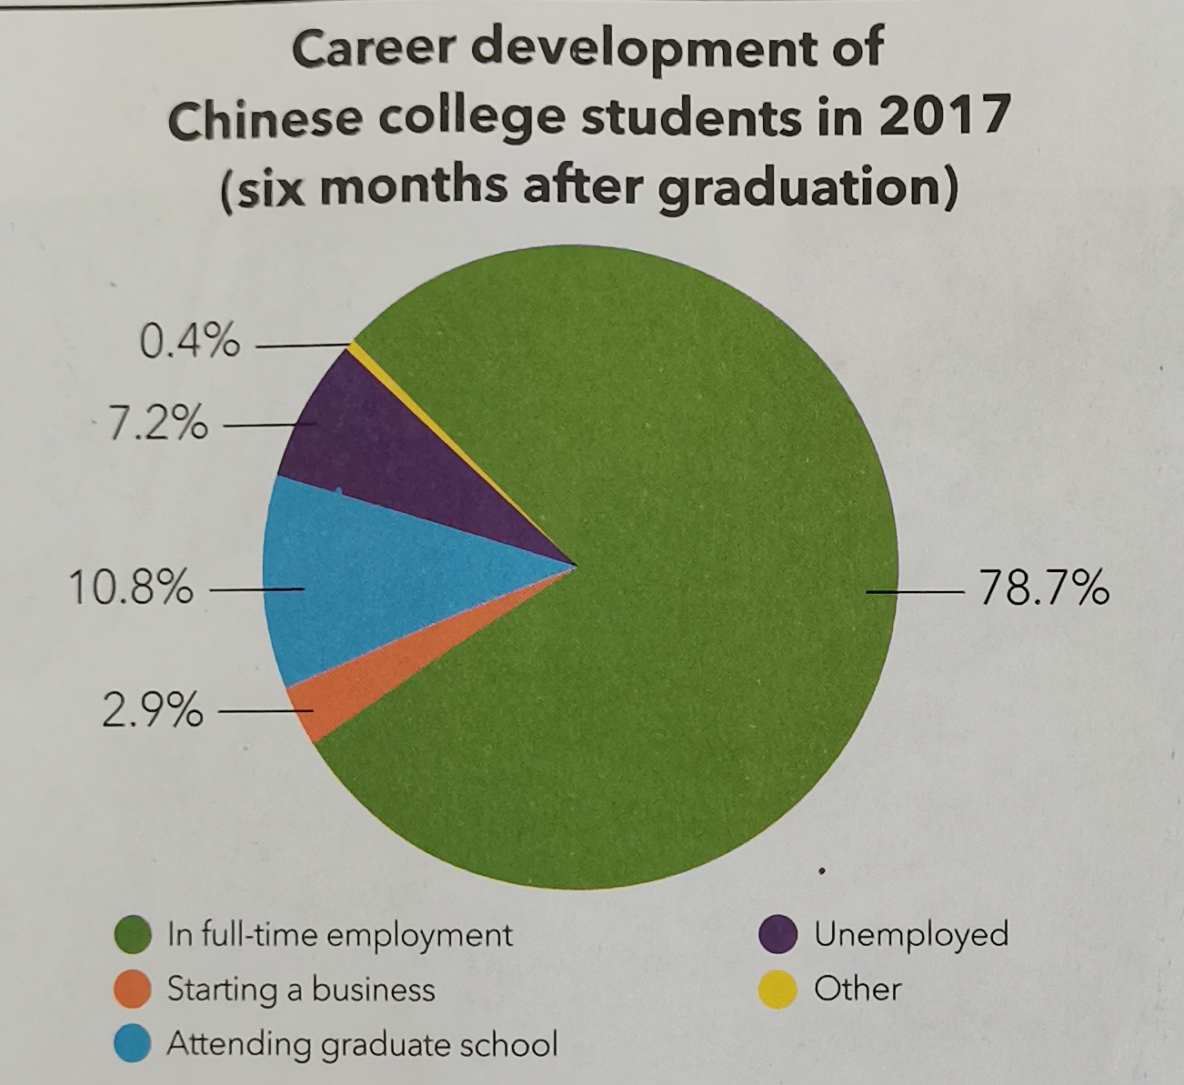
Part Two Reading
Before reading, look at the charts and answer the questions.
What options do college students have after graduation?
They can get a full-time job, pursue further education, or start their own business. They may also choose not to have a job.

Slide 9
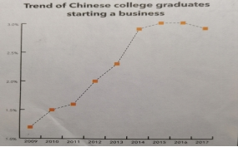
What does the chart tell you about the trend of college graduates starting their own business?
1. From 2009 to 2015, the percentage of university graduates who started a business rose.
2. Between 2015 and 2016, the percentage remained almost at the same level, about 3%, while in 2017, the percentage declined.

Slide 10
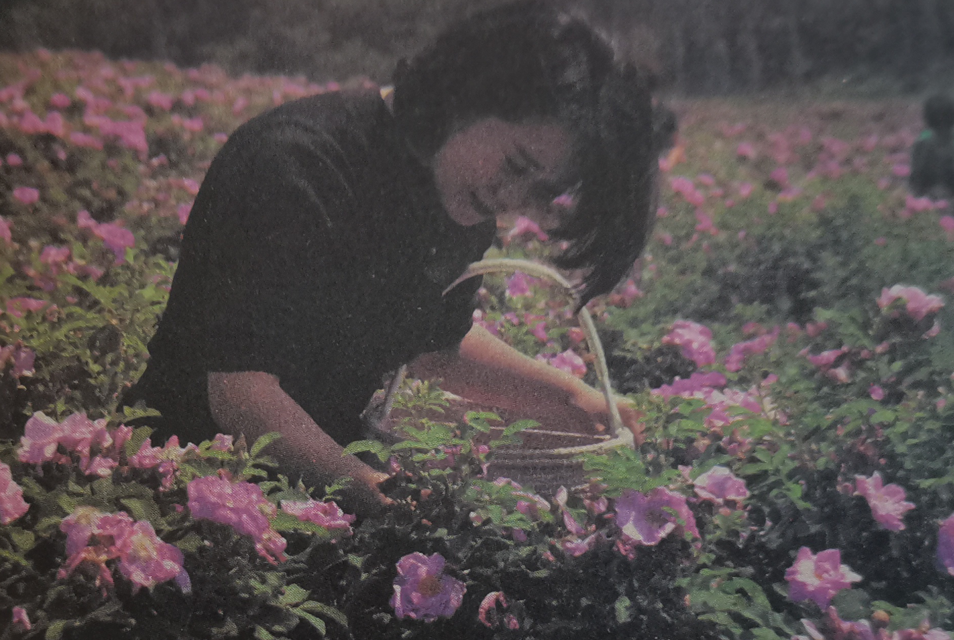

Reading Business Blossoms
Zhang Yue, chairwoman of a compnay
creating a multi-million yuan business form roses

Slide 11
Fast reading
1. What decision did Zhang Yue make to develop her career?
A. She decided to return her home town and start a business growing roses. B. She decided to return her home and start a company selling cosmetics. C. She decided to return her home town and run a training school.
(Answer: _____ )
A
2. Which words can best describe Zhang Yue?
A. Diligent and experienced B. Passionate and devoted C. Potential and doubtful (Answer:_____ )
B

Slide 12
3. What was Zhang Yue biggest difficulty at the beginning?
A. Lacking much money B. Being refused by others D. Lacking labour force (Answer : _______)
A
4. Which is true about Zhang Yue according to the passage?
A. She has dreamed of starting business since children.
B. She only used her own money to start her business.
C. She never thought she would end up growing roses in her own town.
(Answer : _______)
C

Slide 13
Further reading
1. Choose the main purpose of the text and give your reasons. A. To introduce the main reasons why young people choose to start their own businesses. B. To analyse the pros and cons of young people starting their own business. C. To encourage all young people to start their own business after graduation. D. To help young think more realistically before starting their own business. E. To teach young people the correct procedures for starting their own businesses. (Answer :_________)
D

Slide 14
The structure & the theme of the text
Parts | Paragraphs | The main idea
Part 1 | Paras 1/2
Part 2 | Paras 3/4
Part 3 | Paras 5/6
Part 4 | Paras 7/8
General situation of the company
Reasons for starting a business in Zhang’s home town
Challenges in the process of running her company
Zhang’ advice for young enterpreneurs

Slide 15
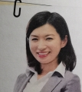
Organize information from the passage
Interview notes
Programme | Young start-ups
Interviewee | Zhang Yue
Occupation | ¹___________________ of Rose Valley Co.Ltd
Date | 26th April
Chairwoman

Slide 16
General situation of the company
◎ One of the best rose products in Asia. ◎ A major Asia manufacturer of cosmetics ²________________________________
Reasons for starting a business in her hometown
◎ ³_______________________________ for growing roses ◎ Experience the freedom of ⁴ _______________________ ◎ ⁵______________________________________________
was willing to purchase the product and help with it distribution
An ideal place
being her own boss
Giving something back to her home town

Slide 17
Challenges
◎ Getting investment. ◎ ⁶ __________________________________________
Advice for young entrepreneurs
◎ You need a good idea, hard work, ⁷ ___________________ ◎ ⁸ ____________________________, access to capital, and ⁹ _________________________________________ ◎ ¹⁰ _________________________________________ ◎ Your limits and the people you work with.
Persuading people to work for her
determination
a sound business plan
good management and negotiating skills
Don’t be too ambitious.

Slide 18
Think & Share
1. What do you think has contribute to Zhang Yue’s success?
In my point of view, she is passionate and devoted, which contributes to her success.
Besides, she has a good idea and works so hard with a strong determination.
2. What other difficulties do you think young people encounter when starting their own business?
Except lacking enough money, they should take many things into consideration,
including support from skilled working force, professional staff, good management
and so on.

Slide 19
Think & Share
3. How well do you understand the characteristics of a feature story?
How are these characteristics reflected in the reading passage?
A feature story mainly describing the scene of an important event
or some important and wonderful scenes, or an important character,
vividly presenting the reported facts to the readers.
The story focuses on key factors of the subject, which is real and thought--provoking in a humorous tone.

Slide 20
Language appreciation
1. It was only after graduating from university overseas and returning to visit her parents that Zhang realized the potential.
[句式分析] 本句采用了强调句结构，即“It’s +被强调部分+that+其它部分”。使用强调句时注意几点：形式主语it不能用其它词代替；被强调部分指人时，可以用who代替，其它情况一律用that；强调句型的判断方法：去掉it’s 和who/that，适当调整语序，若能还原成完整的句子，则为强调句型，否则就不是。
[尝试翻译] 直到她从海外大学毕业回家看望父母后，张悦才意识到自己的潜力。

Slide 21
Language appreciation
2. They stared back, their blank faces giving no clue as to what they would say next.
[句式分析] 该句中“their blank faces giving no clue”为“名词+现在分词”构成 独立主格 结构，在句子中作伴随状语。该结构的特点为：该结构的逻辑主语与句子的主语不相同，而且没有使用连接词。独立结构的逻辑主语与其后的动词构成主动关系时，用 现在 分词；构成被动关系时，用 过去 分词；表示将来动作时，用不定式形式。
[尝试翻译] 他们也盯着对方，脸上毫无表情，不知道接下来要说什么。

Slide 22
Language appreciation
3. She is not the only young person to have been bitten by the start-up bug. [句式分析] 不定式短语“to have been bitten by the start-up bug”作 后置定语 (成分)，修饰“the only young person”。[尝试翻译] 她不是唯一一个对创业感兴趣的年轻人。

Slide 23
Language points
1. take a deep breath | 8. start out
2. struggle to do | 9. as to...
3. row upon row | 10. access to...
4. in the hope of ... | 11. raise a child
5. dream of... | 12. raise one’s potencial
6. run one’s own business | 13. seek guidance from ...
7. end up | 14. rush into...

Slide 24
Assignments for this period
1. Review the basic usage of the new words and expressions learned in this period.
2. Read and listen again for a better understanding of the text.
3. Writing a 60-word summary of the passage.

Slide 25
感谢您的观看

