Slide 1

外研版高中英语 选择性必修第四册
Unit 4 Everyday economics
Period 2 Using language

Slide 2
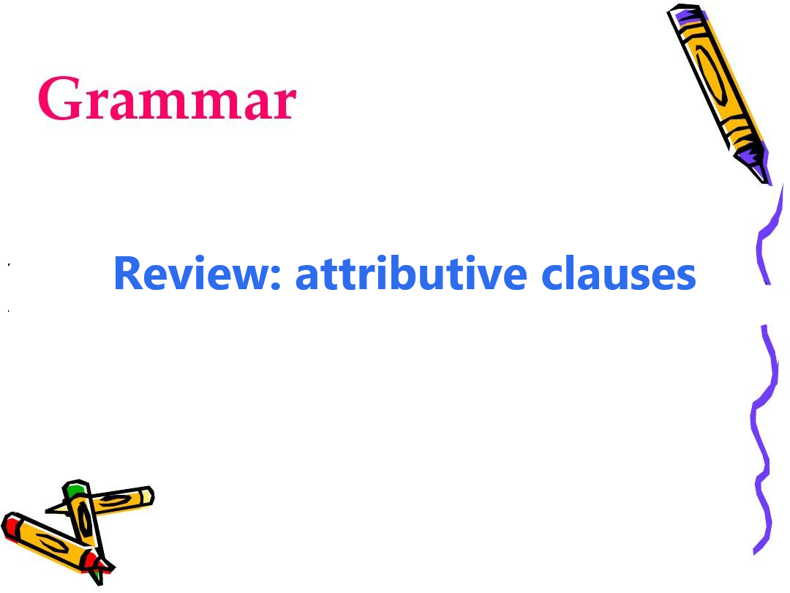
Part One Grammar

Slide 3
Relative words that introduces attributive clauses
Relative pronouns |  | Antecedent | elements in an attributive clause
that | refers to | sb/ sth | subject/ object
which |  | sth | subject/ object
who |  | sb | subject/ object
whom |  | sb | object
whose |  | sb/sth | attributive
as |  | sb/sth | subject/ object

Slide 4
Relative words that introduces attributive clauses
Relative adverbs |  | Antecedent | elements in an attributive clause
 | refers to | time | Adverbials of time
 |  | place | Adverbials of place
 |  | reason | Adverbials of reason
when
where
why

Slide 5
Categories of attributive clauses
The restrictive attributive clauses. | The non-restrictive attributive clause
The restrictive attributive clause shows that the antecedent is an indispensable attributive in meaning. If omitted, the content of the modified main clause will be incomplete or meaningless, which is closely related to the main clause and cannot be separated by commas when written. | The clauseis separated from the main clause by commas when written. The clause doesn’t define or modify its antecedent, but only plays a supplementary and illustrative role.Even if it is removed, it will not affect the meaning of the sentence.

Slide 6
Follow the rule and put it into use
1 | He is the consultant, __________ your company is looking for.
2 | They live in a house ______________ windows face south.
3 | ________ was often the case, the man forgot to bring her keys with him.
4 | Henry is not such an intelligent pupil __________ we think.
5 | The young tourists went to Qingdao, ___________ they ever swam in the sea.
who
whose
As
as
where

Slide 7
Practice Activity 2
Rewrite the underlined sentences using attributive clauses
1. Good Deal is a local movement in some countries. It works to help farmers and workers in less developed areas receive a better deal for their produce.
Good Deal is a local movement that / which in some countries works to help farmers and workers in less developed areas receive a better deal for their produce.

Slide 8
2. The movement has proven popular among young people, and they want to help producers get the payment they deserve.
The movement has proven popular among young people, who want to help producers get the payment they deserve.
3. However, some people are less optimistic, and argue that it discriminates against producers not part of the Good Deal movement.
However, some people who are less optimistic argue that it discriminates against producers not part of the Good Deal movement.

Slide 9
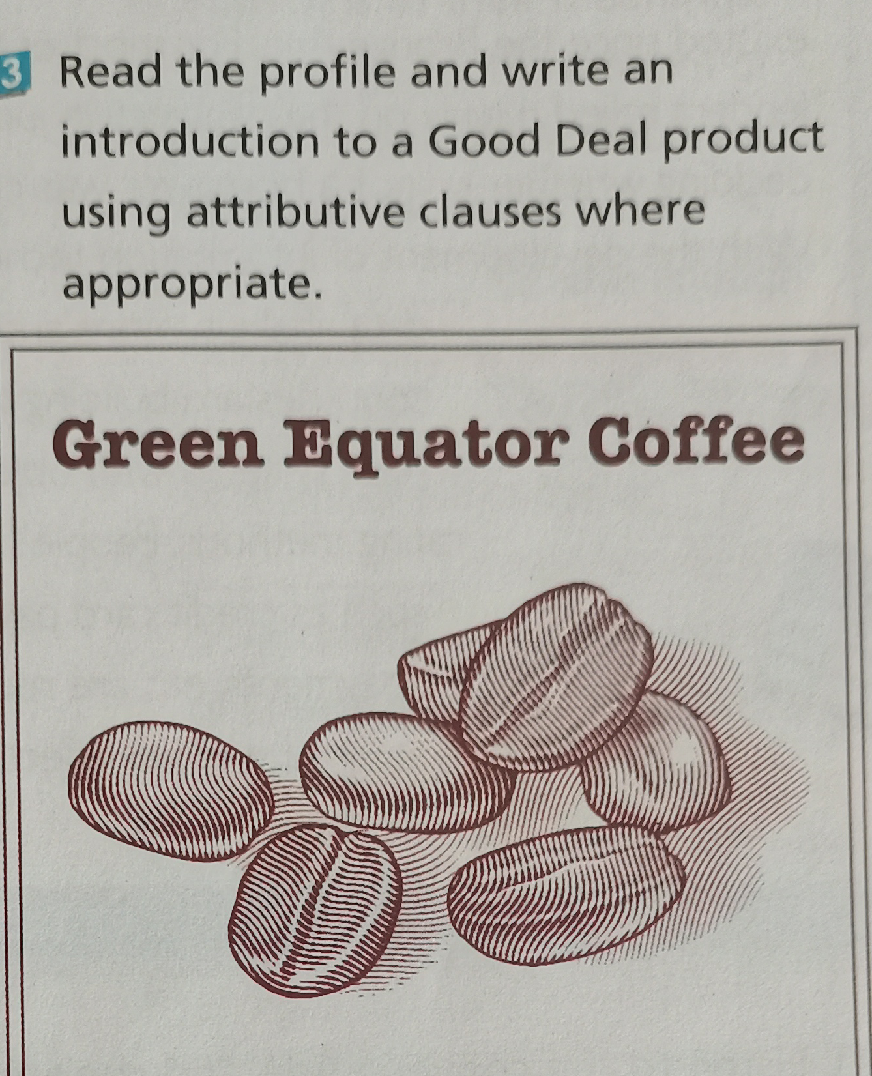
Practice Activity 3
Green Equator Coffee
Price: $ 25 per kg
Origin: grown on the Green Equator Estate
Special feature: 100% organic ; superior, smooth blend, with mild flavour;
Good Deal guarantee: one-third of the sale price returned to local producers

Slide 10
The introduction to Green Equator Coffee
Green Equator Coffee is a Good Deal product, which sells at the price of $25 per kg. It is known on the Green Equator Estate, whose coffee is 100% organic. It is a superior, smooth blend with a mild flavour, which has less than one calorie per cup.
The product is sold under the Good Deal guarantee, which promises that one-third of the sale price will be returned to local producers.

Slide 11
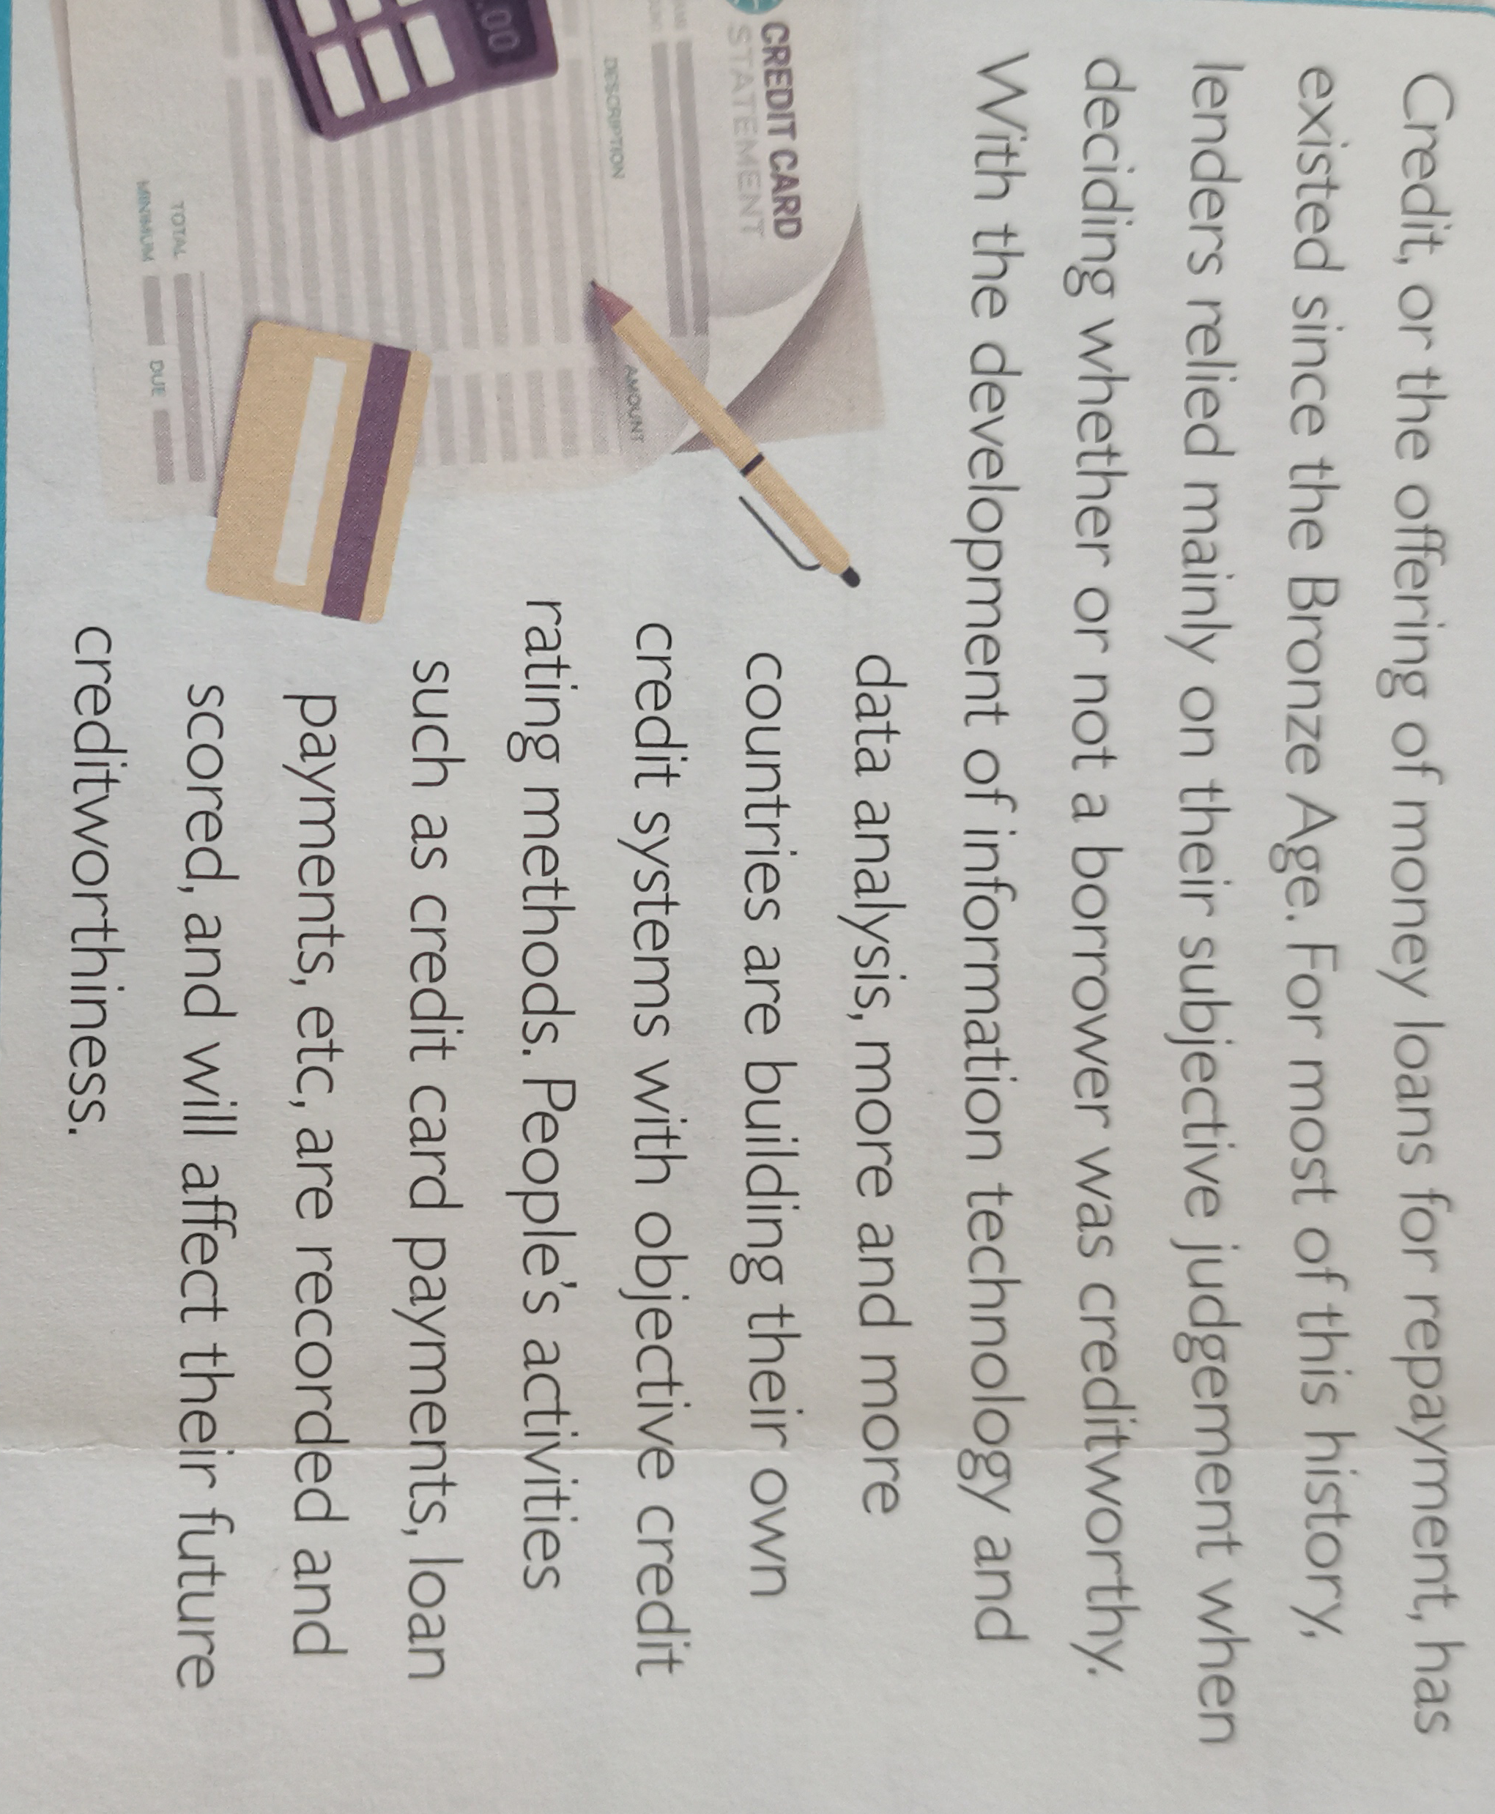

Part 2 Listening
Learn about social credit
1. What is credit ?
2.What’s the credit sysytem?

Slide 12
Listen to the conversation for key infromation
Listen to the conversation and know about the topics discussed
A. The tips to book a good hotel. B. The importance of being creditworthy. C. The origin of the credit system. D. The benefits of a social credit system. E. The cost of having a bad social credit record.
Answer: B D E

Slide 13
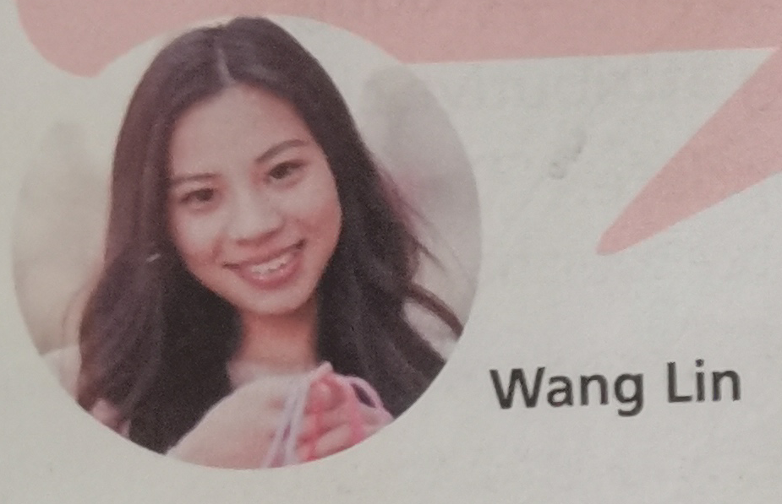
Listen again and complete the paragraph
I have been ¹__________________________ on time, returning books to the library ² ___________________________________. and using ³______________________ properly. As a reward, we didn’t have to pay a deposit when
⁴ _________________________ during our trip to Hangzhou. The hotel is very nice, and it’s quite near the West Lake. This is just one of the many benefits of the social credit system which enables ⁵ _________________________________ to enjoy a more convenient life ⁶ __________________.
paying credit card bills
in good condition without delay
the shared bicycles
we checked in at a hotel
people with good social credit
at a low cost

Slide 14
Post listening Answer the following question
1. What was the man prohibited from doing and why?
He’s prohibited from renting an expensive car because the credit system showed that he’s a laolai.
2. What do you need to pay attention to when spending money?
Apart from renting expensive cars, they may also find it hard to buy fight tickets or tickets for high-speed rail services, among other things.

Slide 15
Post listening
3. Why do you need to bear in mind when making extra money?
The social credit system is an encouragement to those who can be relied on to do the right thing, and the system is an effective way to build a friendly, honest and safe society.

Slide 16
Posting listening Ask for or give a clarification!
1. How did that happen? | 6. How is that so?
2. What’s that? | 7. What does that mean?
3. Could you tell me more about it? | 8. It means...
4. Let me explain. | 9. It’s definitely an encouragement to...
5. It enables ... | 10. ... an effective way to...
Asking for clarification:
Clarifying:
Stating advantages:
1/ 2/ 3/ 6/ 7
4/ 8
5/ 9/ 10

Slide 17
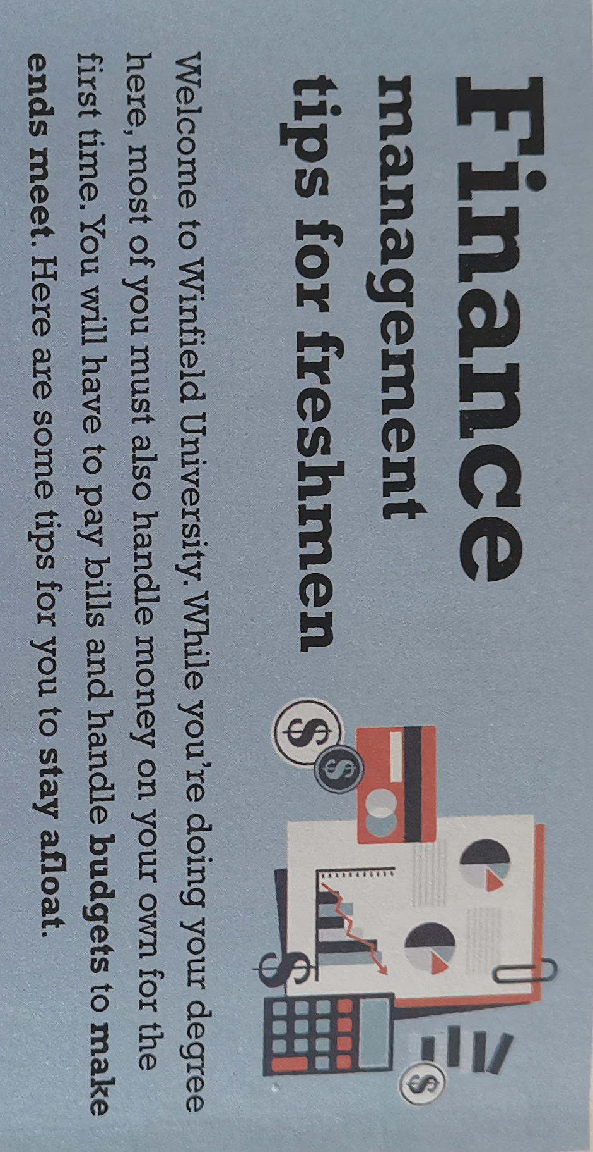
Part 3 Focus on vocabulary
1 budgets | 6 interest
2 make ends meet
3 stay afloat | 7 tax
4 build credit | 8 agree credit limit
5 annual fees | 9 go into debt

Slide 18
Paraphrase the terms about finance
1 |  | the amount of money needed or available for certain purposes
2 |  | to have enough money to buy what you need to live
3 |  | to be out of debt or financial difficulty
4 |  | money paid to the government, usually a percentage of personal income or of the cost of goods.
budget
make ends meet
stay afloat
tax

Slide 19
5 |  | to accumulate the quality of being creditworthy
6 |  | the maximum amount of money that may be borrowed under a credit arrangement
7 |  | to get into the state of owing money
8 |  | costs automatically charged once a year to your credit card account
9 |  | the amount of money charged by a bank when you borrow money, or paid to you when you keep moeny in an account
building credit
agreed credit limit
go into debt
annual fees
interest

Slide 20
Discussion
Work in groups and make suggestions on how to manage your finances and maintain a good social credit record, using the words & expressions in this section.

Slide 21
Language appreciation
1. They have no problem spending a bit more on Good Deal products....
[句式分析] “have (no) problem in doing sth” 意为“做某事没有问题或困难”, 同义性表达还有：have no trouble in doing sth; have no difficult time in doing sth; have no difficulty/ trouble with sth.
[尝试翻译] 他们不介意在物美价廉的商品上多花一些钱...。

Slide 22
Language appreciation
2. Always make payments on time, or your credit score will be affected.
[句式分析] 本句为并列复合句，其结构为“祈使句，+ or +另一句”，其中连词or意为“ 否则 ”，也可以用连词“ or else ”进行连接，前后构成 让步转折 关系。与之同型的并列复合句为“祈使句，+ and +另一句”, and前后表示 承接 关系。
[尝试翻译] 一定要按时付款，否则你的信用评分会受到影响.

Slide 23
Language points
1. make ends meet | 8. maintain a good credit record
2. keep... in mind | 9. the Bronze Age
3. interfere with | 10. affect one’s creditworthiness
4. go into debt | 11. as a reward
5. have no problem in doing... | 12. pay a deposit
6. build credits | 13. improve one’s welfare
7. open a credit account | 14. stay afloat

Slide 24
Assignments for this period
1. Review the new words and expressions learned in this period.
2. Review the grammar item-- the attributive clauses.
3. Write a short passage about the ways to better manage your finances.

Slide 25
感谢您的观看

