Slide 1

外研版高中英语 选择性必修第四册
Unit 5 Into the unknown
Period 1 Starting out & Understanding ideas

Slide 2


Part 1 Starting out
Watch and answer
1 | Natural phenomena mentioned in the video
2 | The ancient people’s explanations | （Please refer to next page）
earthquakes;
solar eclipse;
thunder and lightning;
mirage

Slide 3
For the solar eclipse
For thunder and lightning:
For thunder and lightning:
In many cultures, there were ancient beliefs that solar eclipses were caused by a creature eating the sun. In Vietnam, that creature was a giant frog. In Norway, a wolf, and in China, it was a huge dog.
In Medieval Europe, people thought that supernatural forces caused it, which was a sign of bad times ahead. In Ancient China, people believed that this was caused by the breath of a dragon
In Medieval Europe, people thought that supernatural forces caused it, which was a sign of bad times ahead. In Ancient China, people believed that this was caused by the breath of a dragon

Slide 4
3. The modern scientific explanations
1
2
3
4
Scientists now know that earthquakes are caused by the movement of tectonic plates.
In fact, solar eclipses happen when the Moon passes between Earth and the sun temporarily blocking the sun’s light.
Modern science tells us that lightning is an electric charge moving between clouds and the earth. Thunder is a shock wave of sound caused by lightning.
These days, people know that a mirage happens when layers of air with varying temperatures caused light to bend.

Slide 5
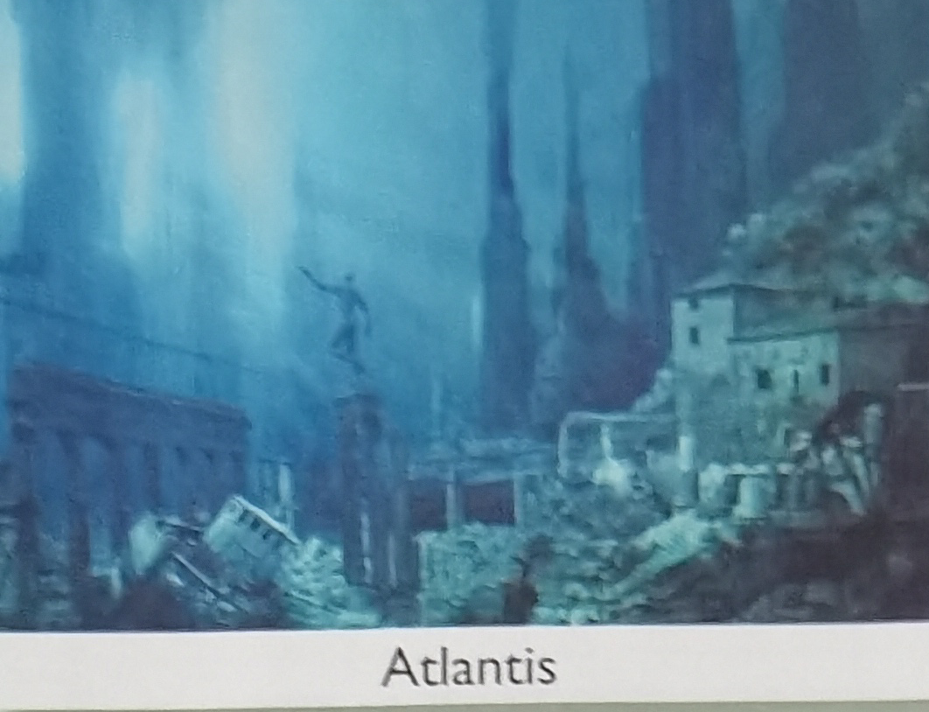
Look and say
Picture 1
A legendary city in the work of the Greek philosopher Plato. It had fabulously wealthy and advanced civilization, swept into the sea to be lost forever.

Slide 6
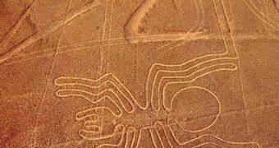
Look and say
Picture 2
A collection of giant geometric patterns and animal shapes.The landscapes was designated a UNESCO World Heritage Site in 1994, but numerous studies and theories have not explained the reason why the lines were created.
Nazca Lines

Slide 7
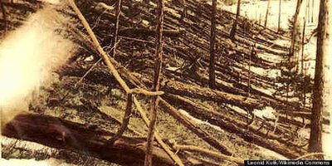
Look and say
Picture 3
Enormous explosion estimated to have occurred at 7:14 am plus or minusone minute on 30 June 1908, at an altitude of 5--10 km, flattering 2000 square km and charring over 100 square km of pine forest near the Podkamennaya Tunguska River in Russia.
TuTnguska event

Slide 8

Look and say
Picture 4
A region of space-time exhibiting gravitational acceleration, which is so strong that nothing, not even light, can escape from it.

Slide 9
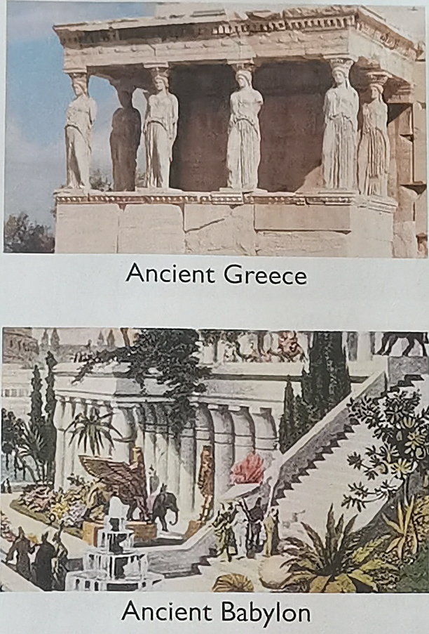
Part 2 Developing ideas
1. What do you know about these ancient civilizations?
They were very popular before the ancient civilizations suddenly disappeared.
2. What might be the reasons behind their collapse?
The destruction of mankind might be the reasons behind their collapse.

Slide 10
Reading The Mysteries of the Maya
Reading comprehension
1. What happened in the early 16th century?
A. The Maya lived a primitive life.
B. Europeans arrived in Central America.
C. The Maya civilization reached its peak.
answer B .
2. Why has no one yet been able to fully explain the Maya writing system?
A. It’s too mysterious.
B. It’s too impractical.
C. It’s too complicated.
answer C .

Slide 11
3. What made the Maya people reduce their ability to deal with natural disasters?
A. The growth of the Maya population.
B. Not following the laws of nature to change the landscape.
C. Conflicts between foreign nationalities and local people.
answer B .
4. What do scientists think was the main reason the Maya civilization began to collapse?
A. Cutting down trees.
B. The drought.
C. Tropical cyclones.
answer B .

Slide 12
The topic sentence & its paragraph
a | Maya civilization has been surrounded by mystery since its rediscovery in the 19th century.
b | But the greatest mystery of all is what caused the Maya to abandon most of their great cities.
c | Although his theory has been dismissed by scholars, it shows how powerful the secrets of Ancient Maya civilization are among people.
d | Research also suggests that those natural disasters may have led to the decline of the Maya.
e | Meanwhile, the rise and fall of this civilization must also leave us thinking about our own past, present and future.
f | Some research seems to indicate that the Maya people themselves may have played a part in their downfall.
Para 2
Para 3
Para 1
Para 5
Para 6
Para 4

Slide 13
The file of Maya civilization
Maya Civilization
Time around 1800 BC to 1100 AD
Location from ¹ __________________ to ² ________________________
Mexico
Central America

Slide 14
The file of Maya civilization
Possible reasons for collapse
1 human causes - reduced the ability to deal with ³ ____________________________;
^{▼4} _____________________________________;
^{▼5} ____________________________________;
^{▼6} ____________________________________;
2 natural causes - a series of the ⁷ ____________________ between 700 AD and 1000 AD, each ⁸ ____________________________________.
natural disasters
turning wetlands into fields
digging huge canal systems
population
droughts
lasting for a couple of years

Slide 15
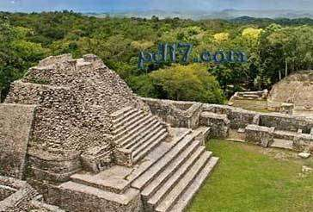
Cultural comparison with information from the text
Comparing the highly-sophisticated civilizations of the Maya and Ancient China reveals some surprising similarities. They both possessed a detailed understanding of ¹ _____________________ and astronomy, which helped them maintain an accurate ² ____________________, and a complex
mathematics
calendar

Slide 16
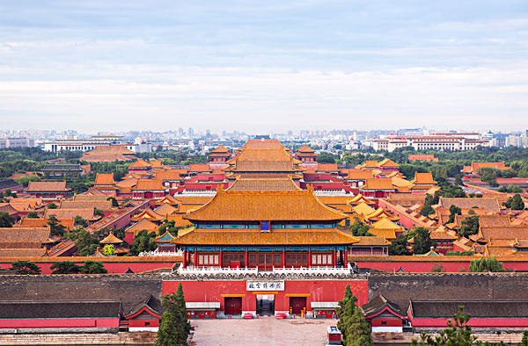
³ ___________________ that used signs to represent sounds and meanings. It can therefore be difficult to explain why, despite their excellent construction skills, the Maya never learned to use
⁴ _______________________________________, while the ancient Chinese did. Facts such as these add to the mystery surrounding Maya civilization, driving people to find out why it
⁵ _______________ while others, such as Ancient China, survived and thrived.
writing system
wheels, metal tools or animal power
disappeared

Slide 17
Think & Share
1. What is the author’s purpose in starting the passage with the story about William Gadoury?
In order to introduce the topic of the passage, the author presents the story shows how the secrets of Ancient Maya civilization have captured people’s imagination.

Slide 18
Think & Share
2. What lessons can you learn from the collapse of Maya civilization? How can this information help the development of today’s society?
Human beings should respect nature and not violate the law of its development. On the one hand, we follow the natural law and believe in the survival of the fittest, On the other hand, we should actively transform the world around us and bravely fight agianst kinds of disasters as possible as we can.

Slide 19
Language appreciation
1. The fact that Maya society was technologically primitive makes its achievements all the more incredible and mysterious.
[句式分析] “that Maya society was technologically primitive”是 that 引导的 同位语 从句，解释说明主名词the fact的具体内容，引导词that只起引导性作用，不在从句中充当任何成分。
[尝试翻译] 事实上，玛雅社会在技术上是原始的，这使得它的成就更加难以置信和神秘。

Slide 20
Language appreciation
2. This is likely to have led to a series of drought, each lasting for a couple of years.
[句式分析] “each lasting for a couple of years”是由“代词+ 现在分词”构成的 独立主格 结构。 其中动词last 与逻辑主语each 构成 主动 语态关系，故使用 现在 分词。
[尝试翻译] 这可能导致了一系列的旱灾，每一次旱灾持续几年时间。

Slide 21
Language appreciation
3. Meanwhile, the rise and fall of this civilization must also leaves us thinking about our own past, present and future.
[句式分析] “leave + 宾语+ 宾语补足语”表示“ 使......处于某种状态 ”，宾语补足语可以是现在分词、过去分词、不定式、形容词、名词或小品词（on/off; up/ down; away/ in/out）。
[尝试翻译] 与此同时，这种文明的兴衰也必然让我们思考自己的过去、现在以及未来。

Slide 22
Language points
1 correspond to ... | 8 be dismissed by ...
2 apply...to... | 9 at its peak
3 on top of... | 10 lead to...
4 all the more | 11 at doffernt rates
5 fall into ruin | 12 be likely to do sth
6 be intrigued by... | 13 drive sb to do sth
7 made an incredible discovery | 14 the rise and fall of this civilization

Slide 23
Assignments for this period
1. Review the basic usage of the new words and expressions learned in this period.
2. Further understand the passage by reading and listening more.
3. Writing a 60-word summary of the passage.

Slide 24
感谢您的观看

