Slide 1

外研版高中英语 选择性必修第四册
Unit 5 Into the unknown
Period 2 Using language

Slide 2

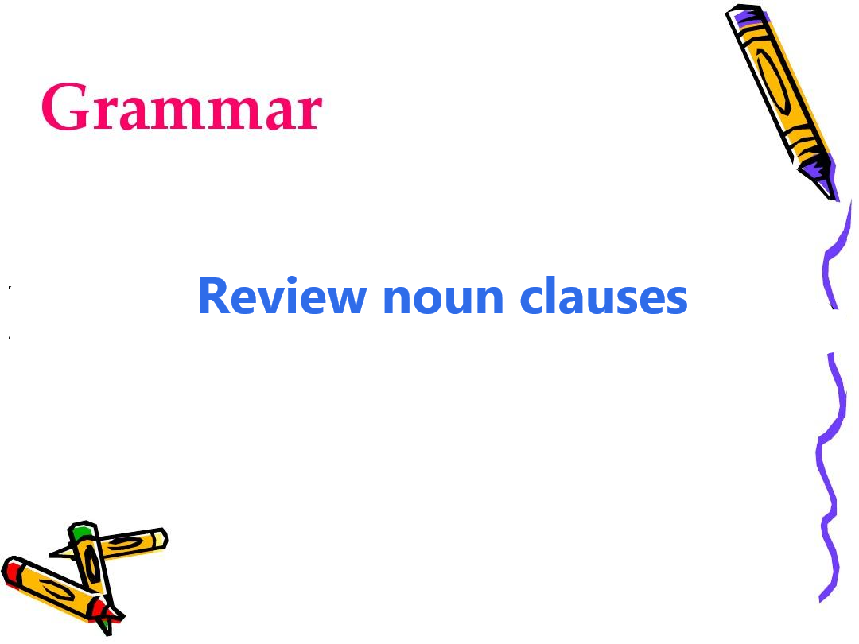
Part One Grammar

Slide 3
Fill in the blanks & decide the type noun clause
1. Although his theory has been dismissed by scholars, it shows _________ powerful the secrets of Ancient May civilization are among people.
This sentence contains a ____________ clause.
how
object
2. But the greatest mystery of all is _________ caused the Maya to abandon most of their great cities.
This sentence contains a ____________ clause.
what
predictive

Slide 4
Fill in the blanks & decide the type noun clause
3. __________ Maya civilization collapsed in the early 16th century remains a mystery.
This sentence contains a ____________ clause.
Why
subject
4. The fact ___________ Maya society was technologically primitive makes its achievements all the more incredible and mysterious.
This sentence contains a ____________ clause.
that
appositive

Slide 5
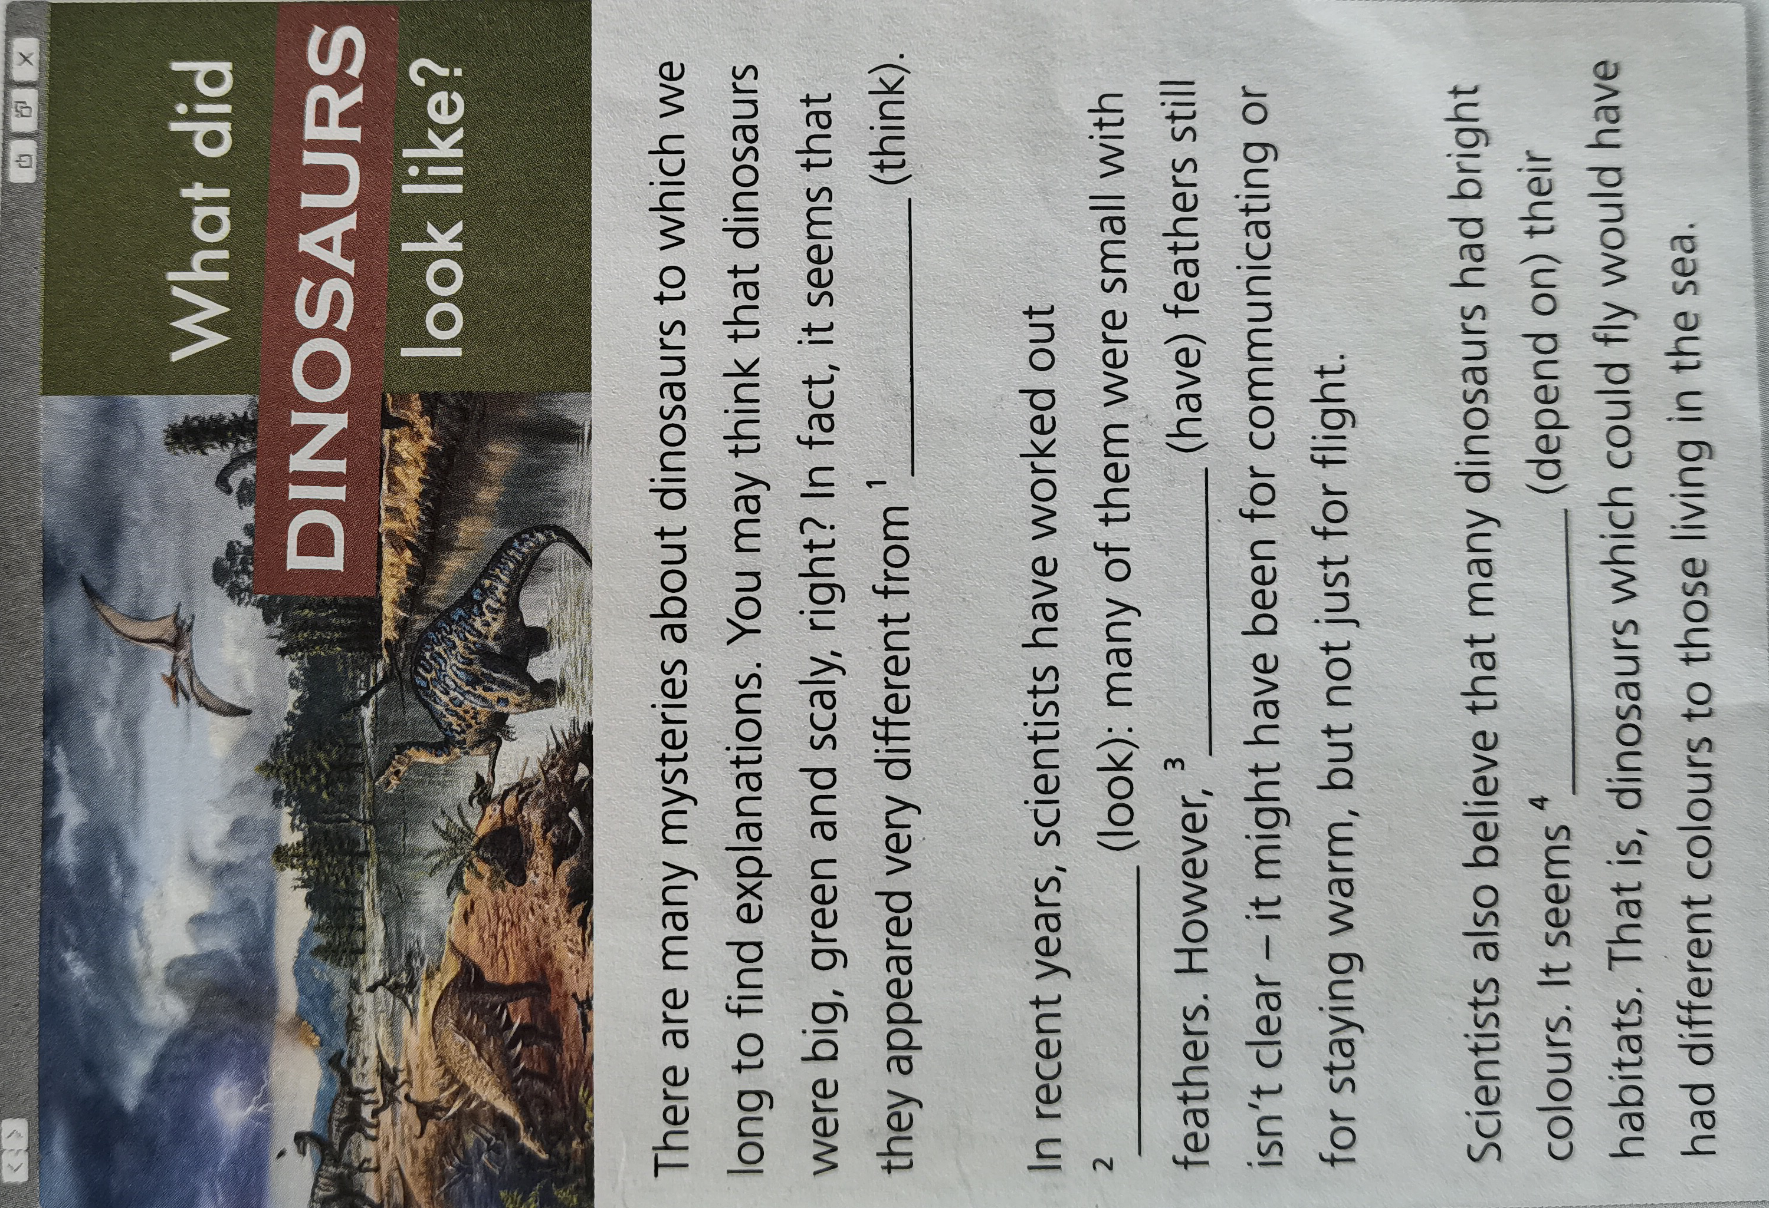
Practice 1 Make noun sentences

Slide 6
1. In fact, it seems that they appeared very different from ________________________ (think).
2. In recent, scientists have worked out _____________________ (look): many of them were small with feathers.
3. However, __________________ (have) feathers still isn’t clear--it might have been for communicating or for staying warm, but not just for flight.
4. It seems _______________________ (depend on) their habitats. That is, dinosaurs which could fly would have had different colors to those living in the sea.
what people think
what they looked like
Why they had
as if they depended on

Slide 7
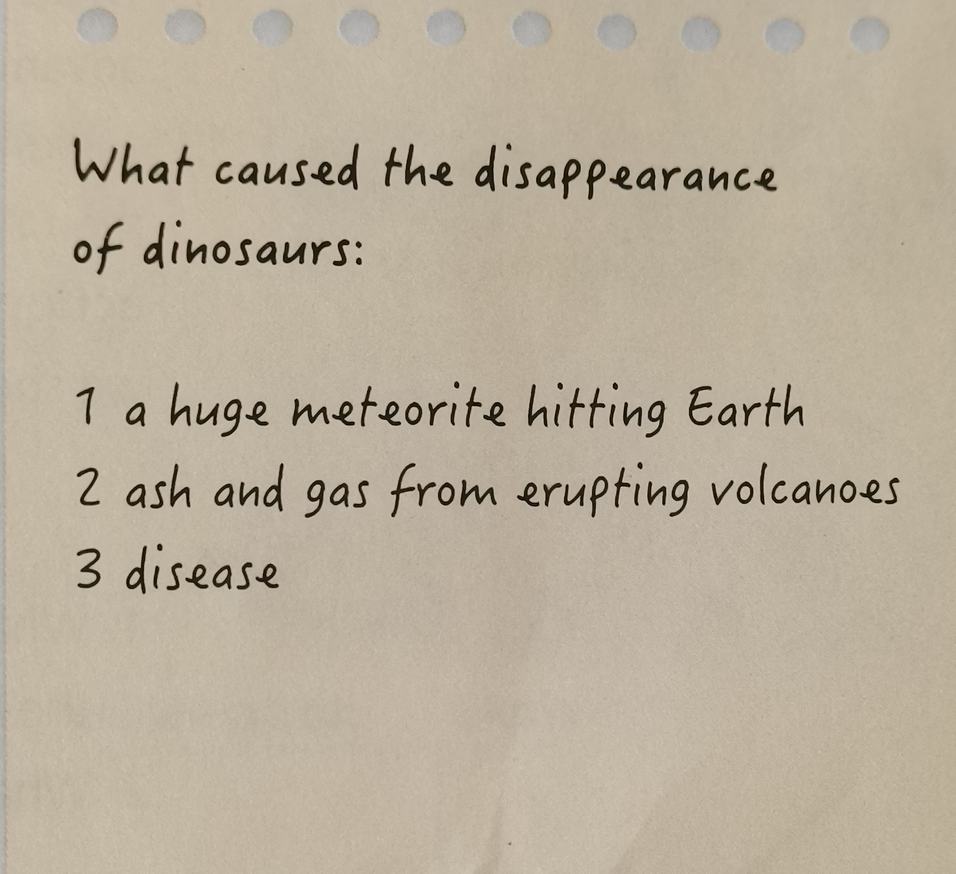
Practice 2 Use noun clauses
Talk about what caused the disappearance of dinosaurs using noun clauses where appropriate.

Slide 8
The disappearance of dinosaurs
Among the many unsolved mysteries about dinosaurs, what really interests me is their disappearance. One possible explanation is that there was a huge meteorite hitting Earth. But what I believed most was ash and gas from erupting volcanoes. Where so much magma went, all the living things including dinosaurs lost their lives. Besides, it is a fact that clouds of fire and smoke blocked the whole sky so that they had no sunshine to enjoy and no oxygen to take in.

Slide 9
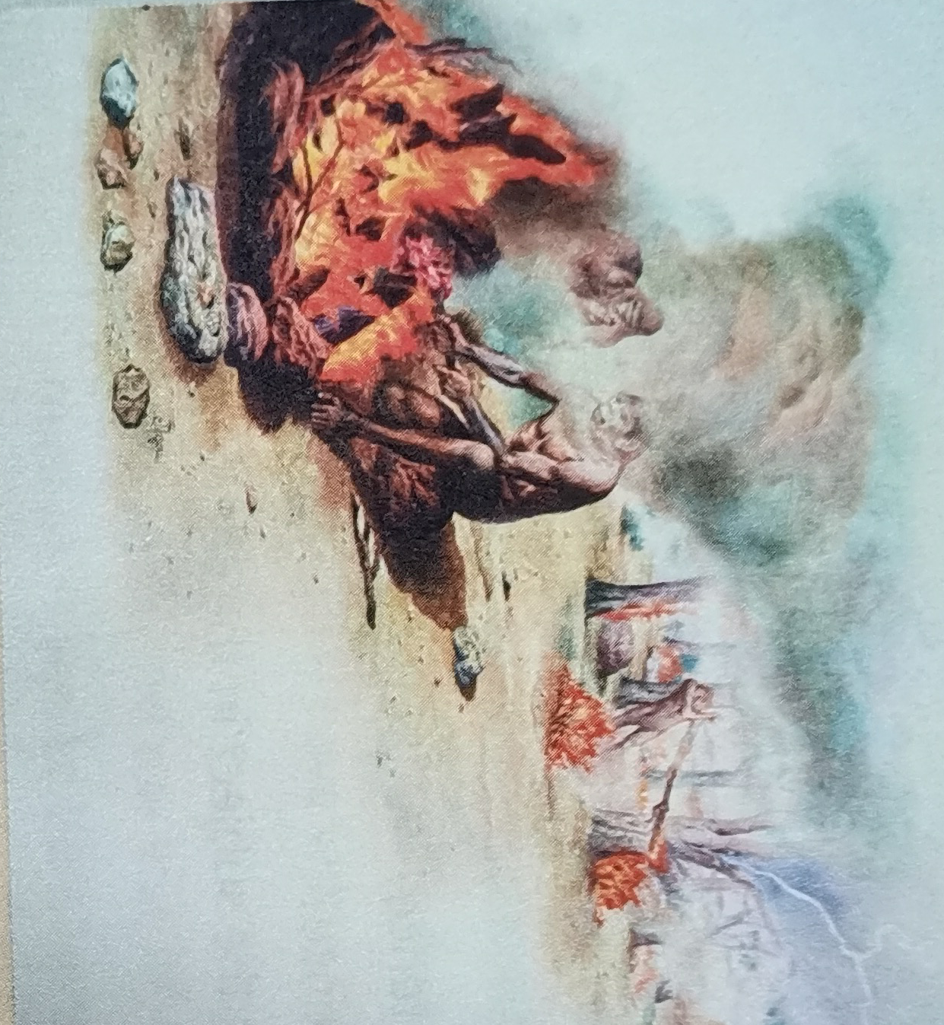
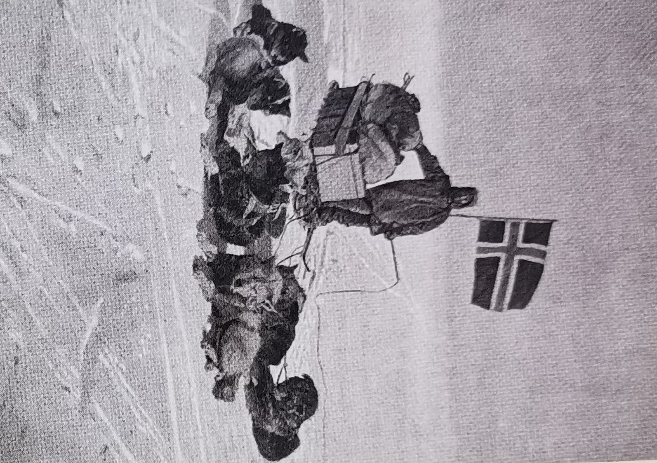
Part 2 Focus on vocabulary (一）
Facing the unknown

Slide 10
Read the passage “Facing the unknown”
1. What is the flight instinct?
Why do some people react that way in the face of the unknown?
Making a quick getaway. It is a human instinct.
2. What other reactions could people have when facing the unknown?
They chose to subdue their fears and pursue the unknown.

Slide 11
Focus on vocabulary (二）
Collect the expressions and put them into cateries
1 make a quick getaway | 9 set out into
2 run for one’s lives from | 10 delve into
3 check out | 11 think twice
4 test the waters of | 12 take action
5 steer clear of | 13 shrink from
6 retreat to | 14 look into
7 subdue | 15 consider one’s options
8 endure
Avoiding | Exploring | Overcoming | Hesitating
1/2//6/13
3/4/9/10/14
7/8/12
11/15

Slide 12
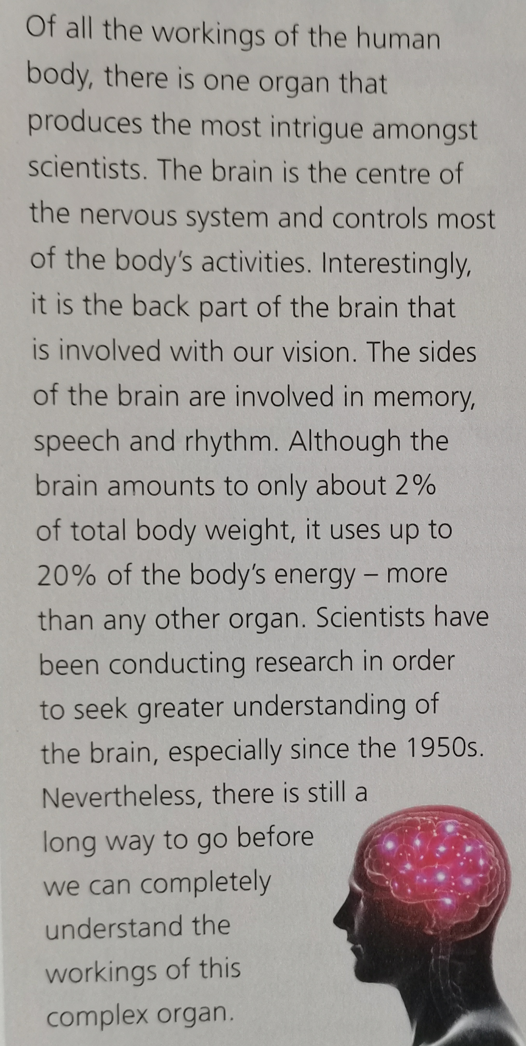
Part 3 Listening
Before listening, read the passage concerning the human brain.
1. What functions of the brain are mentioned in the passage?
2. What is the current research situation concerning the brain?

Slide 13
1. What functions of the brain are mentioned?
The brain is the centre of the nervous system and controls most of the body’s activities. The back part of it is involved with our vision and the sides of it are involved in memory, speech and rhythm.
2. What’s the current research situation about the brain?
There is still a long way to go before we can completely understand the workings of the brain.

Slide 14
Listen to the interview
1. Choose the topic discussed in the interview.
A. Methods to keep the brain healthy and active.
B. Sleep-related mysteries.
C. Ways of improving sleep quality. D. Methods of interpreting dreams.
【答案： 】
B

Slide 15
Listen again and complete the table
Theories | The brain needs time to ¹ ________________________
 | The brain ³ _______________________________ when we’re awake. It needs sleep to ⁴ ________________________
 | ⁷ ______________________________________ in the brain while we’re awake, and the brain reflects on them and ⁸ _______________________________ in our dreams.
rest and do maintenance
makes lots of poisonous chemicals
remove these chemicals
New connections are formed between parts.
use them to form new memories

Slide 16
Dr Long’s comments | Recent students prove that our brains ² ____________________ during sleep.
 | There isn’t ⁵ ____________________________ to confirm this. It might not be ⁶ _____________________________ for sleep.
 | A lot of research has been conducted, but we still can’t prove that ⁹ ____________________________________
Unanswered questions | ✭ Why do we “see” our dreams? ✭10 _______________________________________________________________________
remain active
enough data
the most important reason
sleep is necessary to this function
Why do people dream in color and other don’t?

Slide 17
Post listening
1 Could you tell us something about...? 2 It’s because... 3 ...prove... | 4 What other reasons could there be for it? 5 Would you tell us more about...?
Asking for more information | Explaining
1/ 4/ 5
2/ 3

Slide 18
Discussion
Talk about the investigation into another scientific mystery.
Possible vision：
The aliens are a general term used by humans to describe imaginary life from other planets. Nowadays, the human beings have not actually detected whether there are aliens in universe, though quiet a few people said that they witnessed alien visit the earth. In the last 50 years of researches, astronomers have not found any conclusive evidence of extraterrestrial life.

Slide 19
Language appreciation
1. There are many mysteries about dinosaurs to which we long to find explanations.
[句式分析] “to which we long to find explanations” 为 定语 从句，其结构为“介词 to +which +从句”用来修饰说明先行词 mysteries about dinosaurs 其中介词与explanations构成固定搭配explanations to sth意为“对...的解释”；固定短语long to do sth意为“渴望做某事”。
[尝试翻译] 有许多关于恐龙的谜团，我们渴望找到解释。

Slide 20
Language appreciation
2. Interestingly, it is the back part of the brain that is involved with our vision.
[句式分析] 本句为 强调句 句式“It’s + 被强调部分 +that +句子的其余部分”，本语境为“It’s +主语+ that+句子的其余部分”，句中短语be involved with意为“与...关联，涉及到”。
[尝试翻译] 有趣的是，大脑的后部与我们的视觉有关。

Slide 21
Language points
1 check out | 8 retreat to...from...
2 set out | 9 delve into
3 throw oneself into | 10 amount to
4 shrink from | 11 face the unknown
5 steer clear of | 12 long to do sth
6 test the waters | 13 think twice
7 make a quick getaway | 14 run for one’s life from

Slide 22
Assignments for this period
1. Review the basic usages of the new words and expressions learned in this period.
2. Review the noun clauses in practice.
3. Writing a 60-word summary of the passage.

Slide 23
感谢您的观看

