Slide 1

外研版(2019)高中英语 选择性必修第四册
Unit 5 Into the unknown
Period 3 Developing ideas & Presenting ideas

Slide 2
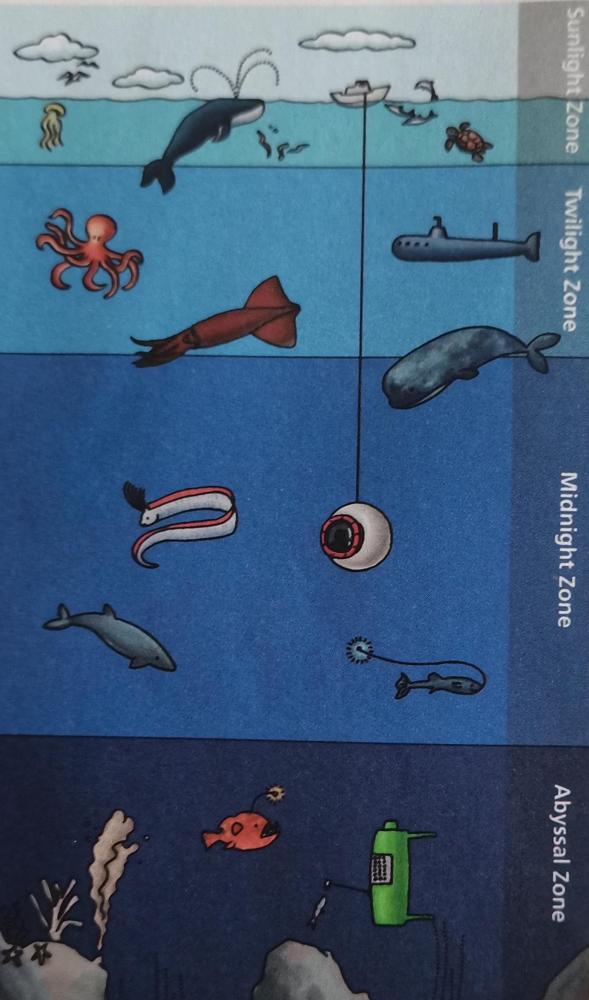
Part One Developing ideas
Before reading, look at the picture and learn about zones of the ocean.
1. What different zones are there in the ocean?
Sunlight Zone, Twilight Zone(弱光层),
Midnight Zone, Abyssal Zone(深海区)
2. Which parts of the ocean have been explored?
I think that the top three zones have been explored with the help of current technologies.

Slide 3
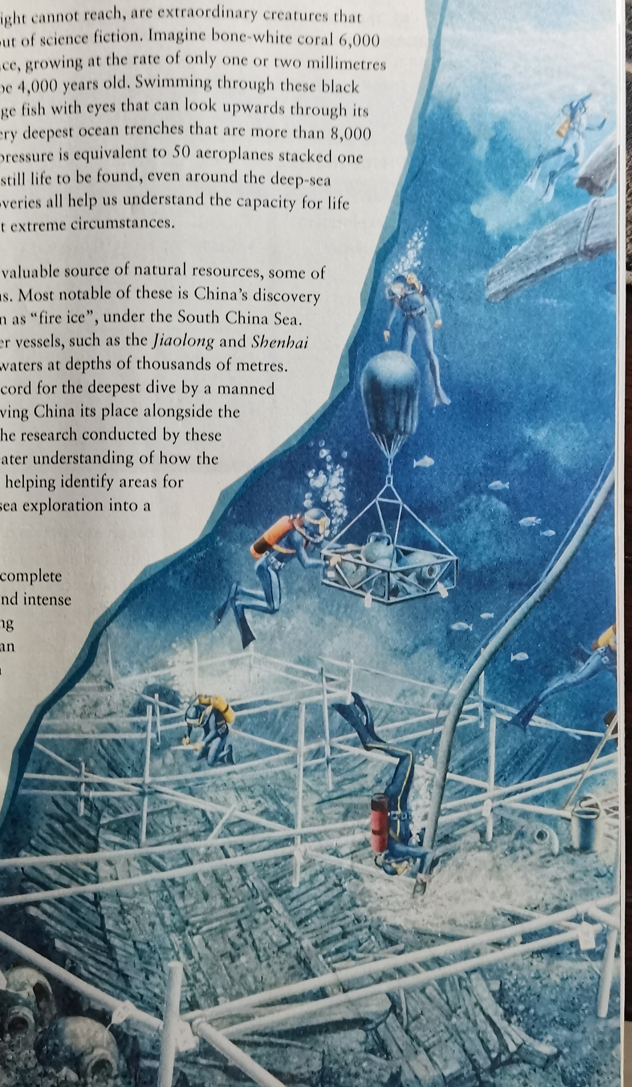
Reading Diving Deep

Slide 4
Skim the text and choose the best answer
1. What caused the ancient Roman city of Neapolis to be buried underwater?
A. An earthquake B. A tsunami C. A war D. A typhoon
【答案 ______ 】
2. What can we know about China’s Shenhai Yongshi?
A. It has explored waters thousands of meters deep. B. It’s a new underwater submarine for China. C. It holds the record for the deepest manned submarine dive. D. It has identified areas for deep-sea drilling.
【答案 ______ 】
B
A

Slide 5
3. It can be inferred from the last paragraph that __________.
A. it is better for a country to explore the ocean alone. B. ocean exploration requires international cooperation. C. the depths of ocean are within the range of human exploration. D. man has become familiar with the underwater world. 【答案 ______ 】
B
4. What has been discovered in the ocean depths according to the text?
Shipwrecks | eg.
Ruins of ancient cities | eg.
Strange deep-sea creatures | eg.
Special substance | eg.
the Esmeralda
Neapolis
bone-white coral and barrel-eye
fire ice

Slide 6
Further reading
Over the centuries: sailing across oceans to explore Earth’s furthest corners
Ocean exploration
Modern age: exploring ¹ ________________
² ______________ exploration | ◎ Finding ancient ruins in ³ _______________________ ◎ Working to overcome challenge and make discoveries at ⁴ ___________________
→Example: | ◎ ⁵ _________________________
deep sea
Archaeological
shallow waters
vast depths
the ruins of Neapolis

Slide 7
⁶ ______________ exploration | ◎ Containing about 90% of ⁷ ____________________ ◎ Helping comprehend ⁸ ___________________________
→Example: | ◎ ⁹ _______________________ ◎ ¹⁰ ______________________ ◎ ¹¹ ____________________________________________
Biological
the planets’ fish
the capacity for life on our planet
bone-white coral
the barrel-eye
life to be found even around the deep-sea volcanic openings

Slide 8
Discovery of natural resources | ◎ Discovering new natural resources. ◎ Studying ^{12 _}_____________________ ◎ Identifying areas for ¹³ _____________________
→Example: | ◎ ¹⁴ ____________________________ ◎ ¹⁵ ______________________________
the sea bed
deep sea drilling
fire ice
China’s underwater vessels

Slide 9
The structure & the theme of the text
Parts | Paragraphs | The main idea
Part 1
Part 2
Part 3
Para 1
Over centuries, sailing across oceans to explore Earth’s further corners
Para 2/3/4
In modern age, exploring deep sea
Para 5
In future, promote international cooperation to explore deep sea

Slide 10
Post reading
Think & Share
1. Why do you think the author uses statistics in the passage?
The use of statistics makes the passage more convincing.
2. What other examples of ocean exploration do you know of?
In 2010, China’s underwater archaeology team fished out a steel basket containing the 30-meter-long vessel, also known as the Nanhai No. 1, or "South China Sea.
3. What common message do the two reading in this unit convey?
Both passages convey the message that humans have the desire and means to explore the
unknown. The first passage does this by looking at our fascination with history’s greatest
mysteries, while the second passage looks at pioneering exploration of Earth’s oceans.

Slide 11
Post reading
Talk about the influences of ocean exploration on your daily life.
Influences of ocean explorations
Trade & economy
Cultural exchange
Transport & travel
Environment &
conversation

Slide 12
The influence of ocean exploaration on our daily life
Possible version
The ocean accounts for 70% of the total area of the earth, more than 90% of the living space of the earth. In fact, in the vast ocean world, the ocean affects the climate and weather on the land.
A large number of Marine plants and animals are important food sources for human beings. Therefore, it is very important for us to explore the world's oceans, which will directly affect our life on land, so it is necessary for us to detect what changes have happened to seas and oceans as well as increasing our understanding of oceans.

Slide 13
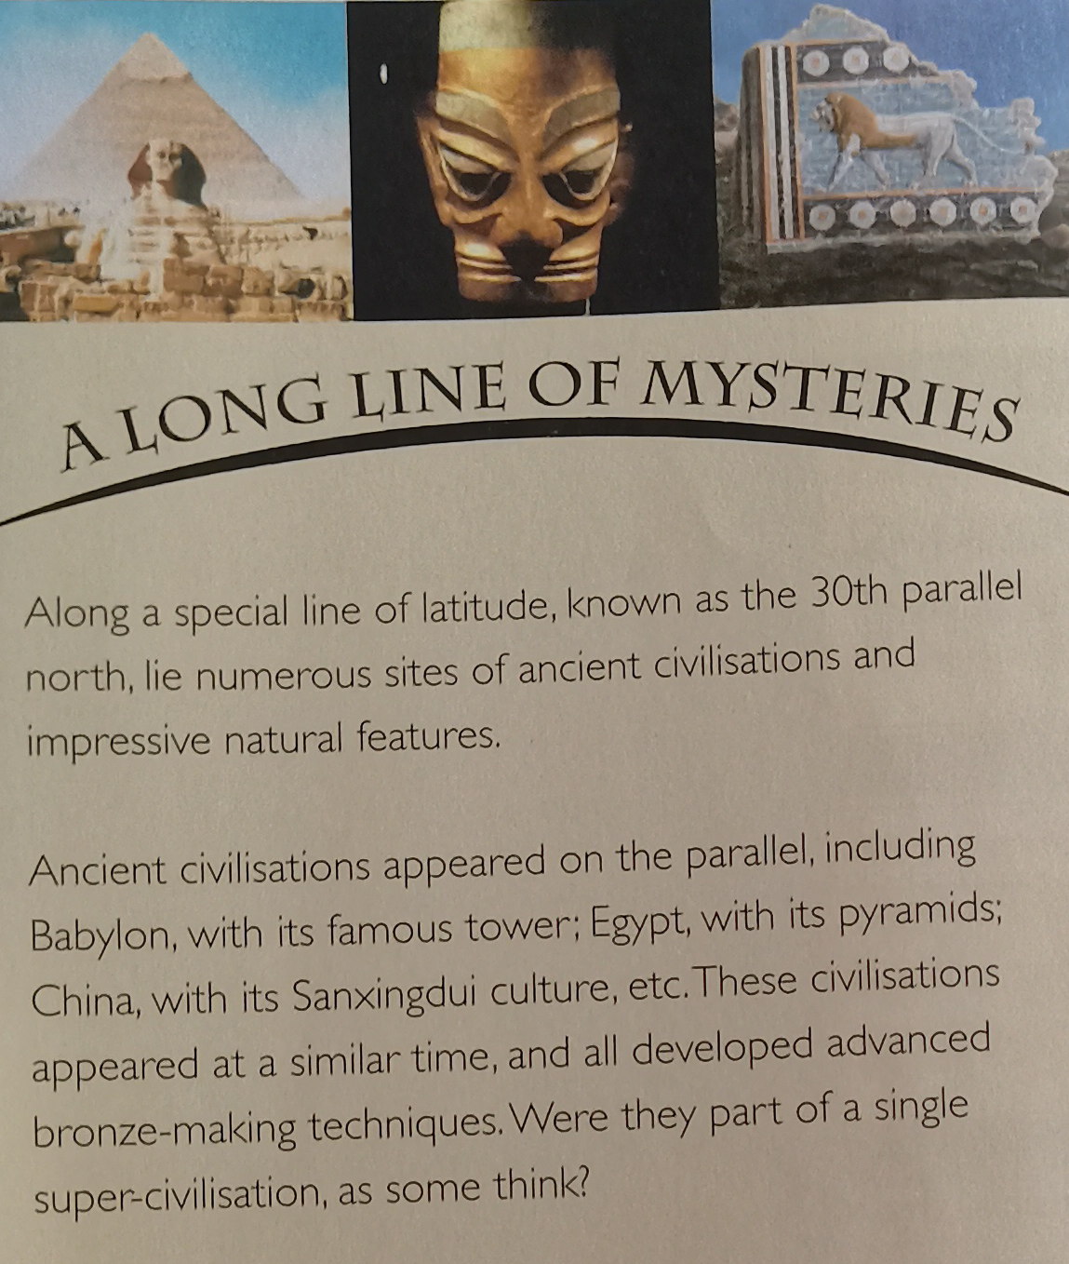
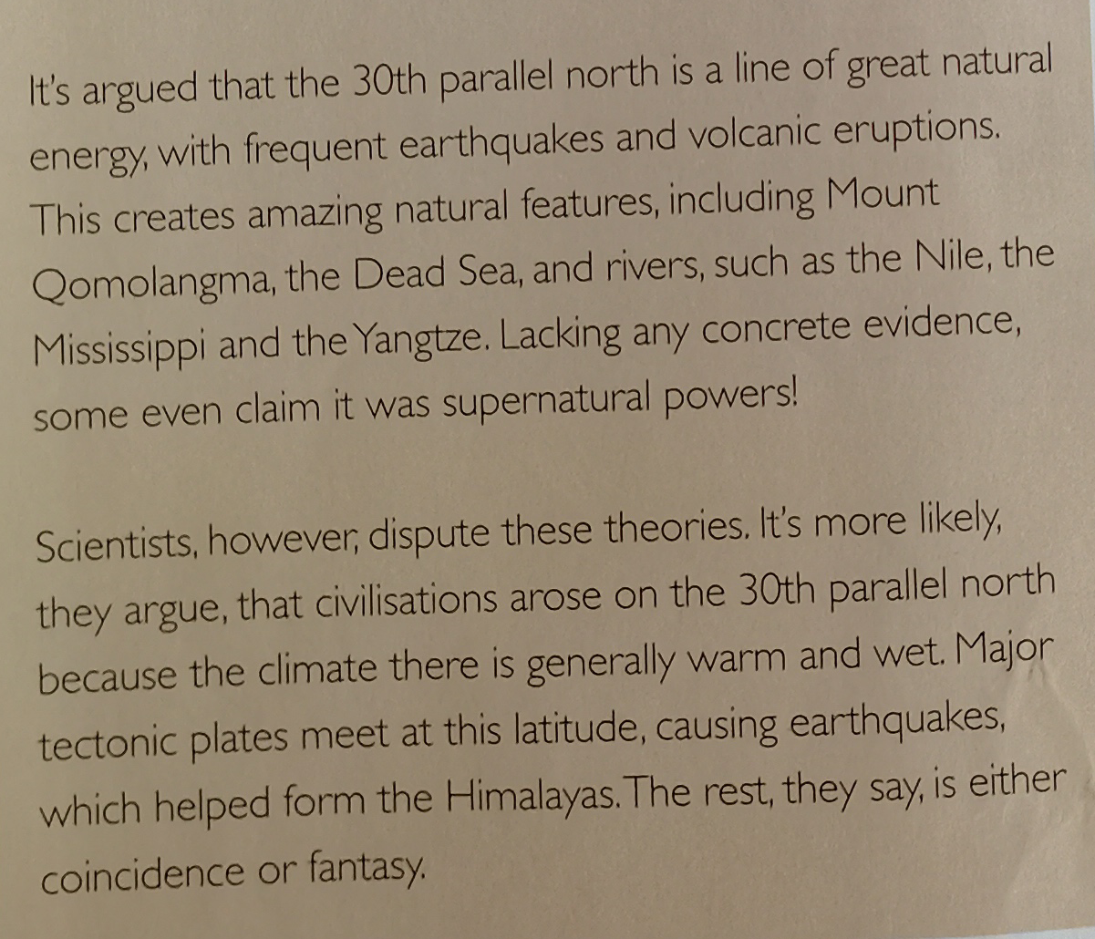
Part Two Writing about the unexplained
Before writing, read the magazine article about a long line of mysteries.

Slide 14
A long line of mysteries, known as the ^{th} parallel north
The reason why it’s mysterious
Unusual explanations for it
Possible scientific explanations
Because it’s where numerous sites of ancient civilizations and impressive natural features lie.
Some think it is a line of great natural energy, with frequent earthquakes and volcanic eruptions, and others even claim that its amazing natural features were caused by supernatural powers.
They include the generally warm and wet climate that made it a good place for civilizations to develop, and the fact that it’s where major tectonic plates meet.

Slide 15
Write a passage according to the following topic
For example: How much do you know about the Bermuda Triangle? The unsolved mystery of the Bermuda Triangle has been debated ever since.
Possible version
Para 1. Far below the surface of the North Atlantic Ocean, in a roughly triangular area known as the the Bermuda Triangle, lie more than 50 shipwrecks and 20 plane wrecks. What makes these wrecks so mysterious is that the cause of their fate remains largely unknown--ships were abandoned without apparent reason, distress singles were never sent and aircraft were lost without trace.

Slide 16
Para 2. Some believe that supernatural forces are responsible, while others put the accidents and disappearances down to coincidence. Scientific theories, meanwhile, include pilot error when trying to navigate the area, and huge “rogue waves” caused by terrible storms. Although many ships and planes cross the the Bermuda Triangle without incident, the stories behind those doomed vessels’ fates continue to capture people’s imaginations.

Slide 17
Part Three Presenting ideas
Read the sentence & answer the questions.
“The only true voyage of discovery would be not to visit strange lands but to possess other eyes, to look at the universe through the eyes of another person, or of a hundred other people, to see the hundred universes that each of them sees.”
Remembrance of Things Past (VOL 5):
The Captive by Marcel Proust.
(adaptation)

Slide 18
1. What is your understanding of the sentence?
In my opinion, the author argues that people should learn to observe and understand the world from different perspectives and try to collect new solutions to problems.
2. What does Proust mean by “The only true voyage of discovery”?
Maybe it means that whoever wants to make a discovery must take action in person to find answers to the doubts in his or her mind.

Slide 19
Language appreciation
1. Among these is Esmeralda, the earliest wreck from the age of the European exploration of Asia.
[句式分析] 本句使用了 全倒装 句式。Esmeralda为主句，the earliest wreck from the age of the European exploration of Asia作主语的 同位语 。
[尝试翻译] 埃斯梅拉达号就在其中，它是欧洲探索亚洲时期最早的沉船。

Slide 20
Language appreciation
2. We have more detailed maps of the Moon, and even of Venus and Mars, than we do of Earth’s own sea bed.
[句式分析] 本句中than引导 比较状语 从句，其中do代替实意动词have ,从而以避免和主句的谓语动词have 重复。
[尝试翻译] 我们有月球，甚至金星和火星的地图，比我们有地球海床的地图还要详细。

Slide 21
Language appreciation
3. Being a tough environment of complete darkness, enormous pressure and intense cold, the ocean depths have long been beyond the reach of human exploration.
[句式分析] “ Being a tough environment of complete darkness, enormous pressure and intense cold” 为现在分词短语作 原因状语 ，相当于原因状语从句：Because it’s a tough environment of complete darkness, enormous pressure and intense cold.
[尝试翻译] 海洋深处环境恶劣，一片漆黑，压力巨大，温度极低，长期以来都是人类无法探索的。

Slide 22
Language points
1 set sail for | 8 offer a window into...
2 continue to do sth | 9 at the rate of...
3 be equivalent to... | 10 in the extreme circumstances
4 hold the record for... | 11 overcome the challenges of...
5 beyond the reach of ... | 12 It’s no surprise that-clause
6 if any | 13 open up
7 as with... | 14 be familiar to sb

Slide 23
Assignments for this period
1. Review new words , phrases and useful expressions learned in this period.
2. Feed back the structure and writing characteristics of an expository essay.
3. Polish your writing- an article about an unexplained phenomenon.

Slide 24
感谢您的观看

