Slide 1

外研版高中英语 选择性必修第四册
Unit 6 Space and beyond
Period 2 Using language

Slide 2
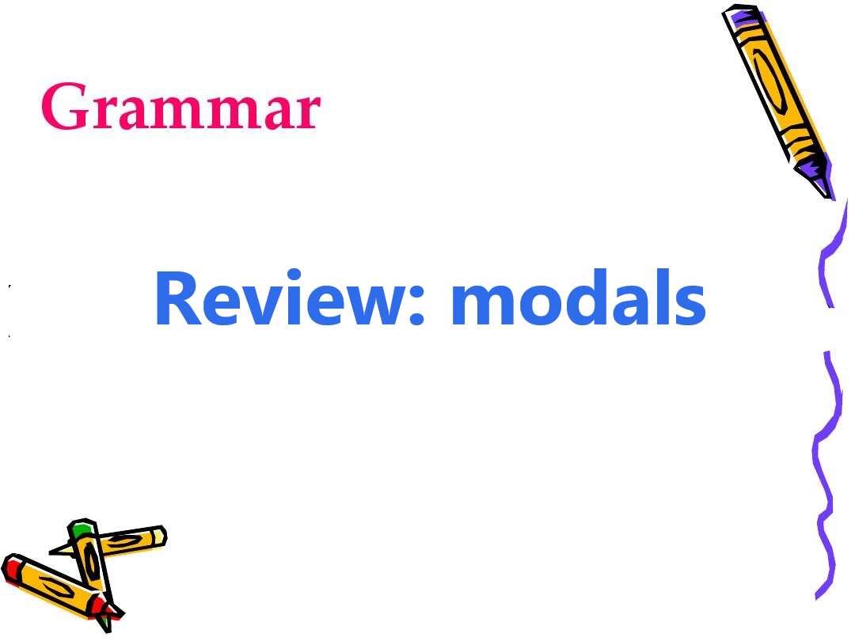
Part One Grammar

Slide 3
Modal verbs and Uages
Modals | Meanings | What do they indicate?
1. could |  | → used to talk about
2. would |  | → used to talk about
3. can |  | → used to talk about
4. must |  | → used to talk about
可能，可以
possibility
将，将会
prediction
能，能够
ability
必须， 一定
necessity

Slide 4
Modals | Meanings | What do they indicate?
5. shall |  | → used to talk about
6. should |  | → used to talk about
7. need |  | → used to talk about
8. may |  | → used to talk about
将， 将会
possibility
应该
necessity
必定，有必要
necessity
也许
prediction

Slide 5
Practice 1
Choose the correct modals:
1. | So great was the distance from Earth that it would/ shall need to travel for almost six years to reach its destination.
2. | Cassini made numerous trips around Saturn so it could/ must collect data.
3. | Cassini was pointed towards Saturn so that it should/ would meet a fiery end.
Answer: would
Answer: could
Answer: would

Slide 6
Choose the correct modals:
4 | Scientists had decided that Cassini could/ must be destroyed this way, so it must/ would not collide with any of Saturn’s moons.
5 | Cassini provided so much information that scientists could/ would not process it all.
6 | No wonder so many people took to social media to bid it goodbye, saying, “Farewell, dear Cassini! We shall/ should never forget you!”
Answer: must/ would
Answer: could
Answer: shall

Slide 7
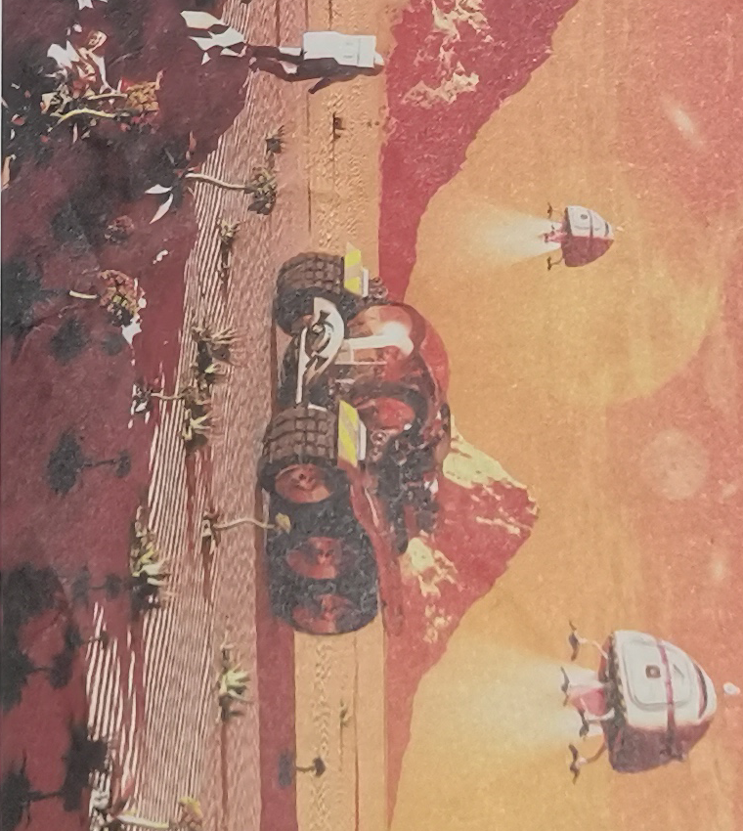
Practice 2
Look at the picture and tell a story using modals.
Possible version:
I couldn’t believe it when I looked into the Martian shy. It's scary but beautiful-Martian-red dirt dotted with unknown plants, chocolate-brown mountain ranges and a sky that makes Martian sky look like the glow of a flame. Without special glasses, I couldn’t see much because the light is too bright. Besides, it must be too hot in the day and too cold in the evening so that I should wear a kind of coat to live a normal life there.

Slide 8

Part 2 Listening
Life in space
The Fermi Paradox: according to some calculations, there should be many other civilisations out there, but there is no evidence of these at all. No spacecraft, no radio tranmissions, nothing. So, as Fermi said: “Where is everybody?”
Did You Know?

Slide 9
Listen to the interview and the question
① | Is there life on other planets?
② | What would life on other planets look like?
③ | Should we use robots to explore space?
④ | What’s the Fermi Paradox?
⑤ | Will people ever make contact with life on other planets?
Suggested answer: ① ② ⑤

Slide 10
Listen and complete the table
 | Answers
Q1 | Sophie: Three must be millions of planets like ours, and some could have life ¹________________________. Eric: You would think it likely that ² ___________________________________. But that’s ³ _______________________ the Fermi Paradox.
Q2 | Sophie: Life on other planets won’t look like us because ⁴ ___________________________________________________. Eric: Because evolution ⁵ _________________________________________, like on other planets is likely to look like us.
similar to our own
there are forms of life somewhere
without considering
conditions on other planets won’t be those on Earth
would work the same way everywhere

Slide 11
Listen to the interview and the question
Q3 | Eric: We cannot ⁶ ______________________________, which means it would take more than a lifetime to reach planets where there might be life. Sophie: Maybe we don’t need to travel in straight lines. Perhaps we will be able to ⁷ ________________________________________________________________ to make contact with life on other planets.
travel faster than light
take short cuts, through a “warm-hole” in space, for example

Slide 12
Expressing opinions and hopes
A. I think there definitely is. B. Since..., it isn’t reasonable to... C. There’s evidence that... | D. It would be wonderful if ... E. The fact that ... means ...F. Let’s hope that ...
Expressing opinions:
Expressing hopes:
A/ B/ C/ E
D/ F

Slide 13
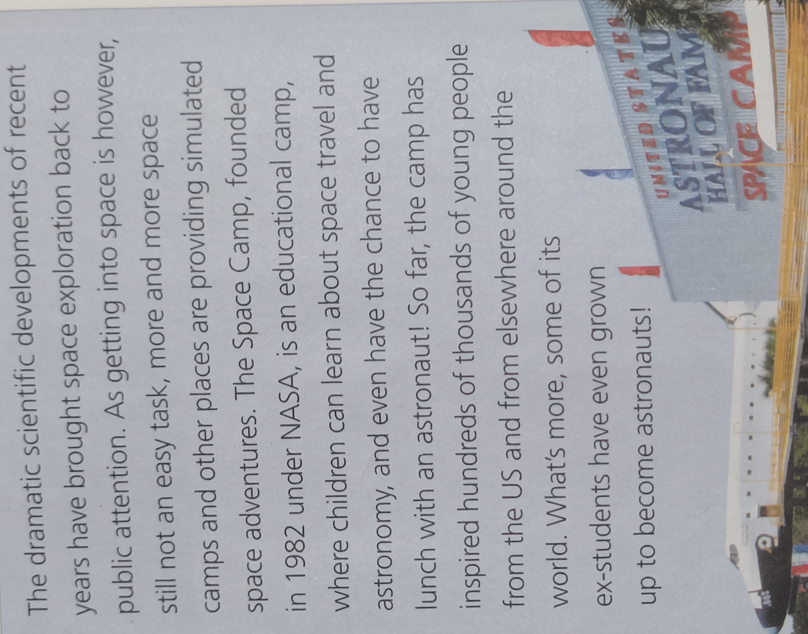
Part 3 Focus on vocabulary1.
1. What is the passage mainly about?
The passage is mainly about the space camp.
2. Would you like to take part in a space camp? Why or why not?
Yes, of course. The camp not only help me learn about space travel and astronomy but also even have the chance to have lunch with an astronaut.

Slide 14
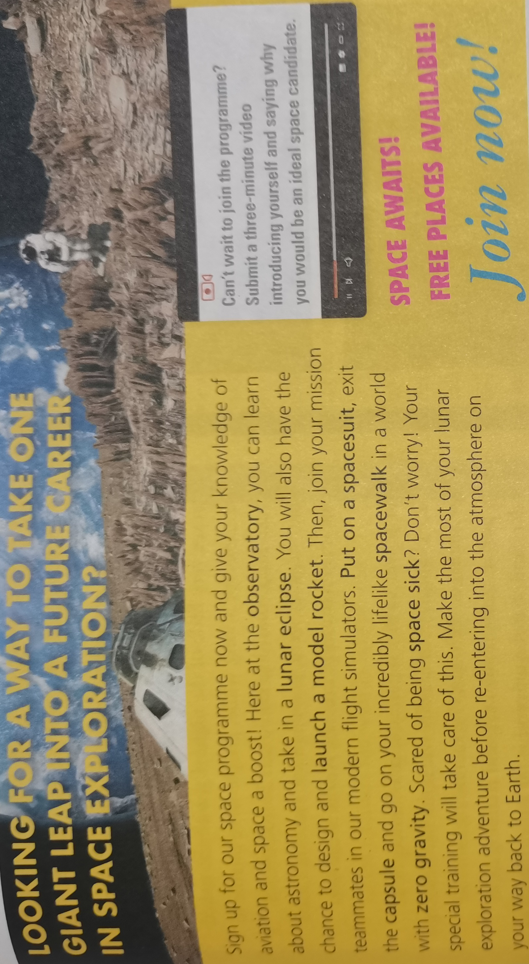
Focus on vocabulary2.

Slide 15
Learn the works and expressions in bold
◎ observatory | ◎ capsule
◎ lunar eclipse | ◎ spacewalk
◎ launch a model rocket | ◎ zero gravity
◎ put on a spacesuit | ◎ space sick

Slide 16
Complete the email
Dear Ted, Remember when I told you I’d signed up for the space programme? Well I just got back from a week of simulated manned flight activities, and it was awesome! We started out with some theory, learning about astronomy in the ¹ ________________, and then ² ___________ model rockets. After that we tried the simulator. I put on a ³ ___________ and went for a walk in ⁴ _____________________________. It’s strange to float around like that - in fact, a lot of people get ⁵ ________________ ! Luckily, I felt fine. Then I returned to the ⁶ _____________ and travelled to the “Moon” for some lunar exploration. You should join the programme too —you’d love it!
observatory
launched
spacesuit
a world with zero gravity
space sick
capsule

Slide 17
Discussion
1. Imagine going to apply for the program and brainstorm a list words and phrases about the space exportation.
2. Organize the ideas for the short video.
3. Present your ideas for the video.

Slide 18

Language points
1 make contact with ... | 7 on a mission
2 sign up for ... | 8 no wonder that-clause
3 submit sth to sb | 9 bid ...goodbye
4 zero gravity | 10 bring ... to public attention
5 start out with... | 11 have the chance to do sth
6 be scared of ... | 12 There is evidence of...

Slide 19
Language appreciation 1
1. So great was the distance from Earth that it would need to travel for almost six years to reach its destination.
[句式分析] 这是一个倒装句。在so/such... that...结构中， so/such...置于句首时 ，主句采用部分倒装， that引导的从句不倒装。
[尝试翻译] 从地球到土星的距离是如此之远，以至于它将需要航行近6年才能到达目的地。

Slide 20
Language appreciation 1
2. No wonder so many people took to social media to bid it goodbye, saying, “Farewell, dear Cassini! We shall never forget you!”
[句式分析] 语境中 No wonder 的完整形式为 “ It’s no wonder that-clause ”, 意为“难怪......”，其中的从句为主语从句而且后置。...saying... 为现在分词在句子中充当伴随状语。
[尝试翻译] 难怪这么多人在社交媒体上跟它说再见，说:再见，亲爱的卡西尼!我们永远不会忘记你！

Slide 21
Assignments
1. Review the useful words and expressions learned in this period.
2. Do more exercise to further master the grammar item-- modal verbs.
3. Listen to the interview on Page 66 again for more details.

Slide 22
感谢您的观看

